Slide 1

Notes:
Bluegrass Greensource
Sustainability Summit March 8, 2023

Slide 2

Eastern Kentucky Flood 2022
Beginning July 26 and continuing through July 30, 2022
The rain was not constant, but there were periods of heavy rain
The rains followed a period of drought in the region
Flash flooding and flooding in the Kentucky River

Slide 3
Eastern Kentucky Flood 2022
  According to the National Weather Service:
  The highest total rainfall was recorded in Knott County at 14 inches over this 5-day period
  On July 28, 2022, 8 inches of rain fell overnight
  In Whitesburg, the Kentucky River crested at 21 feet
    The previous high was 14 feet, recorded in 1957
  In Jackson, the Kentucky River crested at 43.47 feet
    The previous record was 43.1 feet in 1939
  There was less than a 1 in 1000 chance for these rainfall totals
    The rain totals were 600% over normal

Slide 4
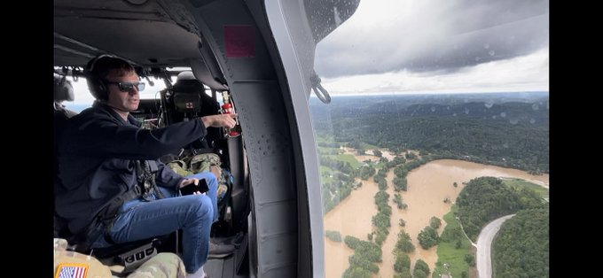

Slide 5
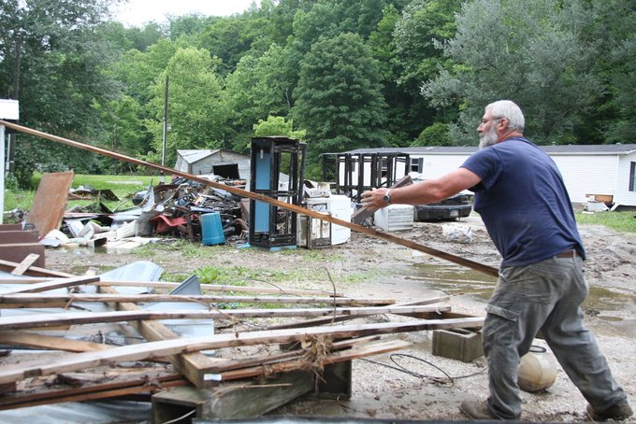

Slide 6
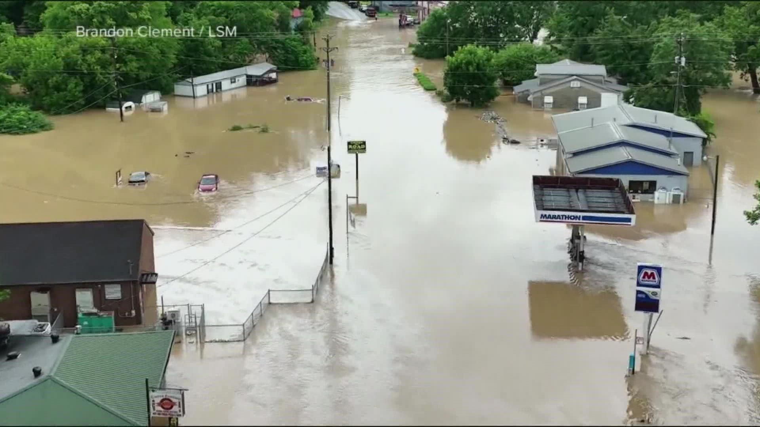

Slide 7
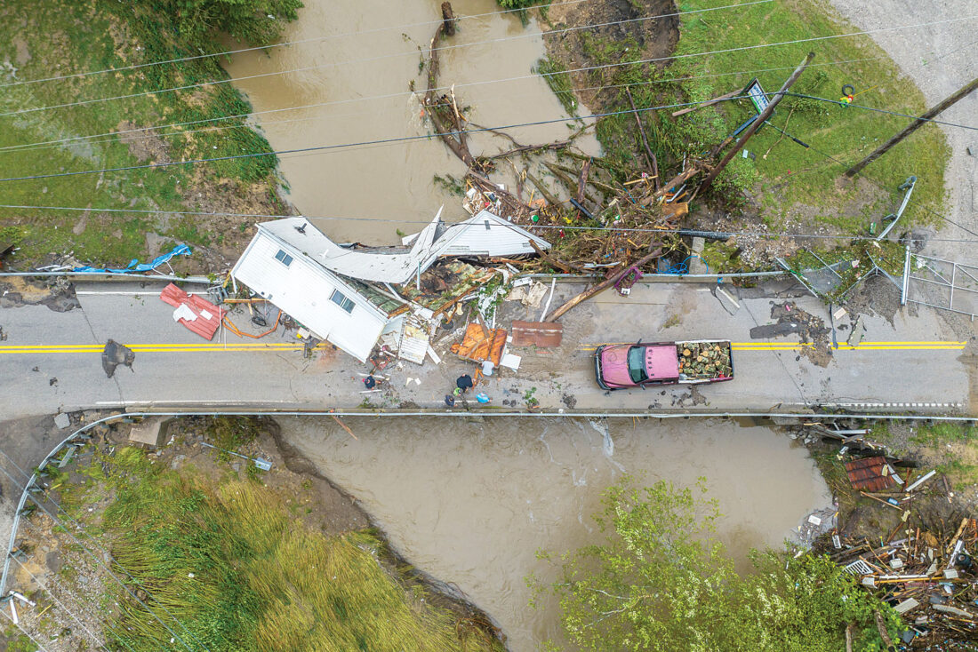

Slide 8
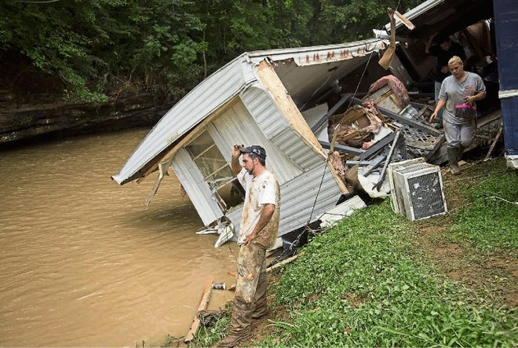

Slide 9
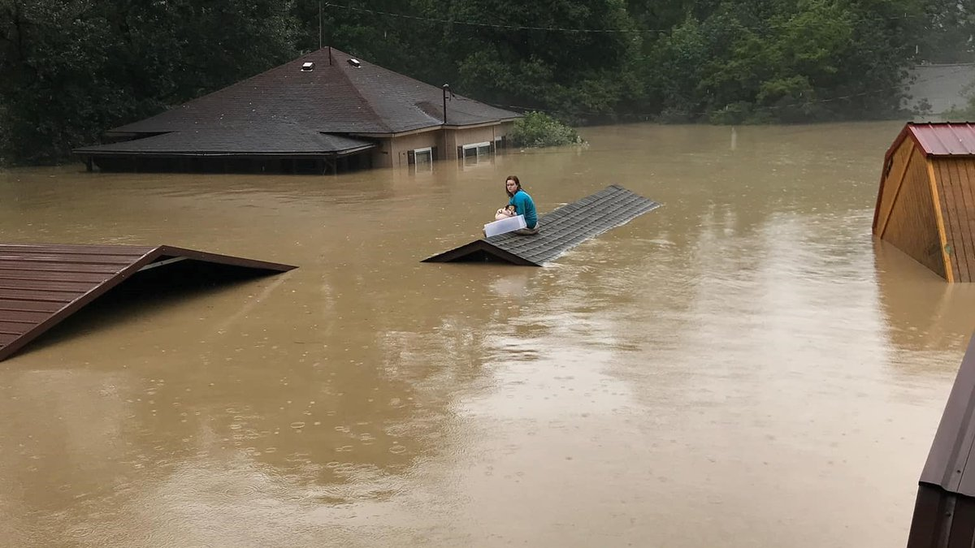

Slide 10
Scope of Disaster
  The flood resulted in significant damage to roads, bridges, infrastructure, homes
    44 people lost their lives; one person remains missing
    600 helicopter rescues were conducted
    480,000 tons of storm debris were removed from roads and waterways
    606 miles of creeks and streams had storm and vegetative debris

Slide 11
Scope of Disaster
  FEMA designated disaster areas:
    13 counties to receive individual assistance
    20 counties to receive public assistance
  As of 1/31/2023 in conjunction with state and local partners, FEMA has:
    Visited 24,000 homes to inspect needs
    Paid out $96.9M under the individual and household program
    Paid out $57.7M in small business administration loans
    Paid $24.6M for 461 claims under the federal flood program

Slide 12
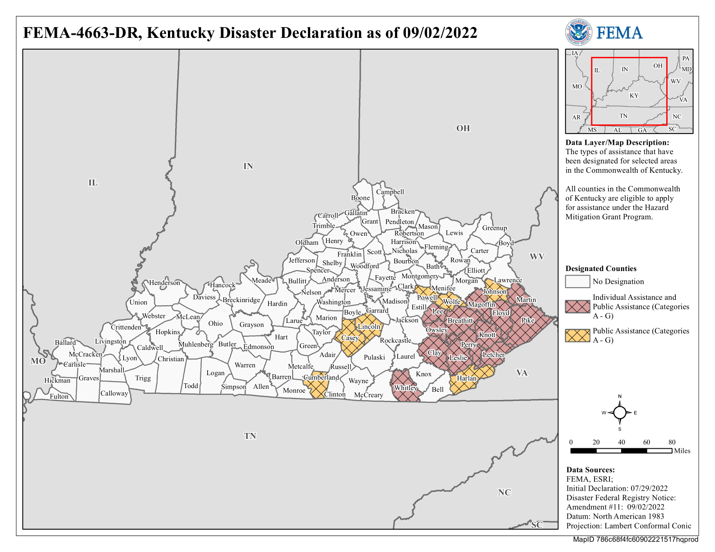

Slide 13
Damaged Home Estimates
  American Red Cross initial estimates:
  332 homes destroyed
  1,764 homes with major damage
  663 homes with minor damage

Slide 14
Continuing Challenges
Lack of reliable, complete data
Safeguarding against fraud v. need to assist timely
Cost of recovery vs. available funding
How to equitably distribute the funds
Lack of insurance for homes
      Less than 2% had flood insurance
Lack of land for building
Supply chain issues, labor shortages
Perceptions

Slide 15
EKY SAFE Funds
  $212M appropriated for:
    Replacement or renovation of publicly owned buildings
    Reimbursement for services, personnel an equipment provided during the response and recovery
    Assistance for expenses related to planning efforts for rebuilding and recovering from damage
    Disaster recovery and relief needs of local school districts
    Contracted employees to administer and report on the funds

Slide 16
Team Eastern KY Flood Relief Fund
  Over $13M donated funds
    Paid for funerals
    Provided $500 supplemental payment to FEMA assistance (ongoing)
    Paid $200,000 for a matching grant to repair 80 homes
    Provided $600,000 to build 8 new homes in impacted counties
    Remaining funding for long-term housing

Slide 17
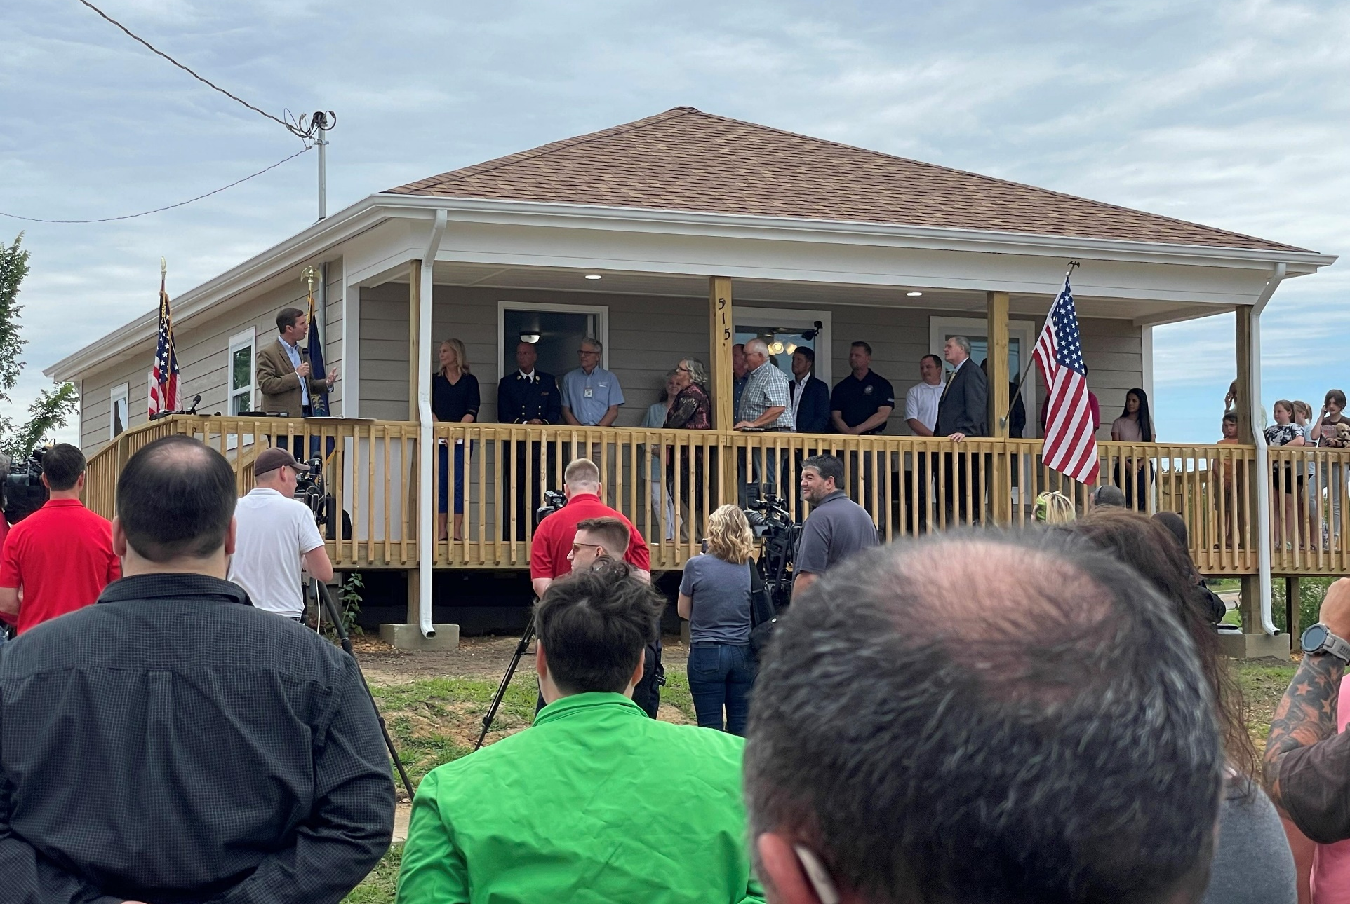
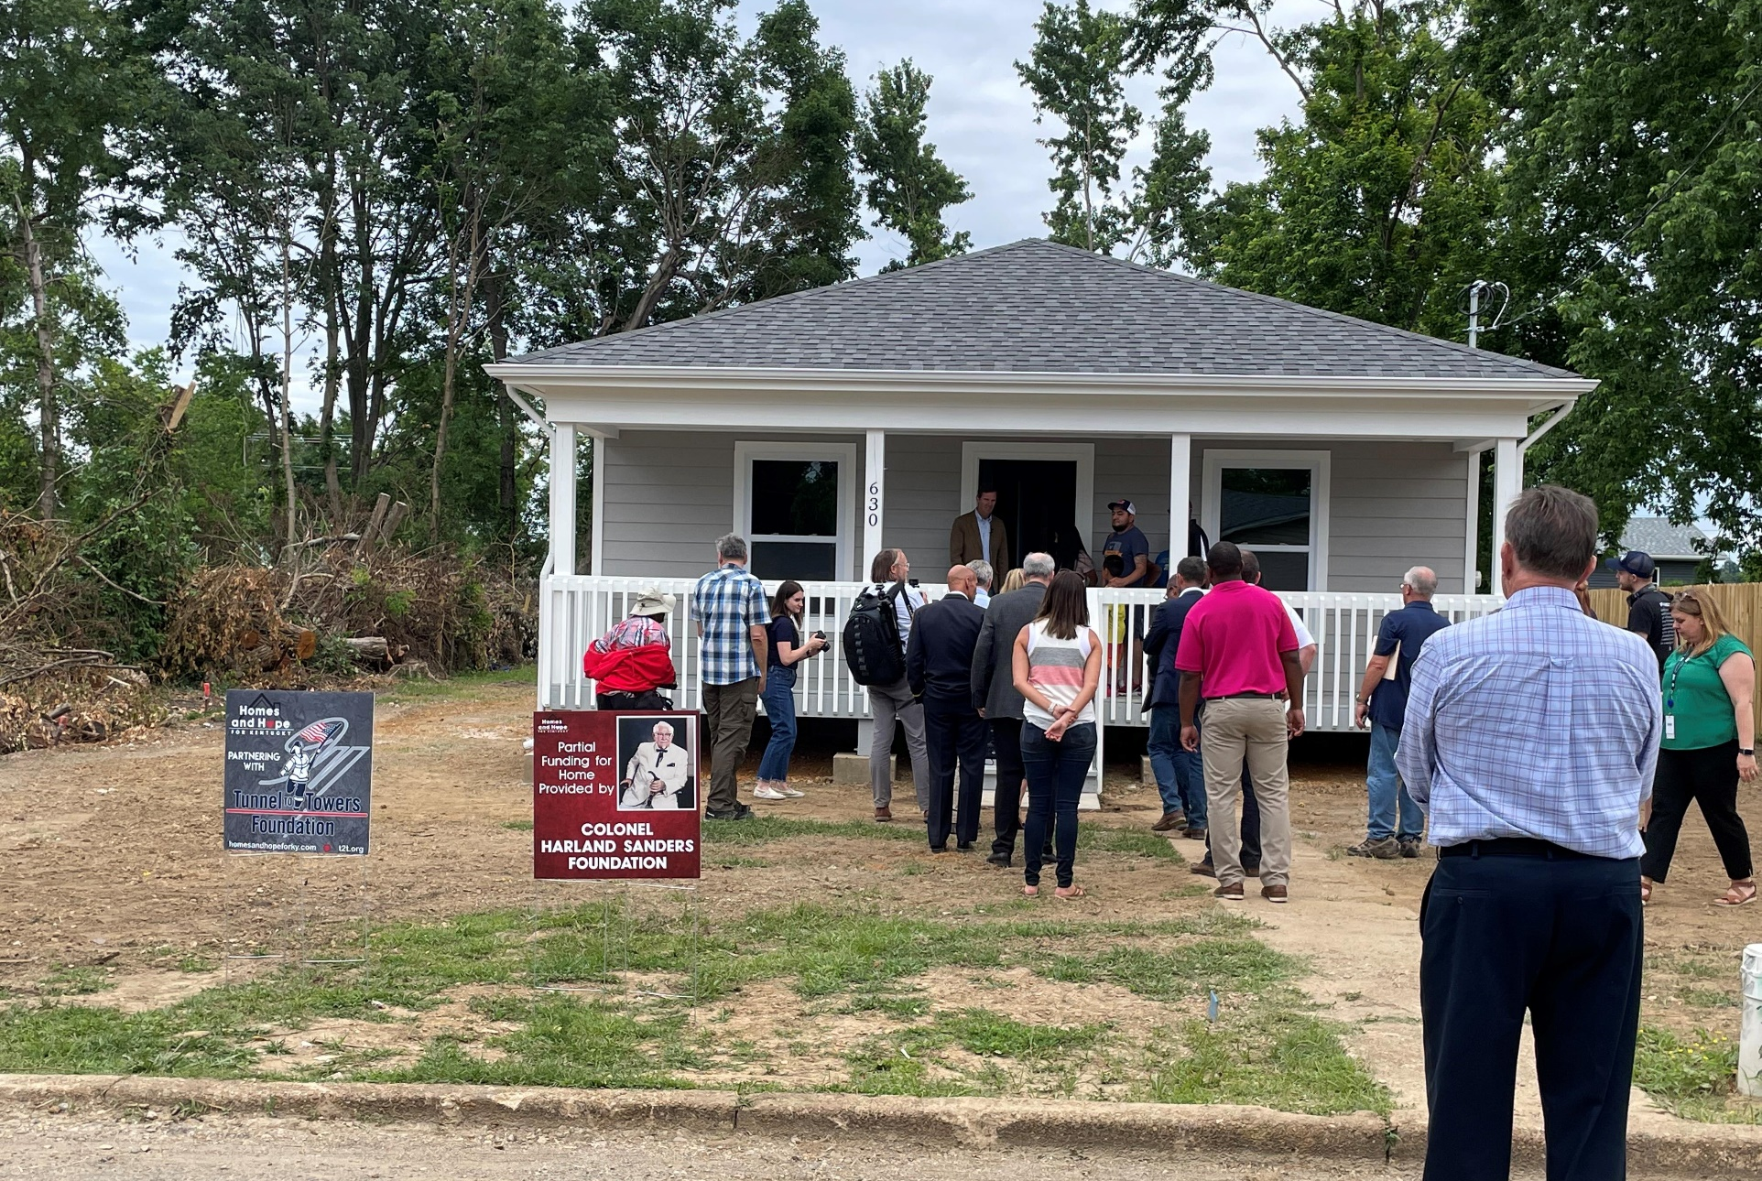

Slide 18
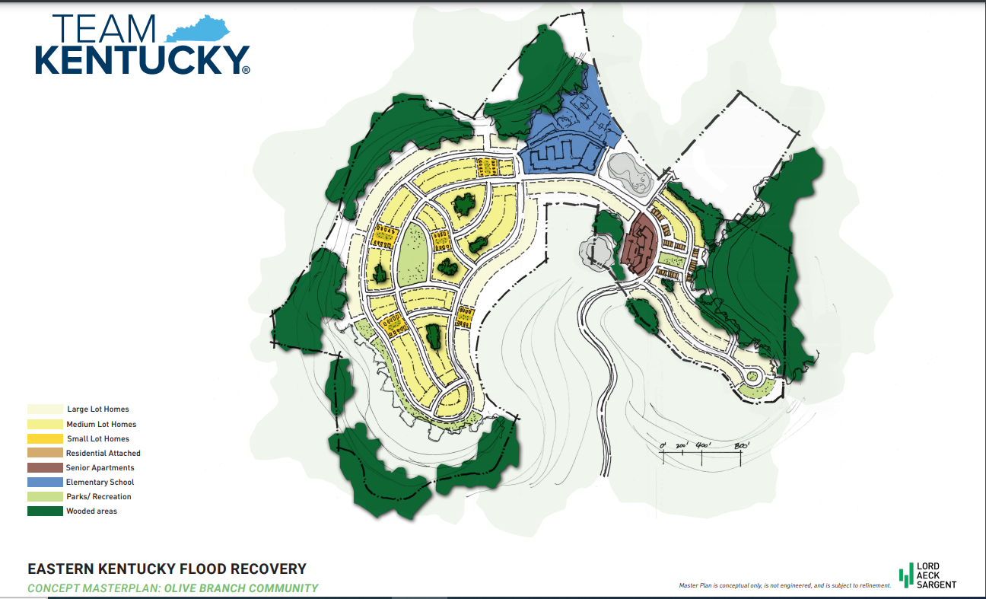

Slide 19
Questions?
PPC.ky.gov

