Slide 1

Objectives
An up-close view of the floods
Impacts beyond housing
How climate change impacts recovery
Intersection of disaster, recovery, climate change and environmental justice

Slide 2
On July 27th, We Had a Housing Crisis
At least 40% of population was inadequately housed.
Living in places not-designed for human habitation
Living in substandard housing
Overcrowded
Cost burdened
Homeless

Slide 3
Fundamental Cause of Housing Crisis Was Economic
Extremely Low Incomes
Median Income is about 50% of national average
1 in 3 households can only afford $500 (or less) for housing/utilities.
Persistent Poverty Region
Dilapidated housing stock
Interlocking challenges

Slide 4
On July 27th, We Had a Housing Crisis
275 Families seeking home repair
210 Families seeking homeownership
Rental waiting list full

Slide 5
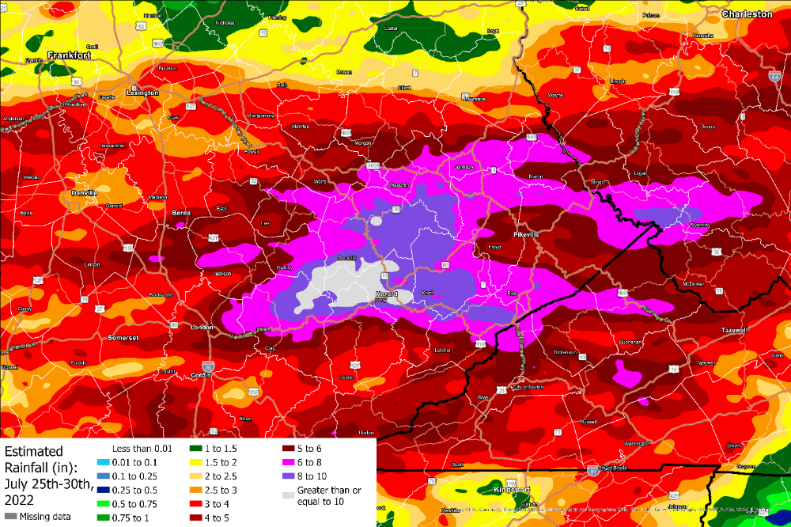
July 28th
Image from National Weather Service for July 2022 Flooding (https://www.weather.gov/jkl/July2022Flooding)

Slide 6
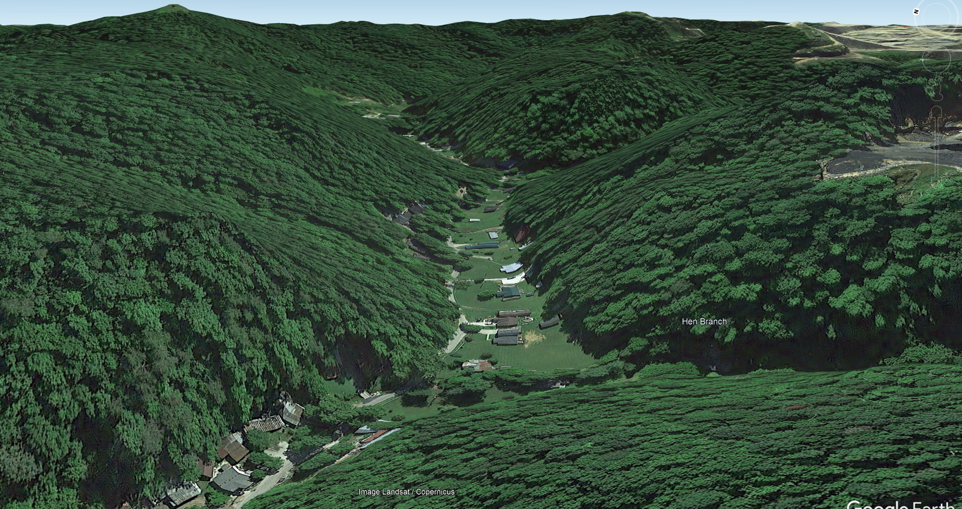
Topography

Slide 7
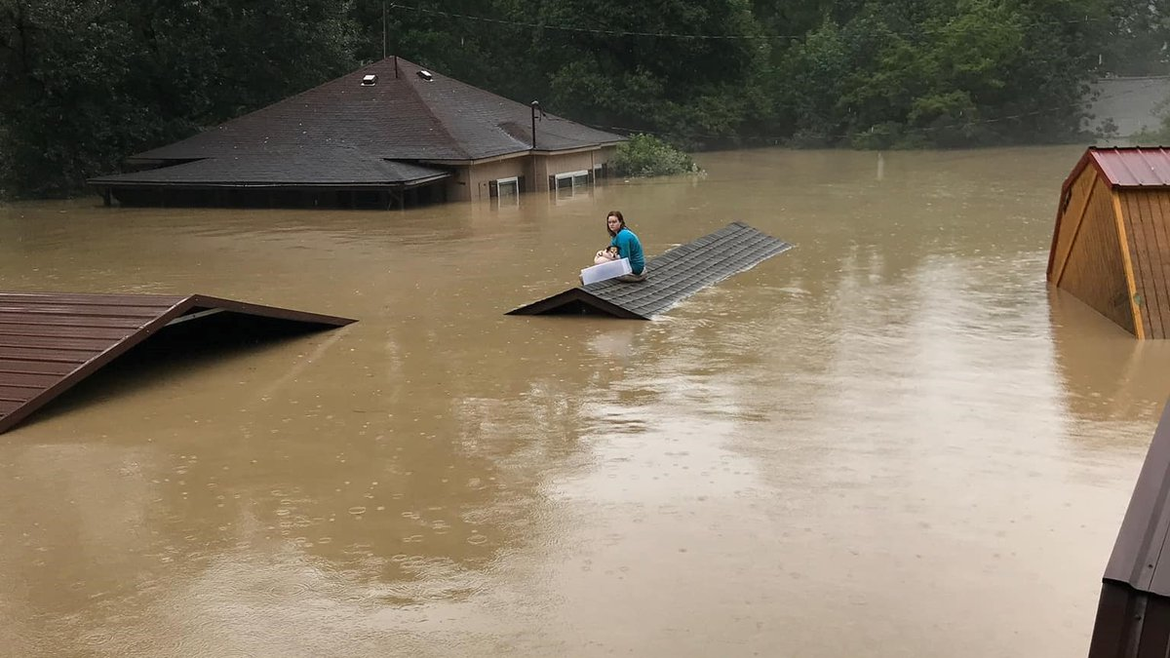

Slide 8
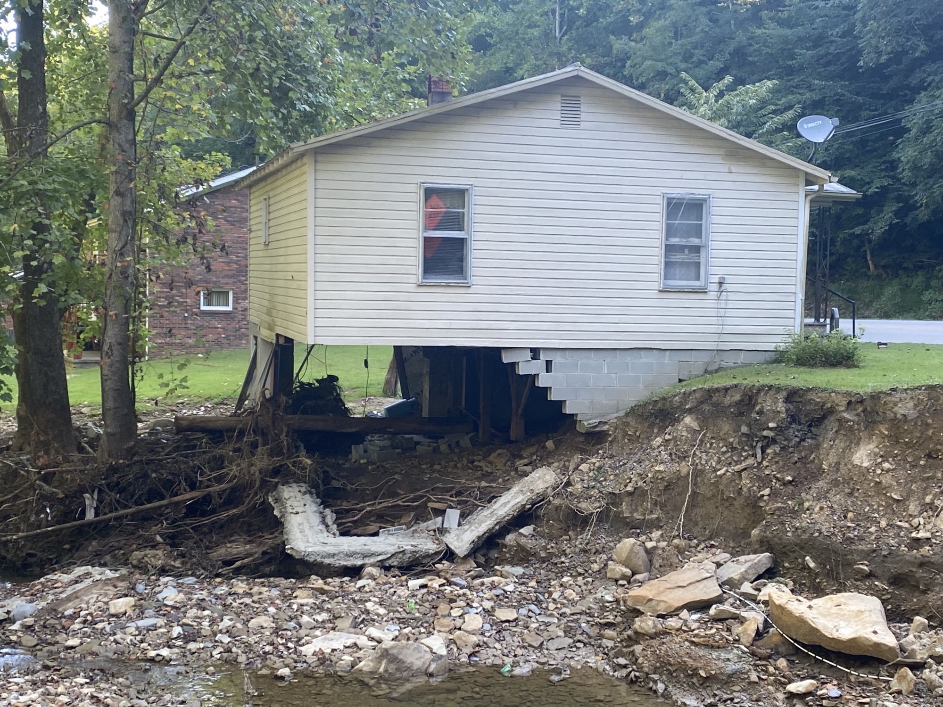
=

Slide 9
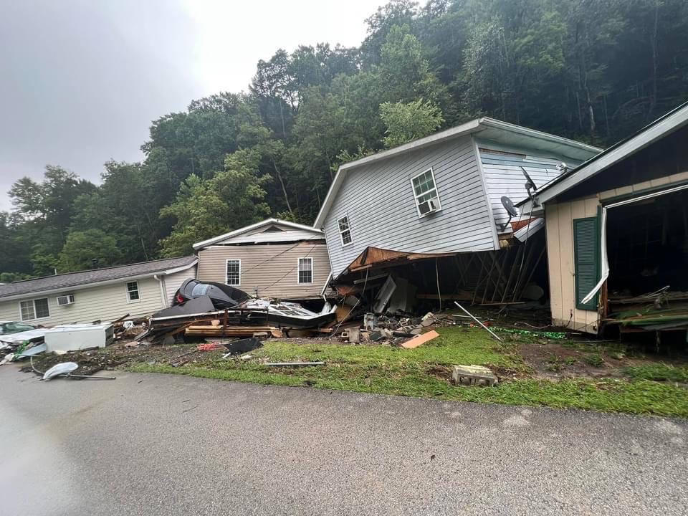

Slide 10
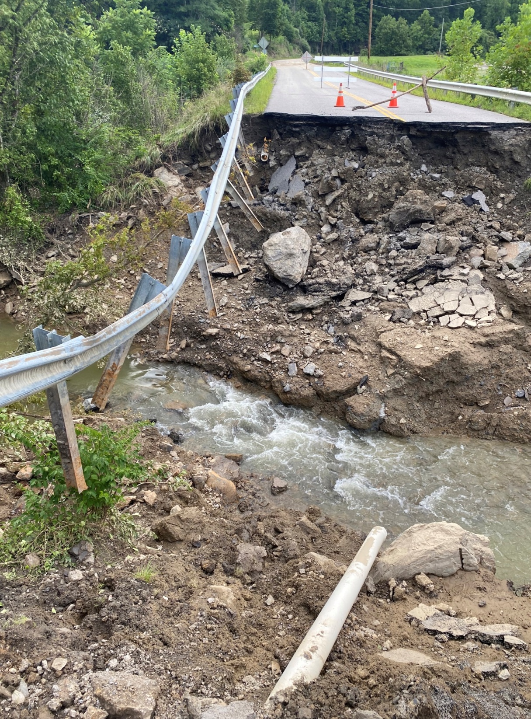

Slide 11
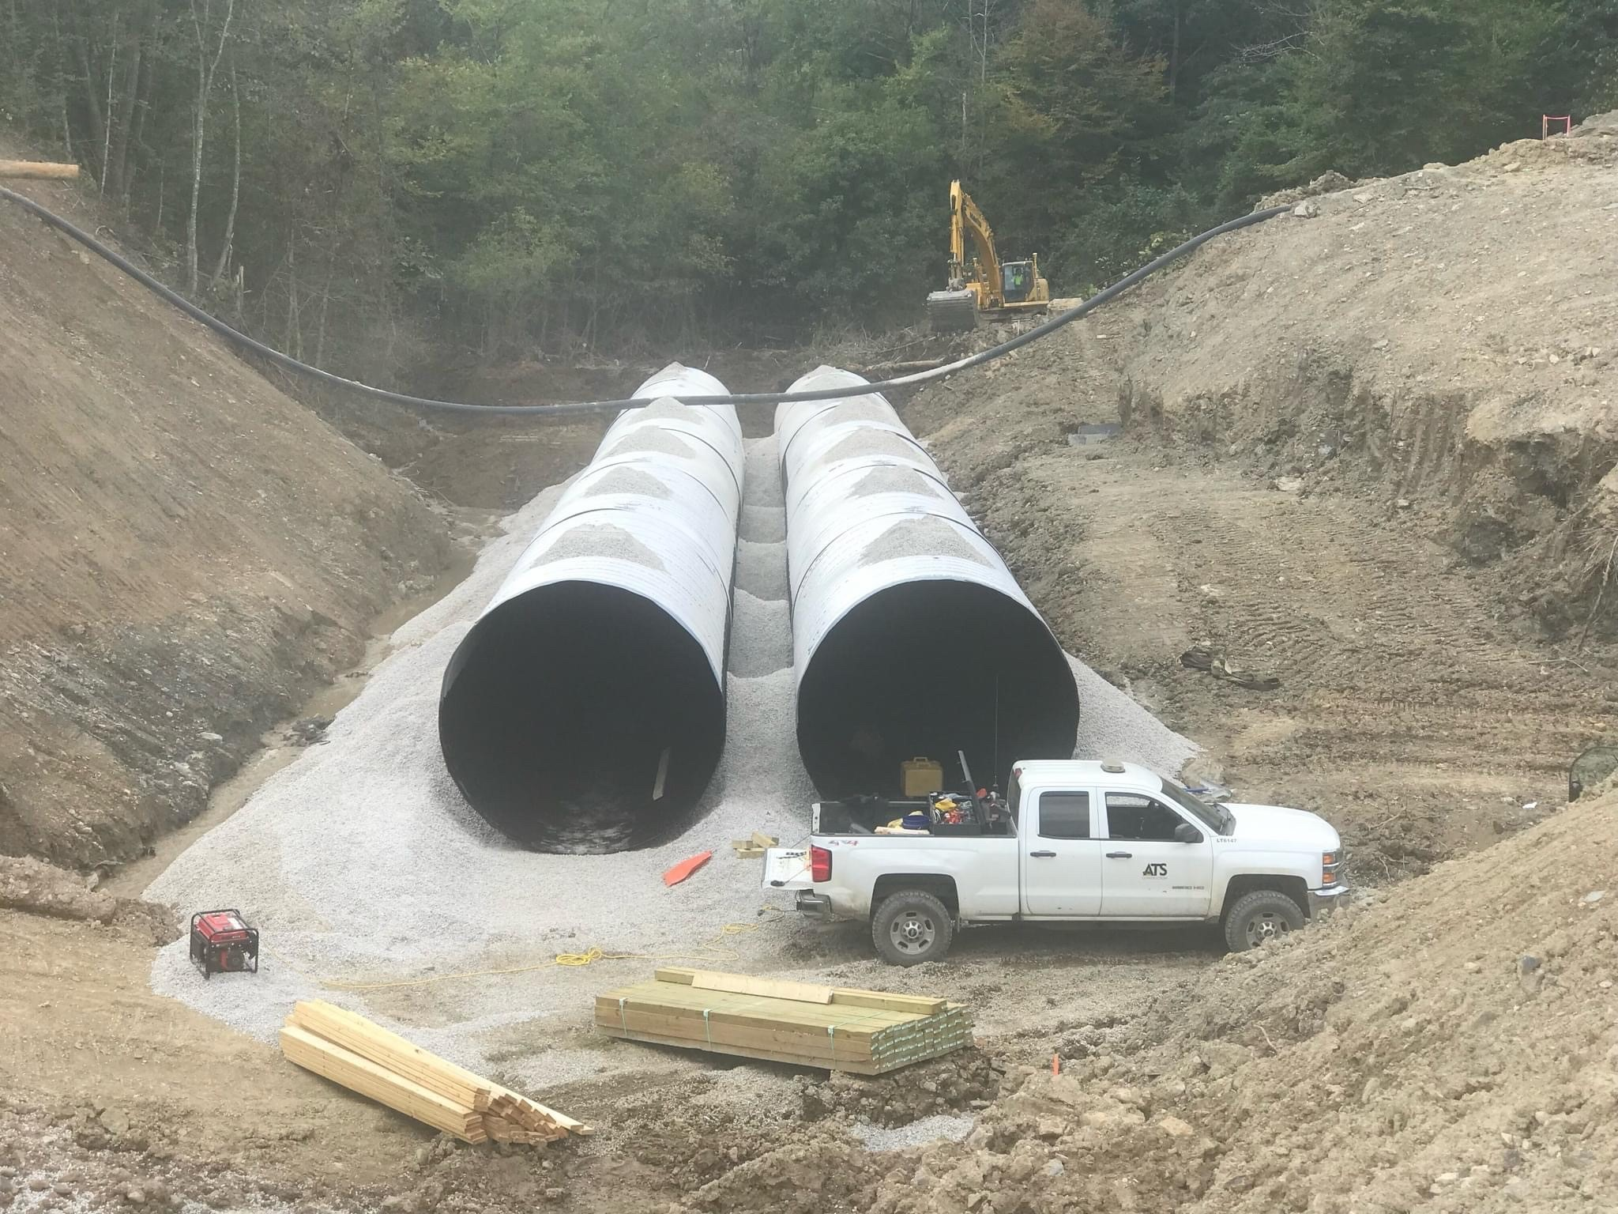

Slide 12
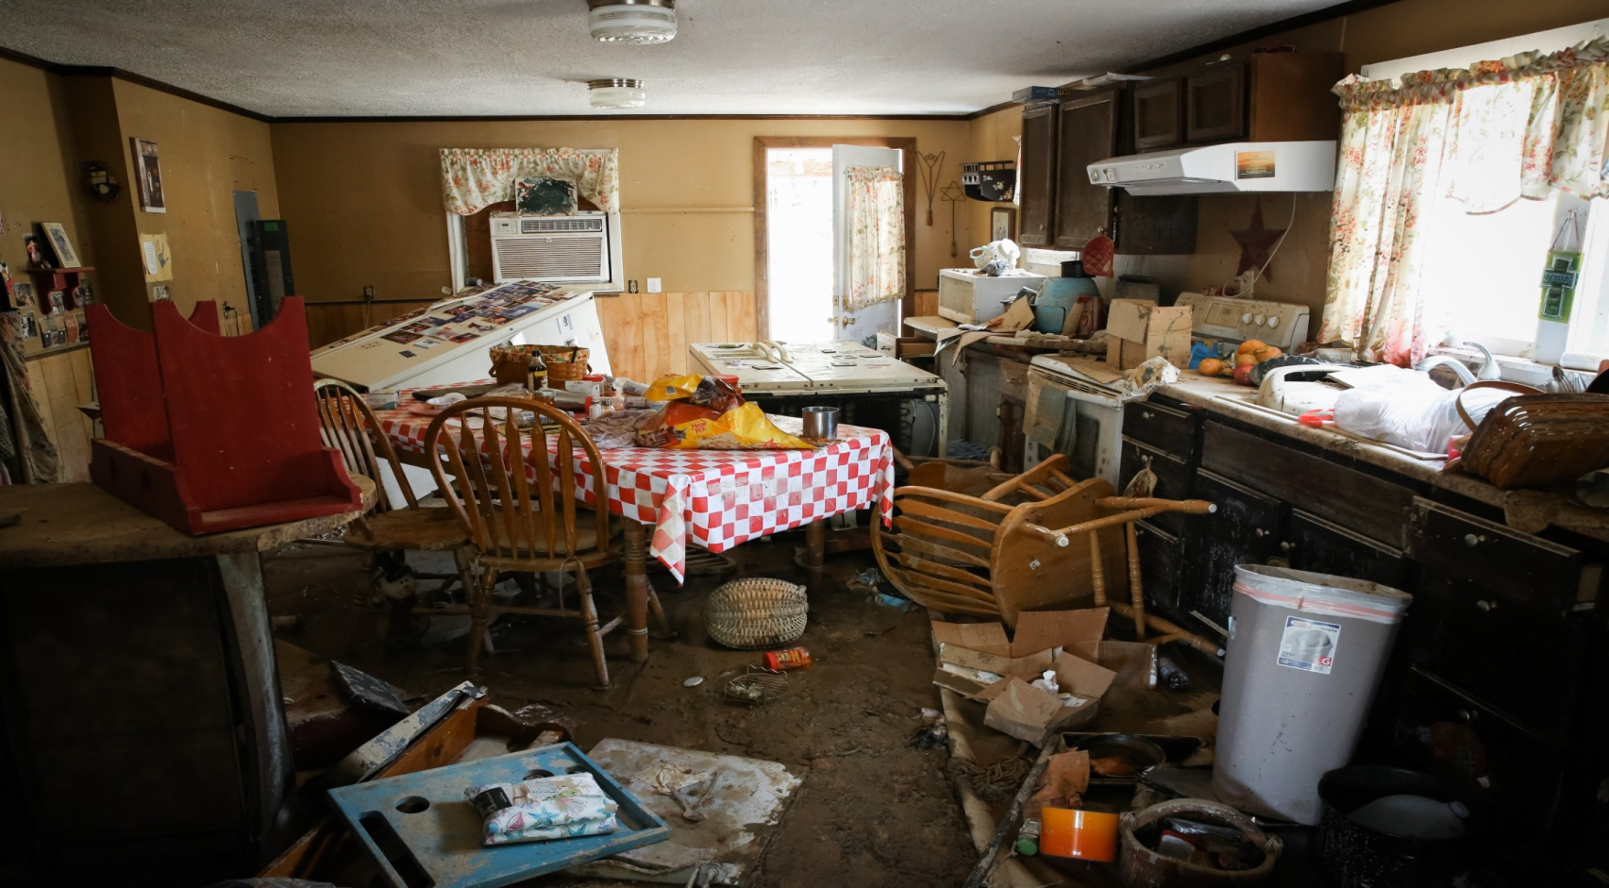
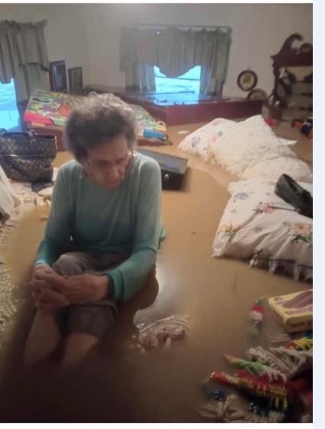


Slide 13
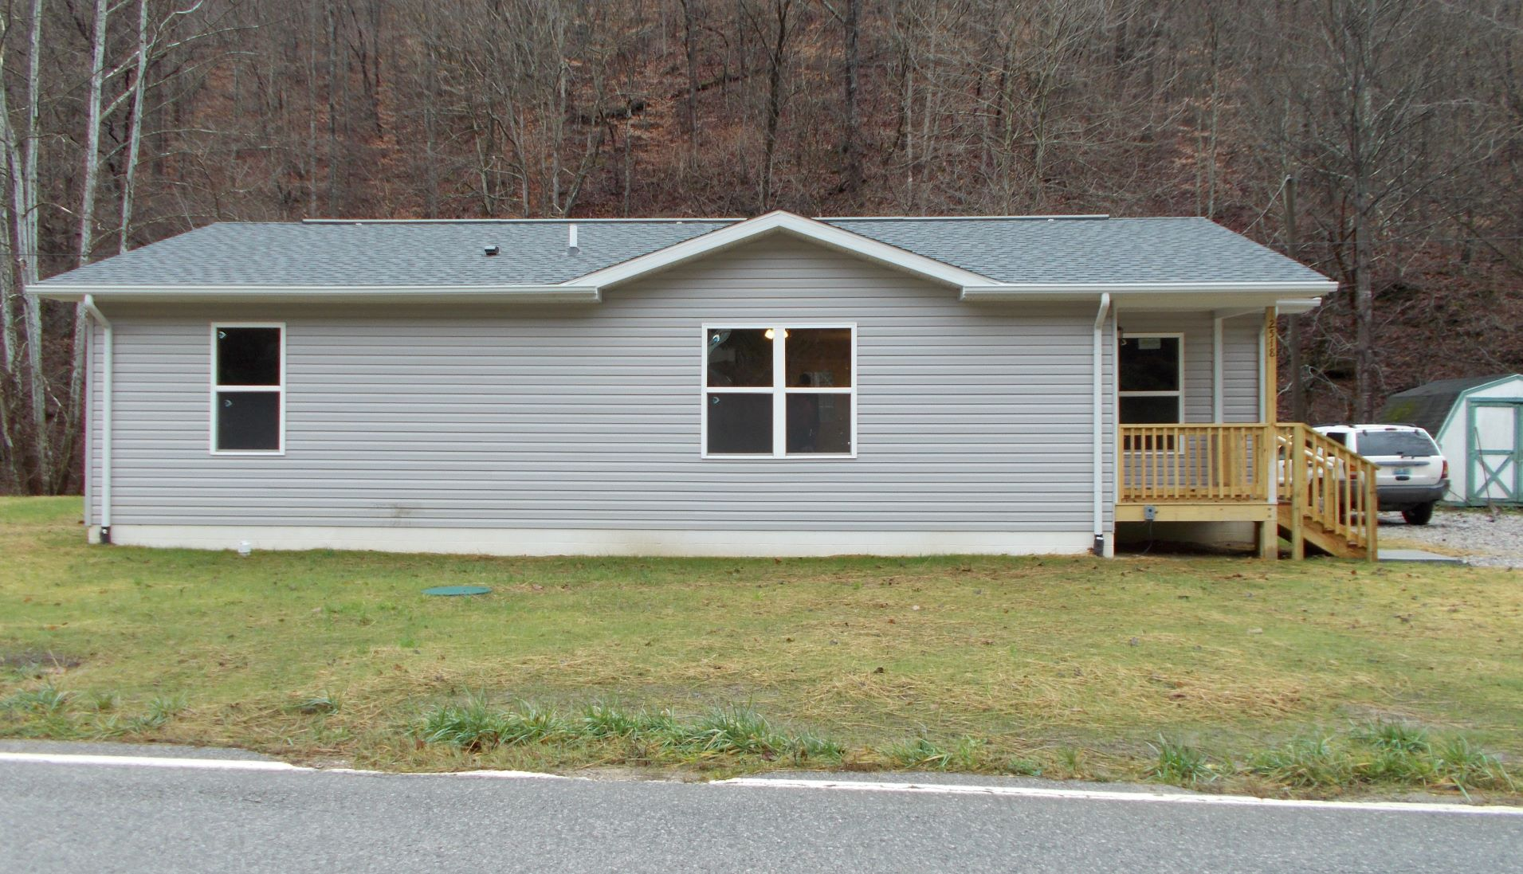

Slide 14
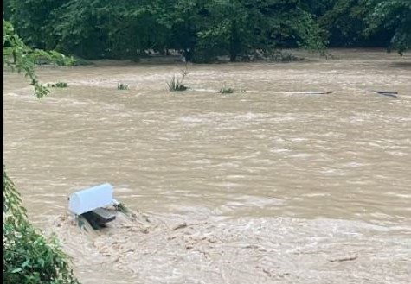

Slide 15
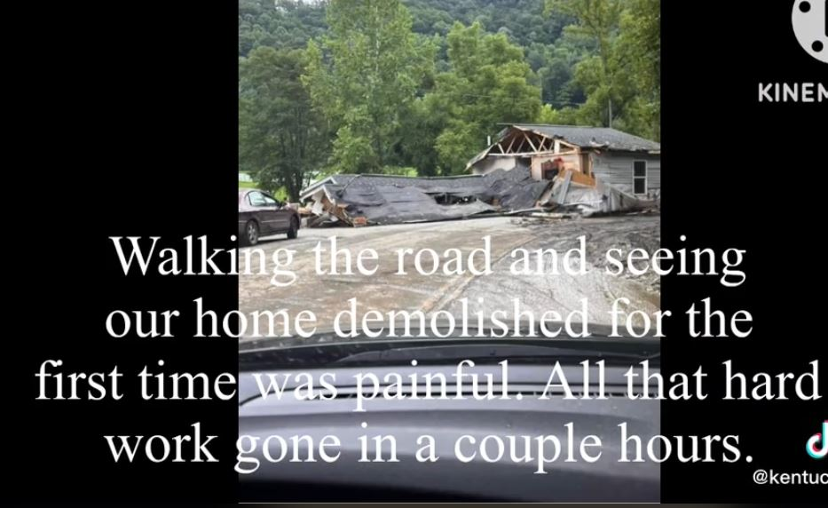

Slide 16
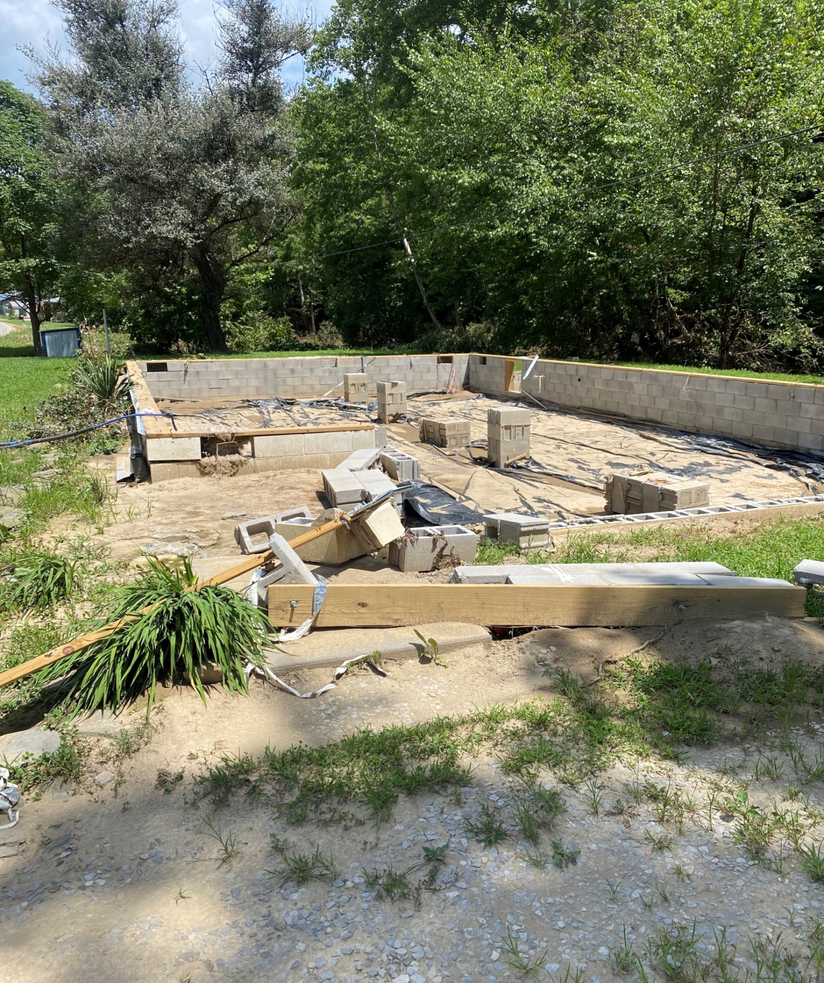

Slide 17
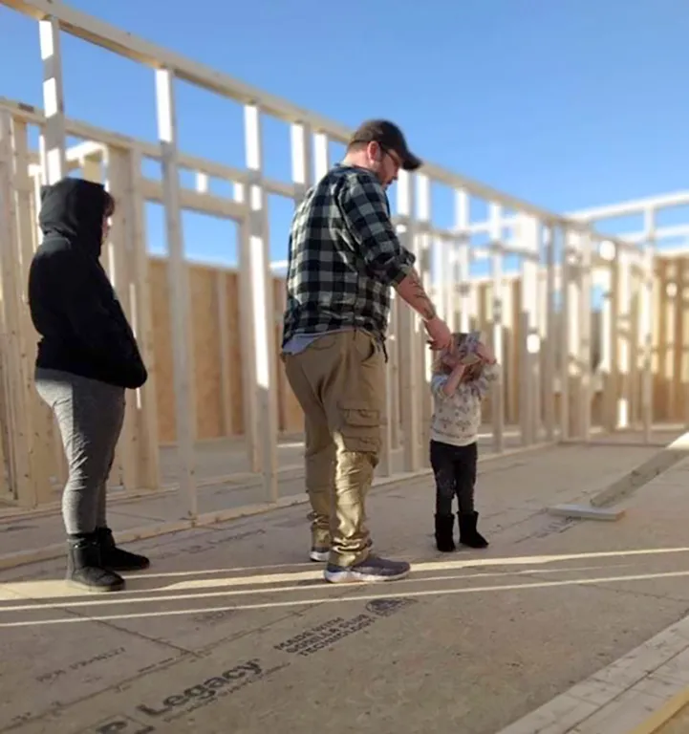

Slide 18
Impacts
FEMA Data (Eric Dixon, Ohio River Valley Institute)
393 Homes Destroyed
8,304 Uninhabitable without Repairs
13,833 Reported Damage to House
More than 1 in 7 homes had at least 1 inch of water (hardest hit counties)
Red Cross
385 Homes Destroyed
1,934 Major Damage
$450 million to $950 million to rebuild
(Eric Dixon & Rebecca Shelton, Appalachian Citizen’s Law Center)

Slide 19
Impacts Beyond Housing
Trauma, Secondary Trauma, Childhood Trauma
Substance Abuse Disorder
Abusive Behaviors
Health – stress, mold, contaminants, lifestyle changes

Slide 20
Impacts Beyond Housing
Financial – loss of wealth, increased expenses, credit/debit
Food Insecurity – no power, incomplete kitchens, financial, gardens and canning
Economic – Businesses, side gigs, farming
Education – damage to schools, disruption, learning while in temporary housing

Slide 21
Climate Change and Recovery

Slide 22
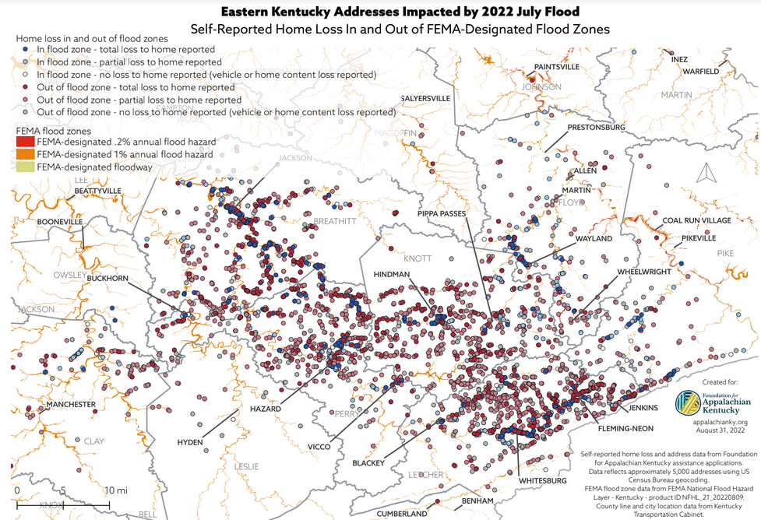

Slide 23
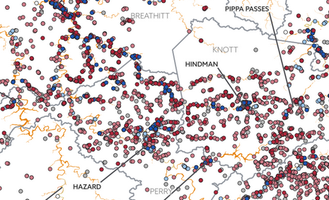

Slide 24
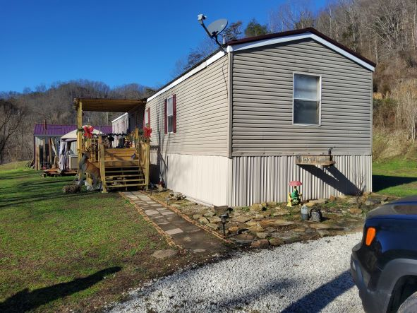
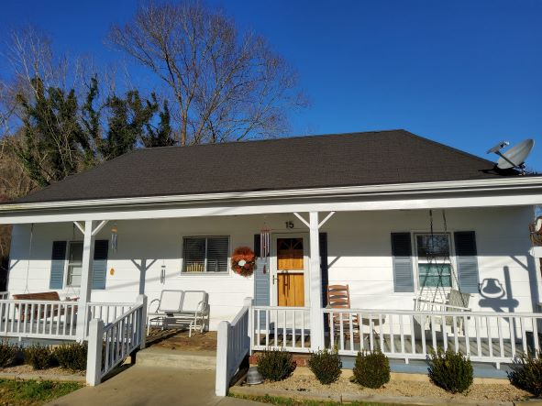
Climate Change and Recovery

Slide 25
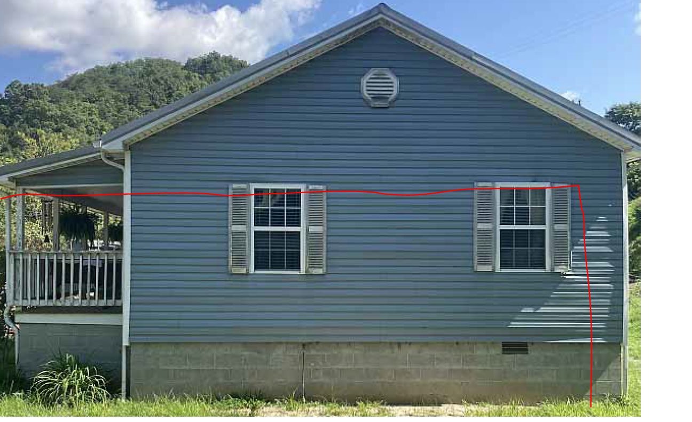
Flood Plain Maps Are Inadequate

Slide 26
Our Goal – Get Folks Out of Harm’s Way
Relocation
Families living in homes 50% damaged, regardless of flood plain status
Anyone who wants to relocate
Fortify homes of those who don’t relocate
Raise mechanicals above water level
Strengthen foundation and the connection to the foundation
Elevate?
Bridges not culverts

Slide 27
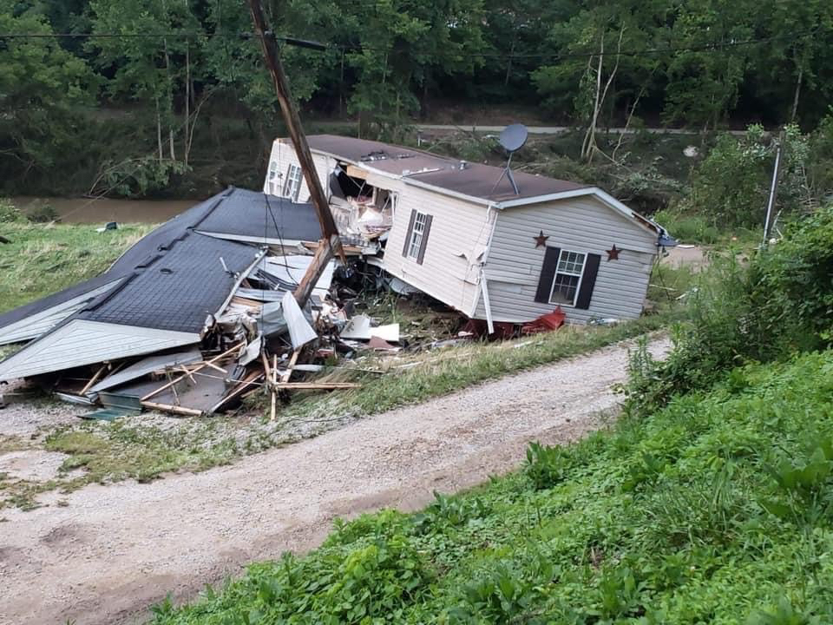
All of This is Costly, But . . .

Slide 28
Climate Justice - Recovery is Broken
Disaster | Rescue | Relief |  | Recovery
 |  | Volunteers and VOADS
 |  | Local Resources |  |  |  |  |  |  |  | The Great Recovery Gap*
 |  |  |  |  |  |  |  |  |  |  |  |  |  | HUD
 |  | Philanthropic
 |  |  |  |  |  |  |  |  |  |  |  |  |  | CDBG-DR
 |  | Private Insurance
 |  | Individual Resources |  |  |  |  |  |  |  |  |  |  | *SBPUSA
 |  | FEMA
 |  | 30 | 90 | 120 | 150 | 180 | 210 | 240 | 270 | 300 | 330 | 360 | 390 | 420

Slide 29
In Eastern Kentucky, It’s Really, Really Broken
Disaster | Rescue | Relief |  | Recovery
 |  | Volunteers and VOADS
 |  | Local Resources |  |  |  | The Great Recovery Gap*
 |  |  |  |  |  |  |  |  |  |  |  |  |  | HUD
 |  | Philanthropic
 |  |  |  |  |  |  |  |  |  |  |  |  |  | CDBG-DR
 |  | Private Insurance
 |  | Individual Resources |  |  |  |  |  |  |  |  |  |  | *SBPUSA
 |  | FEMA
 |  | 30 | 90 | 120 | 150 | 180 | 210 | 240 | 270 | 300 | 330 | 360 | 390 | 420

Slide 30
Hard Decisions
In the recovery gap, people are making the best decisions they can in really, really hard circumstances.
Setting new/used mobile homes where their old one washed away
Converting storage sheds to makeshift tiny homes
Staying in unsafe, flood-damaged homes
Paying rent/utilities they can’t afford
Leaving the region

Slide 31
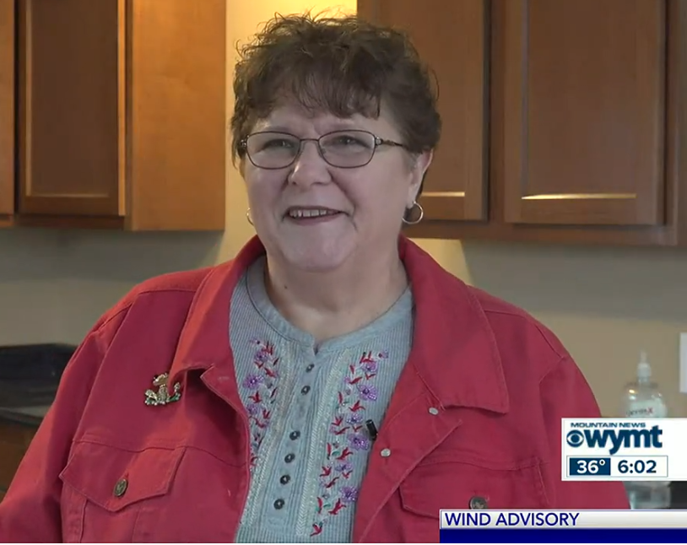
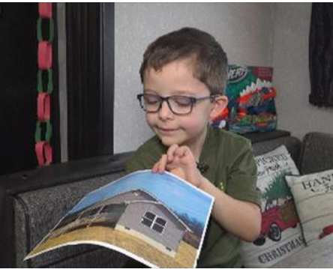
Housing Can’t Wait
Speeding up recovery matters!

