Slide 1



Kentucky Climate:
Past, Present, and Trends
Dr. Jerry Brotzge
Dir. KY Climate Center, KY Mesonet
Dr. Stu Foster (retired KY State Climatologist)
Sustainability Summit 2023

Slide 2
Weather & Climate
Introduction

Slide 3
Weather vs Climate
NASA – “The difference between weather and climate is a measure of time. Weather is what conditions of the atmosphere are over a short period of time, and climate is how the atmosphere "behaves" over relatively long periods of time.” http://www.nasa.gov/mission_pages/noaa-n/climate/climate_weather.html
University Corporation for Atmospheric Research (UCAR) – “Weather is the mix of events that happen each day in our atmosphere including temperature, rainfall and humidity. … Climate is the average weather pattern in a place over many years.” http://www.eo.ucar.edu/basics/index.html

Slide 4
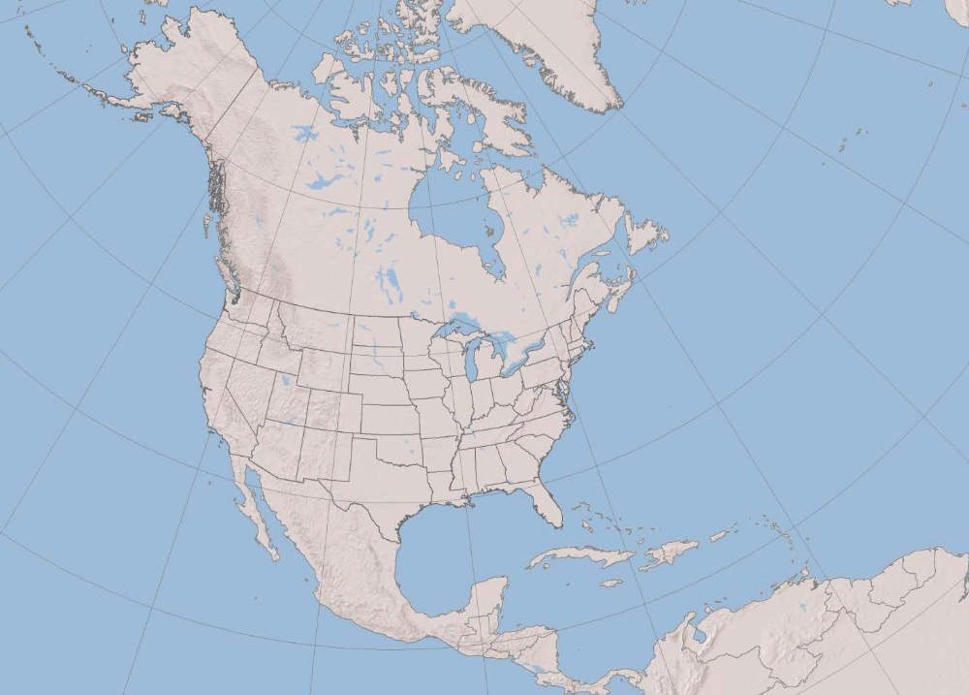
Key Climate Drivers
Continental
Interior regions are often dry and prone to extremes of heat and cold
Tropical
Advection of moist tropical air moderates temperature extremes and contributes to abundant precipitation
Storm Track
Position and strength of the jet stream greatly influences day-to-day weather
Continental
(cool, dry)
Storm Track
Tropical
(warm, moist)

Slide 5
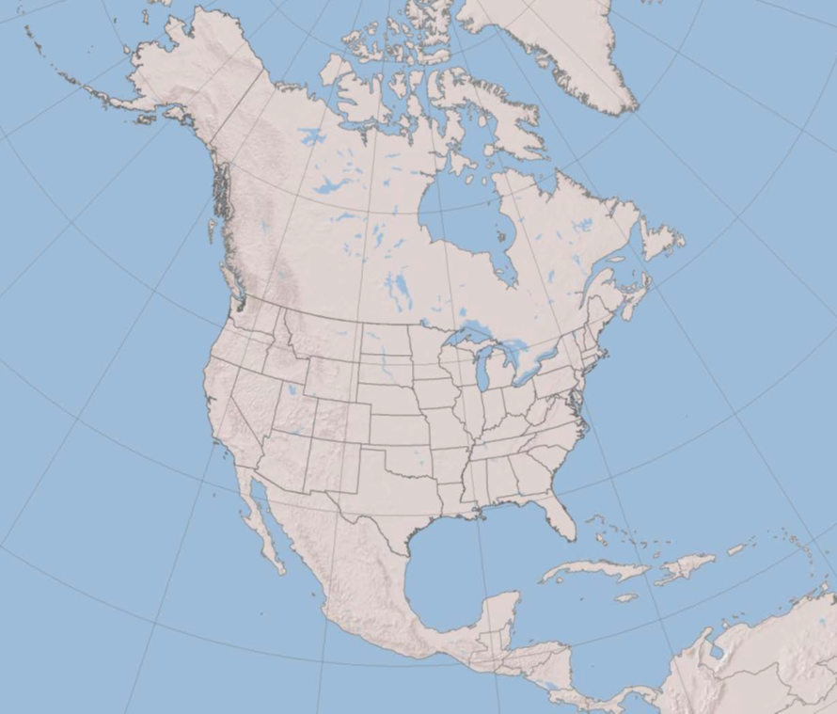
Polar Jet Stream
Polar Jet Stream
Winter – strengthens and moves southward
Summer – weakens and moves northward
Position fluctuates but can persist or recur in a favored area due to teleconnections, particularly during winter
Cool, Dry
Warm, Moist

Slide 6
General climate trends
National trends
Temperature
Moisture

Slide 7
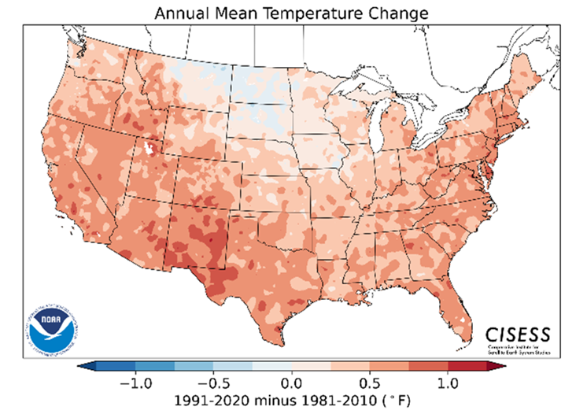

The 1991-2020 Climate Normals
Highlight Decadal Change
--- Annual ---
https://www.ncei.noaa.gov/products/us-climate-normals

Slide 8
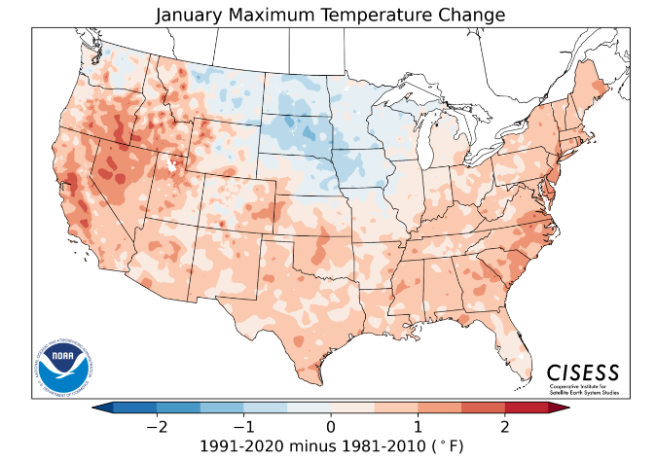

The 1991-2020 Climate Normals
Highlight Decadal Change
--- January ---
https://www.ncei.noaa.gov/products/us-climate-normals

Slide 9
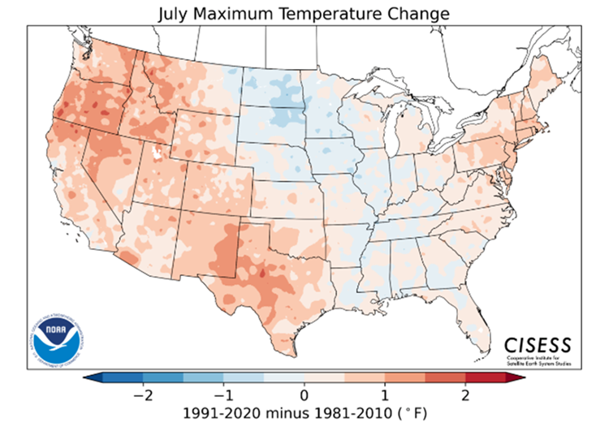

The 1991-2020 Climate Normals
Highlight Decadal Change
--- July ---
https://www.ncei.noaa.gov/products/us-climate-normals

Slide 10
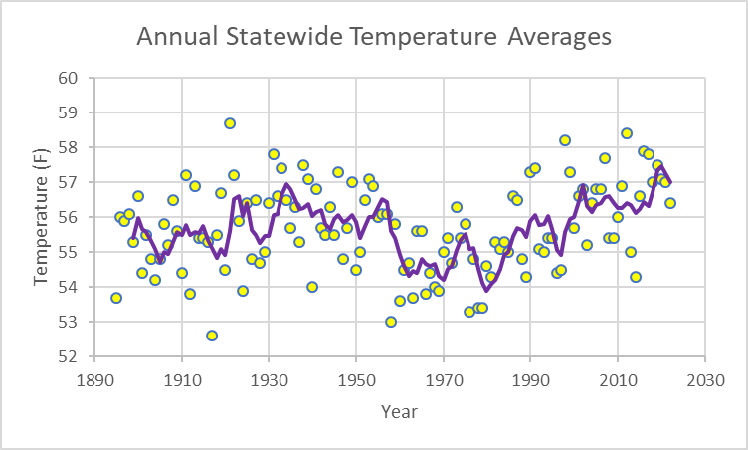
Kentucky Statewide Average Temperature
1895-2022
While 1921 remains the warmest year on record, five of the top ten warmest years have occurred since 2007.
Top 10 Warmest Years
1921 58.7F
2012 58.4F
1998 58.2F
2016 57.9F
2017 57.8F
1931 57.8F
2007 57.7F
1938 57.5F
2019 57.5F
1933 57.4F
1991 57.4F

Slide 11
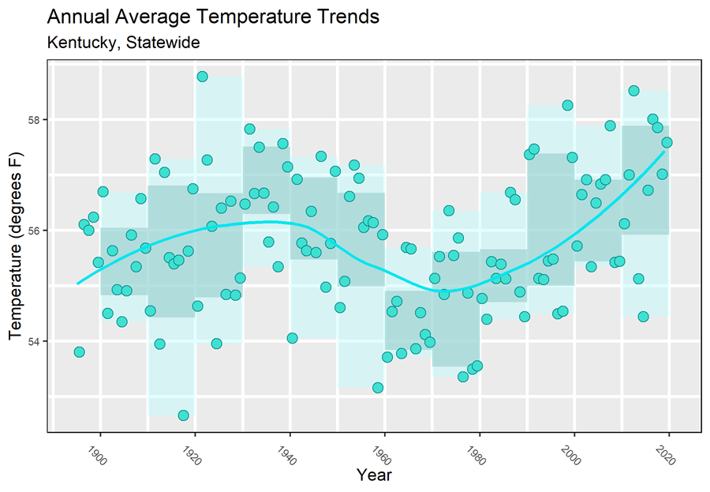
Kentucky Statewide Average Temperature
1895-2022
General warming 1895-1930, cooling 1930-1970, and warming 1970-present.
Relatively cool prior to 1920 and 1960-1990.
Relatively warm 1920-1960 and post 1990.

Slide 12
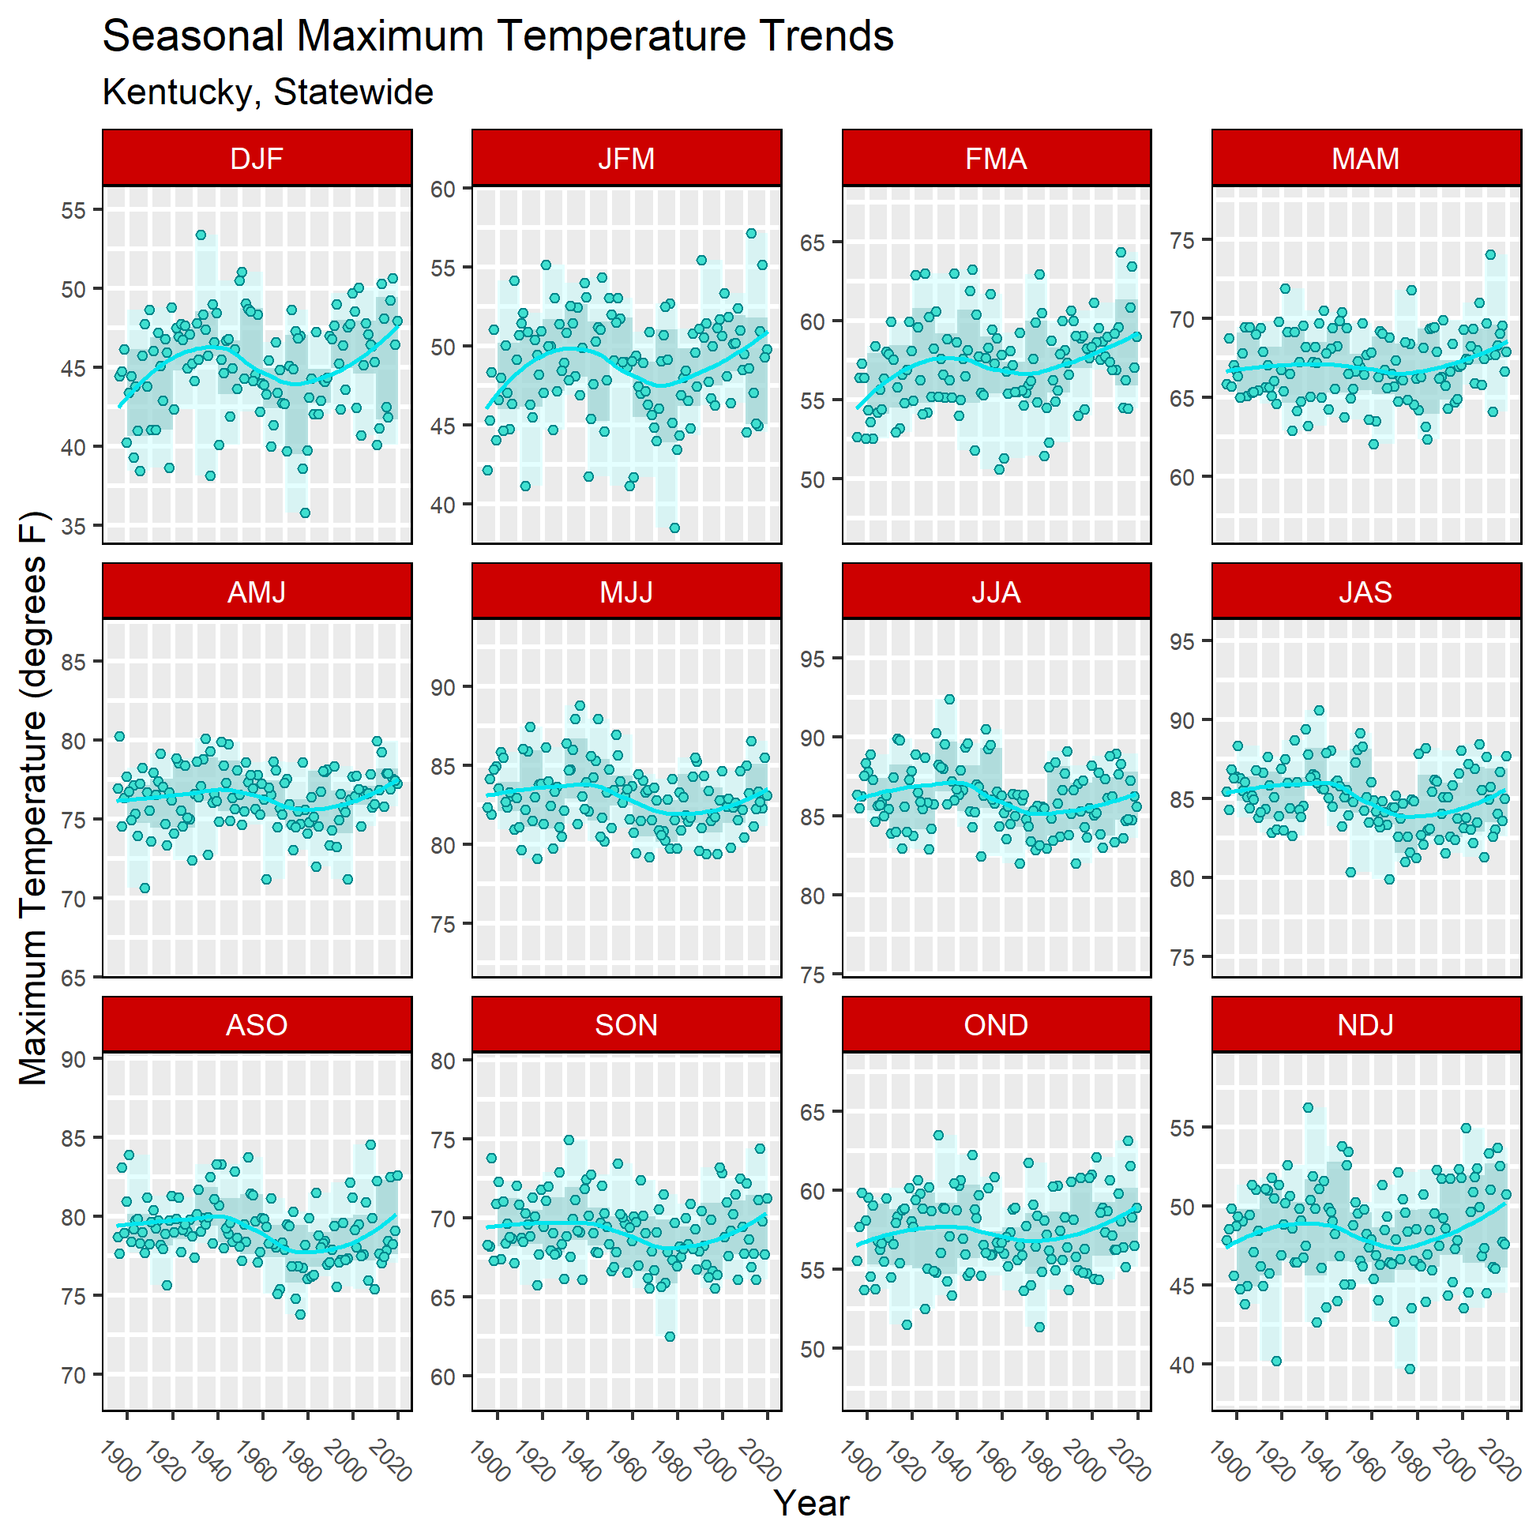
The average daily maximum temperature in summer remains below the historical peak of the first half of the 1900s.

Slide 13
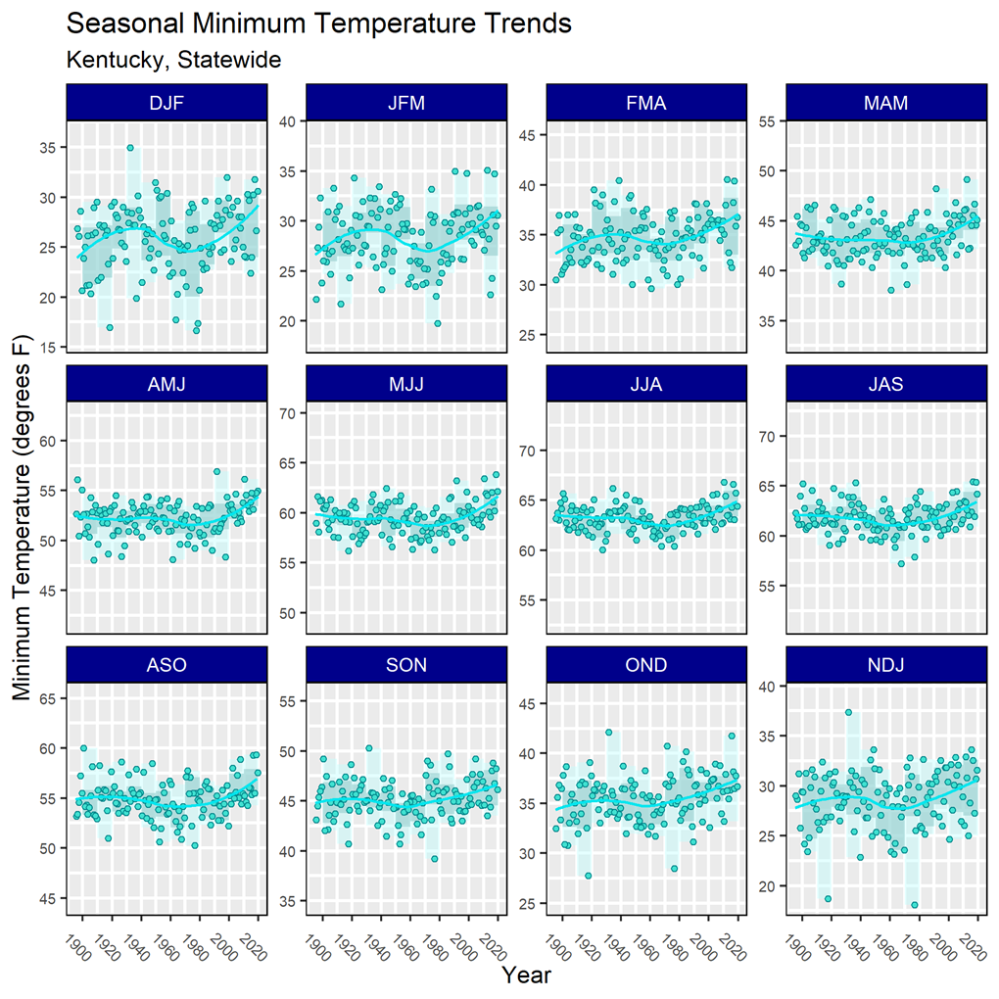
The average daily minimum temperature has exceeded historical peaks in all seasons.
The greater increase in average daily minimum temperature compared to average daily maximum temperature in the spring and summer is consistent with a wetter climate (and/or possibly a cloudier climate).

Slide 14
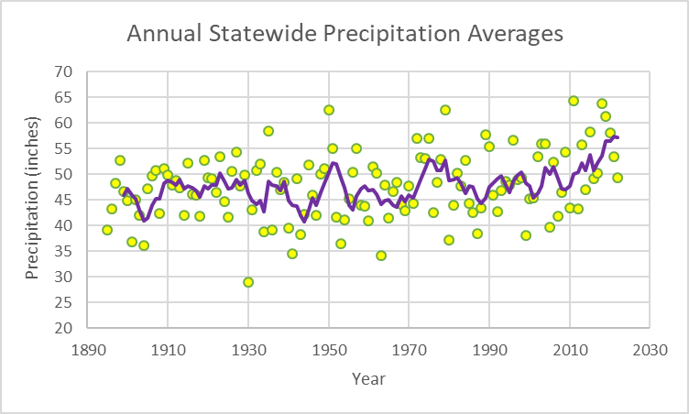
Kentucky Statewide Average Precipitation
1895-2022
Five of the top 10 wettest years have occurred since 2011.
Top 10 Wettest Years
2011 64.35 inches
2018 63.74
1950 62.63
1979 62.58
2019 61.32
1935 58.38
2015 58.31
2020 58.11
1989 57.74
1972 57.08

Slide 15
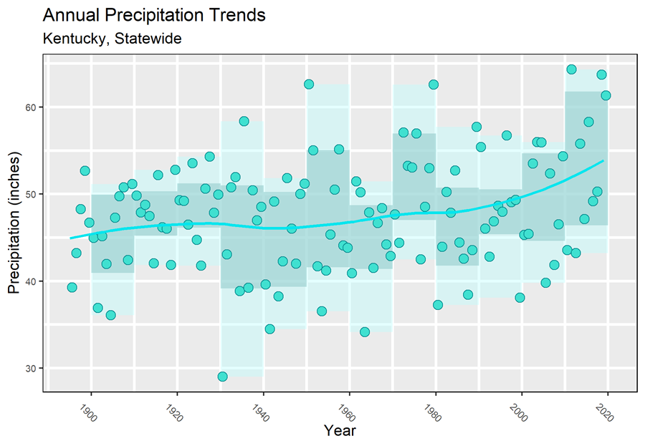
Kentucky Statewide Average Precipitation
1895-2022
Mean precipitation has trended from the mid 40s to over 50 inches.
Extremely dry years have become less frequent.

Slide 16
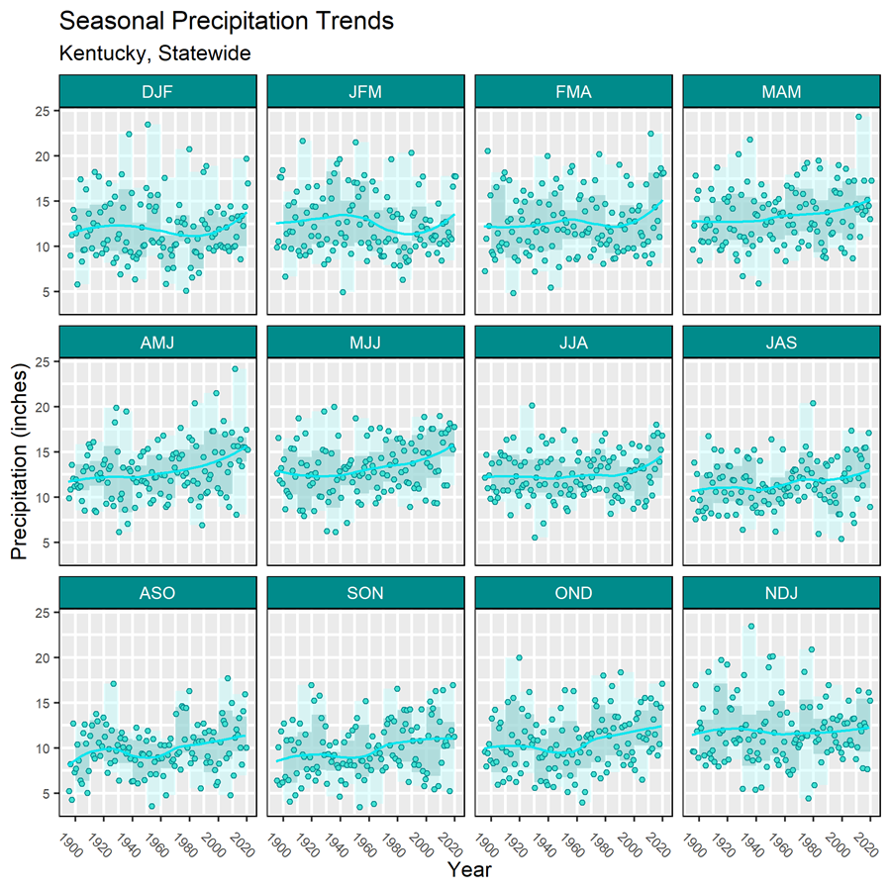
While the increase in precipitation is broad based, it is most prominent in the spring.

Slide 17
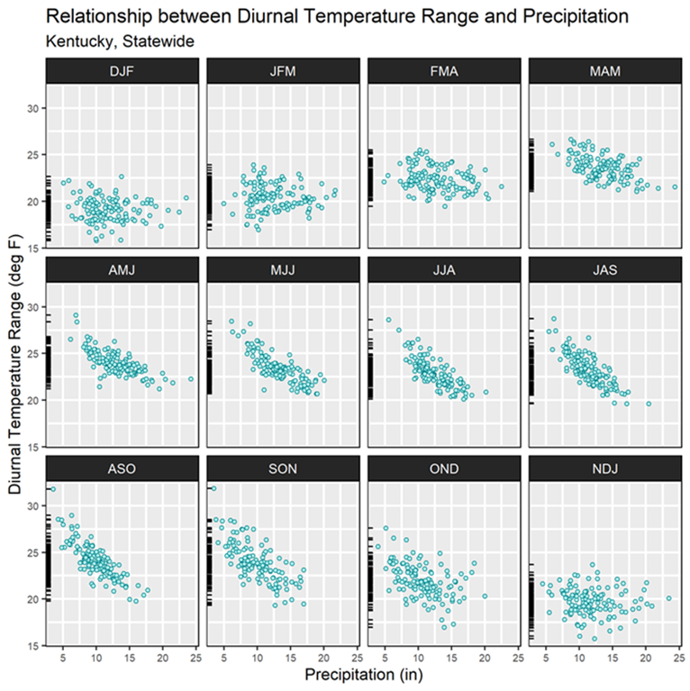
As moisture is depleted from the environment, solar radiation is increasingly converted into sensible heat instead of latent heat.

Slide 18
Extreme events
Long history
Wide variety of natural hazards

Slide 19
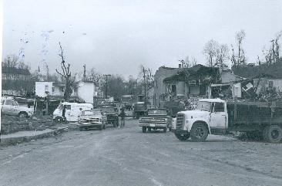
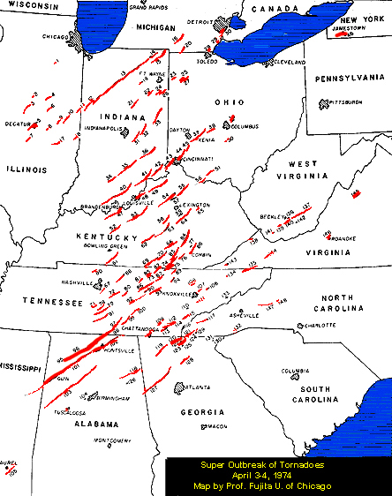
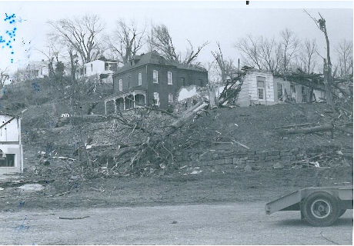
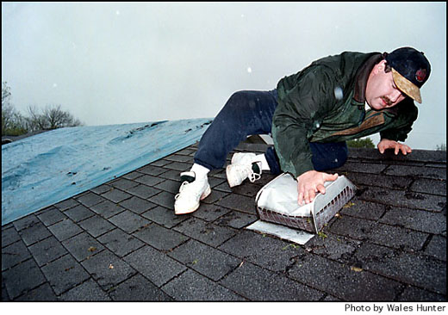
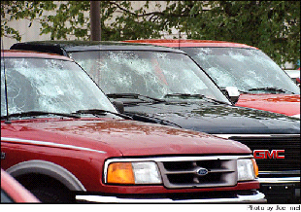
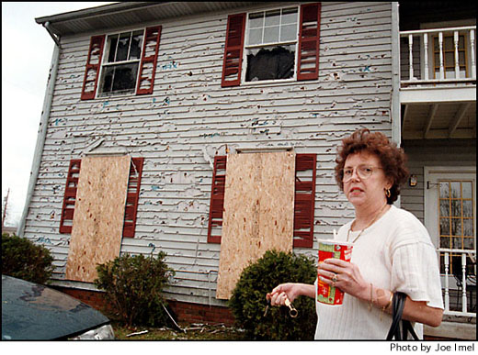
Tornado Outbreak of 1974
1998 Hailstorm
Impact in Warren County
11,000 homes damaged
10,000 automobiles damaged
16 airplanes damaged or destroyed
Damage estimated over $500 million
Photos from NWS Archive
At least 26 tornadoes struck 39 counties on April 3rd
77 people killed and 1,377 injured
Brandenburg destroyed, 28 dead
Pulaski County hit by 3 tornadoes

Slide 20
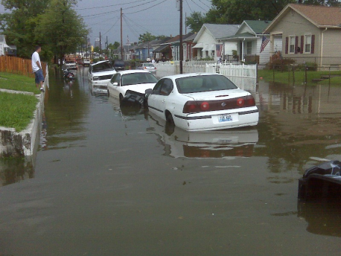
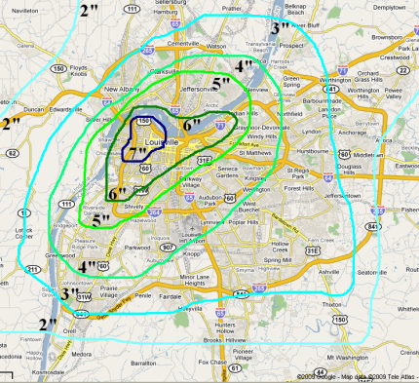
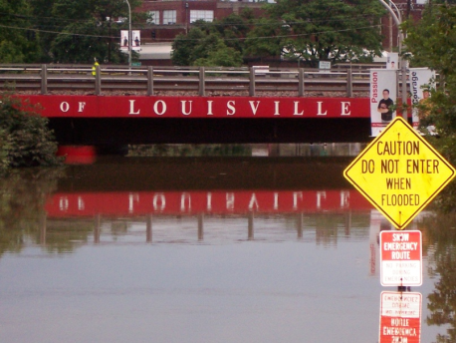
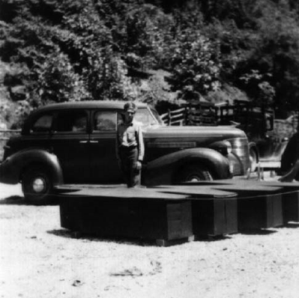
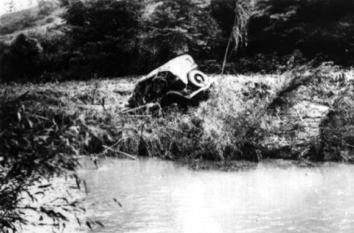
Flash Floods
Frozen Creek
July 4, 1939
Precipitation estimates over 12”
Wall of water estimated up to 22’
Without warning, 79 people died
Louisville August 4, 2009
Source: NWS, Louisville WFO
Up to 6” within 3 hours
Extensive property damage
No fatalities, no injuries
Source: www.breathittcounty.com

Slide 21
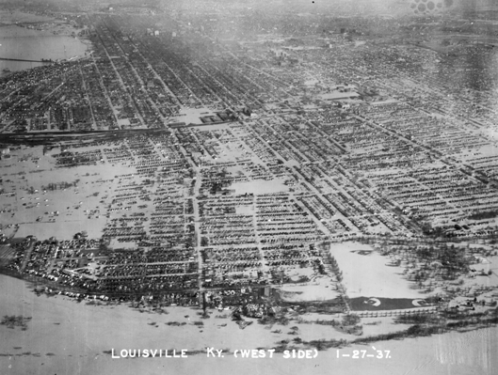
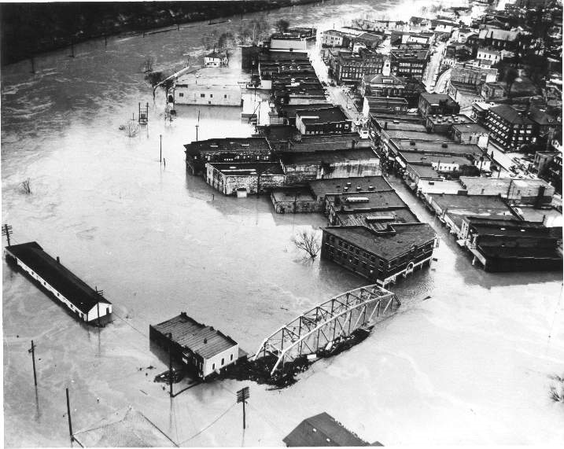
River Floods
Communities of the Kentucky, Cumberland, Big Sandy, and Licking River basins have been devastated by flooding on many occasions, including 1927, 1937, 1957, 1977, and 1997.
Photo from Courier Journal
The Great Flood of January 1937
Precipitation averaged 15.77” statewide
Some areas recorded over 22” for the month
Over 50% of Louisville, 95% of Paducah flooded
Damage exceeded $3 billion (2008 dollars)
Hazard, KY 1963
http://hazardkentucky.com/flood.htm

Slide 22
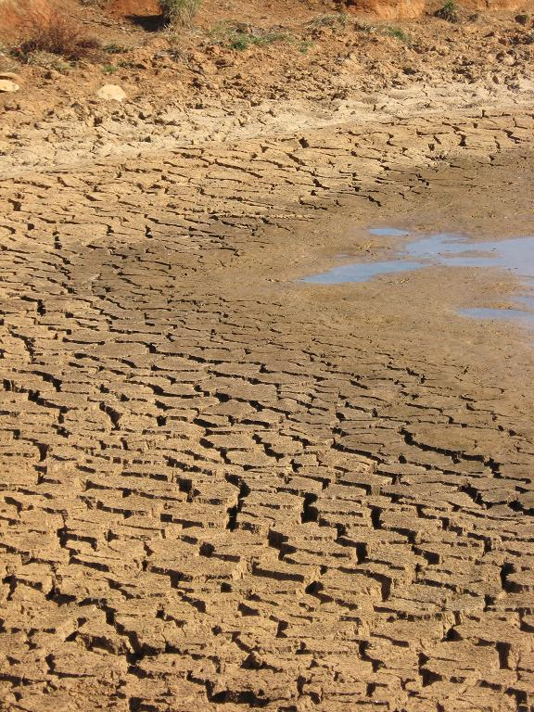
Drought Years in Kentucky
1854
1881
1901
1904
1908
1913-14
1930
1936
1941
1953-54
1963-64
1988
1999-2000
2007
2012
2016
Annual precipitation deficits of 15 to 25 inches
Growing season precipitation averaged 51% of normal
Record high temperature of 114° F
Extreme heat in July with 100° F or higher on 15 days

Slide 23
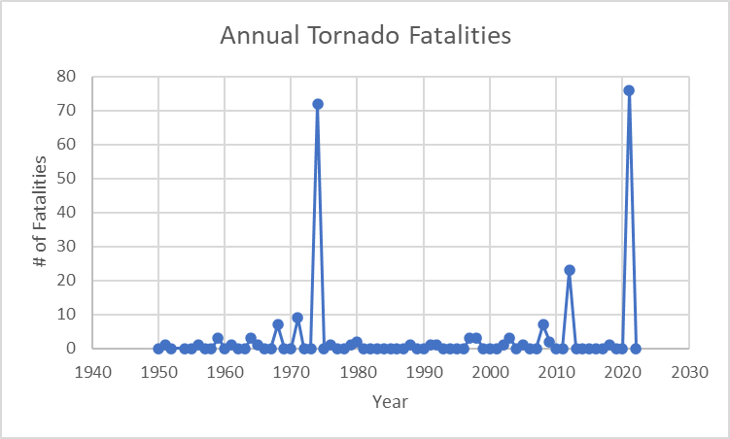
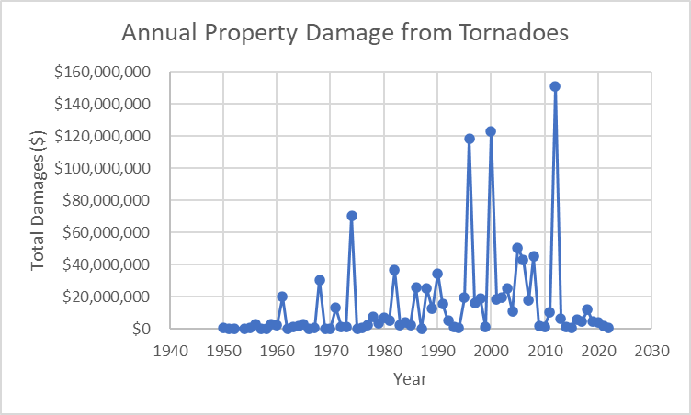

Slide 24
General risks & vulnerability
Vulnerability
Human health and economic impacts

Slide 25
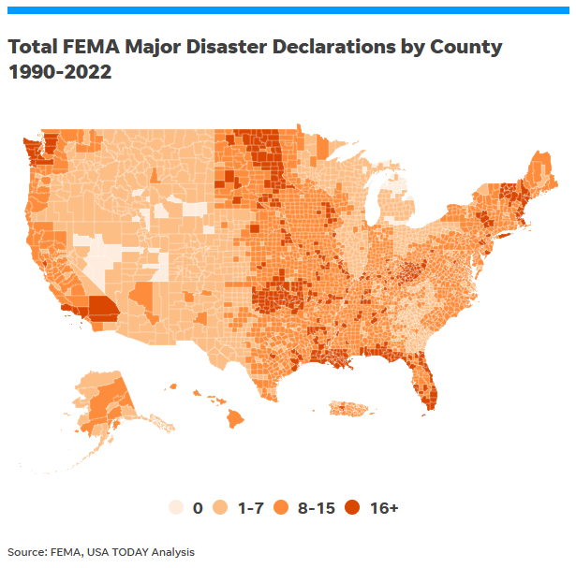

Slide 26
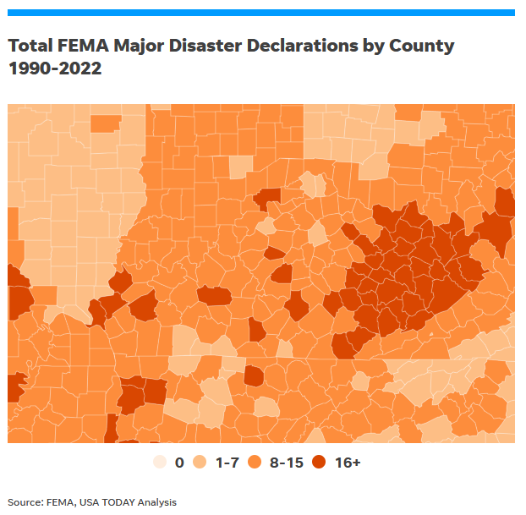
Top 10 Counties in the US:
Lawrence County, Kentucky (30)
Caddo County, Oklahoma (30)
Johnson County, Kentucky (28)
Perry County, Kentucky (28)
Magoffin County, Kentucky (28)
Logan County, Oklahoma (27)
Breathitt County, Kentucky (26)
Lafourche Parish, Louisiana (26)
Floyd County, Kentucky (26)
Owsley County, Kentucky (26)
Canadian County, Oklahoma (26)
Okmulgee County, Oklahoma (26)

Slide 27
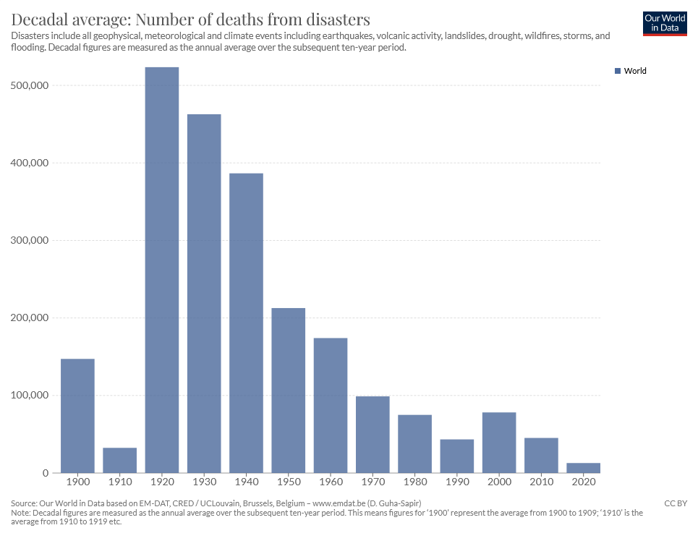
Good news!
We’re now more prepared and safer than ever before.

Slide 28
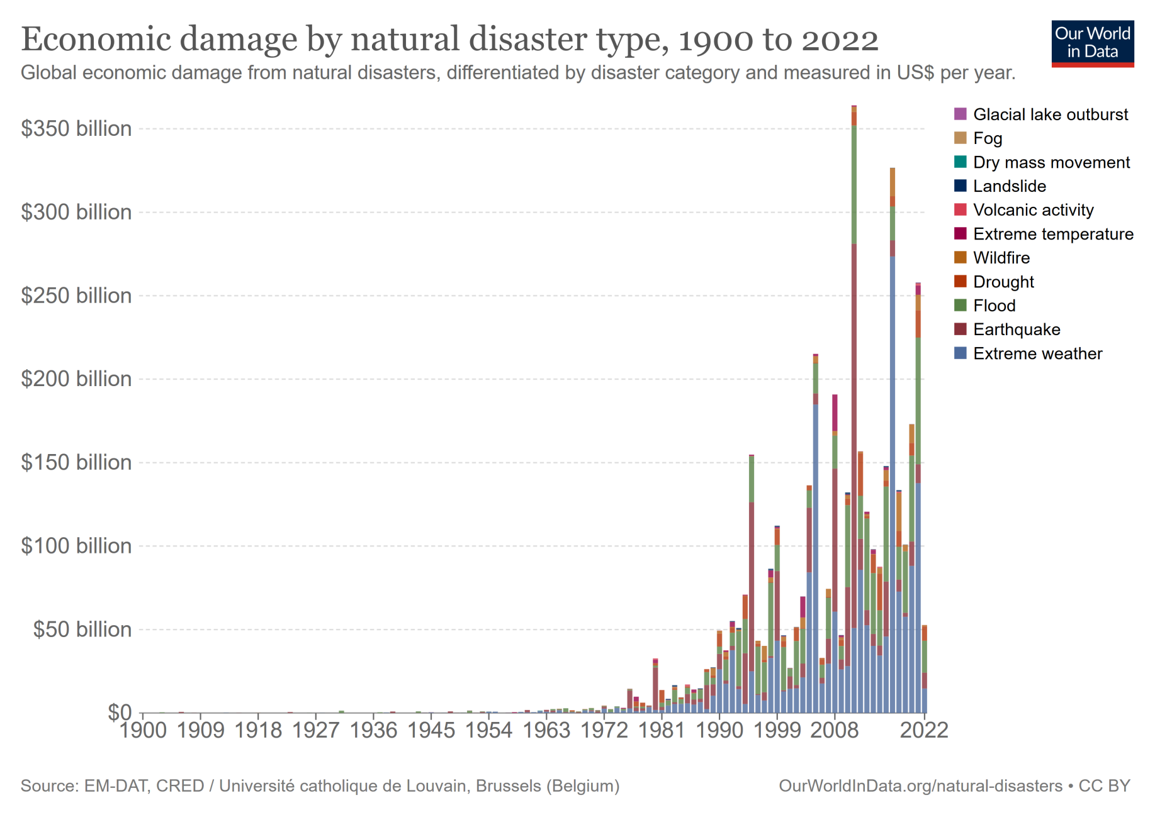
Bad news… we’re becoming less economically resilient.

Slide 29
Key Takeaway Points…
Kentucky is vulnerable to a wide variety of natural disasters – tornadoes, hail, severe winds, extreme temperatures, floods, and droughts among others.
KY temperature has warmed about 1-2⁰ F since 1980, on par with the 1930s.
KY is about 5 inches (10%) wetter now than in decades past.
No evidence of increased extreme events (yet). Possibly fewer droughts but more floods in the future?
More resilient than ever before, but much more can be done.

