Slide 1
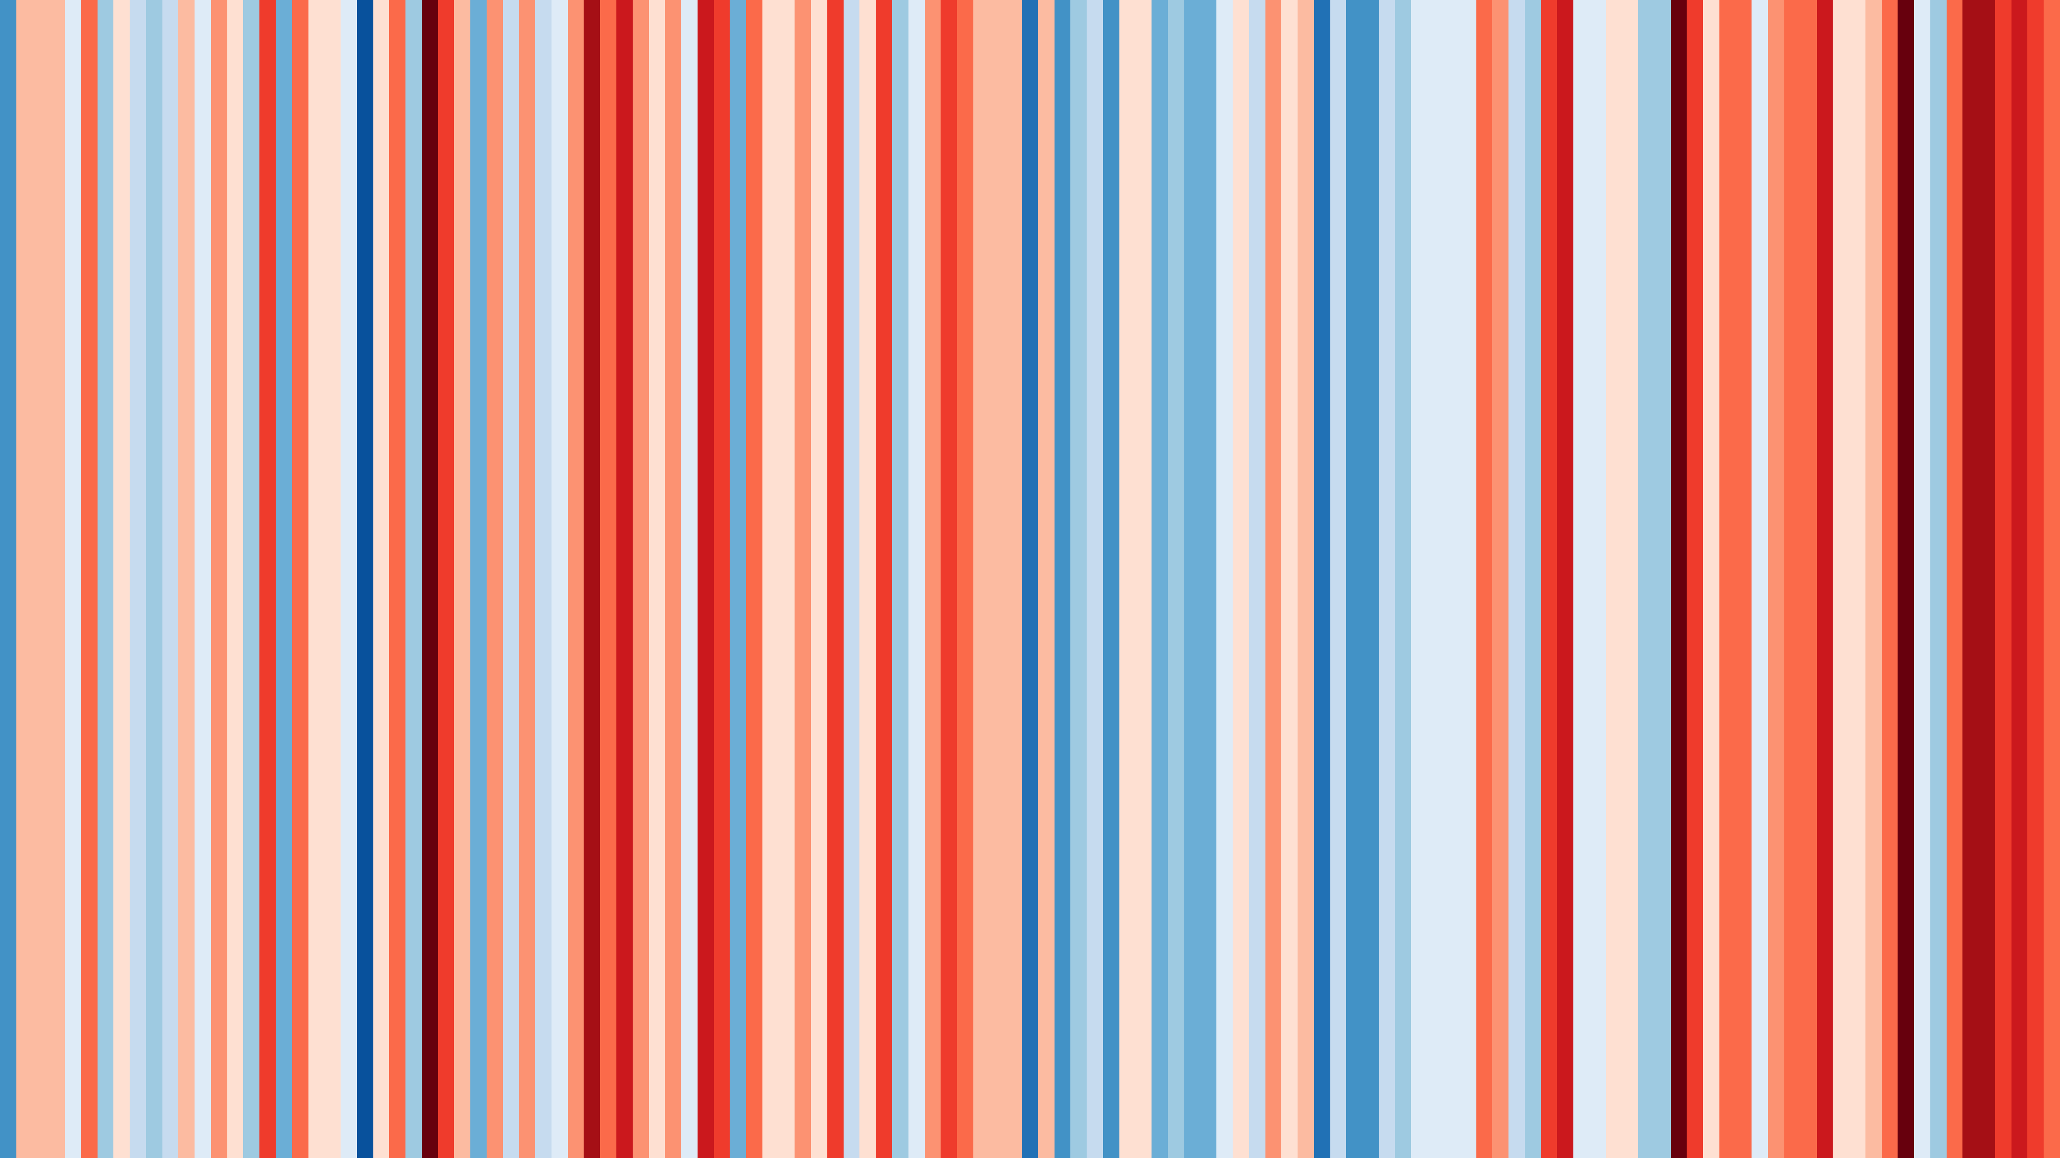
The HOW and WHO of Climate Change Impacts in Kentucky
William C. Haneberg, Ph.D., P.G.
State Geologist and Director, Kentucky Geological Survey
Research Professor, Earth and Environmental Sciences
1895
2021

Slide 2
IT’S REAL
IT’S HAPPENING
IT’S US

Slide 3
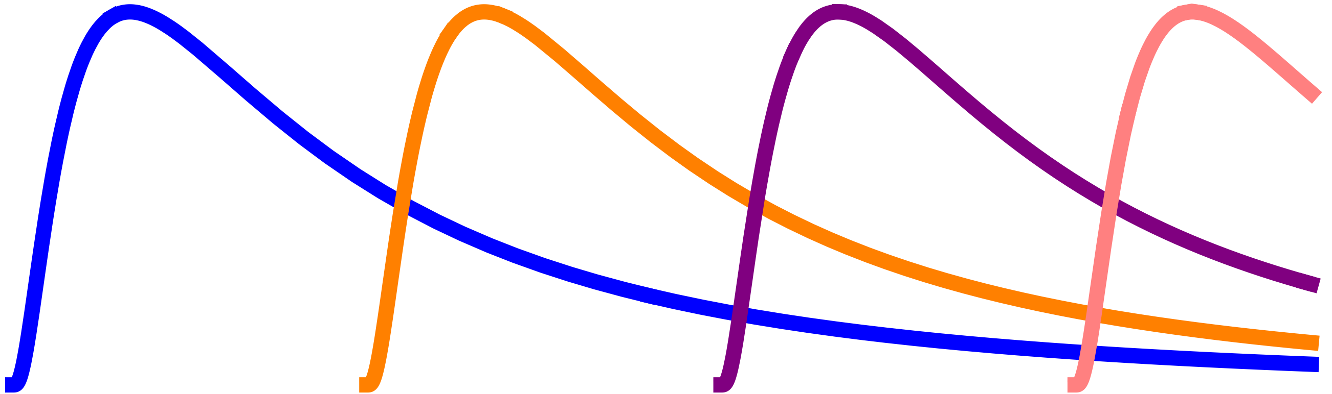
A timeline of naiveté, denial, and misinformation
OK, humans are causing it. We’ll adapt!
CO₂ is plant food. Bring it on, baby!
It’s not real!
Also, models!
It’s real but natural.
It’s been hotter!
TIME
THEN
NOW

Slide 4
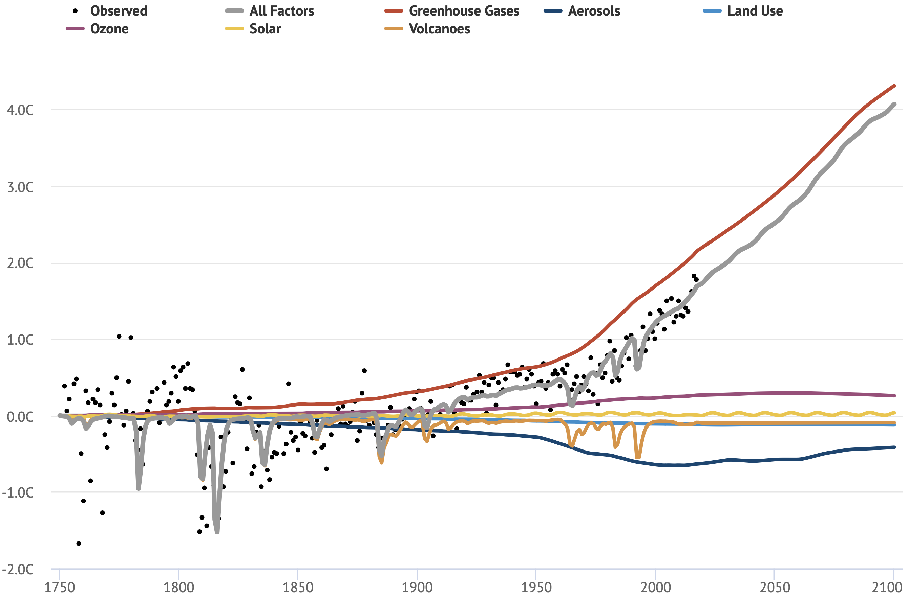
Global land temperatures 1750 – 2100 (RCP 6.5)
PROJECTED
Source:
www.carbonbrief.org

Slide 5
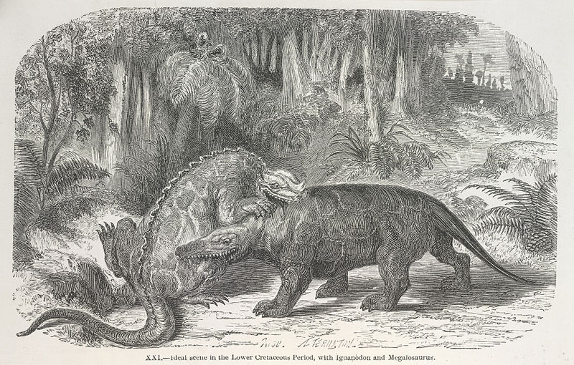
Y’all would NOT have enjoyed life during the Cretaceous
Sure, there was lots of lush tropical vegetation
But it was not a paradise:
CO₂ levels > 1,000 ppm (RCP 8.5: 1,200 ppm in 2100)
Ocean temperatures were 5°C to 10°C (9°F to 18°F) warmer
Sea levels 50 m to 100 m higher
Tropical plants in Alaska
Dinosaurs could kill you
Artist: Édouard Riou (1865) Source: British Library

Slide 6
SO WHAT DOES THAT
MEAN FOR
KENTUCKY?
Ask not for whom the CLIMATE changes

Slide 7
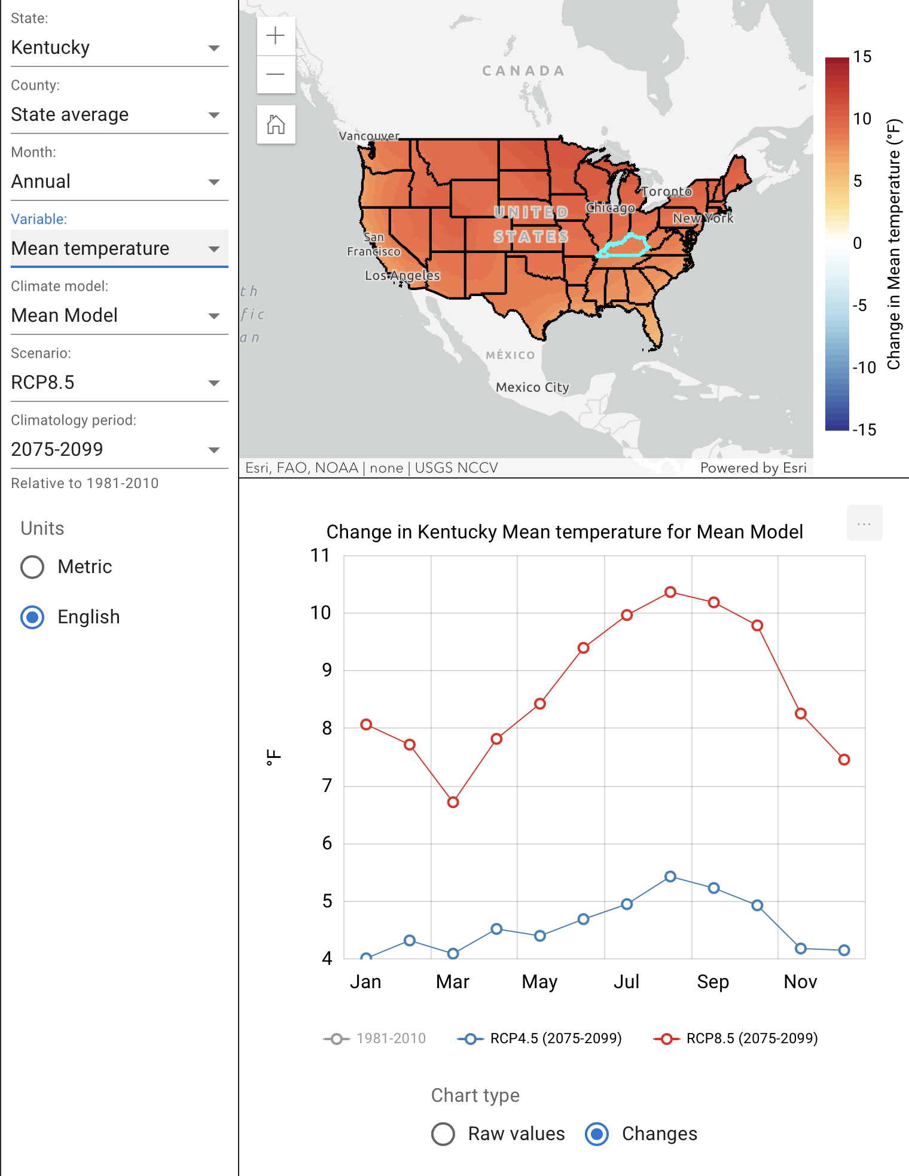
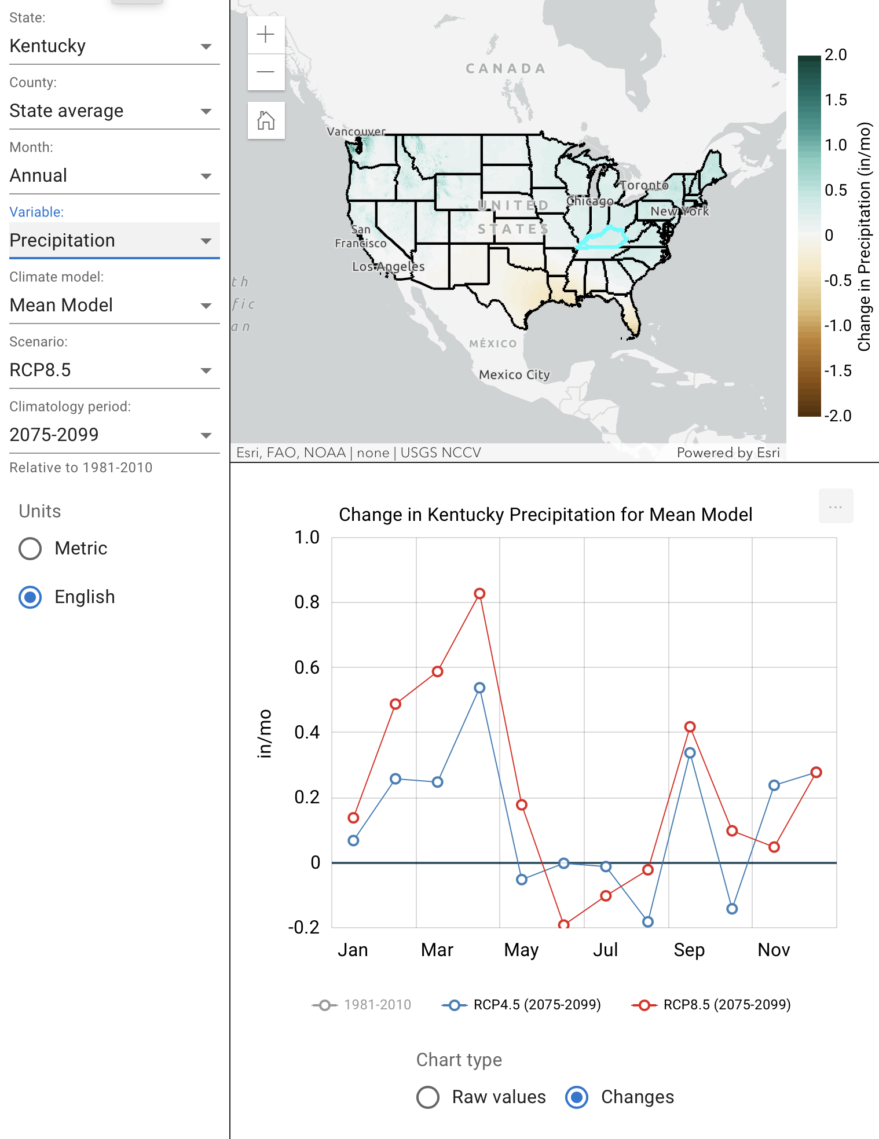
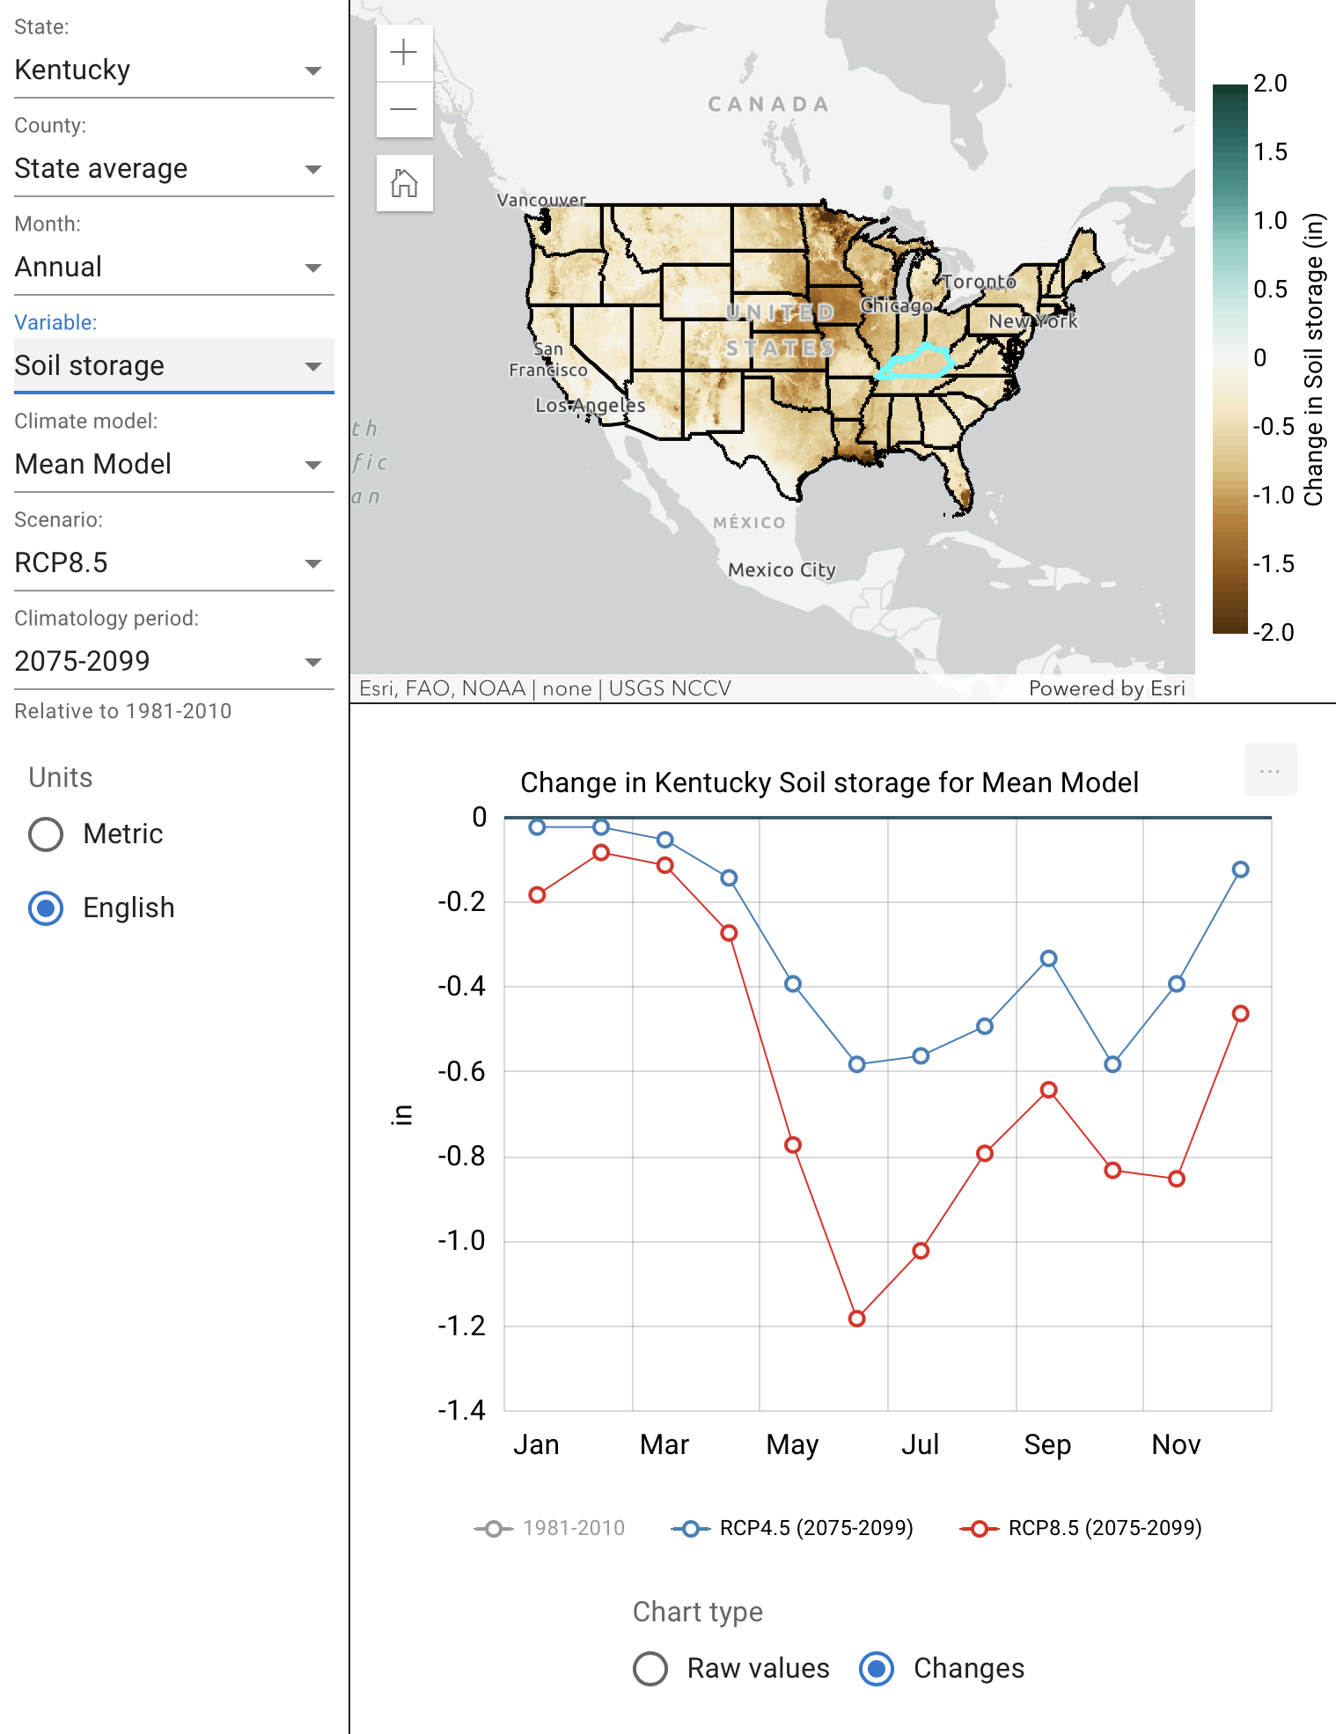
RCP 8.5 statewide averages (2075 – 2099)
TEMPERATURE
PRECIPITATION
SOIL MOISTURE
Source: USGS National Climate Change Viewer

Slide 8
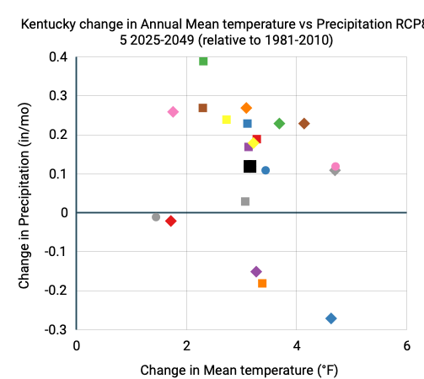
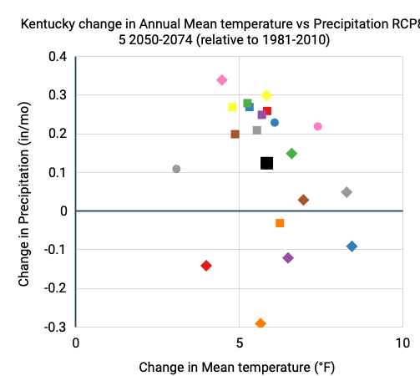
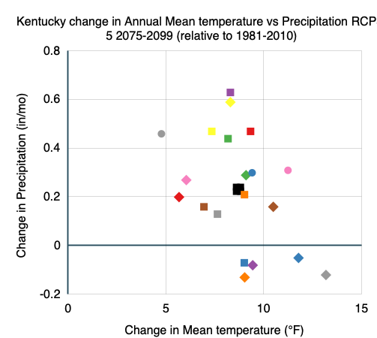
Kentucky temperature and precipitation changes
2025-2049 RCP 8.5
1°F to 5°F Increase
Mean KY Temperature
2050-2074 RCP 8.5
3°F to 8°F Increase
Mean KY Temperature
2075-2099 RCP 8.5
5°F to 13°F Increase
Mean KY Temperature
Source: USGS National Climate Change Viewer

Slide 9
Let’s look locally at Lexington and Hindman
 | Hindman |  | Lexington
 | 1990 | 2070-2099 | 1990 | 2070-2099
Days with max temperature ≥ 105° | 0 | 7 | 0 | 12
Days with max temperature ≥ 100° | 0 | 21 | 0 | 30
Highest daily max temperature | 94° | 105° | 96° | 108°
Days with precipitation ≥ 1” | 4 | 6 | 6 | 8
Dry days | 102 | 112 | 140 | 148
Average annual precipitation | 46” | 49” | 45” | 49”
Source: Climate Mapping for Resilience and Adaptation (http://resilience.climate.gov)

Slide 10
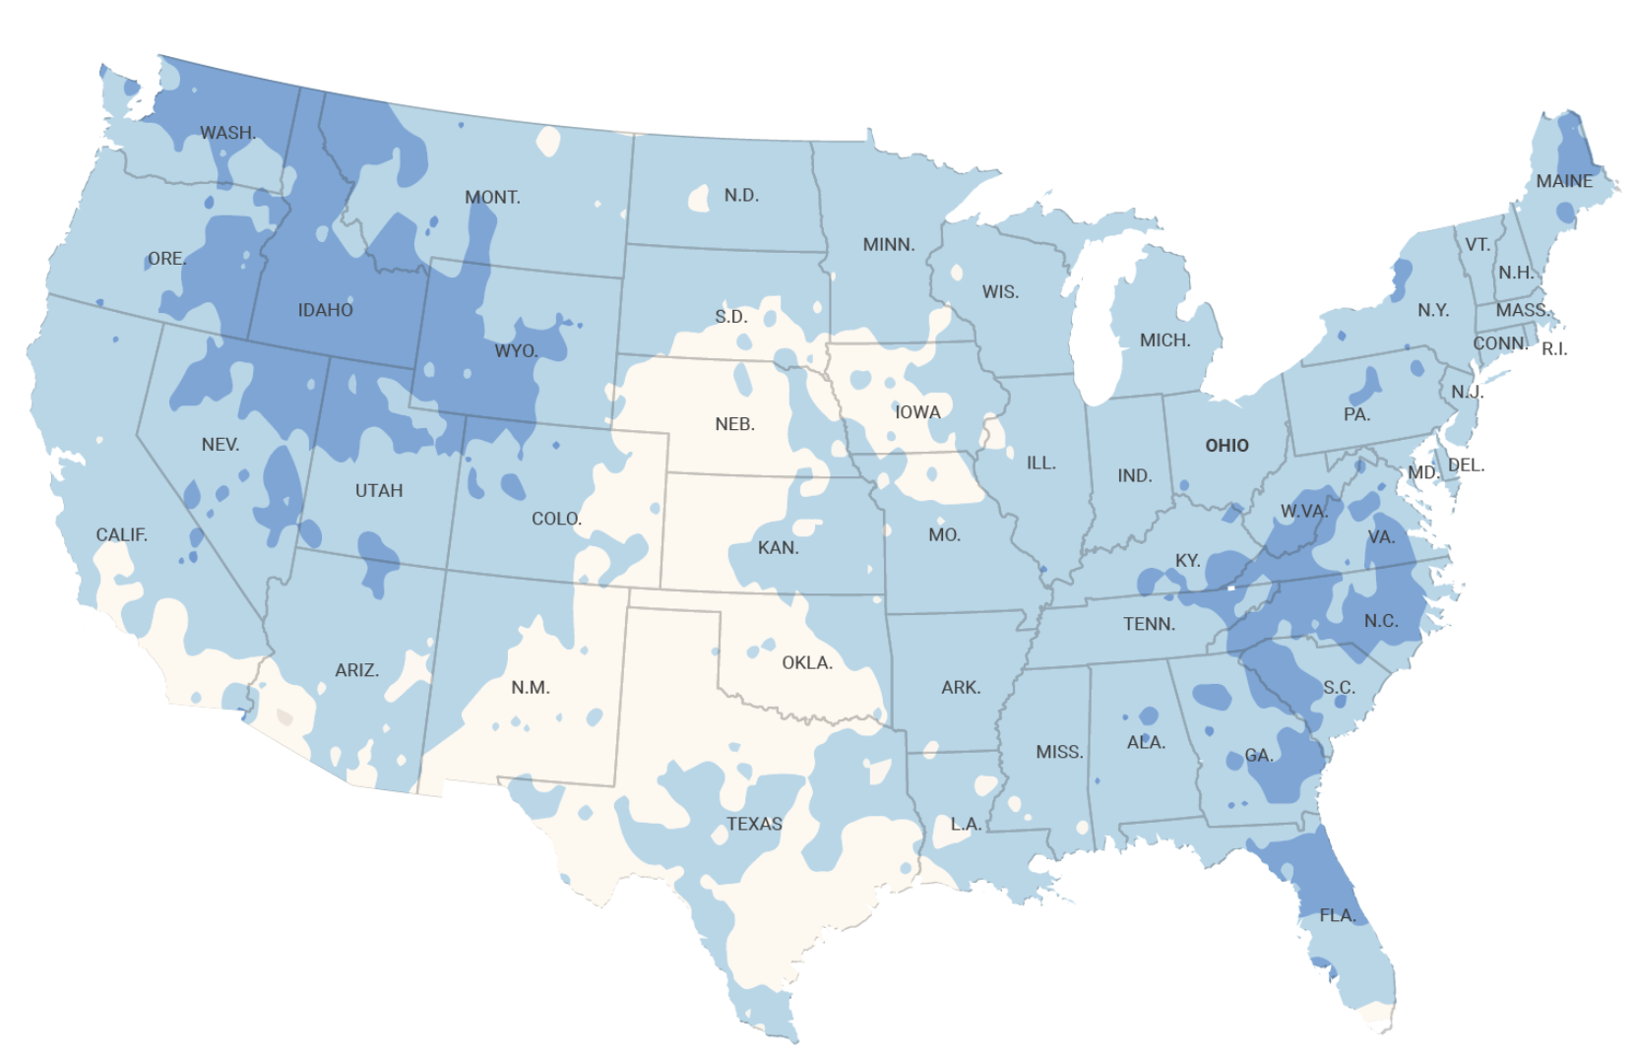
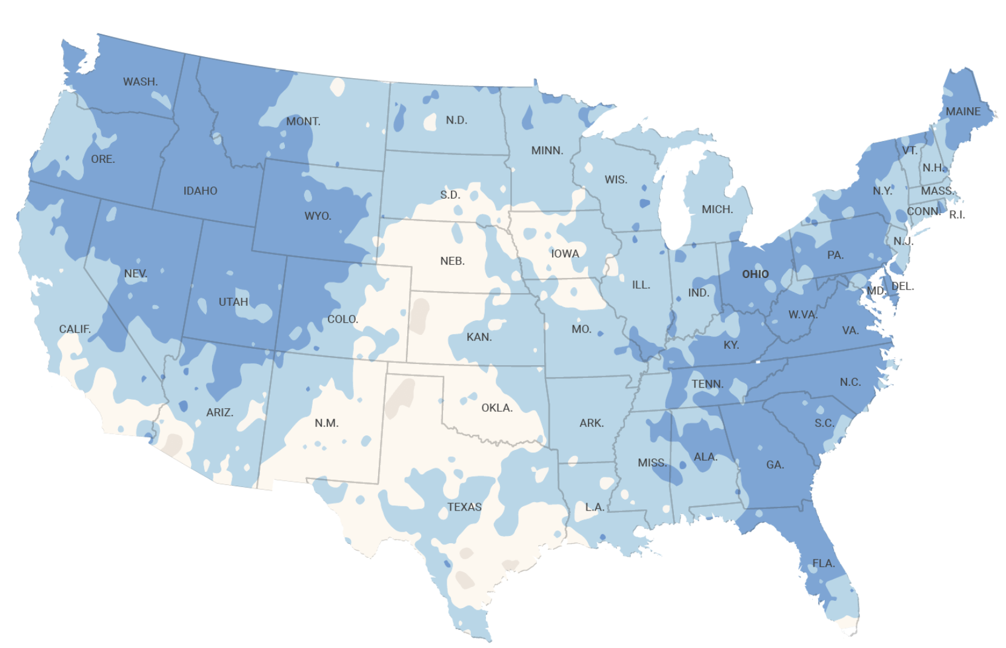
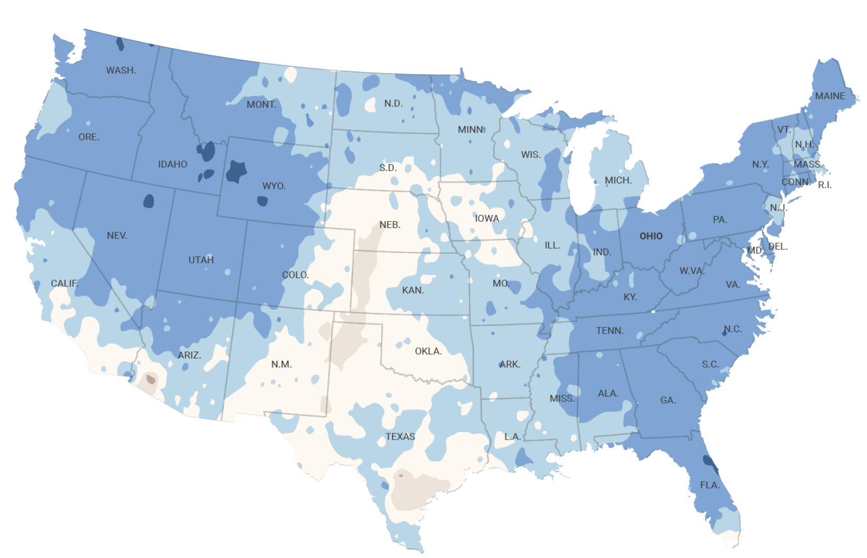
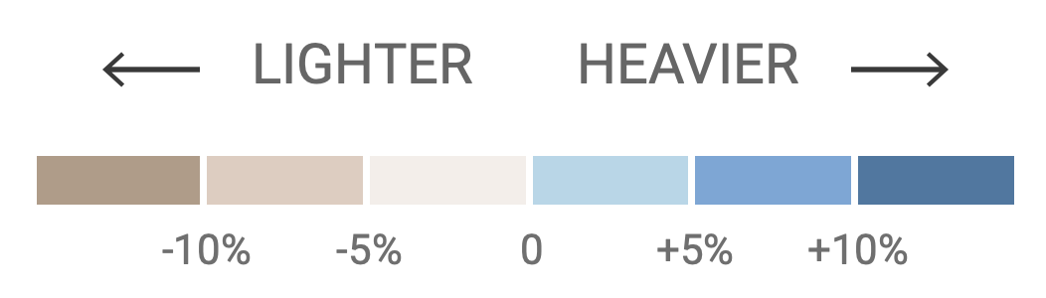
Extreme precipitation compared to 1980 – 2010 average
This year
+15 years
+30 years
Source: First Street Foundation using NASA Earth Exchange Global Daily Downscaled Projections

Slide 11
Peak annual flood risk will increase as climate changes
Recurrence Interval | 500 yr | 100 yr | 20 yr | 5 yr
Annual Likelihood | 0.2% | 1% | 5% | 20%
Properties Affected (now) | 302,500 | 245,200 | 176,900 | 126,900
Properties Affected (+15 yr) | 306,200 | 248,900 | 180,900 | 129,500
Properties Affected (+30 yr) | 309,800 | 252,600 | 184,800 | 132,200
Absolute Change (+30 yr) | 7,300 people | 7,400 people | 7,900 people | 5,300 people
Percent change (+30 yr) | +2.4% | +3.0% | +4.5% | +4.2%
Source: First Street Foundation

Slide 12
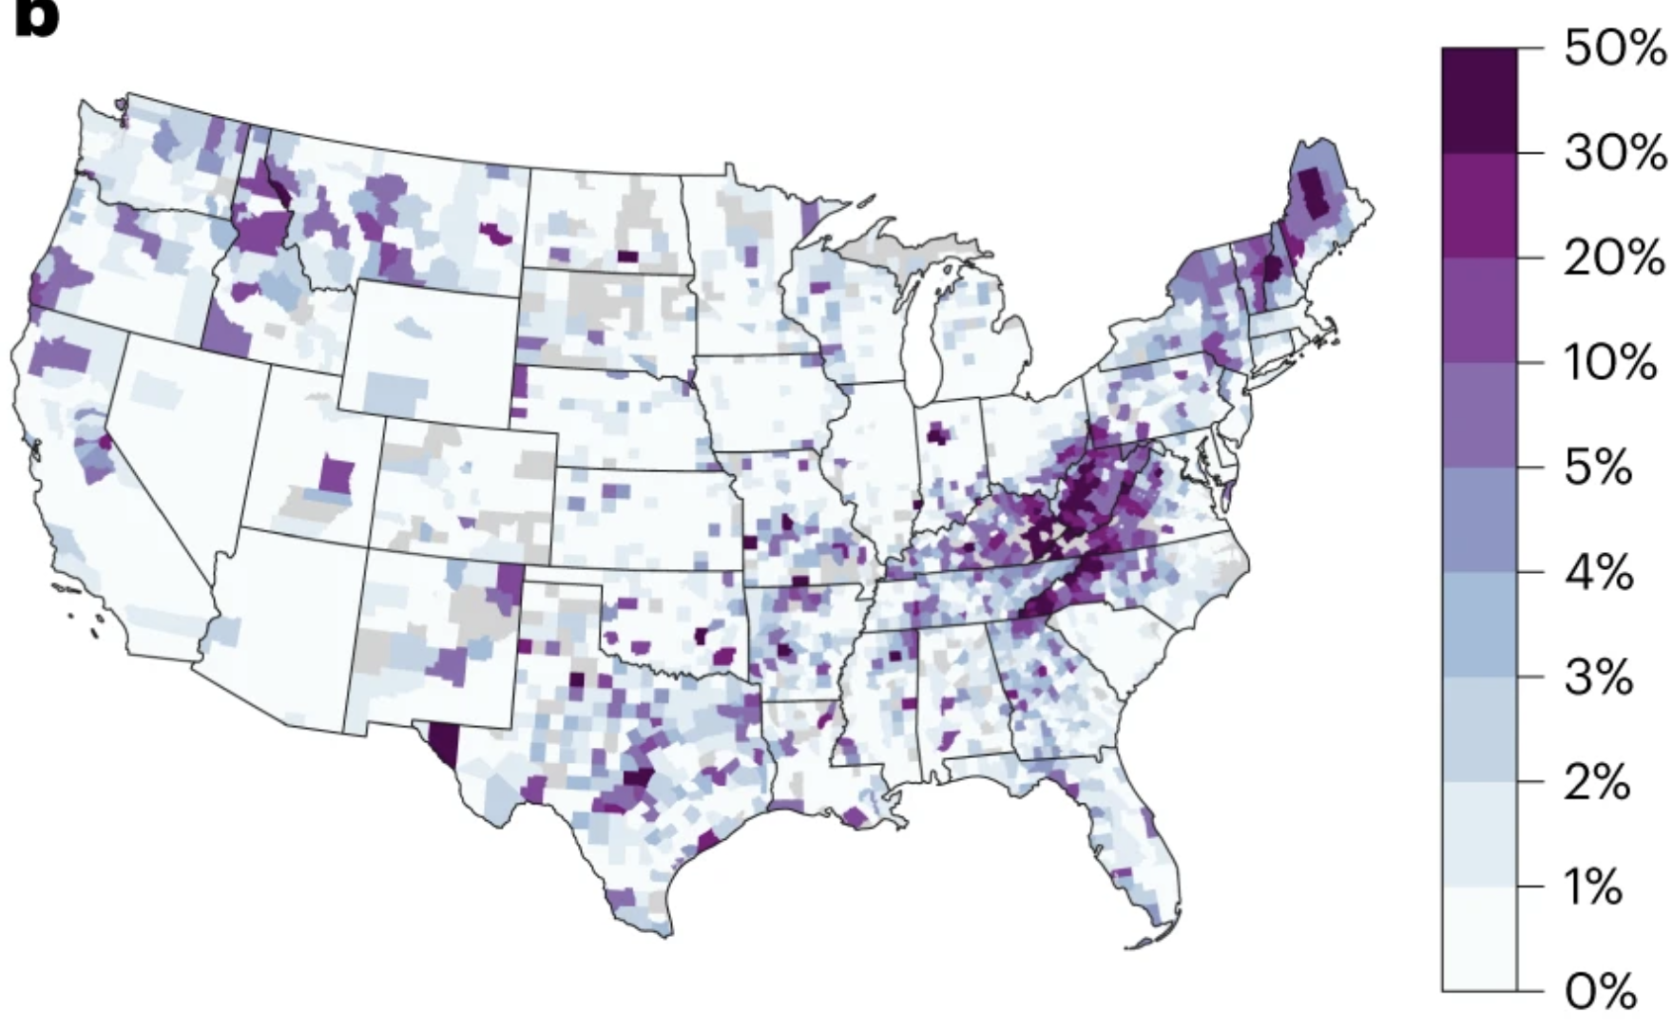
Home overvaluation relative to flood risks
From Gourevitch et al. (2023, Nature Climate Change)

Slide 13
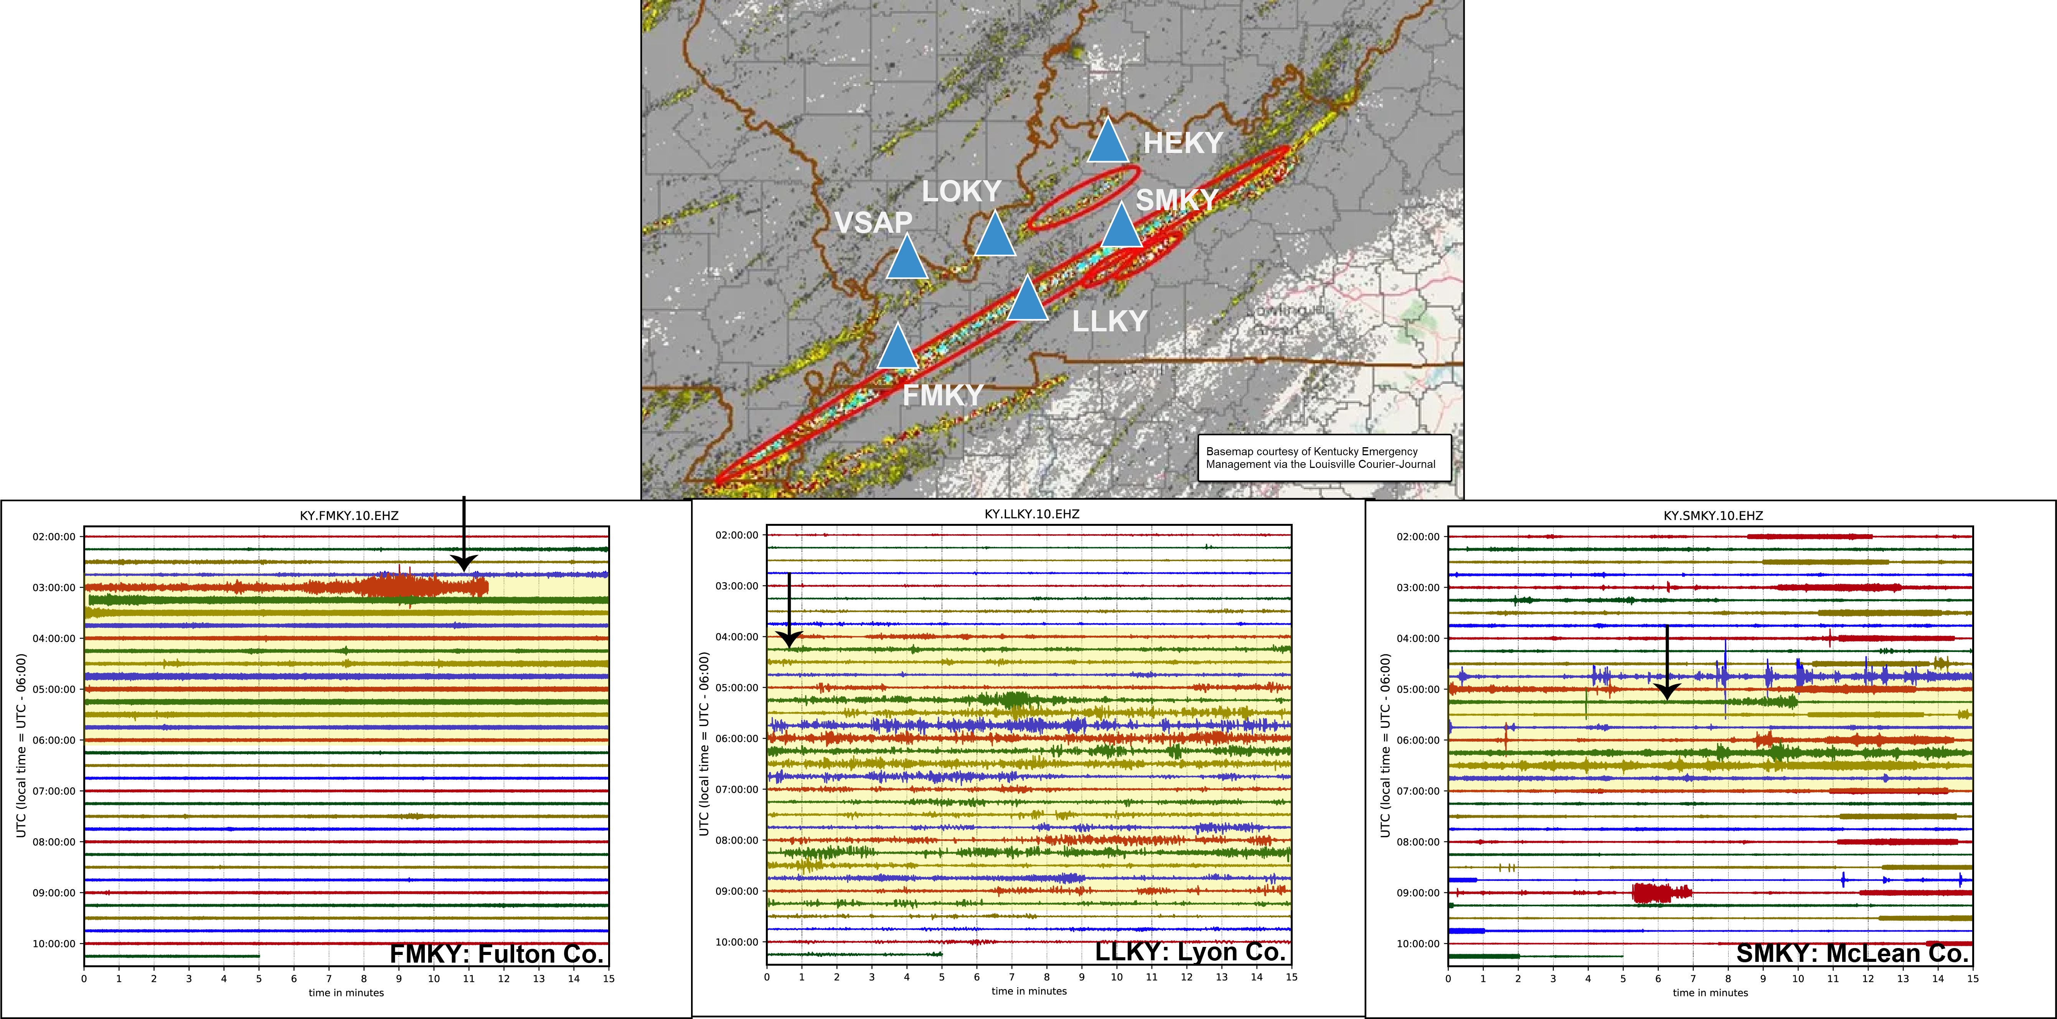
More extreme events like the December 2021 tornadoes

Slide 14
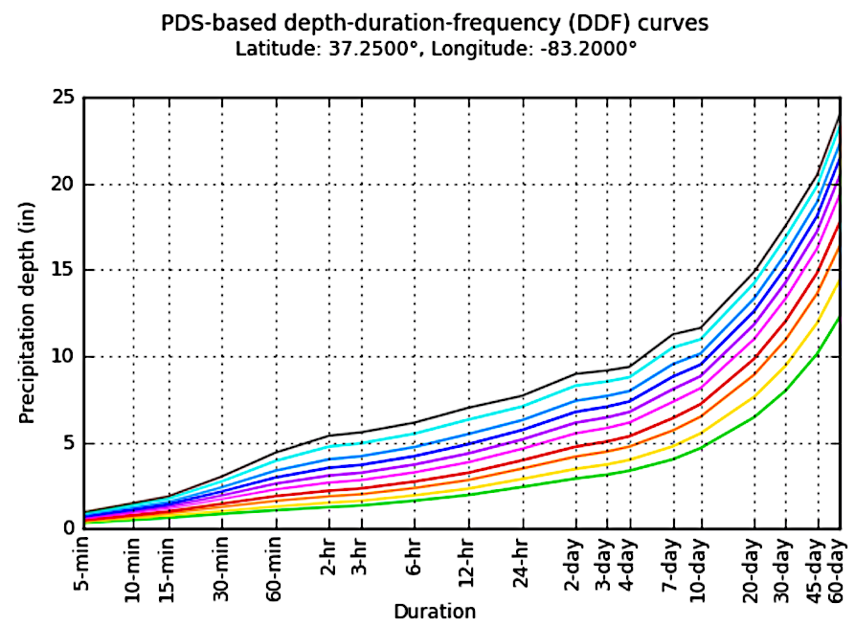
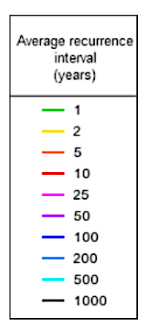
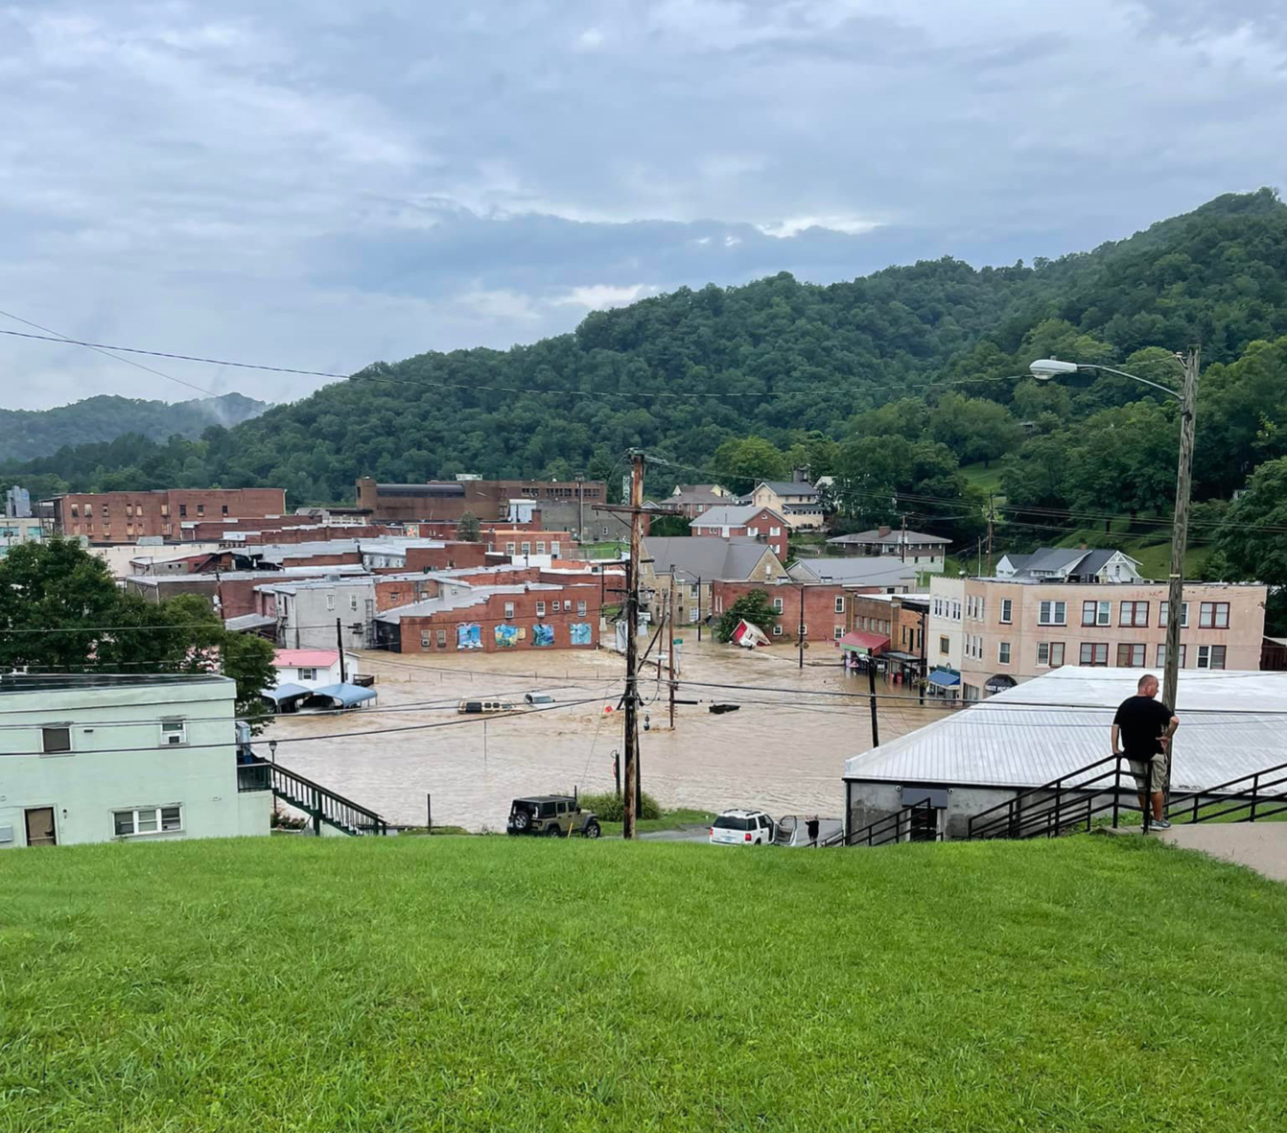
More extreme events like the July 2022 storms and floods
Hazard KY
July 2022 storm
1000-year curve
“Severe flash flooding caused extensive damage in downtown Whitesburg, KY.” (NOAA National Weather Service, 2022).

Slide 15
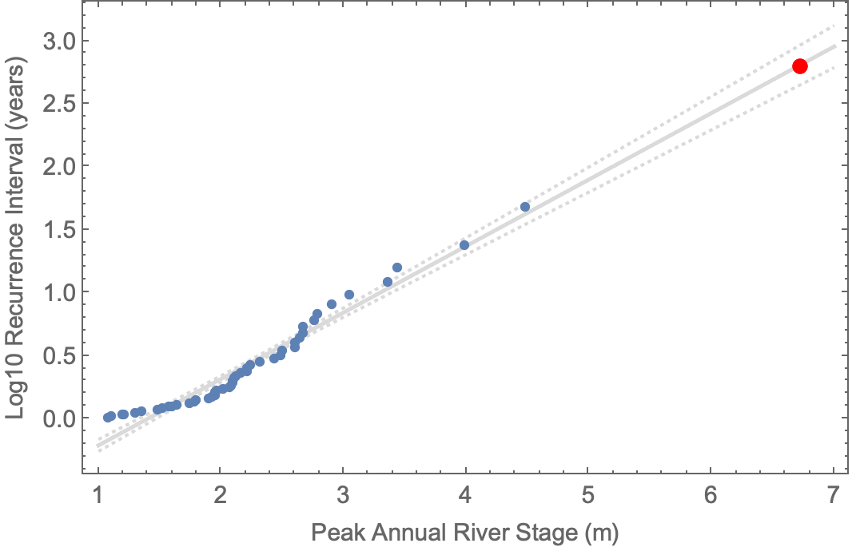
More rain means more floods
North Fork Kentucky River at Whitesburg
July 28, 2022
Record 9830 cfs
Record 6.70 m (22 ft) stage
636-year estimated recurrence
Data: USGS

Slide 16
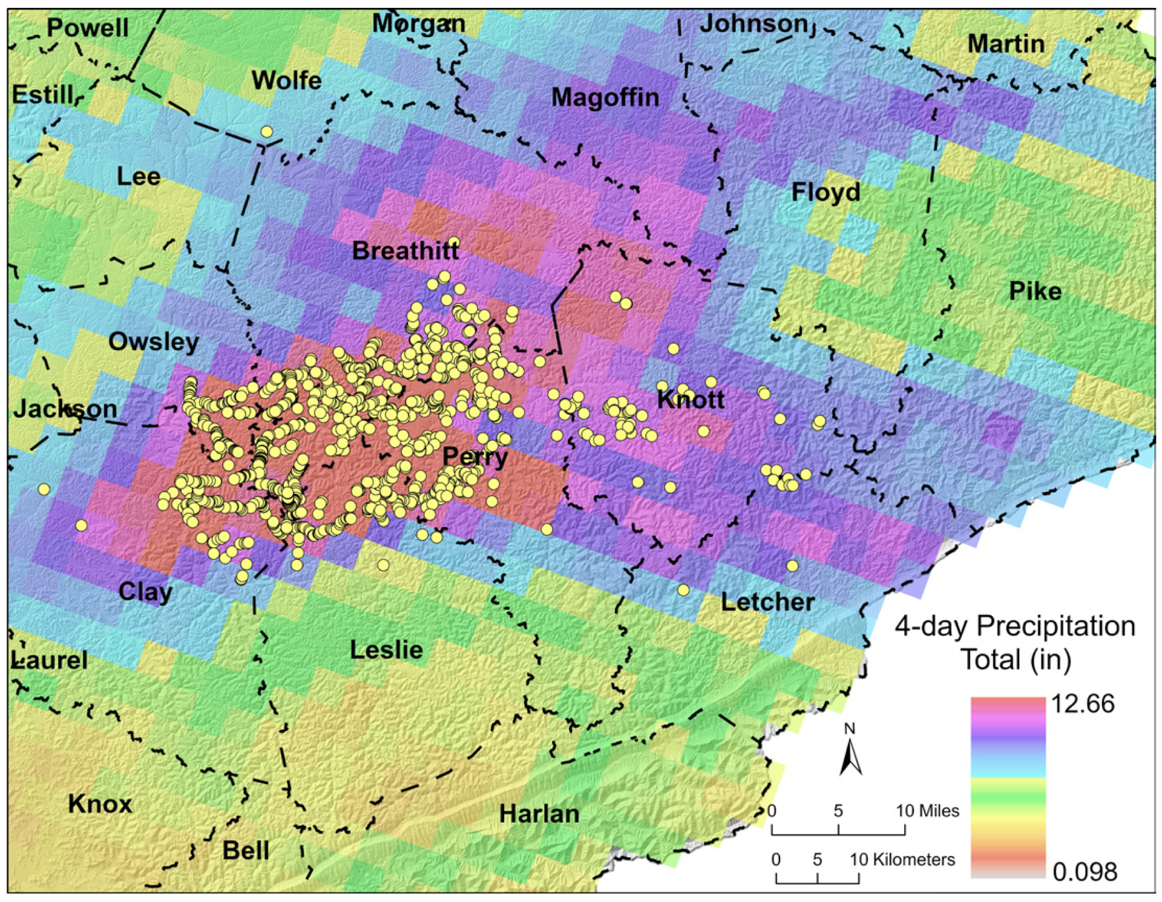
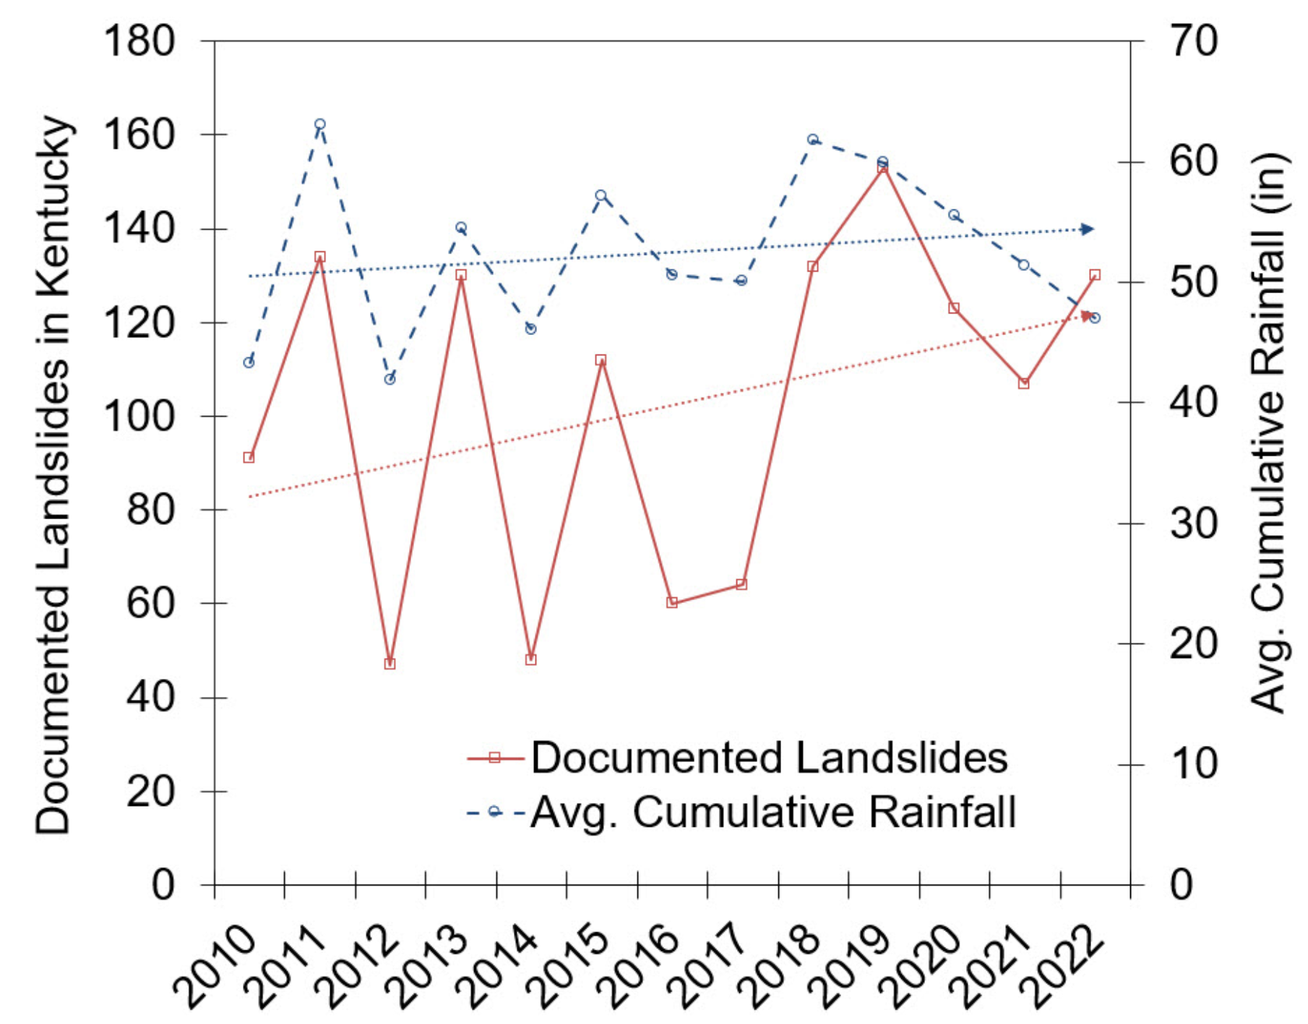
More rain means more landslides
July 2022 landslides
Images: Crawford et al. (2023, KGS RI-13, Series XIII)

Slide 17
WE’RE ALL IN THIS
TOGETHER!
Or maybe NOT…

Slide 18
Climate change is risky business…let’s talk about that
Potential Loss x Social Vulnerability
Risk =
Community Resilience
Source: FEMA National Risk Index (hazards.fema.gov/nri)

Slide 19
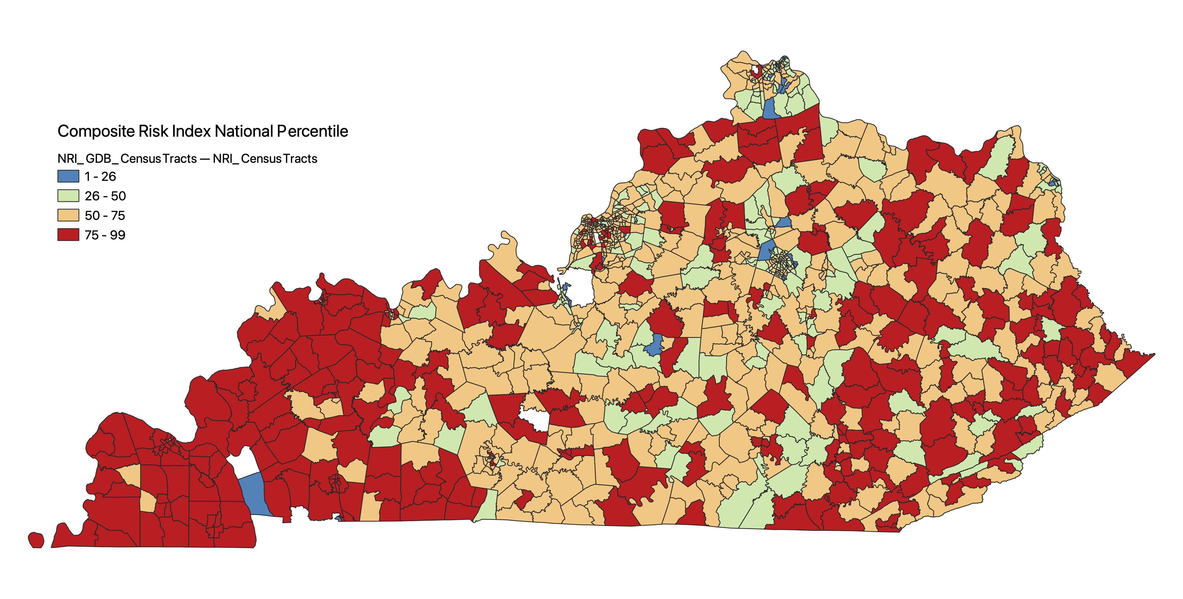
FEMA composite risk index

Slide 20
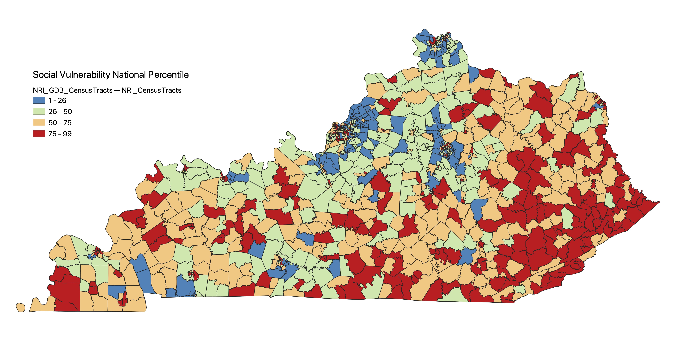
Social vulnerability

Slide 21
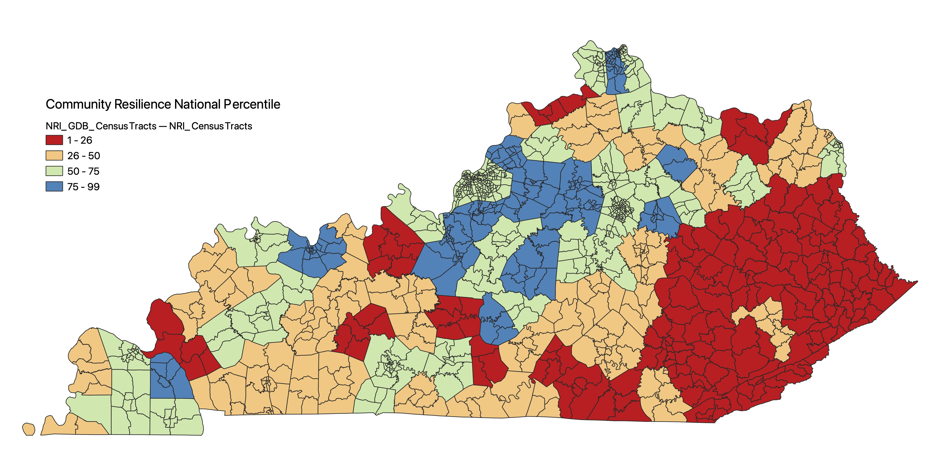
Community resilience

Slide 22
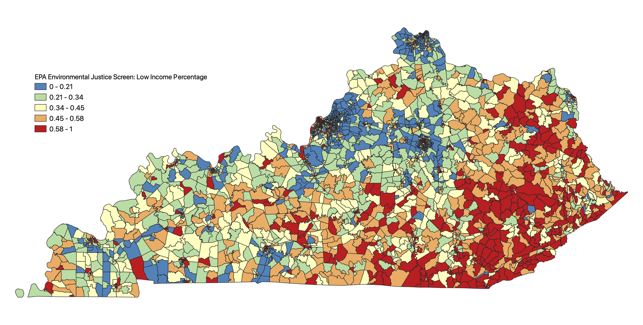
Income

Slide 23
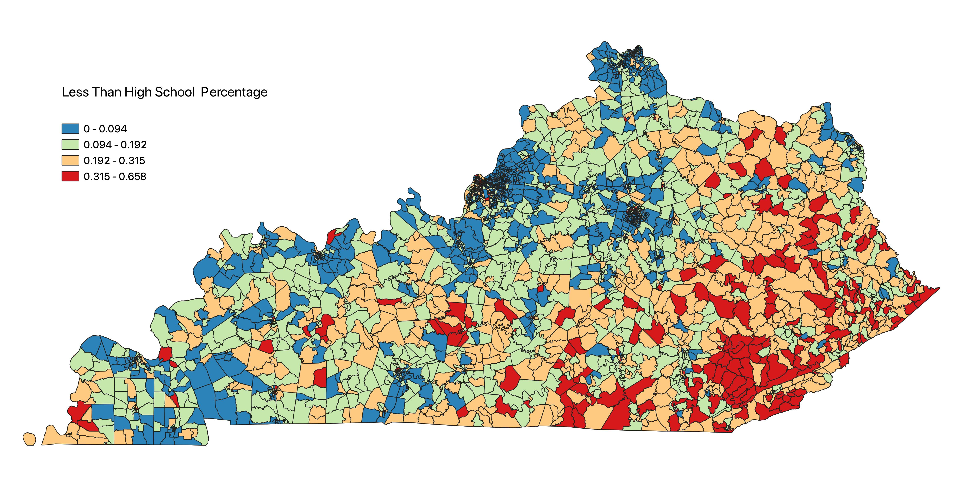
Education

Slide 24
Points to take home and talk about
Climate change is real, occurring now, and driven by human activities
In terms of geohazards, we expect more spring + fall rainfall and higher summer temperatures that will likely result in more spring + fall floods, more landslides, and more summer droughts in Kentucky
We also expect more frequent extreme events as a consequence of climate change
Kentucky — especially Appalachian Kentucky — contains some of the highest-risk, most socially vulnerable, and least resilient communities in the United States
The effects of climate change in Kentucky will be exacerbated by high social vulnerability and low community resiliency

