Slide 1


13 Ways of Looking at
Climate Change in Kentucky
Associate Professor of UK Writing, Rhetoric, & Digital Studies
Director, Kentucky Climate Consortium
lauren.cagle@uky.edu | laurenecagle.com/talks
Notes:
Hello! Thank you all for coming out tonight and staying for my talk, 13 ways of looking at climate change in Kentucky.
I took this title from a poem by the great American poet, Wallace Stevens, who published a poem in 1954 called “Thirteen Ways of Looking at a Blackbird.” In it, he writes these beautiful compact stanzas–13 of them, of course– each a different glimpse of or encounter with a blackbird. It’s a great organizational strategy when you want to share a bunch of little insights about a topic without having to write transitions or like, an overall argument.
But I have a reason for setting up the talk this way. I need to tell you a little bit about my background to explain that reason.
I’m a rhetorician – people often don’t know what that is, so if you don’t, you’re in good company. What that means is that I have a PhD in rhetoric, which is not necessarily that helpful to know, since we most often hear the word rhetoric in everyday life as a synonym for ‘bullshit.’ I mean, maybe I have a PhD in bullshit, but I do like to think there’s more to it than that.
When you get a PhD in rhetoric, what you’re doing is a type of humanistic work, like philosophy or linguistics or literature. And in the humanistic field of rhetoric, what we’re studying is symbolic meaning-making – how do we make meaning out of symbols like words or images or sounds. How is that as I’m talking to you, we’re building up this communicative space in between us, where you interpret the things I’m saying and build them into your own worldview and then maybe reflect back at me during the Q&A–that whole process is magical, and rhetoric is trying to understand the magic trick.
Rhetorical study has roots in a lot of cultures. In the west, we tend to look to the Ancient Greeks, like Plato and Socrates and Aristotle, so I read all those old dead guys in grad school. And their work and the work of a lot of different rhetorical theorists across centuries and across cultures helps contemporary rhetoricians like me understand the world we’re living in now.
So in graduate school, I got really really interested in climate change rhetoric. How do people talk about climate and climate change, where does climate denial come from, what’s the relationship between climate discourse and policy? All that stuff.
And one of the observations that I’ve made over the years along with a bunch of other scholars – this is definitely not my unique insight – is that one of the hardest things when we’re talking about climate change is how big and complex it is. And somewhat ironically, given that complexity, how much we often over-simplify it.
So my theory is that we can break through that problem by talking climate change in all its complexity but at totally different scales. I want to talk about climate in Kentucky, which is already a lot smaller scale than the whole planet, but also at the scale of a watershed or a farm or your lawn or your basement. We’re seeing climate change in Kentucky at all those scales, and if you can see it around you and imagine it in your everyday life, then maybe we can get motivated and activated to mitigate and adapt.
Ok. that’s a very lofty goal. Let’s see how we manage.

Slide 2
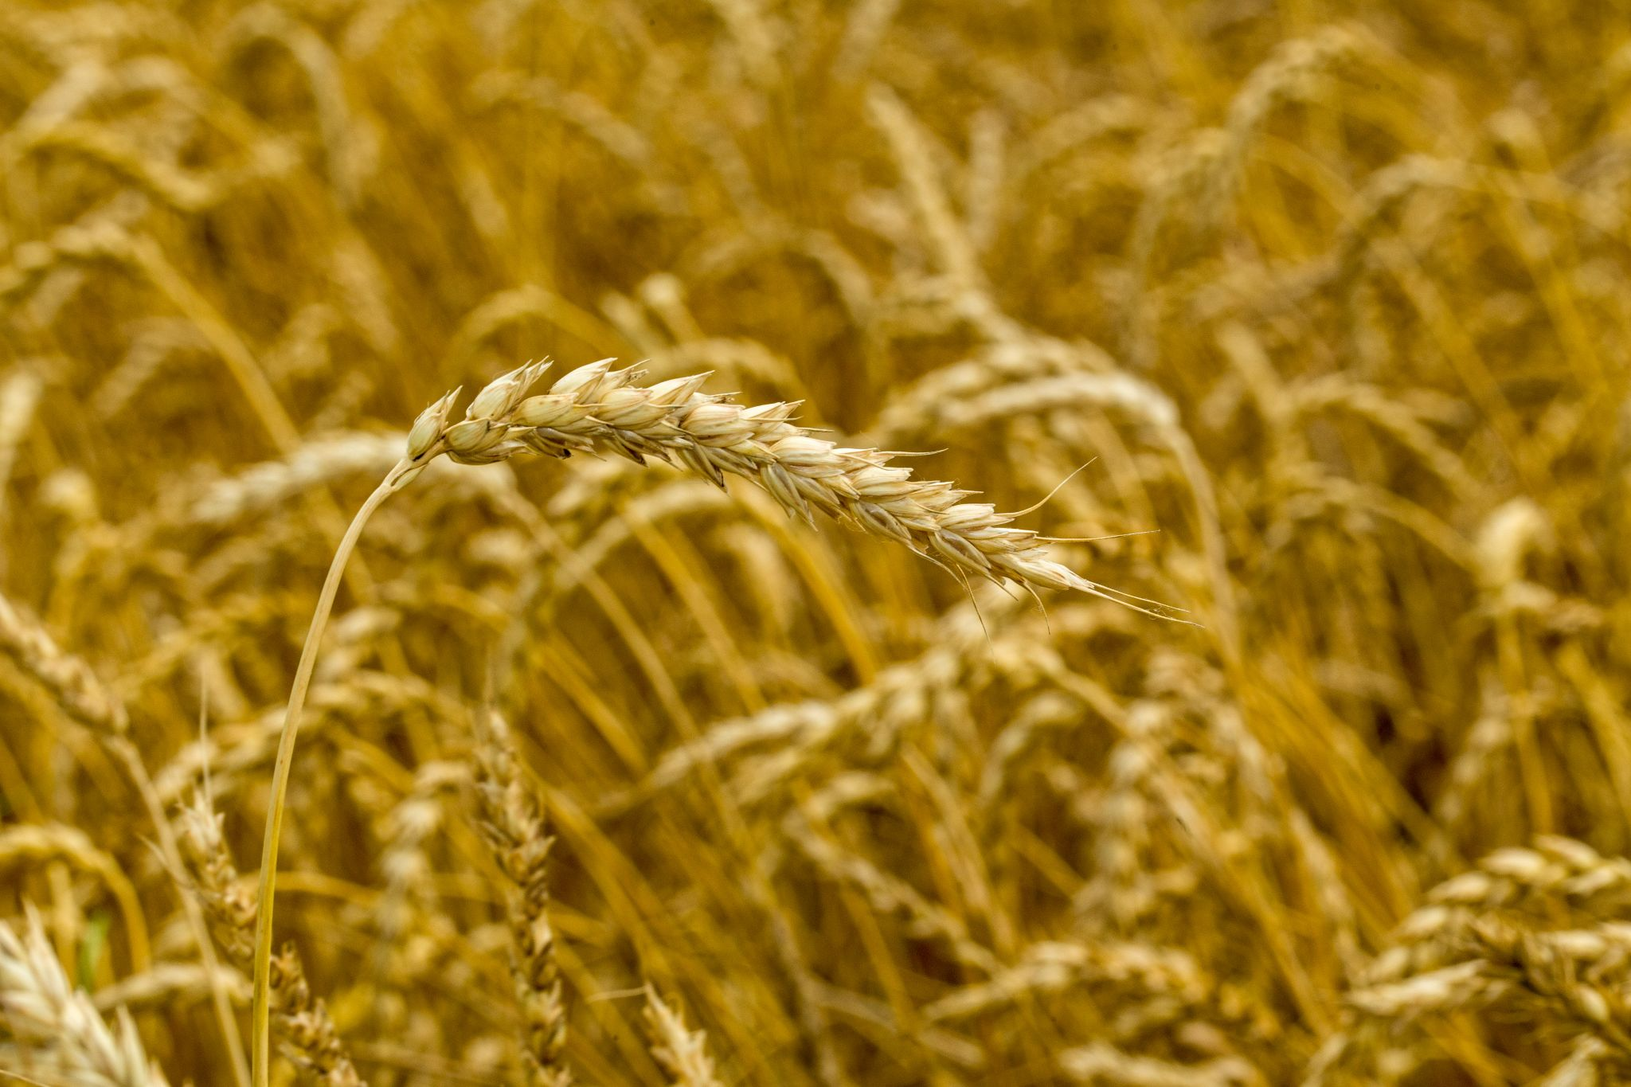
Agriculture
Bourbon
Hazards
Horses
Housing
Human Health
Infrastructure
Insects
Livestock
Plants
Social Justice
Soils
Work
warmer temps → more insects + more feeding → cereal crop losses
1
Water
Notes:
In preparation for this talk, I spent some time talking with Nick Teets, an entomologist here in town at the University of Kentucky. We expect crop damage for major cereal crops to increase bc warmer temps mean 1) we get more generations from insects, and 2) their metabolism will increase with warmer temps so they’ll need to eat more.
See relevant paper: https://drive.google.com/file/d/1y5L1rn9AYJ5sVixnZL6IuFHsyvxb9zlG/view?usp=share_link
Pest species tend to benefit from CC bc they’re well adapted to monocultures. Phenology = typical seasonal cycle of an organism, it gets really complex and nuanced (e.g., pollinator insects need to emerge at the same time that plants are flowering) → often the phenological relationships between insects and plants has been shaped by millions of years of evolution. Not Kentucky, but also there are some examples where insect abundance peak is not lining up with bird nesting (insects are cold-blooded driven by temp, birds are warm-blooded and driven by daylength). Insects will often go into dormancy based on daylength and then they come out of it in the spring based on a length of dormancy and then when it’s been warm enough long enough (see degree days), for them to accumulate enough heat to complete development and emerge in the spring. If everything shifted earlier, it wouldn’t be a problem, but things are shifting differently – it’s hard to pull out a signal bc of confounding issues (e.g., land use). A lot of the phenology work does come from citizen science. We gotta talk about winter as much as summer – a warmer winter is NOT that great – cherry trees blossoming earlier
https://ukcafe.canto.com/v/medialibrary/library?keyword=grain%20insect&viewIndex=0&display=fitView&from=fitView&filter=%7B%22type%22:%22image%22%7D&column=image&id=gbce2e3np95of34nn9ccat2i59

Slide 3
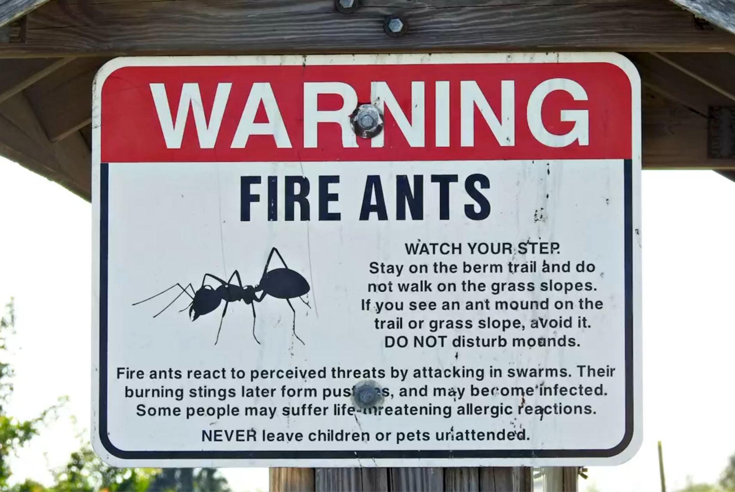
Agriculture
Bourbon
Hazards
Horses
Housing
Human Health
Infrastructure
Insects
Livestock
Plants
Social Justice
Soils
Work
warmer winters → shifting invasive species ranges → fire ants at your picnic
2
Water
Notes:
Nick Teets: new potential for invasive species to take hold – we now have fireants in Kentucky. Did postdoc in FL, it’s a FL and TX problem, but now it’s everywhere – ~2010 southern TN was the line for fireants, but now extension people are getting calls about fireants. We think the primary reason is that winter’s getting warmer, so they can survive further north
https://ukcafe.canto.com/v/medialibrary/library?keyword=fire%20ant&viewIndex=0&display=fitView&from=fitView&filter=%7B%22type%22:%22video%22%7D&column=video&id=4q3s067gal5p50i1934fcf305l

Slide 4
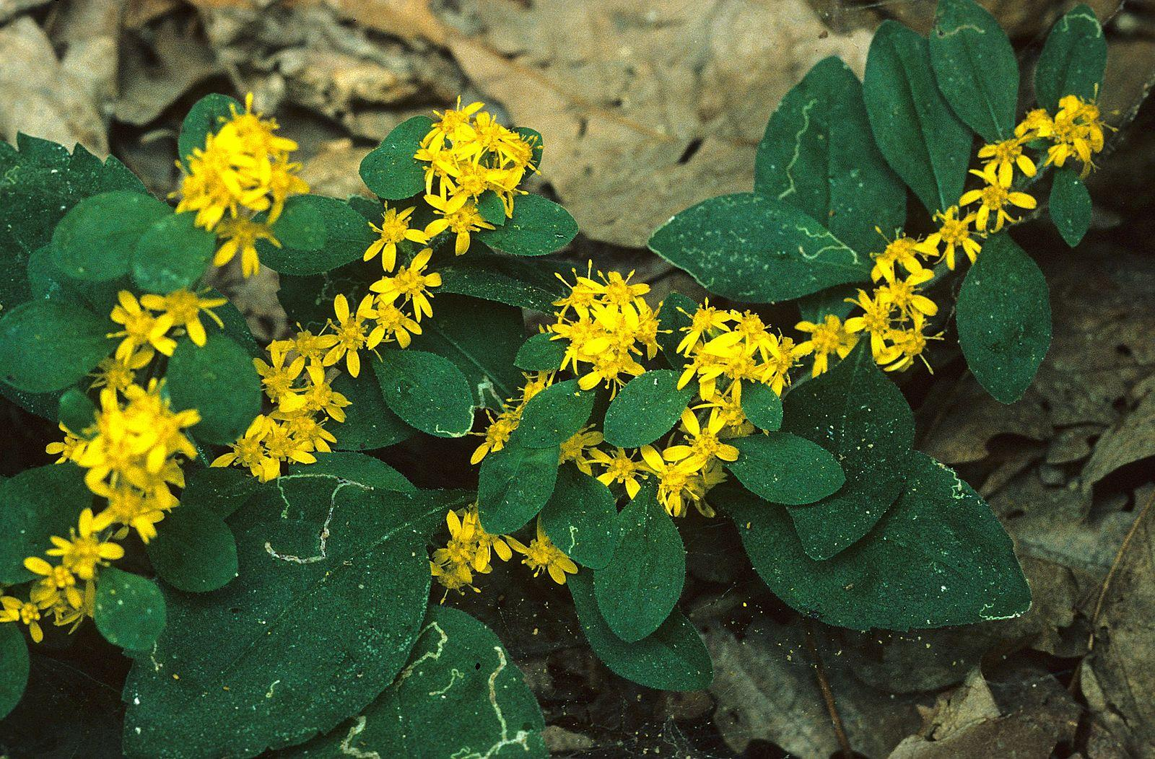
Agriculture
Bourbon
Hazards
Horses
Housing
Human Health
Infrastructure
Insects
Livestock
Plants
Social Justice
Soils
Work
warmer winters → goldenrod gall fly burning more energy → ecological mismatch
3
Water
Notes:
Nick Teets: specific issues could include range expansion for some warm-adapted species. Some insects don’t fare as well when the winter is warmer, esp if they’re adapted to a specific plant – they might burn through their all their energy before the food is available – Ohio work on goldenrod gall fly that lives in goldenrod (Nick’s sending me that study)
Things might shift northward but the soils won’t be right and eventually you run out of room
Kentucky is interesting bc it’s right at the line between warm south and cold north
See relevant papers:
https://drive.google.com/file/d/1tma5f7IgjJmZI7X0ra1Ex9ao2Hkap4GN/view?usp=share_link
https://drive.google.com/file/d/1FNRJHK2q3gvATAYrHoQJ2LJCZ2-0ukwB/view?usp=share_link
https://commons.wikimedia.org/wiki/File:White-haired_goldenrod.jpg

Slide 5
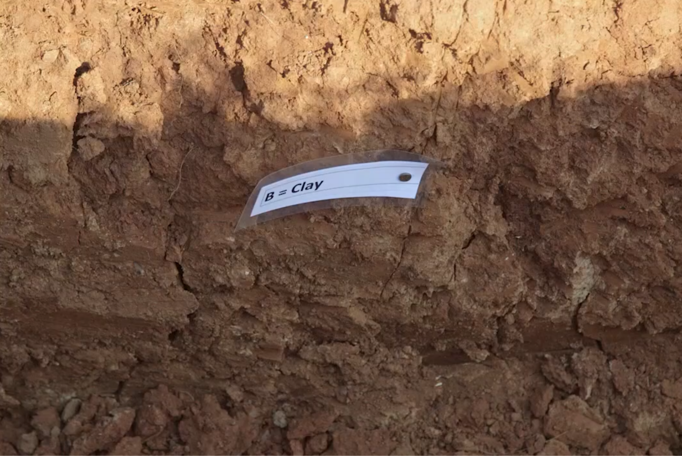
Agriculture
Bourbon
Hazards
Horses
Housing
Human Health
Infrastructure
Insects
Livestock
Plants
Social Justice
Soils
Work
more summer droughts → clay shrinkage → soil cracking → foundation repairs
4
Water
Notes:
Bill Haneberg: Shrinkage of clayey soils during summer droughts, which are expected to increase as the climate continues to warm, can cause the soil to crack and pull away from foundations, requiring thousands of dollars of foundation repairs to some homes.
Video on Kentucky soils: https://ukcafe.canto.com/v/medialibrary/library?keyword=clay&viewIndex=0&display=fitView&from=fitView&filter=%7B%22type%22:%22video%22%7D&column=video&id=5qcuqreke14036dqilf24ujk0q

Slide 6
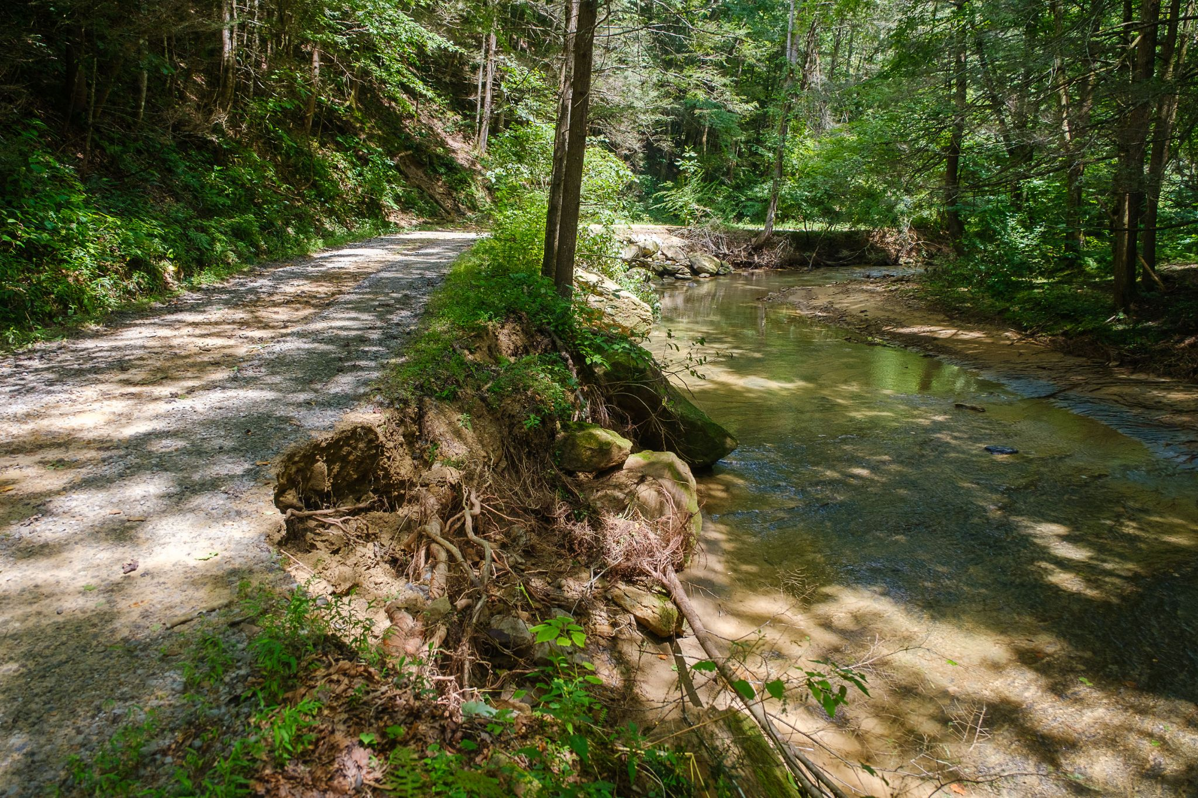
Agriculture
Bourbon
Hazards
Horses
Housing
Human Health
Infrastructure
Insects
Livestock
Plants
Social Justice
Soils
Work
prolonged drought → lack of vegetation → soil loss during rain → sediment in water bodies → aquatic habitat degradation
5
Water
Notes:
Amanda Gumbert: The impact of drought on soil erosion is complex but prolonged drought leads to lack of vegetation, lack of vegetation contributes to soil loss when rain finally returns, and that erosion contributes to sediment in water bodies leading to aquatic habitat degradation.

Slide 7
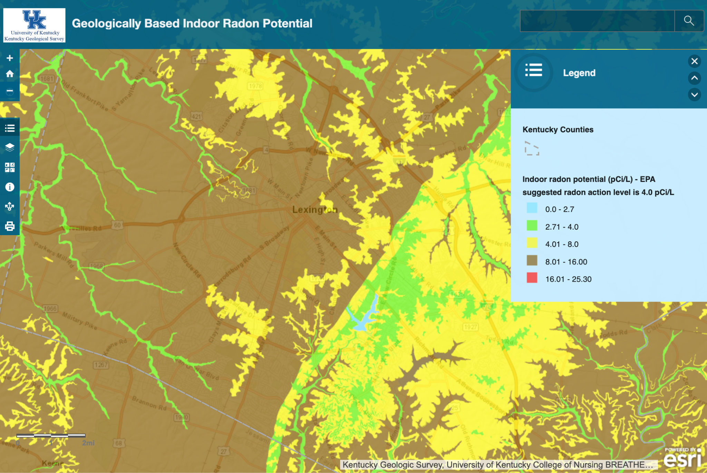
Agriculture
Bourbon
Hazards
Horses
Housing
Human Health
Infrastructure
Insects
Livestock
Plants
Social Justice
Soils
Work
increased precipitation → increased soil radon → increased indoor radon concentrations → higher lung cancer rates
6
Water
Notes:
Bill Haneberg: Some studies have shown that increased precipitation leads to increased soil radon and indoor radon concentrations. Radon is the second leading cause of lung cancer in the United States and people who are exposed to both high indoor radon levels and smoke tobacco—which many Kentuckians do—are about 9x more likely to develop lung cancer than those who do not smoke. So, climate change could lead to higher lung cancer rates in Kentucky.
Devan Robinson: Drought in Karst area soils and high uranium rock types (black Shales and phosphatic Limestones) can also cause Radon to escape easily via any cracks that propagate in the ground as a result. And water is also known to slow down or even trap the movement of Radon in saturated soils, as well as potentially push Radon into homes. It's a complicated relationship!
View KGS’s interactive radon map: https://www.uky.edu/KGS/radon/

Slide 8
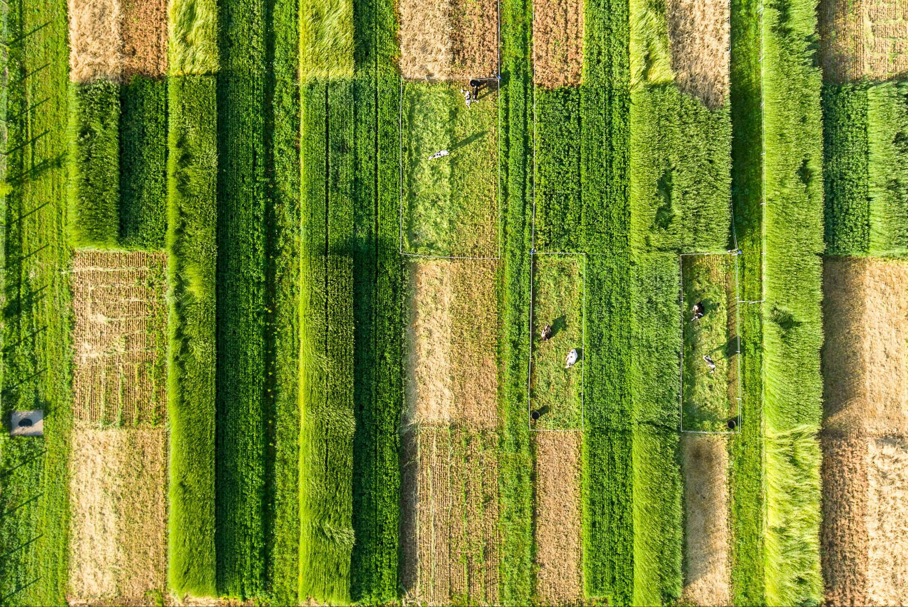
Agriculture
Bourbon
Hazards
Horses
Housing
Human Health
Infrastructure
Insects
Livestock
Plants
Social Justice
Soils
Work
warmer temps → more warm-season grass species → pastures & lawns change
7
Water
Notes:
Rebecca McCully: I think KY producers with pastures (and potentially people with lawns) are noticing an increase in warm-season (C4 physiology) grasses. KY pastures/lawns have traditionally been dominated by cool-season (C3 physiology) grasses (e.g., tall fescue, KY bluegrass), but over the past decade, people are reporting increases in warm-season species (e.g., Bermuda grass, crab grass). I have a research project that clearly demonstrates that as things get warmer the warm-season species become more dominant
Check out Rebecca’s extensive work: https://www.researchgate.net/profile/Rebecca-Mcculley

Slide 9
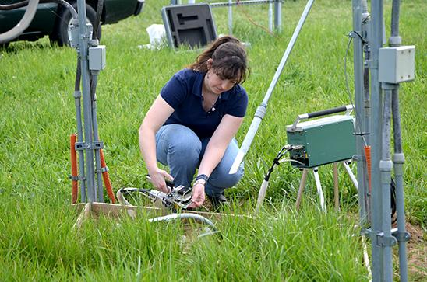
Agriculture
Bourbon
Hazards
Horses
Housing
Human Health
Infrastructure
Insects
Livestock
Plants
Social Justice
Soils
Work
warmer temps → increased concentrations of the toxin in tall fescue + increased effects of toxins on grazing animals → increased fescue toxicosis → water quality issues
8
Water
Notes:
Rebecca McCully: I’ll add that we also know warmer temperatures increase concentrations of the toxin in tall fescue (dominant forage in KY) which causes fescue toxicosis. Effects of these toxins on grazing animals are more pronounced under hot temperatures – so kind of a double whammy – and likely means affected animals will spend more time in shade/water trying to cool down/thermoregulate.
Then UK graduate student Marie Bourguignon, UK agroecologist Rebecca McCulley and Randy Dinkins, a scientist with the U.S. Department of Agriculture’s Forage-Animal Production Research Unit, looked at the potential effects of warmer and wetter conditions on four different genotypes of KY 31 tall fescue, one of the most common grasses used in pastures in Kentucky and the Southeast.
Check out Rebecca’s extensive work: https://www.researchgate.net/profile/Rebecca-Mcculley

Slide 10
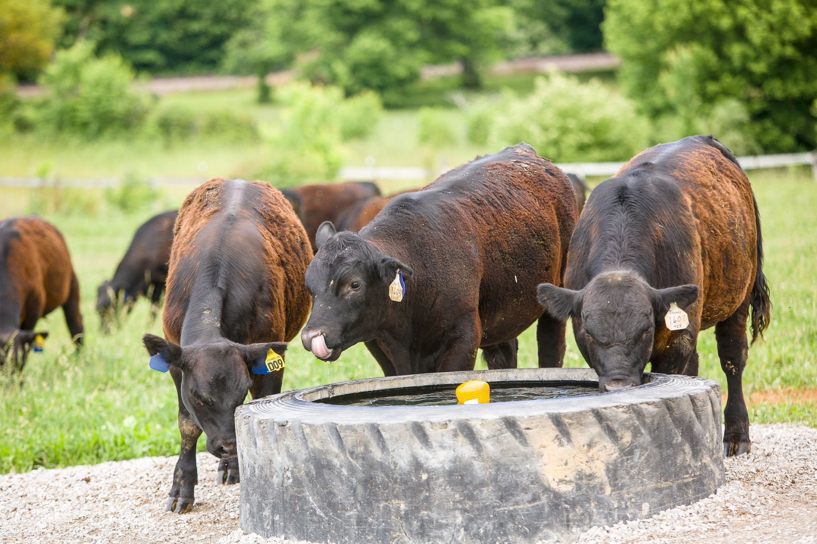
Agriculture
Bourbon
Hazards
Horses
Housing
Human Health
Infrastructure
Insects
Livestock
Plants
Social Justice
Soils
Work
warmer temps → harmful algal blooms in inland water bodies → water quality issues → livestock illness + human health impacts + increasing industry costs
9
Water
Notes:
Mike McGlue: harmful algal blooms are becoming even more problematic as inland water bodies warm up (cyanobacteria, for example, outcompete other algae when waters are warm and nutrients become limiting)...it can be a real problem because treating the water prior to use is expensive, health implications for anything that drinks it, and more. Potentially important implications for industries in KY that use alot of water (...bourbon, horses...)
Amanda Gumbert: Yes, warmer temps means algae on ponds for longer times and often all year (previously this was more of a summertime concern) – these algae blooms have the potential for cyanotoxin production which can lead to livestock illness or death
Warmer temps overall require higher intake of water for cattle to stay cool – increasing demands on water resources. Cattle may seek out shade or cooler temps near streams and loaf in the water. Greater traffic in and out of streams results in erosion of streambanks and sediment entering water bodies, as well as loafing resulting in “direct deposits” of nutrients and bacteria from urine and feces.
Photo credit: UK CAFE, Beef cattle drank from a watering station in a pasture of Dave Burge's farm outside Lawrenceburg, Ky.

Slide 11
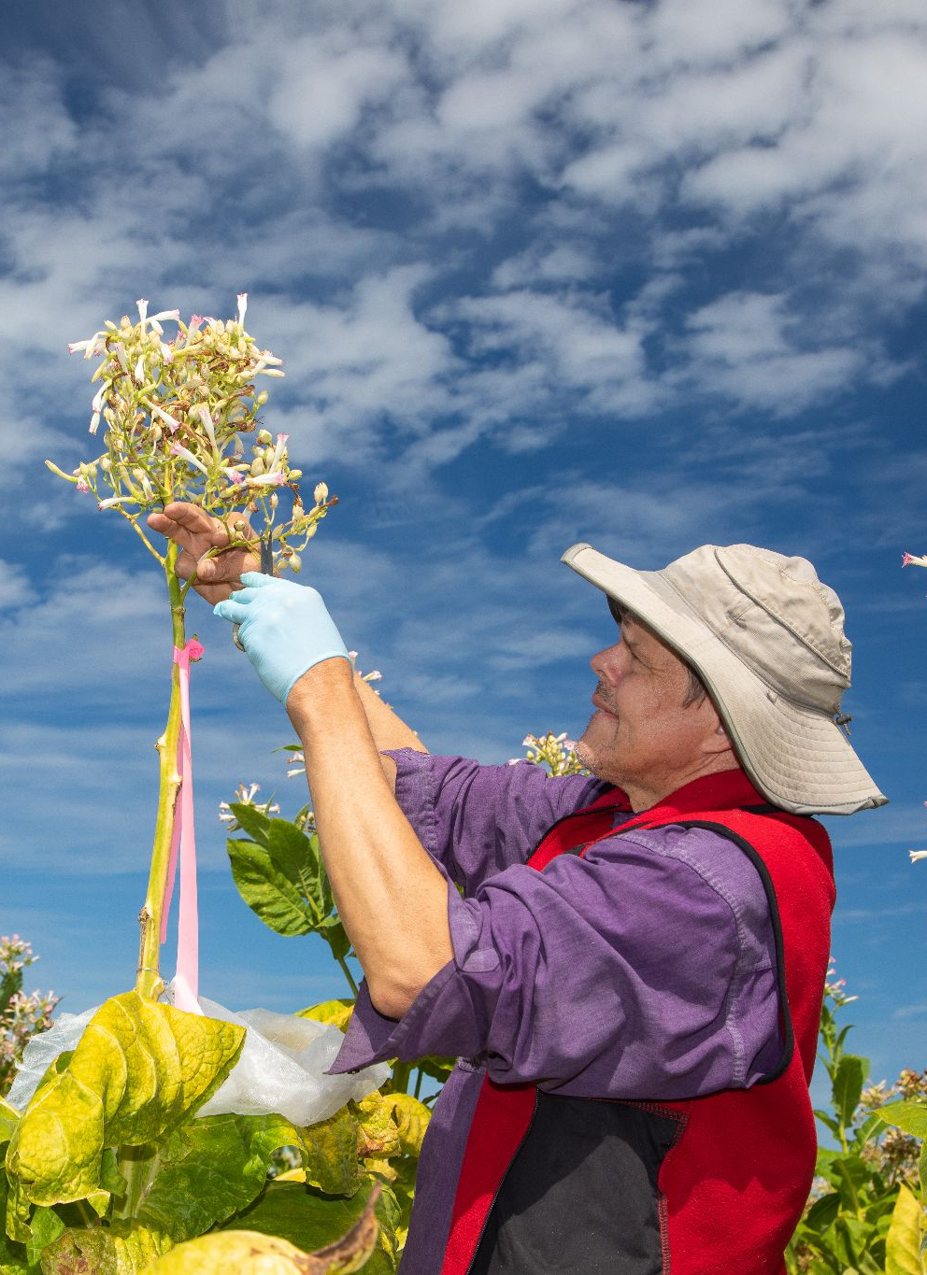
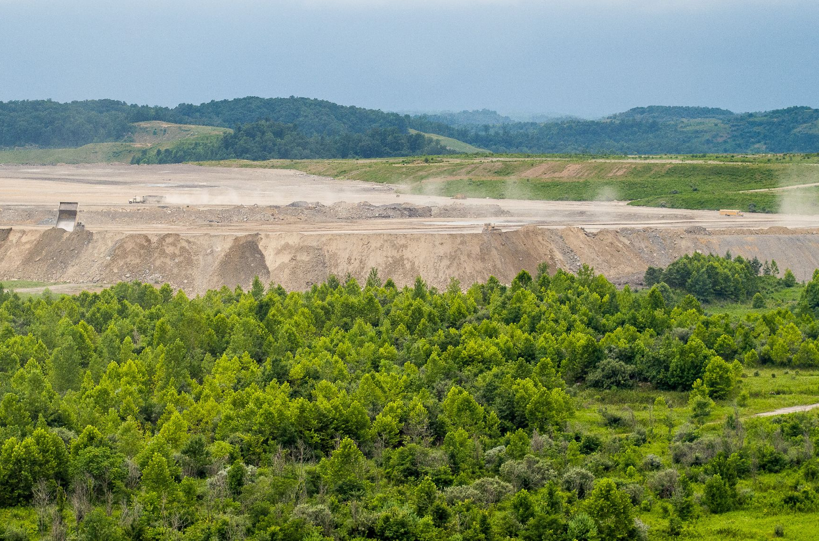
Agriculture
Bourbon
Hazards
Horses
Housing
Human Health
Infrastructure
Insects
Livestock
Plants
Social Justice
Soils
Work
decline of the coal industry → need for a just transition → lessons to be learned from the tobacco buyout
10
Water
Notes:
Avery Kolers: As an ethicist, I've been thinking that maybe there's a distinctively but not uniquely Kentucky aspect that might be called, "Building a Bridge to a Win-Win Transition".
Coal miners are the clearest example. They are in the position that tobacco farmers were in 20 years ago. What Kentucky showed then, and what it can help teach now, is the importance of a just transition for those who have genuinely contributed to the problem, but who have never been the ones to profit most by it. They have been exploited by those who drove the problem, but risk suffering the most as we transition away from it.
One thing that makes that potentially politically useful is that the tobacco buyout was one of Mitch McConnell's proudest achievements. (Not to mention that he's excited about building a bridge right now.)
Some reporting on the tobacco buyout: https://news.ca.uky.edu/article/tobacco-buyout-means-changes-kentucky-agriculture

Slide 12
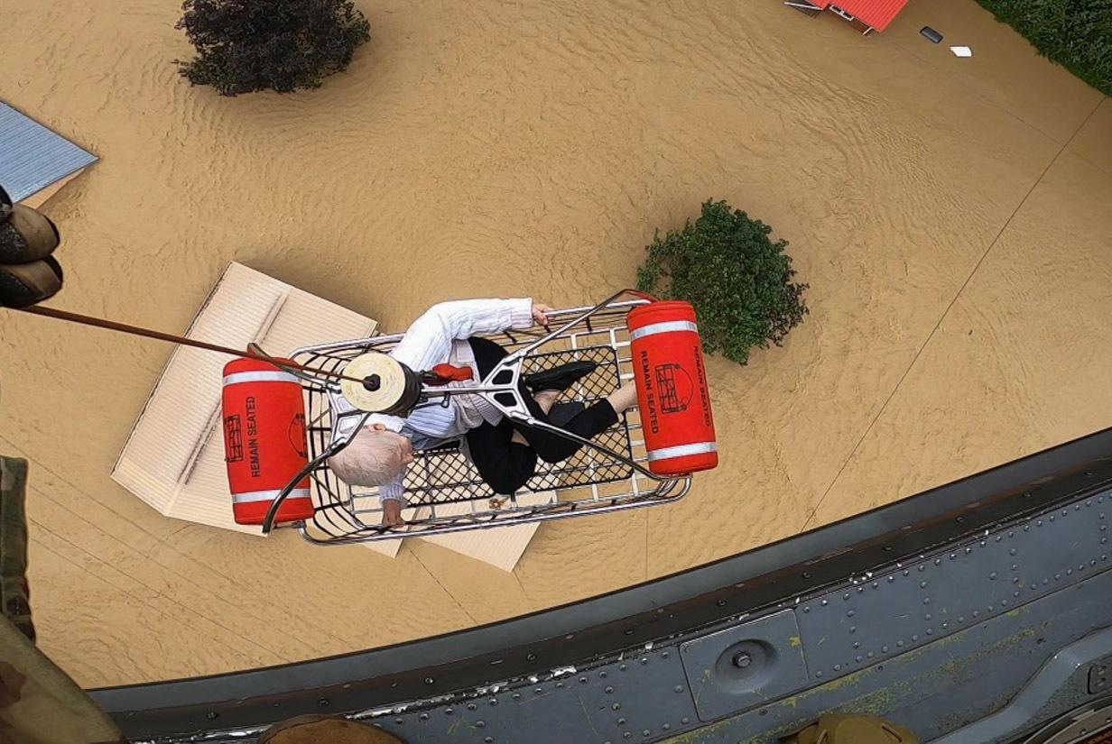
Agriculture
Bourbon
Hazards
Horses
Housing
Human Health
Infrastructure
Insects
Livestock
Plants
Social Justice
Soils
Work
increased climate disasters → displacement → greater disparities between privileged & marginalized
11
Water
Notes:
Tony Arnold: Another kind of climate change impact that is increasingly affecting Kentucky communities is climate-related relocation and dislocation. The impacts are especially hard on the most marginalized and vulnerable populations. The impacts of climate change have these cumulative effects with various insecurities (housing, food, income, health) and vulnerabilities (environmental, economic, social, political). So when these climate disasters occur, people are physically or financially or both displaced from their homes and communities.
And the people with resources, power, and privilege can get ahead of that – they can preemptively move from higher-risk areas to lower-risk areas, creating increasing housing demand and prices, neighborhood gentrification, and displacement of those who lack the wealth and power to adapt to the gentrified markets.
Unfortunately, there's a lot of money to be made from rising property values and more development, so it's difficult to have a lot of confidence in policy makers to proactively address these changes. And a lot of people will be caught off-guard. These are some of the kinds of issues that we're trying to address with the Resilience Justice Project.
Photo credit: https://commons.wikimedia.org/wiki/File:July_2022_Kentucky_floods_airlift.jpg

Slide 13
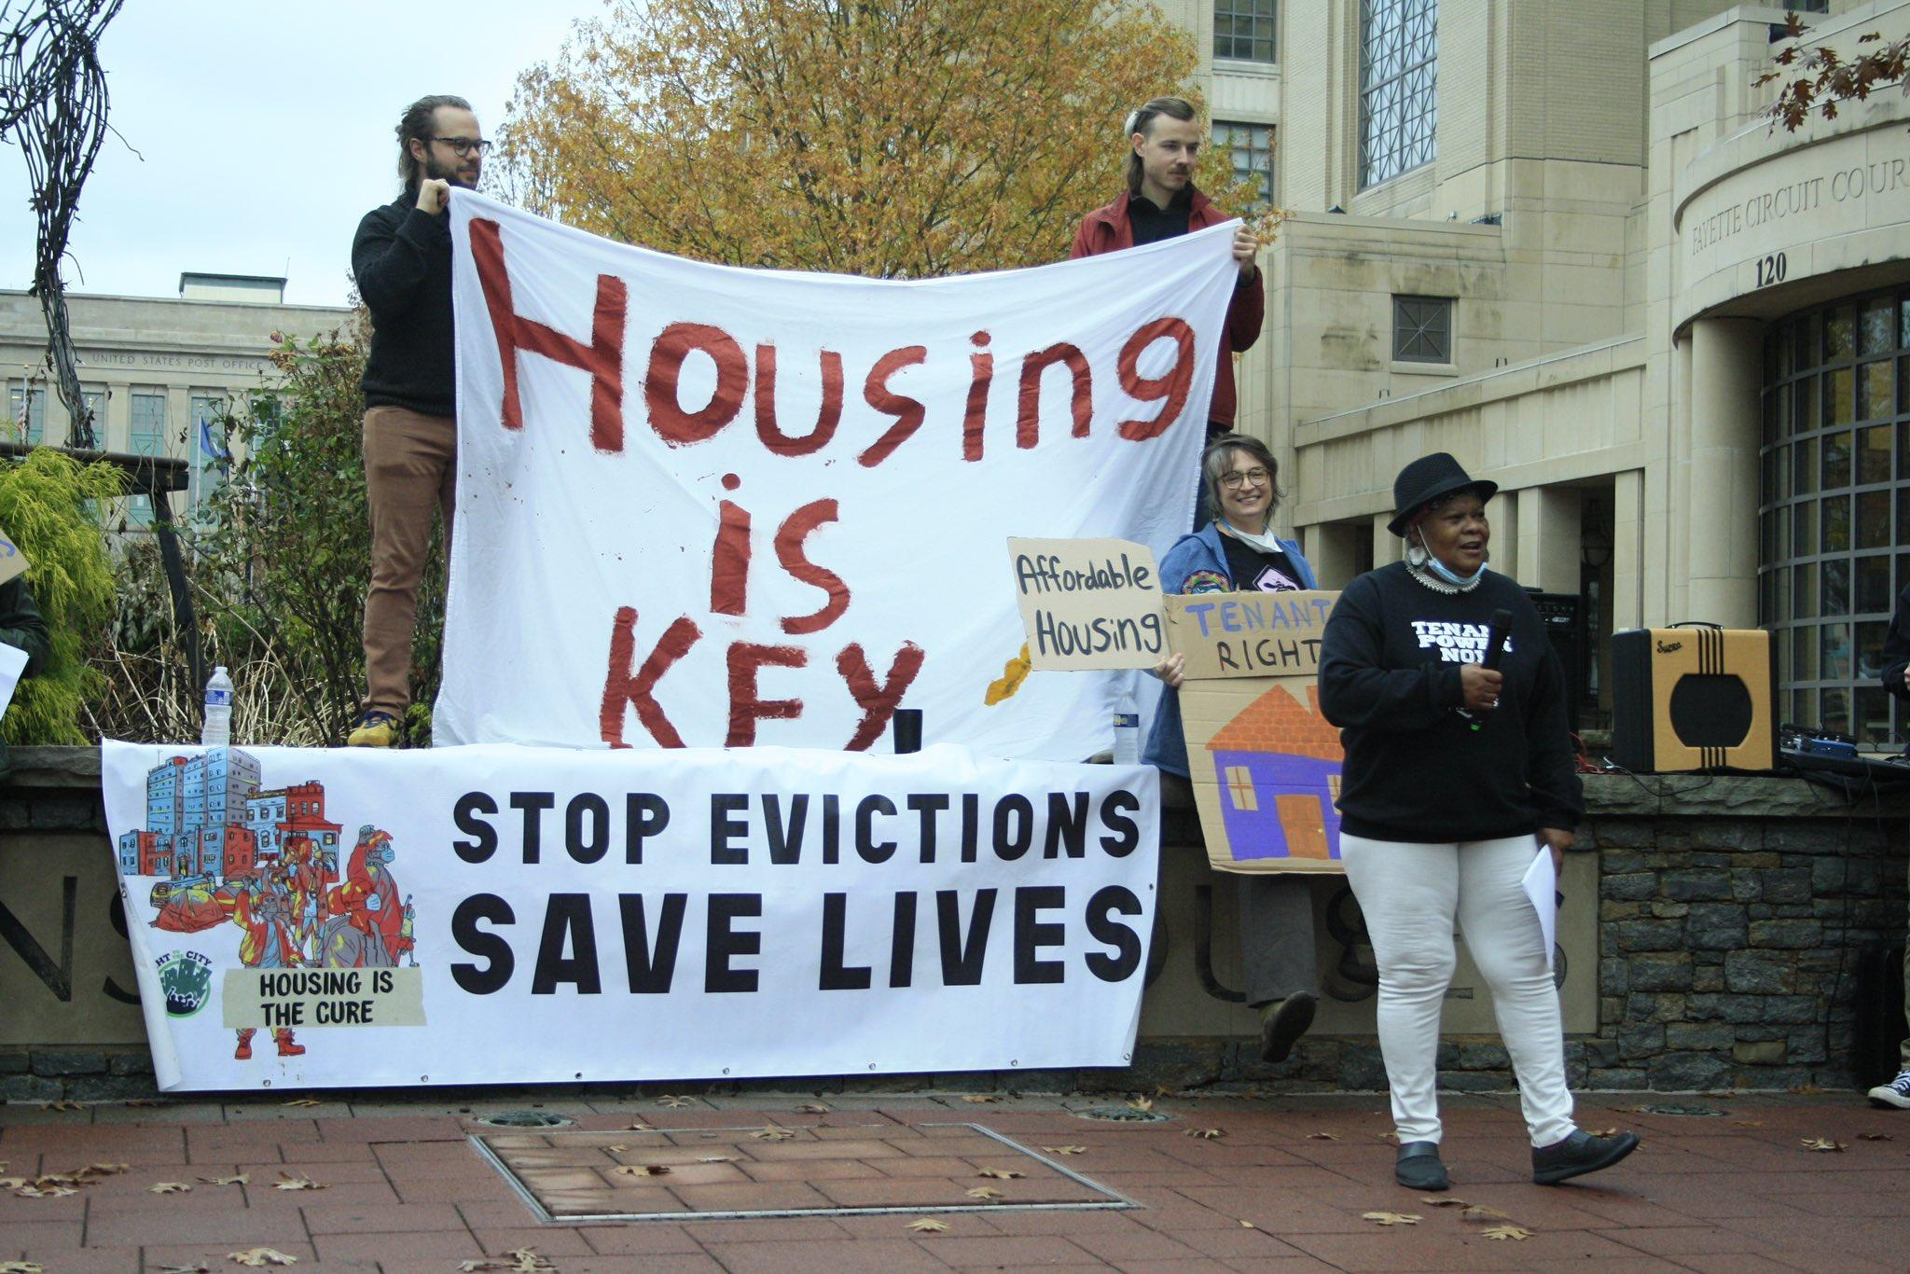
Agriculture
Bourbon
Hazards
Horses
Housing
Human Health
Infrastructure
Insects
Livestock
Plants
Social Justice
Soils
Work
increased climate in-migration → gentrification → increased unmet need for affordable & non-discriminatory housing
12
Water
Notes:
Tony Arnold: Kentucky is increasingly attractive to climate refugees and re-locators who want to move away from more extreme climate-altered locations, such as Florida's coastal areas, the increasingly drier and hotter American Southwest, the American West's crises (e.g., shrinking Colorado River, toxic-dust air quality from the evaporating Great Salt Lake, unprecedented wildfires year-round, etc.)., and even from other nations where climate change is already hitting really hard. Those who have wealth and don't experience housing-market discrimination will spur the forces of gentrification. Those who experience discrimination and/or lack wealth will add to an existing unmet demand for affordable housing..
Photo credit: https://twitter.com/KYTenants/status/1601714617587499008/photo/4

Slide 14
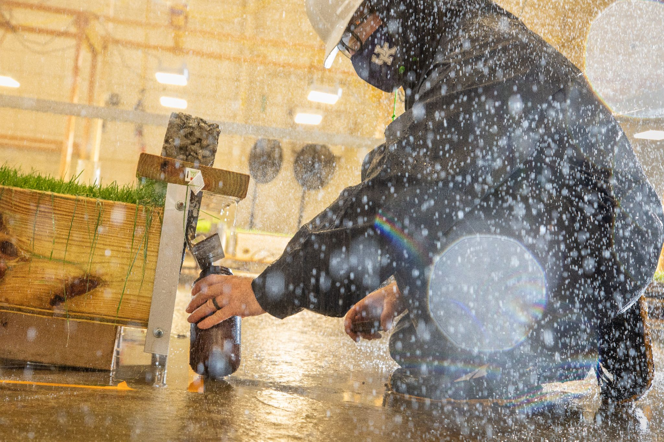
Agriculture
Bourbon
Hazards
Horses
Housing
Human Health
Infrastructure
Insects
Livestock
Plants
Social Justice
Soils
Work
higher intensity rain events → greater stormwater runoff → increased water contaminants from pet waste
13
Water
Notes:
Amanda Gumbert: Higher intensity rain events result in greater stormwater runoff in urban and rural areas, contributing to higher water volumes/greater water velocities in streams which exacerbates issues such as pet waste adding unwanted contaminants to our surface and groundwater, as well as streambank erosion. Brad Lee, with UK Extension, and Ennis Beck with the Kentucky Geological Survey, have done research focused on pet waste and educating the local community about it.

Slide 15
13 Ways of Doing Something about Climate in Kentucky
Join KFTC’s New Energy & Transition working group
Join Lex Climate Conversations and check out a climate yard sign from their library
Attend a free energy efficiency workshop hosted by Bluegrass Greensource
Use the backyard conservation grant from the Fayette County Conservation District to plant a pollinator garden
Ride the bus – Lextran is free with a UK ID!
Join the Louisville Climate Action Network
Sign up for compositing services with Treehouse Compost
Ask your city councilmember how they’re working on climate
Pay attention to local races such as the Soil and Water Board of Supervisors here in Fayette
Volunteer with Wild Ones to manage native plants and remove invasives
Shop for plastic bits and bobs at the LEX Center for Creative Reuse instead of buying new
Take extra bags to the dog parks in case they’re out (and pick up other dogs’ waste!)
Get a free radon test kit from the Cabinet for Health & Family Services
Talk about climate, all the time, with everyone. If I’ve done a half-decent job tonight, I hope I’ve persuaded you that climate is connected to everything.
laurenecagle.com/talks

