Slide 1
Climate Change and Health:
Implications for Kentucky and Beyond
Anna Goodman Hoover, Ph.D.
Assistant Professor, Epidemiology and Environmental Health
University of Kentucky College of Public Health
Sustainability Summit | 8 March 2023

Slide 2
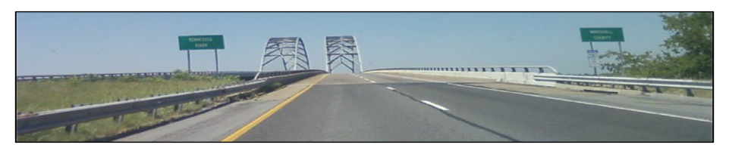
Roadmap
Environmental Health: What It Is & Why It Matters
Climate Change and Health
Planning for Climate Change to Improve Health Outcomes
﻿An Equal Opportunity University

Slide 3
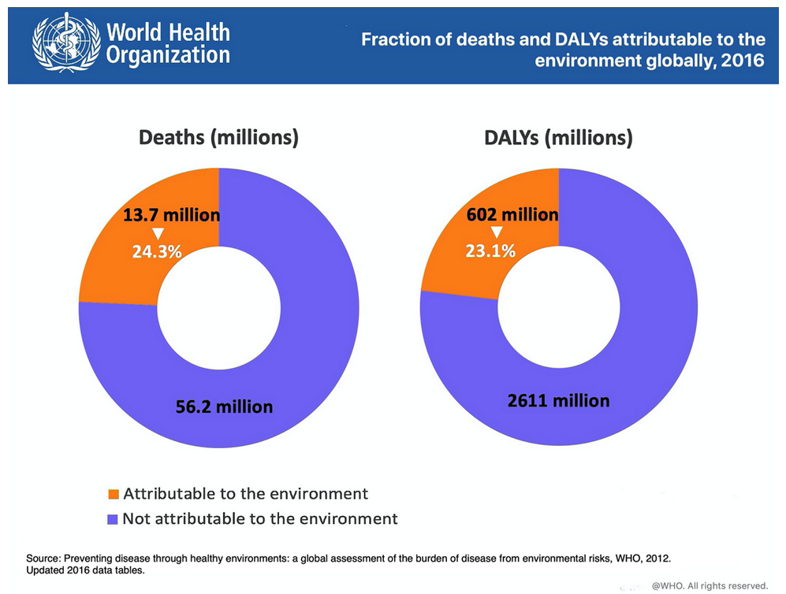
Environmental Health: What It Is and Why It Matters
Image Source: World Health Organization Global Health Observatory Data
Notes:
Definition
One DALY can be thought of as one lost year of "healthy" life. The sum of these DALYs across the population, or the burden of disease, can be thought of as a measurement of the gap between current health status and an ideal health situation where the entire population lives to an advanced age, free of disease and disability.
DALYs for a disease or health condition are calculated as the sum of the Years of Life Lost (YLL) due to premature mortality in the population and the Years Lost due to Disability (YLD) for people living with the health condition or its consequences:
Calculation
DALY=YLL-YLD

Slide 4
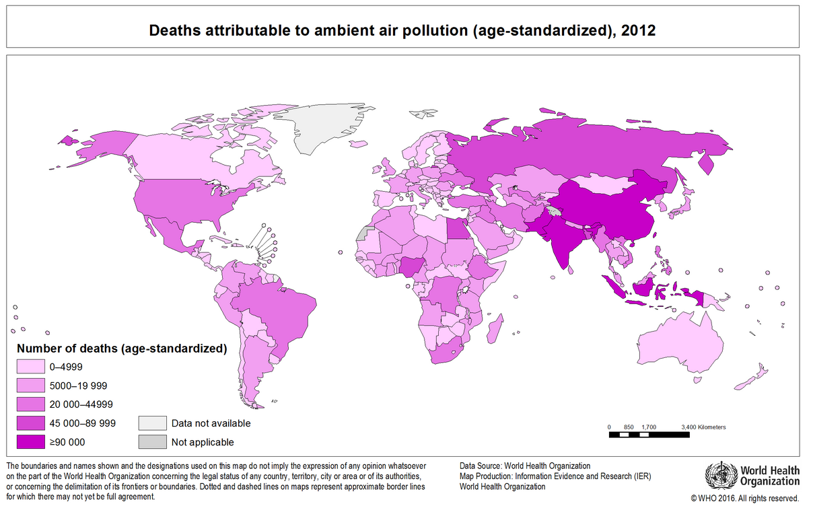
Environmental Health: What It Is and Why It Matters
Worldwide ambient air pollution accounts for:
29% of all deaths and disease from lung cancer
17% of all deaths and disease from acute lower respiratory infections
24% of all deaths from stroke
25% of all deaths and disease from ischaemic heart disease
43% of all deaths and disease from chronic obstructive pulmonary disease
-WHO
Image Source: World Health Organization
Notes:
Pollutants with the strongest evidence for public health concern, include particulate matter (PM), ozone (O3), nitrogen dioxide (NO2), and sulphur dioxide (SO2).
Exposure to smoke from cooking fires causes 3.8 million premature deaths each year, mostly in low- and middle-income countries, including: Burning fuels such as dung, wood and coal in inefficient stoves or open hearths

Slide 5
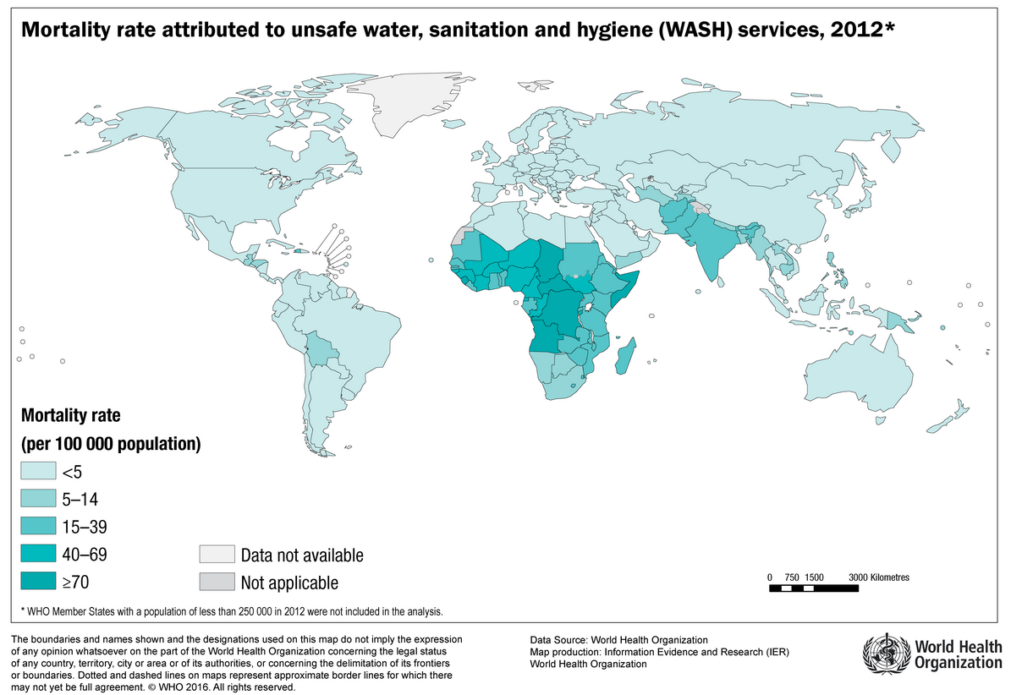
Environmental Health: What It Is and Why It Matters
Unsafe water is responsible for nearly 10% of the annual global disease burden, including:
1.4 million child deaths from diarrhea;
500,000 deaths from malaria;
860,000 child deaths from malnutrition; and
280,000 deaths from drowning.
-WHO
Image Source: World Health Organization

Slide 6
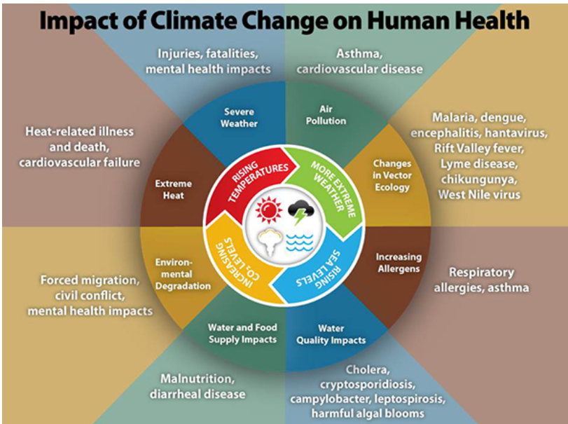
Climate Change and Health
Image Source: Centers for Disease Control and Prevention
Notes:
Four broad categories of ecosystem services: provisioning, such as the production of food and water; regulating, such as the control of climate and disease; supporting, such as nutrient cycles and oxygen production; and cultural, such as spiritual and recreational benefits.

Slide 7
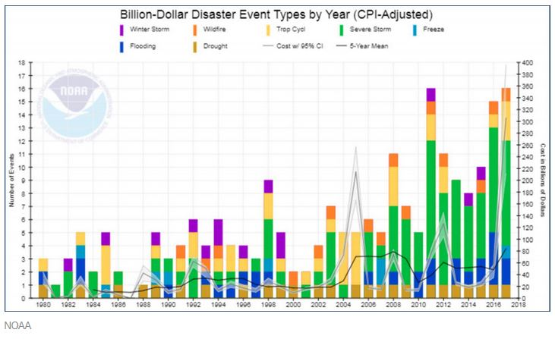
Climate Change and Health
﻿An Equal Opportunity University
Notes:
Weather and climate
Weather: atmospheric conditions over a short period of time (minutes to months)
Climate is how the atmosphere behaves over a long period of time
Is it just weather disasters? Vectors.

Slide 8
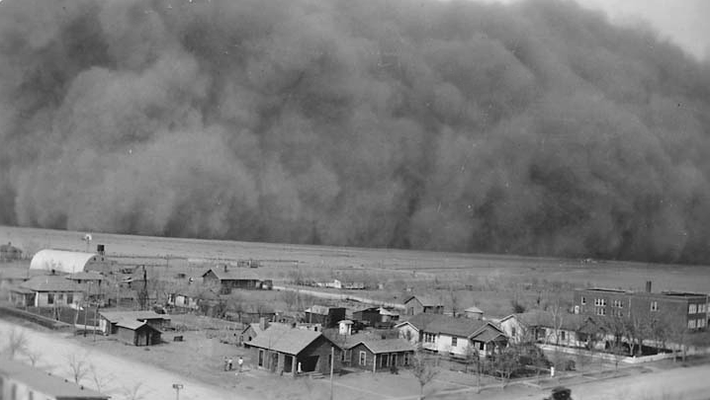
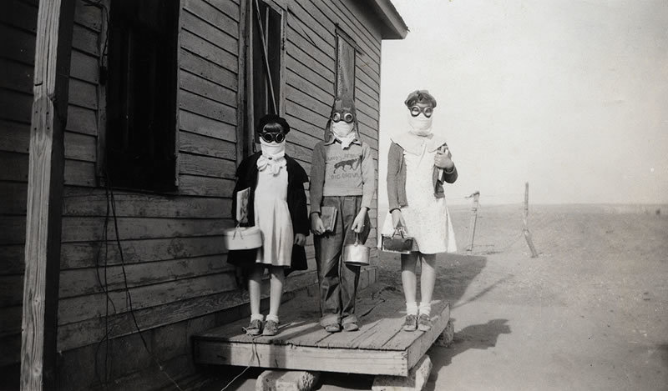
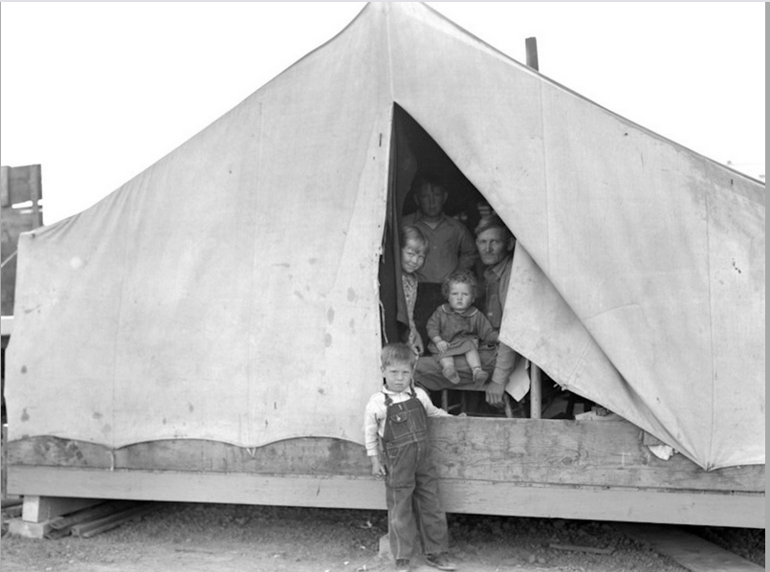
Climate Change and Health: Historical Example
Image Source: National Drought Mitigation Center
Image Source: PBS/The Dust Bowl
Image Source:
PBS/The Dust Bowl
Notes:
https://youtu.be/X2dPAd-SEuE
2:53 – 6:15

Slide 9
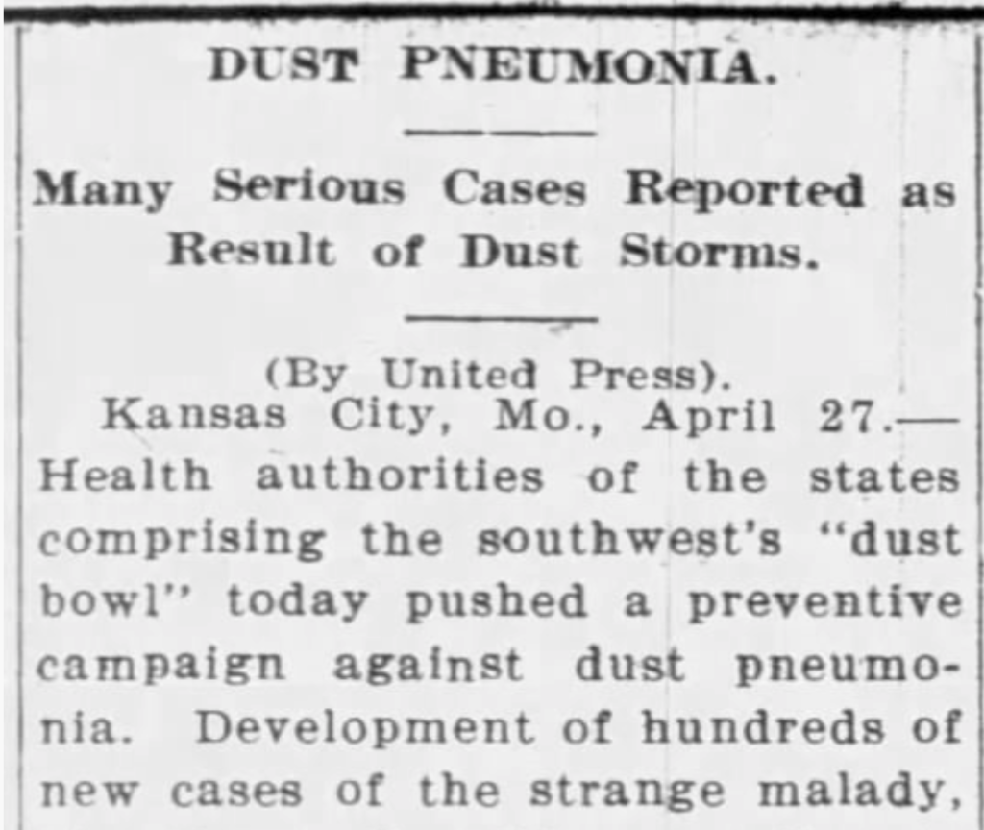
Climate Change and Health
Direct Effects on Health
Dust pneumonia
Asthma
Eye infections
Infant mortality
Mental Health
Social Determinants of Health
Food insecurity
Adverse childhood events (ACES)
Physical environment
Migration (stress, substandard housing, overcrowding)
Image Source: Newspapers.com
Notes:
Haboob

Slide 10

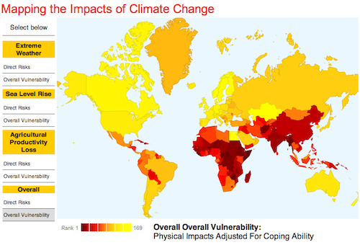

Planning for Climate Change: Disproportionate Impacts
﻿An Equal Opportunity University
Source: Center for Global Development
Notes:
Climate justice links human rights and development to achieve a human-centered approach, safeguarding the rights of the most vulnerable people and sharing the burdens and benefits of climate change and its impacts equitably and fairly. Climate justice is informed by science, responds to science and acknowledges the need for equitable stewardship of the world’s resources. – Mary Robinson Foundation

Slide 11
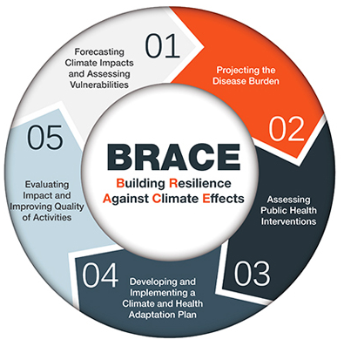
Planning for Climate Change: Topics and Tools
Direct and Indirect Effects on Health
Heat-Related Morbidity and Mortality
Natural Disasters
Mental Health
Malnutrition
Air Pollution
Infectious Diseases
  Waterborne
  Foodborne
  Vector-borne
Resource Struggles
Displacement
Image Source: CDC BRACE Framework
Notes:
Haboob

Slide 12

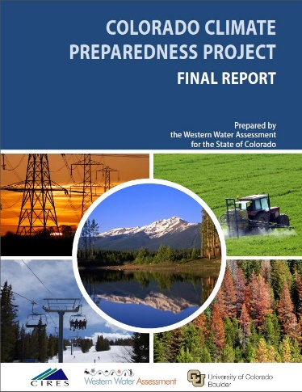
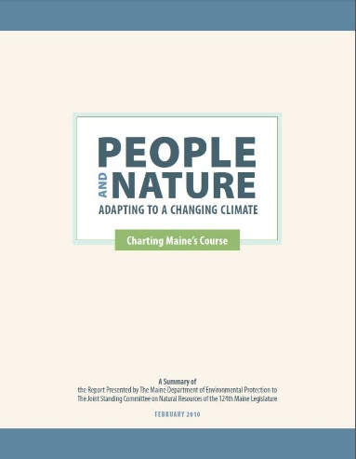
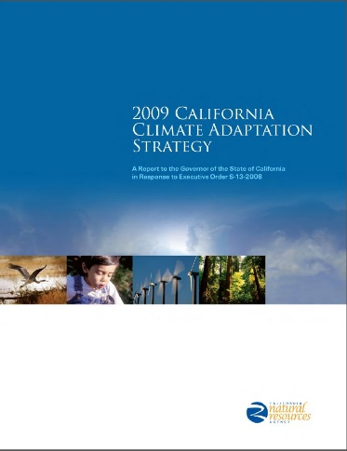
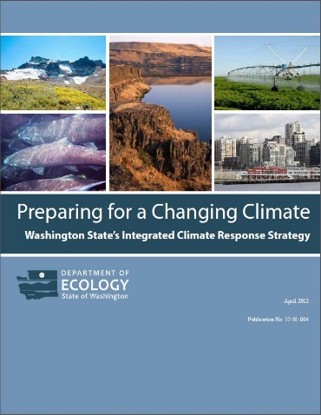
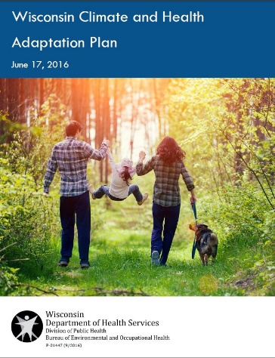
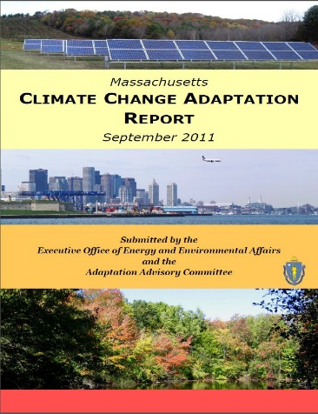
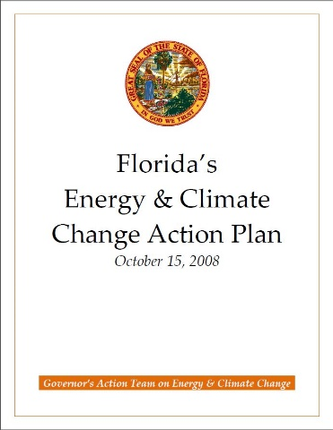
Planning for Climate Change: 15 Heterogeneous State Climate Adaptation Plans
Timelines
  Plan finalization dates range from 2008 to 2016
  75% of coastal states had finalized plans before the first non-coastal state plan was finalized in 2011
  Only 1 new plan since the first Index release in 2013
Length: from 12 pages to >400
Leadership
  Most authored by governor-appointed commissions/task forces
  Some by state environmental agencies
  One by a state health agency
Collaborative Roles
  Less than half of steering committees included public health sector representation
  Stakeholder-engaged processes often included public health sector representation on workgroups
﻿An Equal Opportunity University
Notes:
Wisconsin’s was finalized in mid-2016. Because of lags in data collection, we would not yet be able to see any impact from that work in the 2017 Index release, which relies on data collected in or prior to 2016.

Slide 13
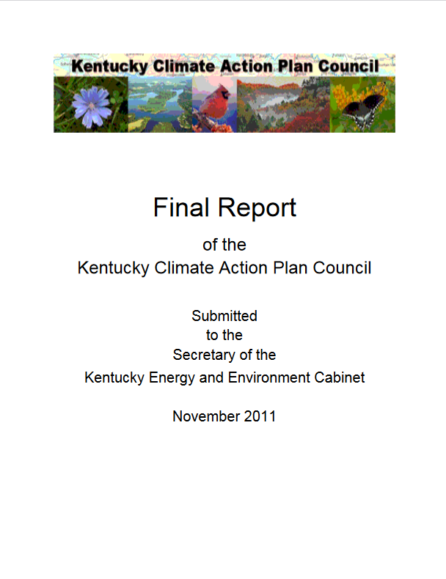
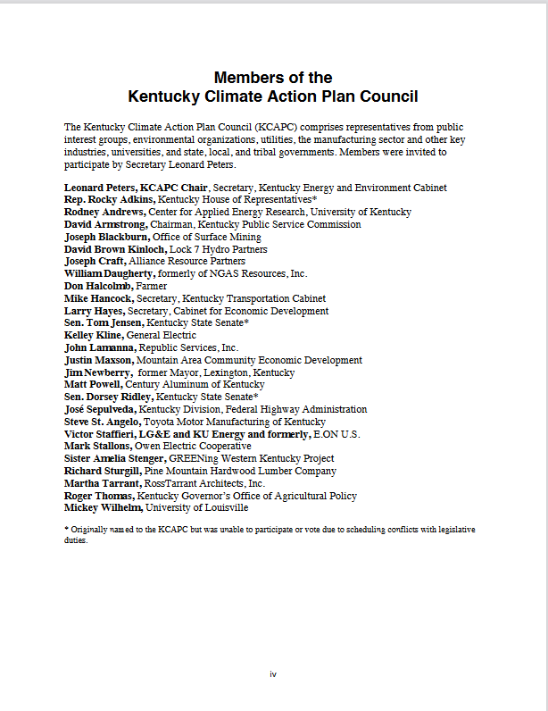
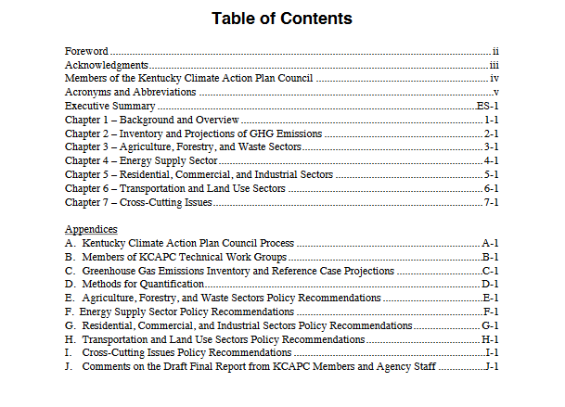
Planning for Climate Change: Public Health Topics/Goals Are in Existing State Plans
Extreme Heat
Other Extreme Weather Health Hazards
Surveillance (Food, Water, Air)
Water Quantity and Quality
Vector Control
Smoke Emergencies
Vulnerable Populations
Preparedness Planning
Information Sharing
_{Source:}
Kentucky Climate Action Plan (2011)
﻿An Equal Opportunity University
Notes:
Lots of monitoring – prevalent measures in the EOH domain of the Index

Slide 14
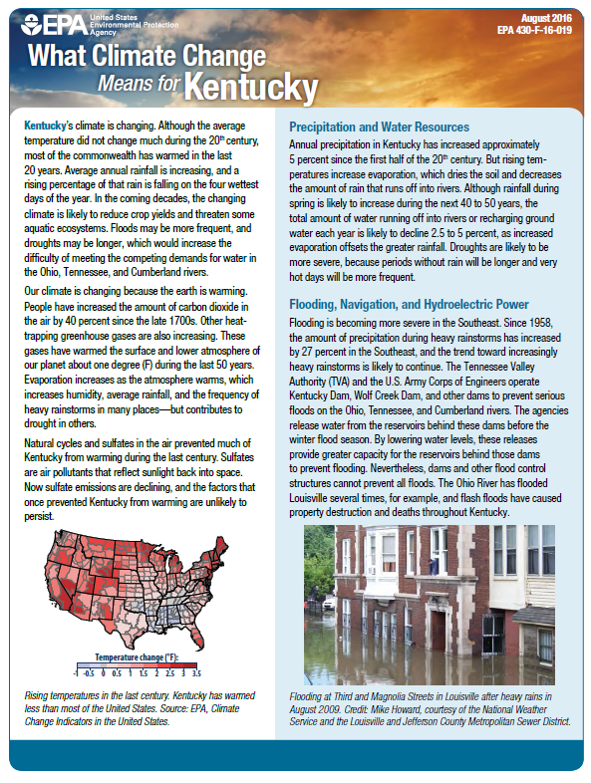
Planning for Climate Change: Kentucky
Precipitation/Water Resources
  Increases in spring rainfall
  Increases in heat-driven evaporation
  Droughts
Flooding
  Increase in heavy rain events ( ~30% since 1957)
  Increases in flash flooding
Agriculture and Aquaculture
  Potentially reduced yields (corn, soybeans)
  Reduced livestock productivity
  Harmful algal blooms/fish kills
Health
  Heat stroke, dehydration
  Increase in ozone/reduced air quality
  Asthma exacerbations/cardiovascular disease
Source: What Climate Change Means for Kentucky (US EPA, 2017)
﻿An Equal Opportunity University

Slide 15

Planning for Climate Change: Spatial Scales
Think Globally (Outcomes)
Reduction in human impacts on climate
Act Locally (Strategies)
Carpooling
Energy efficient businesses home
Community recycling centers
Improve built environment
Educating people on how to reduce waste/emissions
Legislation to reduce emissions locally (e.g., CA fuel efficiency)
Legislation on manufacturing emissions/waste reduction
Think Locally (Outcomes)
Reduction in Traffic
Reduction in Emissions
Reduce Overall Carbon Footprint
Act Globally (or at least regionally – Strategies/Policies)
Telework (corporate decisions, policies, incentives)
Reduce meat consumption (corporate plant-based food policies)
Adhere to Existing Climate Accords and Advance New Accords
Image Source: Button Lore

Slide 16
Contact Me
Anna Goodman Hoover, Ph.D.
University of Kentucky College of Public Health
CPH Building Room 214
Anna.Hoover@uky.edu
Twitter: @AnyaFanya
ZOOM OFFICE:
https://uky.zoom.us/j/6155076360

