Slide 1
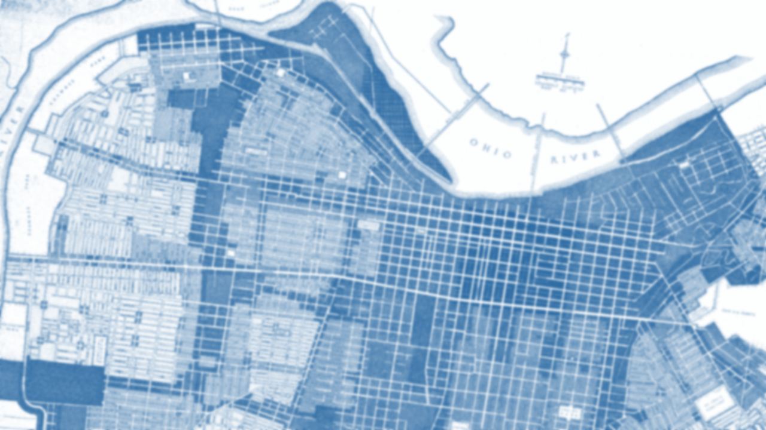

Confronting Racism in City Planning & Zoning
Sustainability Summit 2023
Joel Dock, AICP, Planning Coordinator
Louisville Metro Office of Planning and Design Services

Slide 2
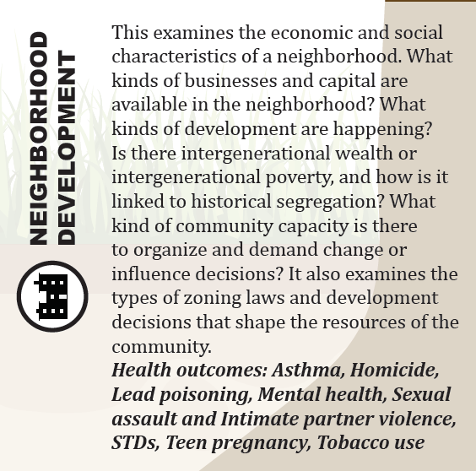
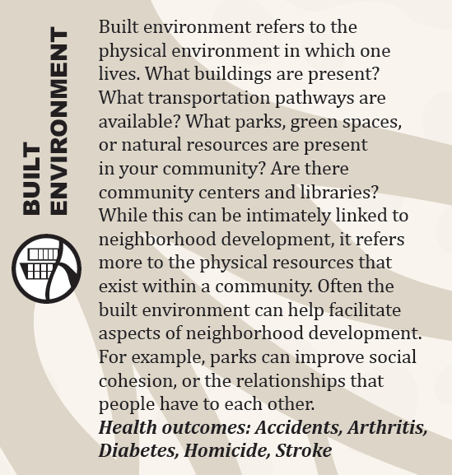
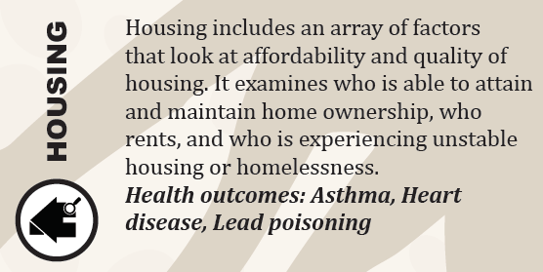
Health Equity Report, 2017: Root Causes & Systems of Power
“In order to address population health outcomes, we must address root causes. Root causes impact health outcomes because the way an individual experiences a root cause often provides either an advantage (such as higher income or more access to fresh, healthy food) or a disadvantage (such as lower income and more access to high sugar, processed foods).”
“Health equity acknowledges that these environments look different for different people, and that if inequities in policy and practice were addressed, these health disparities could be preventable.”
Notes:
Before I dive into the foundations of racism entrenched in local land use policy and systems of power, I’d like to take a moment to frame the conversation. As a planner and as planners, we must recognize that our profession played (and still plays) a significant role in the continuation of systems of racial inequality and housing segregation, as well as the health outcomes of marginalized and disenfranchised communities, specifically Louisville’s Black community.
11 root causes from environmental quality to income and job opprtubities.
Examples:
Housing:
Housing quality is one of the most important factors affecting a child’s asthma. Older, overcrowded, and/or poorly maintained housing units can expose children to many different indoor asthma triggers. Addressing some asthma triggers in rental housing therefore requires the involvement of the property manager for major home modifications, and in some cases, the enforcement of housing code violations by city or county officials.
Neighborhood development:
The help given to White communities in the first half of the 1900s, including subsidized development and homeownership assistance, was critical to developing thriving neighborhoods.13 The stark contrast for communities of color, especially Black communities, led to a significant difference in wealth accumulation between neighborhoods.14 Over time, houses in communities of color often fell into disrepair and lead paint began to break down. Because of the expensive costs, lead paint is often not removed or properly maintained and has become a hazard to children living in these homes.15 Policies and practices from over 100 years ago have had very real impacts on families, impacting their ability to build the financial resources needed for the costly repairs necessary to prevent lead paint from becoming a risk to children in their homes.

Slide 3

In order to create an equitable and inclusionary city, the lasting consequences of discriminatory land use policy must be identified, confronted and corrected. The Land Development Code (LDC) Reform is an equity-focused approach to revise the LDC consistent with Plan 2040, allow for increased housing choices and opportunities in new and existing neighborhoods, create procedures and regulations that are easier to use, and increase the quality of life by reducing the concentration of environmental hazards near housing.
Land Development Code Reform: https://louisvilleky.gov/ldcreform
Notes:
And this is just the beginning. Following this first phase of recommendations, Planning and Design will start moving into Phase II of the reform. We are looking forward to public engagement in a non-covid environment and we are ready for the challenge and we encourage everyone to be involved. Sign up for gov delivery, visit the land development code reform website or call our hotline. We are open to any suggestions you may about improving our public engagement, we would love to speak with you regarding your thoughts and concerns, and we are dedicated to advocating for all voices in our community. So with that, I am going to pass things over to Chris French who will be going into more detail about the process and phase I recommendations. Thank you.

Slide 4
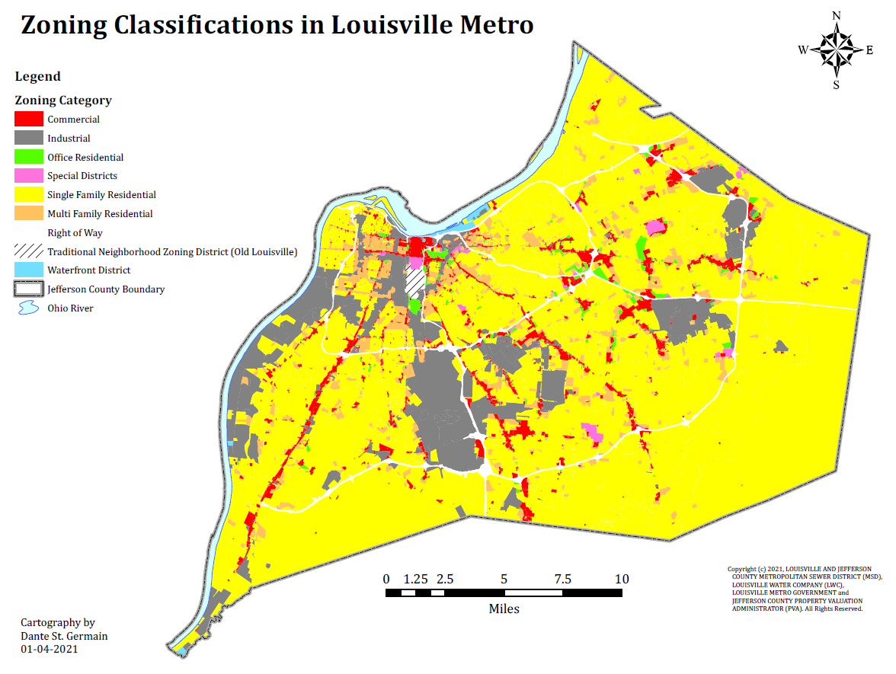
What is Zoning?
Zoning is the law that mandates development in a community by designating each parcel of land into a "zone" that determines how the land can be used
Notes:
Police-Power granted to local authorities to divide land
““Zoning is an all-purpose instrument for urban improvement that would lessen congestion in the streets; secure safety from fire, panic, and other dangers; provide adequate light and air; prevent the overcrowding of land; to avoid undue concentration of population” -Rutherford H. Platt, Land Use and Society, Third Edition

Slide 5
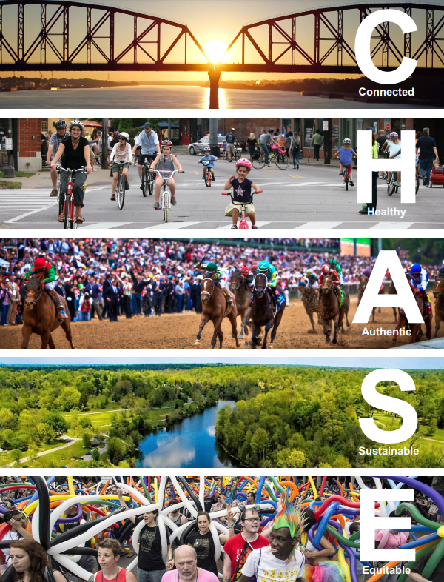
What is a Comprehensive Plan
(Plan 2040)?
Comprehensive plans are long-range planning policy documents (effective for 10 to 20 years), which communities use to identify on-going and anticipated issues, needs, shared goals and development options, and outline a general course forward.
Notes:
Fair and affordable housing at dispersed locations
Master Plan for the city to guide growth and development

Slide 6
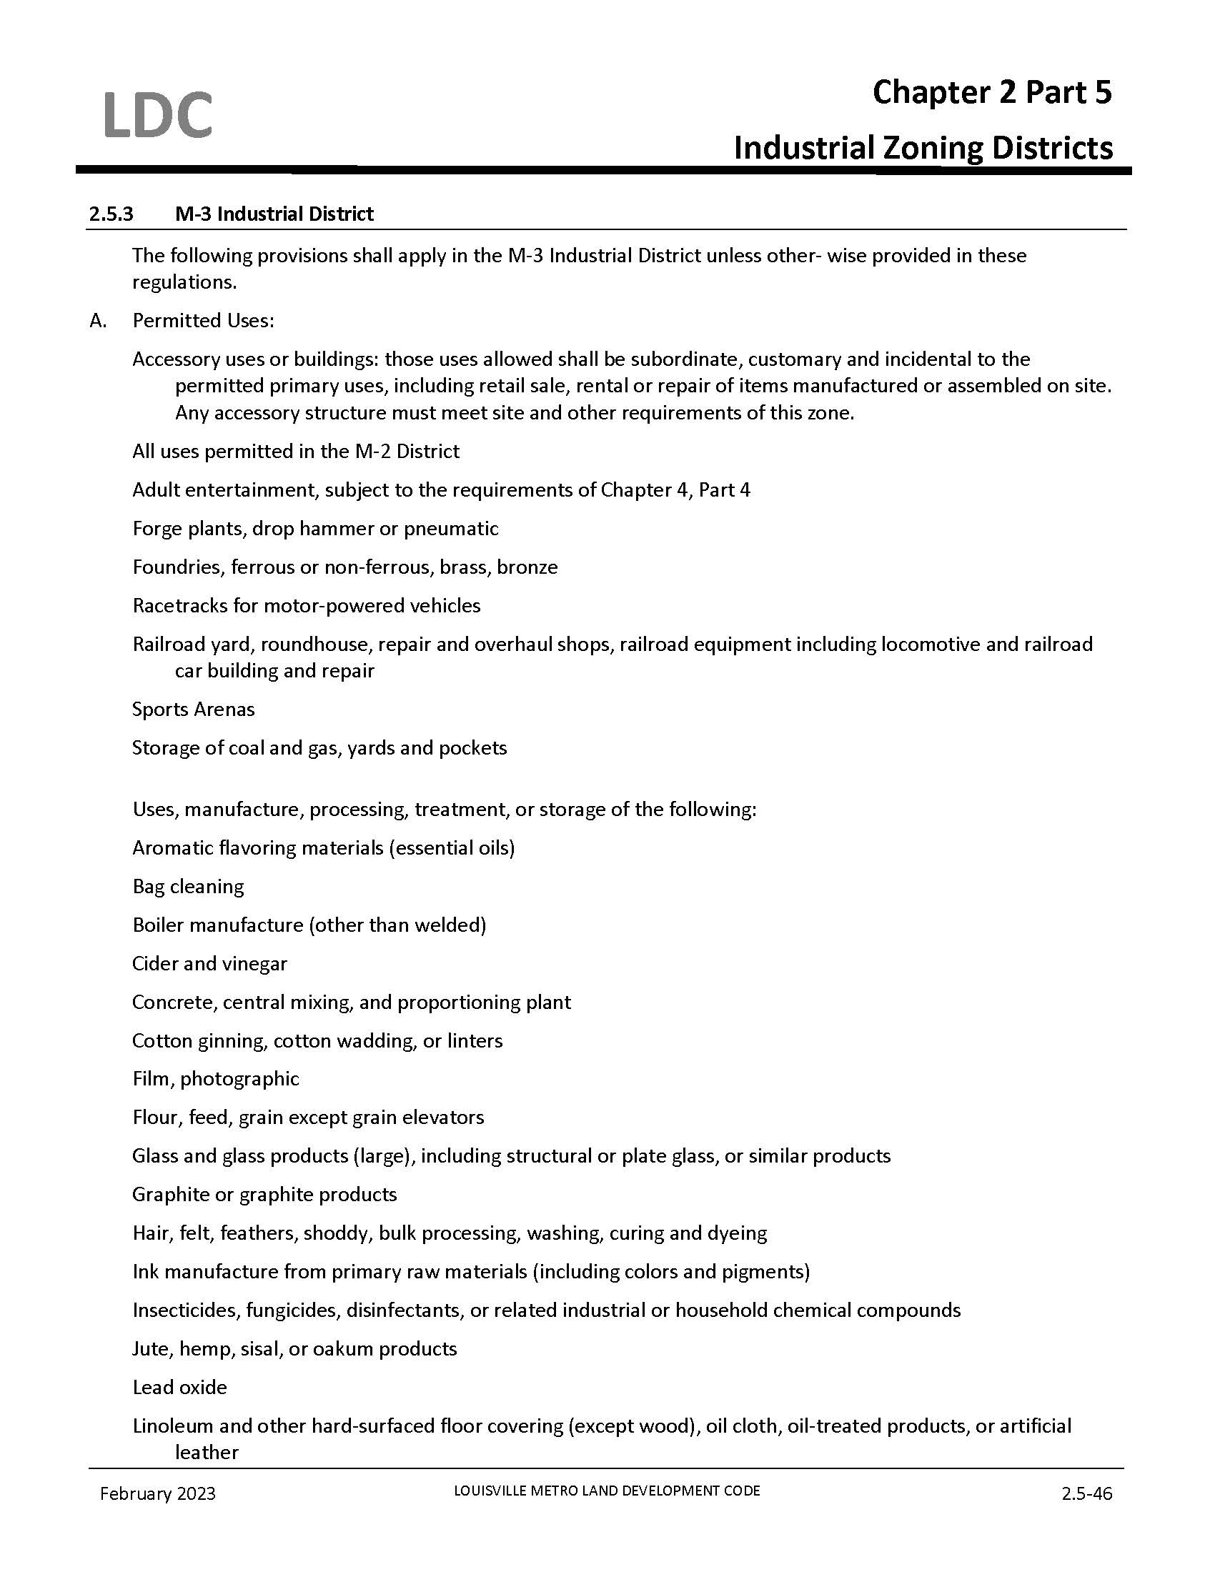
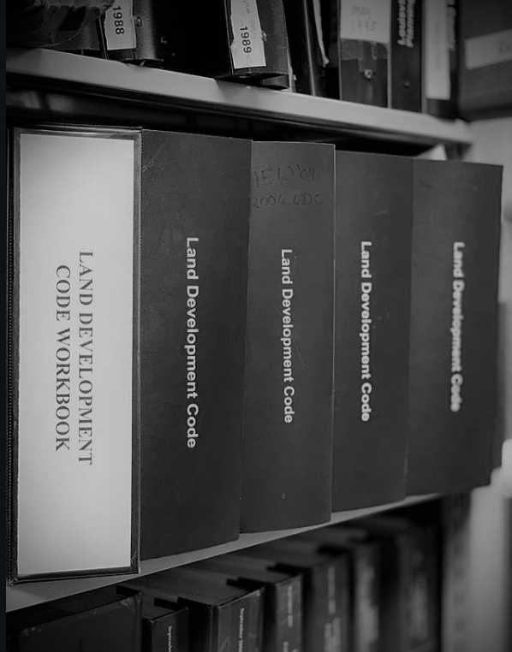
What is the Land Development Code?
The Land Development Code (LDC) is a set of rules and laws that defines how land can be used, how a development such as a new warehouse or home addition must be designed, and the procedures for obtaining approval

Slide 7
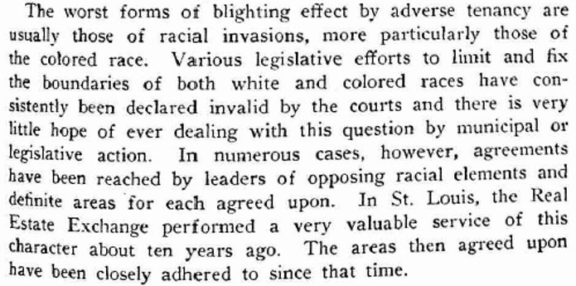
The Man at the Center: Harland Bartholomew
Bartholomew's work often described cities using organic metaphors – “Blight” was used to imply that a contagion existed within the city; one that needed to be removed, discarded, and prevented from spreading.
“Words like blight and slum were used to describe black neighborhoods, and blacks themselves were thought to spread blight, and financial and insurance risk...Bartholomew rarely made references to race explicitly unless in passing, and preferred to talk about blight and slum”
Mark Benton, Saving The City: Harland Bartholomew and Administrative Evil in St. Louis, MO
“The worst forms of blighting effect by adverse tenancy are usually those of racial invasions, more particularly those of the colored race.”
-Address to National Real Estate Boards, Toronto, Canada, 1930
Notes:
Bartholomew put forth policies, devised law, and advocated for the removal of ‘blighted' areas through slum clearance and urban renewal, and the prevention of its spread through homogenous single-family residential zoning districts.
The solutions proposed set into motion Louisville's soon to come slum clearance and urban renewal programing that were advanced through the passage of the U.S. Housing Acts. To hasten removal and reduce costs, the report recommended that legislation be obtained for cities to "assist housing companies to acquire land through condemnation", authorize tax exemptions for such improvements, and authorize "excess condemnation." At a time when the ill-health of the city was used to promote orderly growth and single-family housing districts free from intrusion, large-scale and self-contained multi-family housing in unattractive settings was to replace "the slum and 'blighted' districts" constituting a "real menace to proper city development."
Note the public health narrative

Slide 8
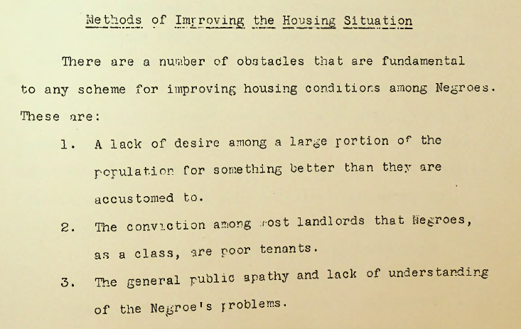
The Man at the Center: Harland Bartholomew
“If it were possible to create among the negro masses a real desire for decent accommodations, the slums would automatically eliminate themselves....All of which leads to the conclusion that some form of large-scale slum clearance and rehabilitation is the only real cure .”
– The Negro Housing Problem in Louisville, May 1932
Notes:
Bartholomew put forth policies, devised law, and advocated for the removal of ‘blighted' areas through slum clearance and urban renewal, and the prevention of its spread through homogenous single-family residential zoning districts.
The solutions proposed set into motion Louisville's soon to come slum clearance and urban renewal programing that were advanced through the passage of the U.S. Housing Acts. To hasten removal and reduce costs, the report recommended that legislation be obtained for cities to "assist housing companies to acquire land through condemnation", authorize tax exemptions for such improvements, and authorize "excess condemnation." At a time when the ill-health of the city was used to promote orderly growth and single-family housing districts free from intrusion, large-scale and self-contained multi-family housing in unattractive settings was to replace "the slum and 'blighted' districts" constituting a "real menace to proper city development."
Note the public health narrative

Slide 9
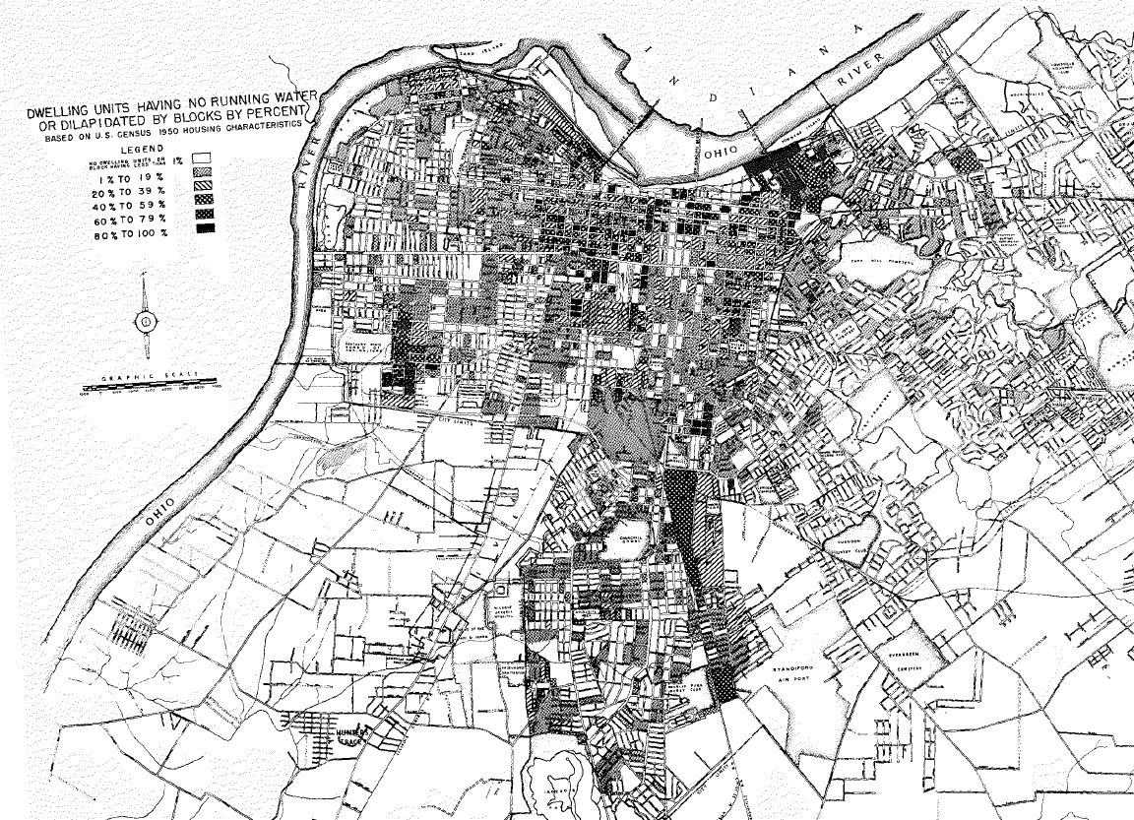
The Man at the Center: Harland Bartholomew
Bartholomew’s scientific approach to comprehensive city planning maintained the legality of racism in planning
He performed an extensive analysis of neighborhood conditions including sewer connectivity and plumbing, prevailing winds, housing maintenance and upkeep, as well as the affordance of light and air upon dwellings.
Notes:
Bartholomew put forth policies, devised law, and advocated for the removal of ‘blighted' areas through slum clearance and urban renewal, and the prevention of its spread through homogenous single-family residential zoning districts.
The solutions proposed set into motion Louisville's soon to come slum clearance and urban renewal programing that were advanced through the passage of the U.S. Housing Acts. To hasten removal and reduce costs, the report recommended that legislation be obtained for cities to "assist housing companies to acquire land through condemnation", authorize tax exemptions for such improvements, and authorize "excess condemnation." At a time when the ill-health of the city was used to promote orderly growth and single-family housing districts free from intrusion, large-scale and self-contained multi-family housing in unattractive settings was to replace "the slum and 'blighted' districts" constituting a "real menace to proper city development."
Note the public health narrative

Slide 10
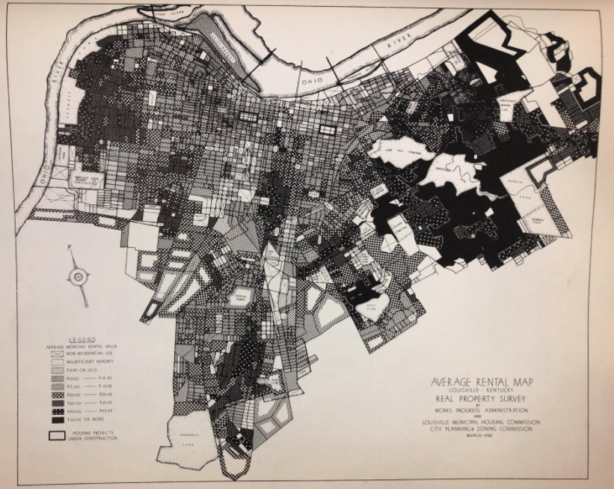
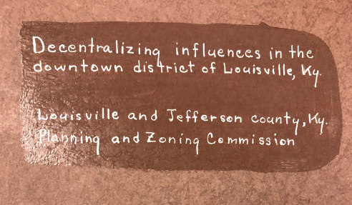
The Man at the Center: Harland Bartholomew
"It is a fundamental principle of real estate value that like uses create higher values than dissimilar use. This applies to all types of residential property...Where persons of different economic classes, national or racial characteristics, are mingled together, values will be lower than they would be in a homogenous district.”
– Decentralizing Influences in the Downtown District of Louisville, KY for the Louisville and Jefferson County Planning Commission, 1944
Notes:
In discussing the park at 4th and Guthrie…..
No plans would be adopted except those that furthered racial segregation, restriction, and removal. Diversity in uses, structures, and people within the city was an unacceptable condition, and homogeneity through the creation and protection of white, single-family neighborhoods and wealth was the solution

Slide 11
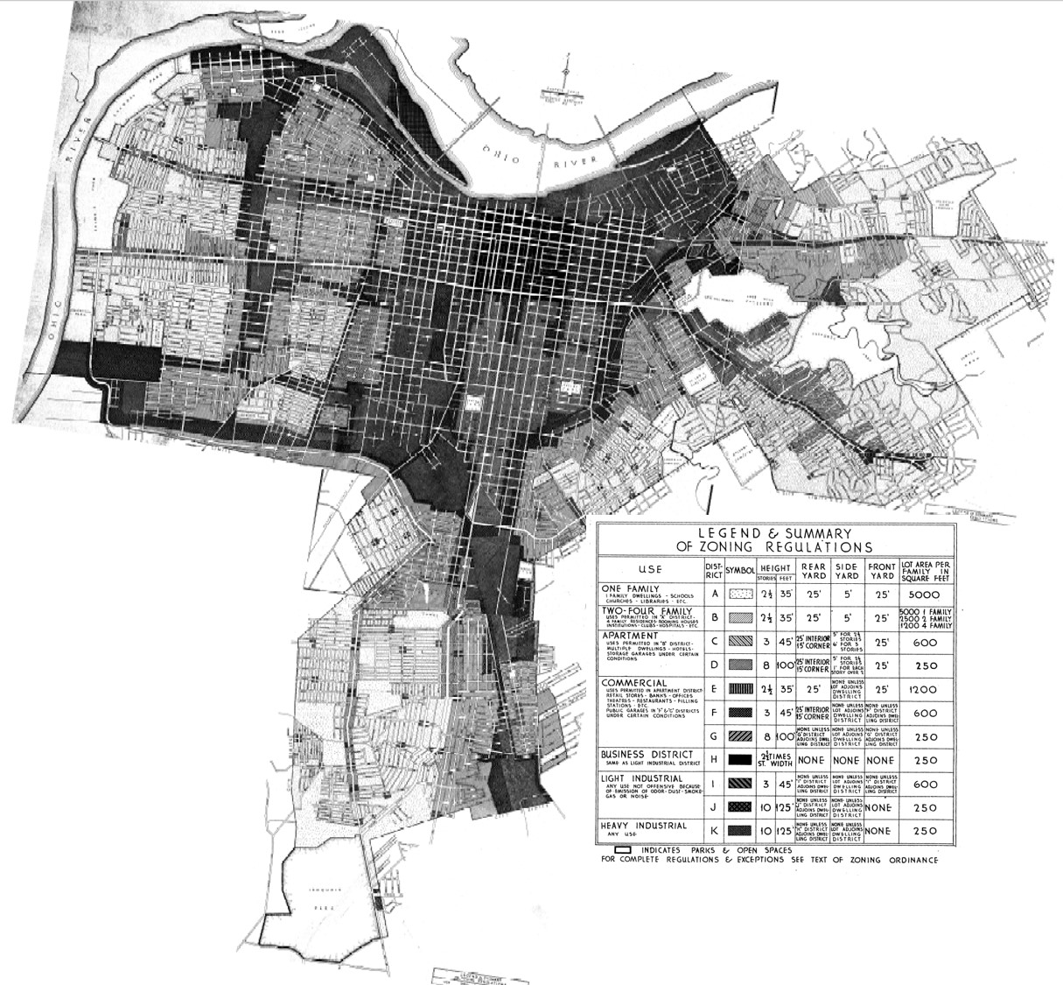
Segregation By Design: Comprehensive Planning in Louisville
1931 Comprehensive Plan & Zoning Ordinance
As apartment living increased nationally, one of the primary goals of residential zoning was to prevent undue congestion and lack of adequate light and air. This would lead to the promotion, protection, and preservation of predominately white, single-family neighborhoods.
The single-family zoning district would also serve to insulate new school sites proposed to replace those in more industrial areas or in areas where authors of the 1931 Plan noted that "negroes are gradually displacing the white population."

Slide 12
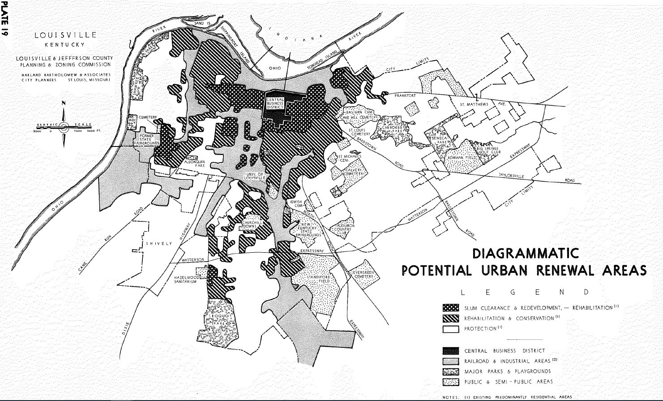
Segregation By Design: Comprehensive Planning in Louisville
1958 Comprehensive Plan
Advised Louisville-Jefferson County to engage in urban renewal programs and take advantage of federal assistance. It promoted the condemnation of land for the resale to a private interest in order to eradicate "blight" from the city.
The plan recommended the use of tightly controlled private land subdivisions, deed restrictions, larger single-family lots, and private open space to create exclusionary single-family neighborhoods

Slide 13
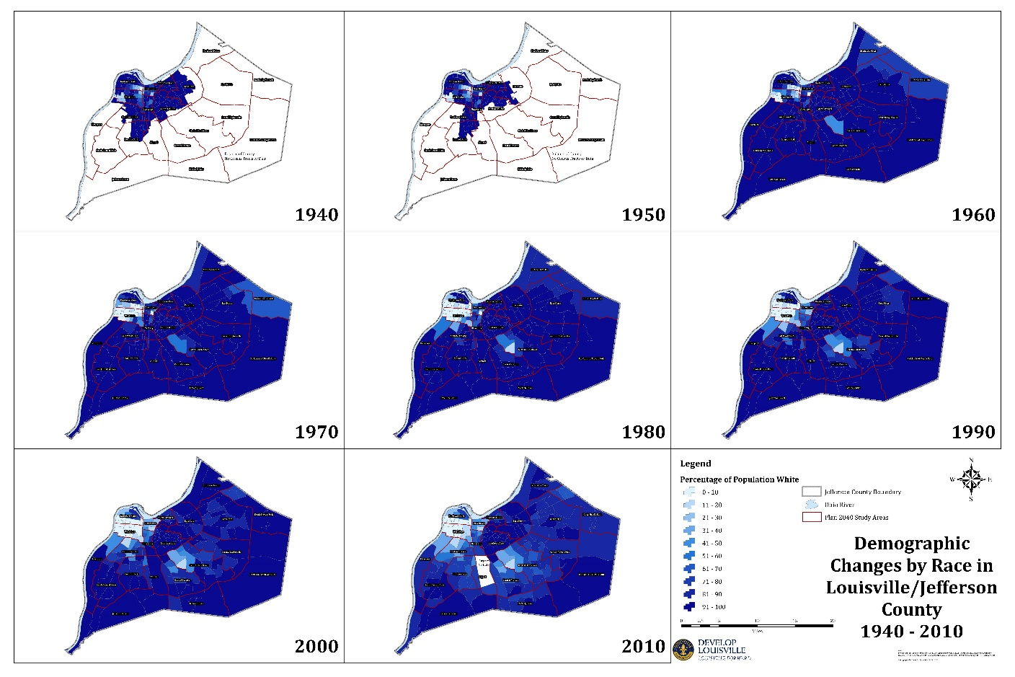
The Problem of Zoning and The Legacy of the Single-family Zoning District
75% single-family zoning
55% reserved for 9,000 sq. ft. minimum lot size
Notes:
Exclusionary zoning in combination with federal housing policies (urban renewal, redlining & FHA), and deed restrictions and racial covenants severely restricted (and continues to restrict) the movement of Black families. Larger lot sizes and homogenous development requirements in single-family districts have remained an effective tool for neighborhood and racial control.
As the white population migrated from the central city to newer development eastward, and attempted to maintain racial exclusivity in neighborhoods like Shawnee,

Slide 14
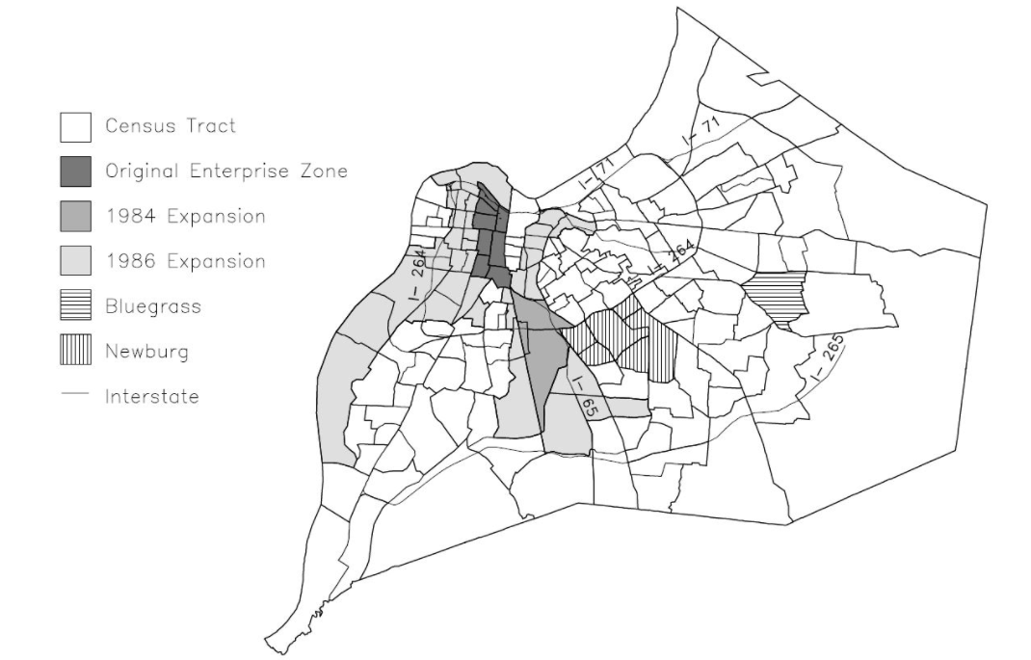
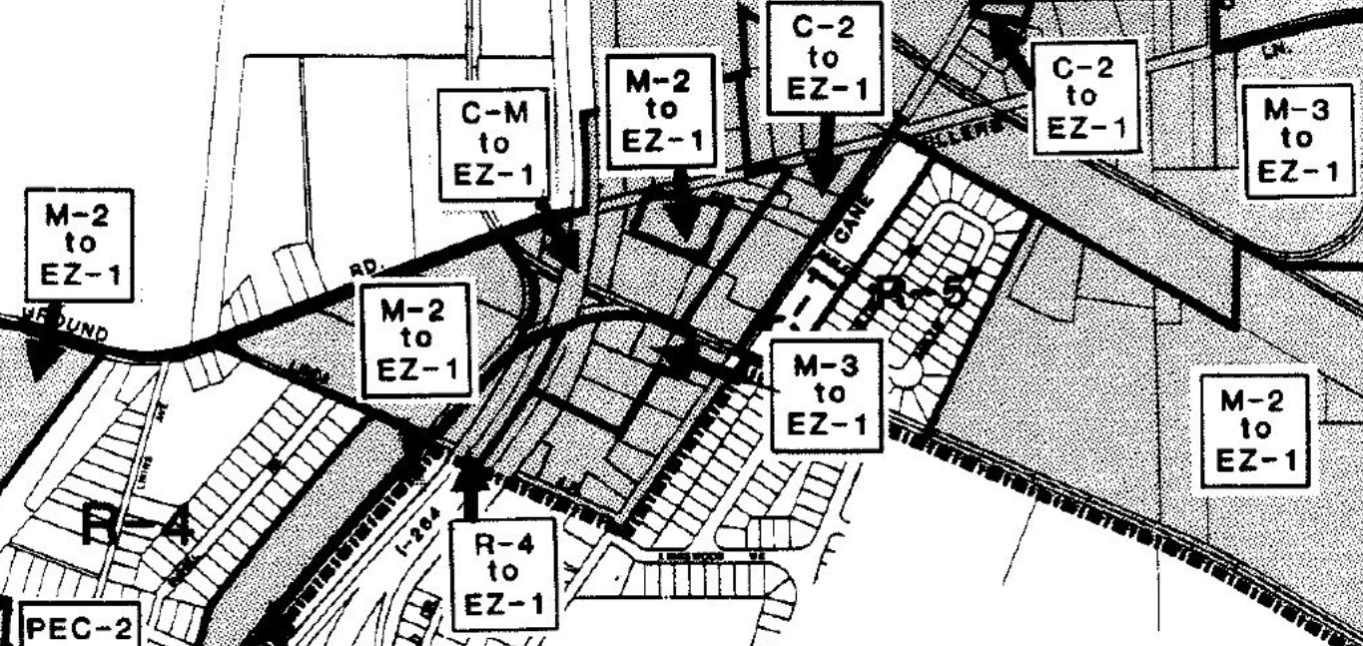
The Problem of Zoning: Enterprise Zone & Enterprise Zoning
An analysis of this program in 2001 by Thomas Lambert and Paul Coomes concluded that the Enterprise Zone provided no positive effect upon the communities it was intended to serve.
The EZ-1 zoning district expanded opportunity for harmful industrial zones to be located within or near neighborhoods occupied by Black populations, and low- to- moderate income households.
The EZ-1 zoning district replaced lower intensity industrial or commercial districts with a hybrid district that permitted higher intensity industrial and noxious uses, as well as residential uses
Notes:
Through careful combination with adjacent socioeconomically disadvantaged census tracts, business owners were able to receive the benefits of the program in areas that were not actually in need.
The expansion of the zone into thriving industrial areas and healthy residential neighborhoods was criticized in legal and political circles as an opportunistic use of the law to provide tax advantages to already prosperous businesses.

Slide 15
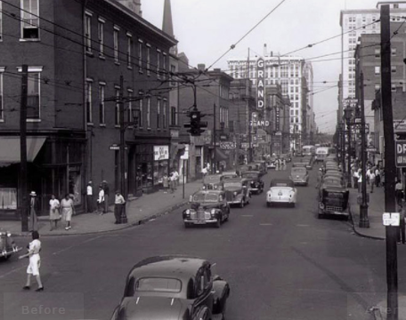
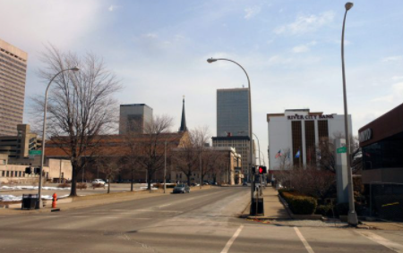
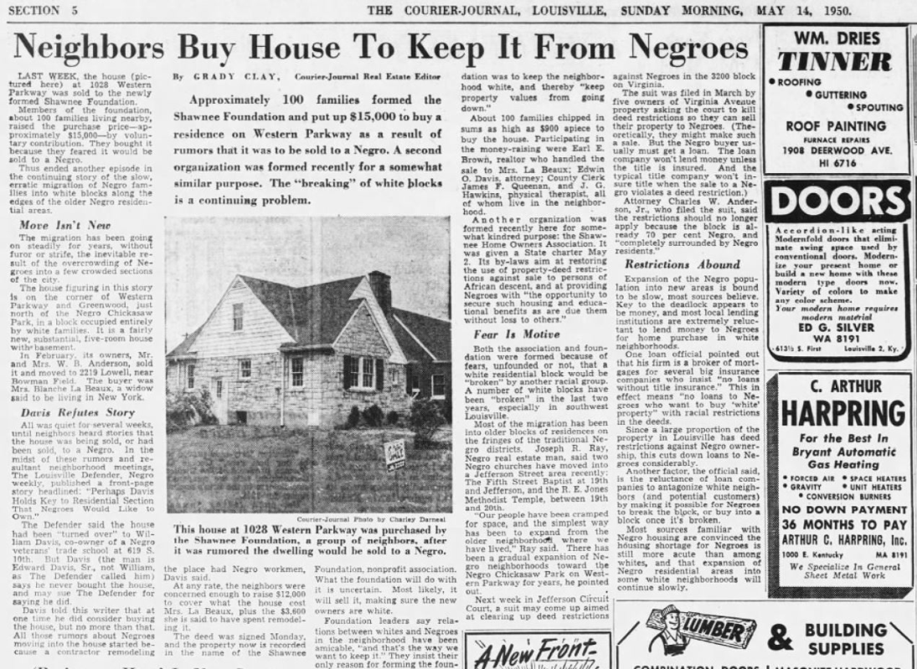
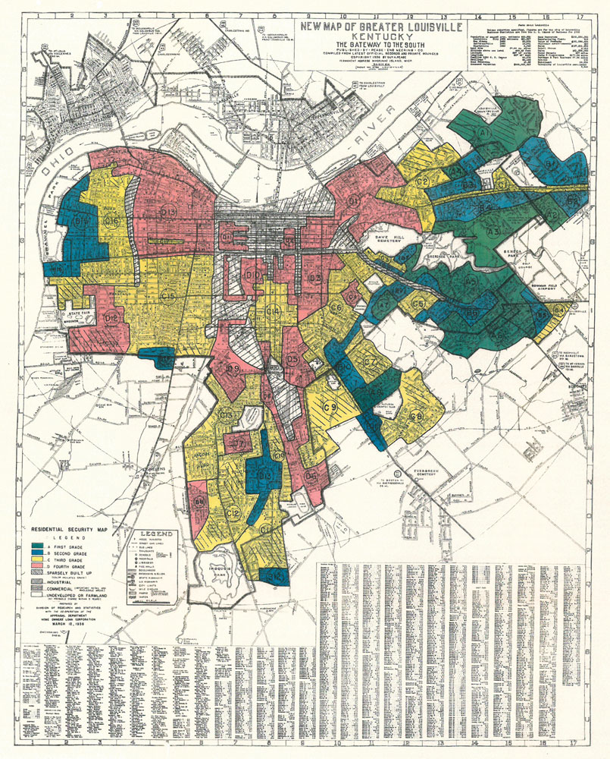
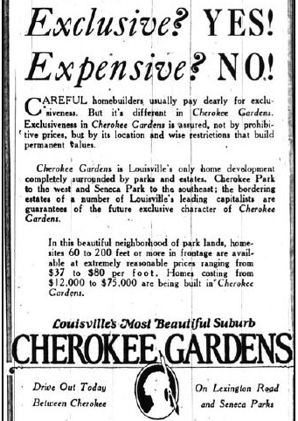
Housing Exclusion
Racial Covenants and Deed Restrictions
Federal Housing Policies
Redlining
Urban Renewal
Notes:
Alternative paths of exclusivity in the form of ‘Covenants, Conditions, & Restrictions’ or 'Deeds of Restriction' enforced by homeowners' associations in single-family residential subdivisions continued this legacy of segregation by limiting the delivery of housing choices and catering to a desired occupant. While the language in current deed restrictions for single-family subdivisions are fairly standard, they can be tailored for the specifically intended community result and include prohibitions on clotheslines, accessory dwellings, above-ground pools, window air conditioning units, playground equipment, the parking of commercial vehicles and basketball goals. Most concerning is the minimum home size restrictions placed on each lot. Regulating the minimum home to be constructed artificially inflates the cost of vacant land. These types of restrictions further exacerbate inequity through socioeconomic barriers, which disproportionately harm People of Color and low- to moderate-income families.

Slide 16
Louisville Today
"The pervasiveness of single-family zoning in almost every major American city has created a scarcity of accessible land for affordable housing options, increasing the cost of development particularly in our most densely populated areas.“
-State of Metropolitan Housing Report, 2021
Notes:
Disbanded 1951; rebuked 1968

Slide 17
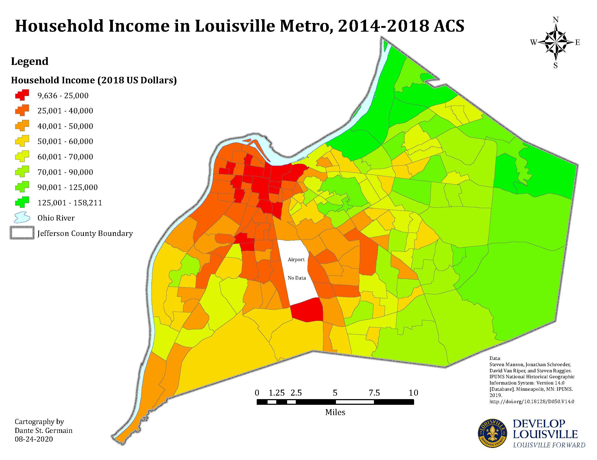
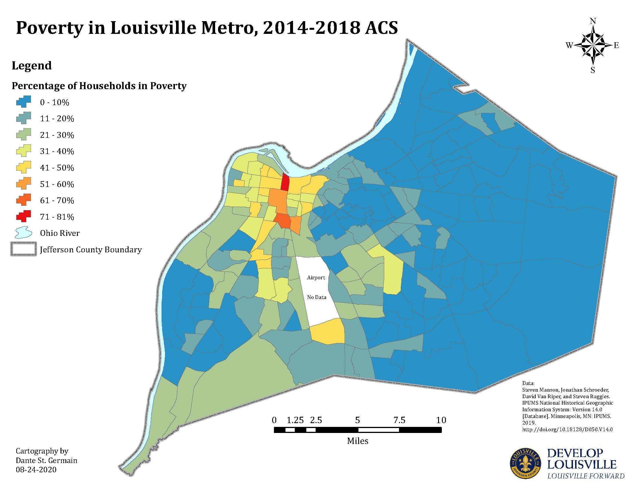
Louisville Today
Notes:
Disbanded 1951; rebuked 1968

Slide 18
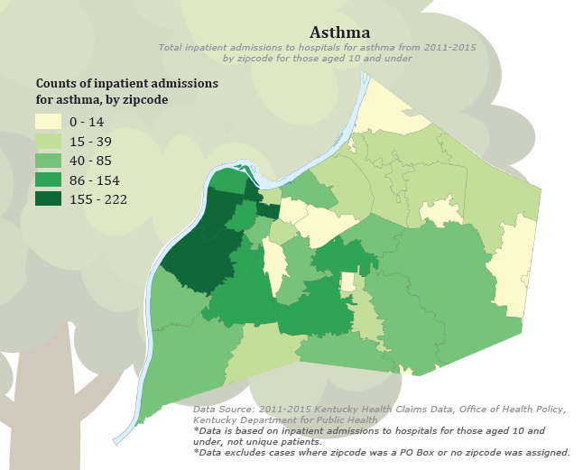
Louisville Today: Health Equity Report 2017
Housing:
Housing quality is one of the most important factors affecting a child’s asthma. Older, overcrowded, and/or poorly maintained housing units can expose children to many different indoor asthma triggers.
Neighborhood Development:
Physical and social conditions of neighborhoods can both increase the risk of developing asthma and worsen symptoms for those already diagnosed.
Environmental Quality:
Children who live in poverty are more likely to live near industries that emit toxins into the environment.
Notes:
Disbanded 1951; rebuked 1968

Slide 19
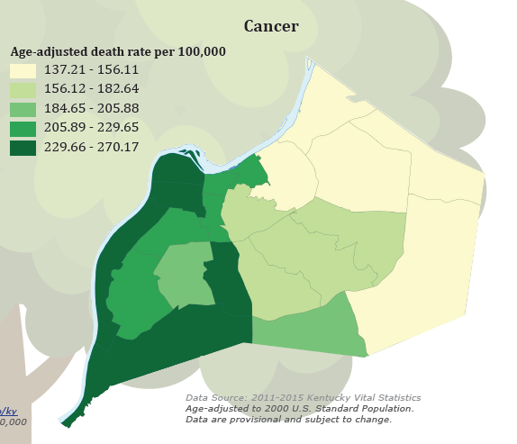
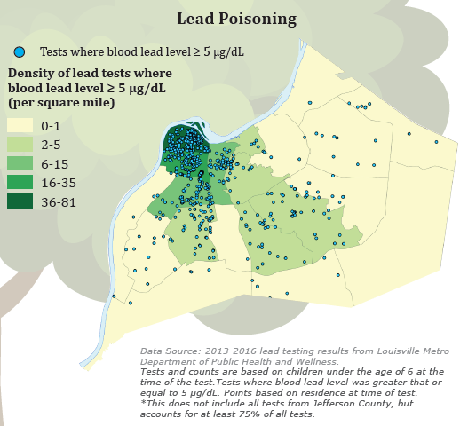
Louisville Today: Health Equity Report 2017
Notes:
Disbanded 1951; rebuked 1968

Slide 20
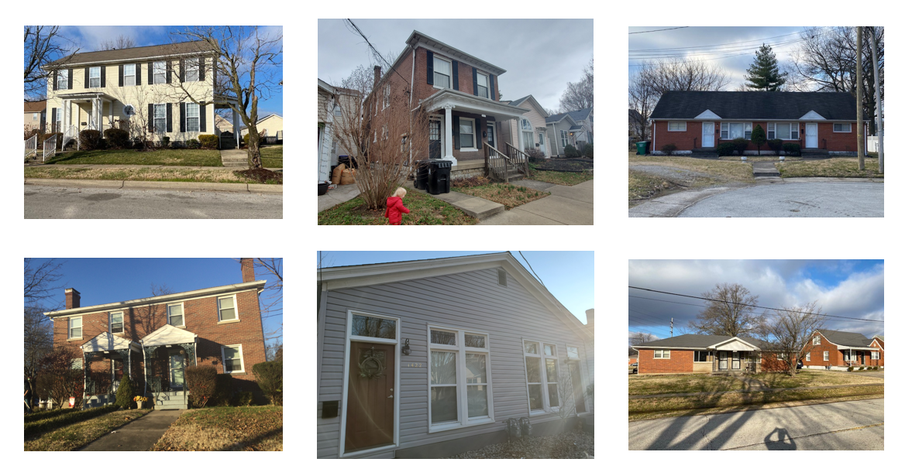
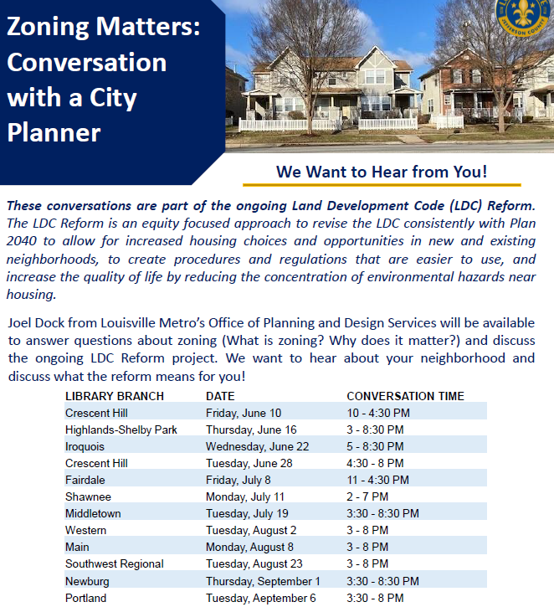
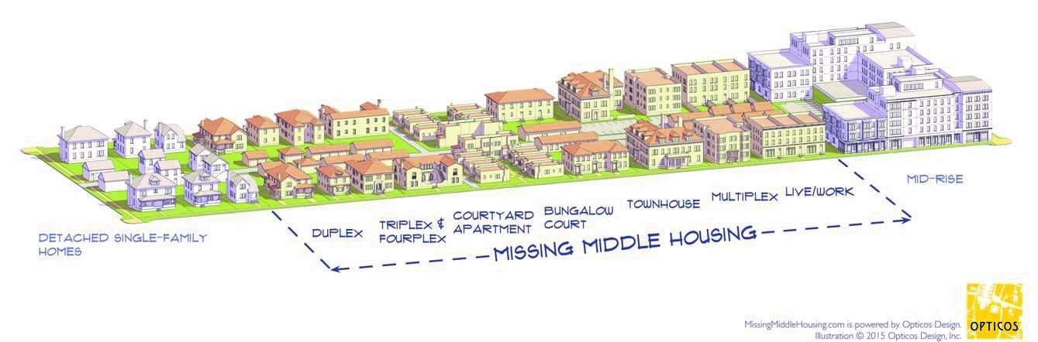
Land Development Code Reform: Where Are We Now?
Notes:
Following all of the research and public engagement conducted by staff, these are the phase I recommendations that are here to be heard today. These recommendations were first introduced to the Planning Commission February 4th of this year. Countless hours of work by the Planning and Design Services team have been put into this reform process. Every person involved has been volunteering their time in addition to their regular day jobs and have been driven by their passion to make Louisville a better, equitable city.

Slide 21
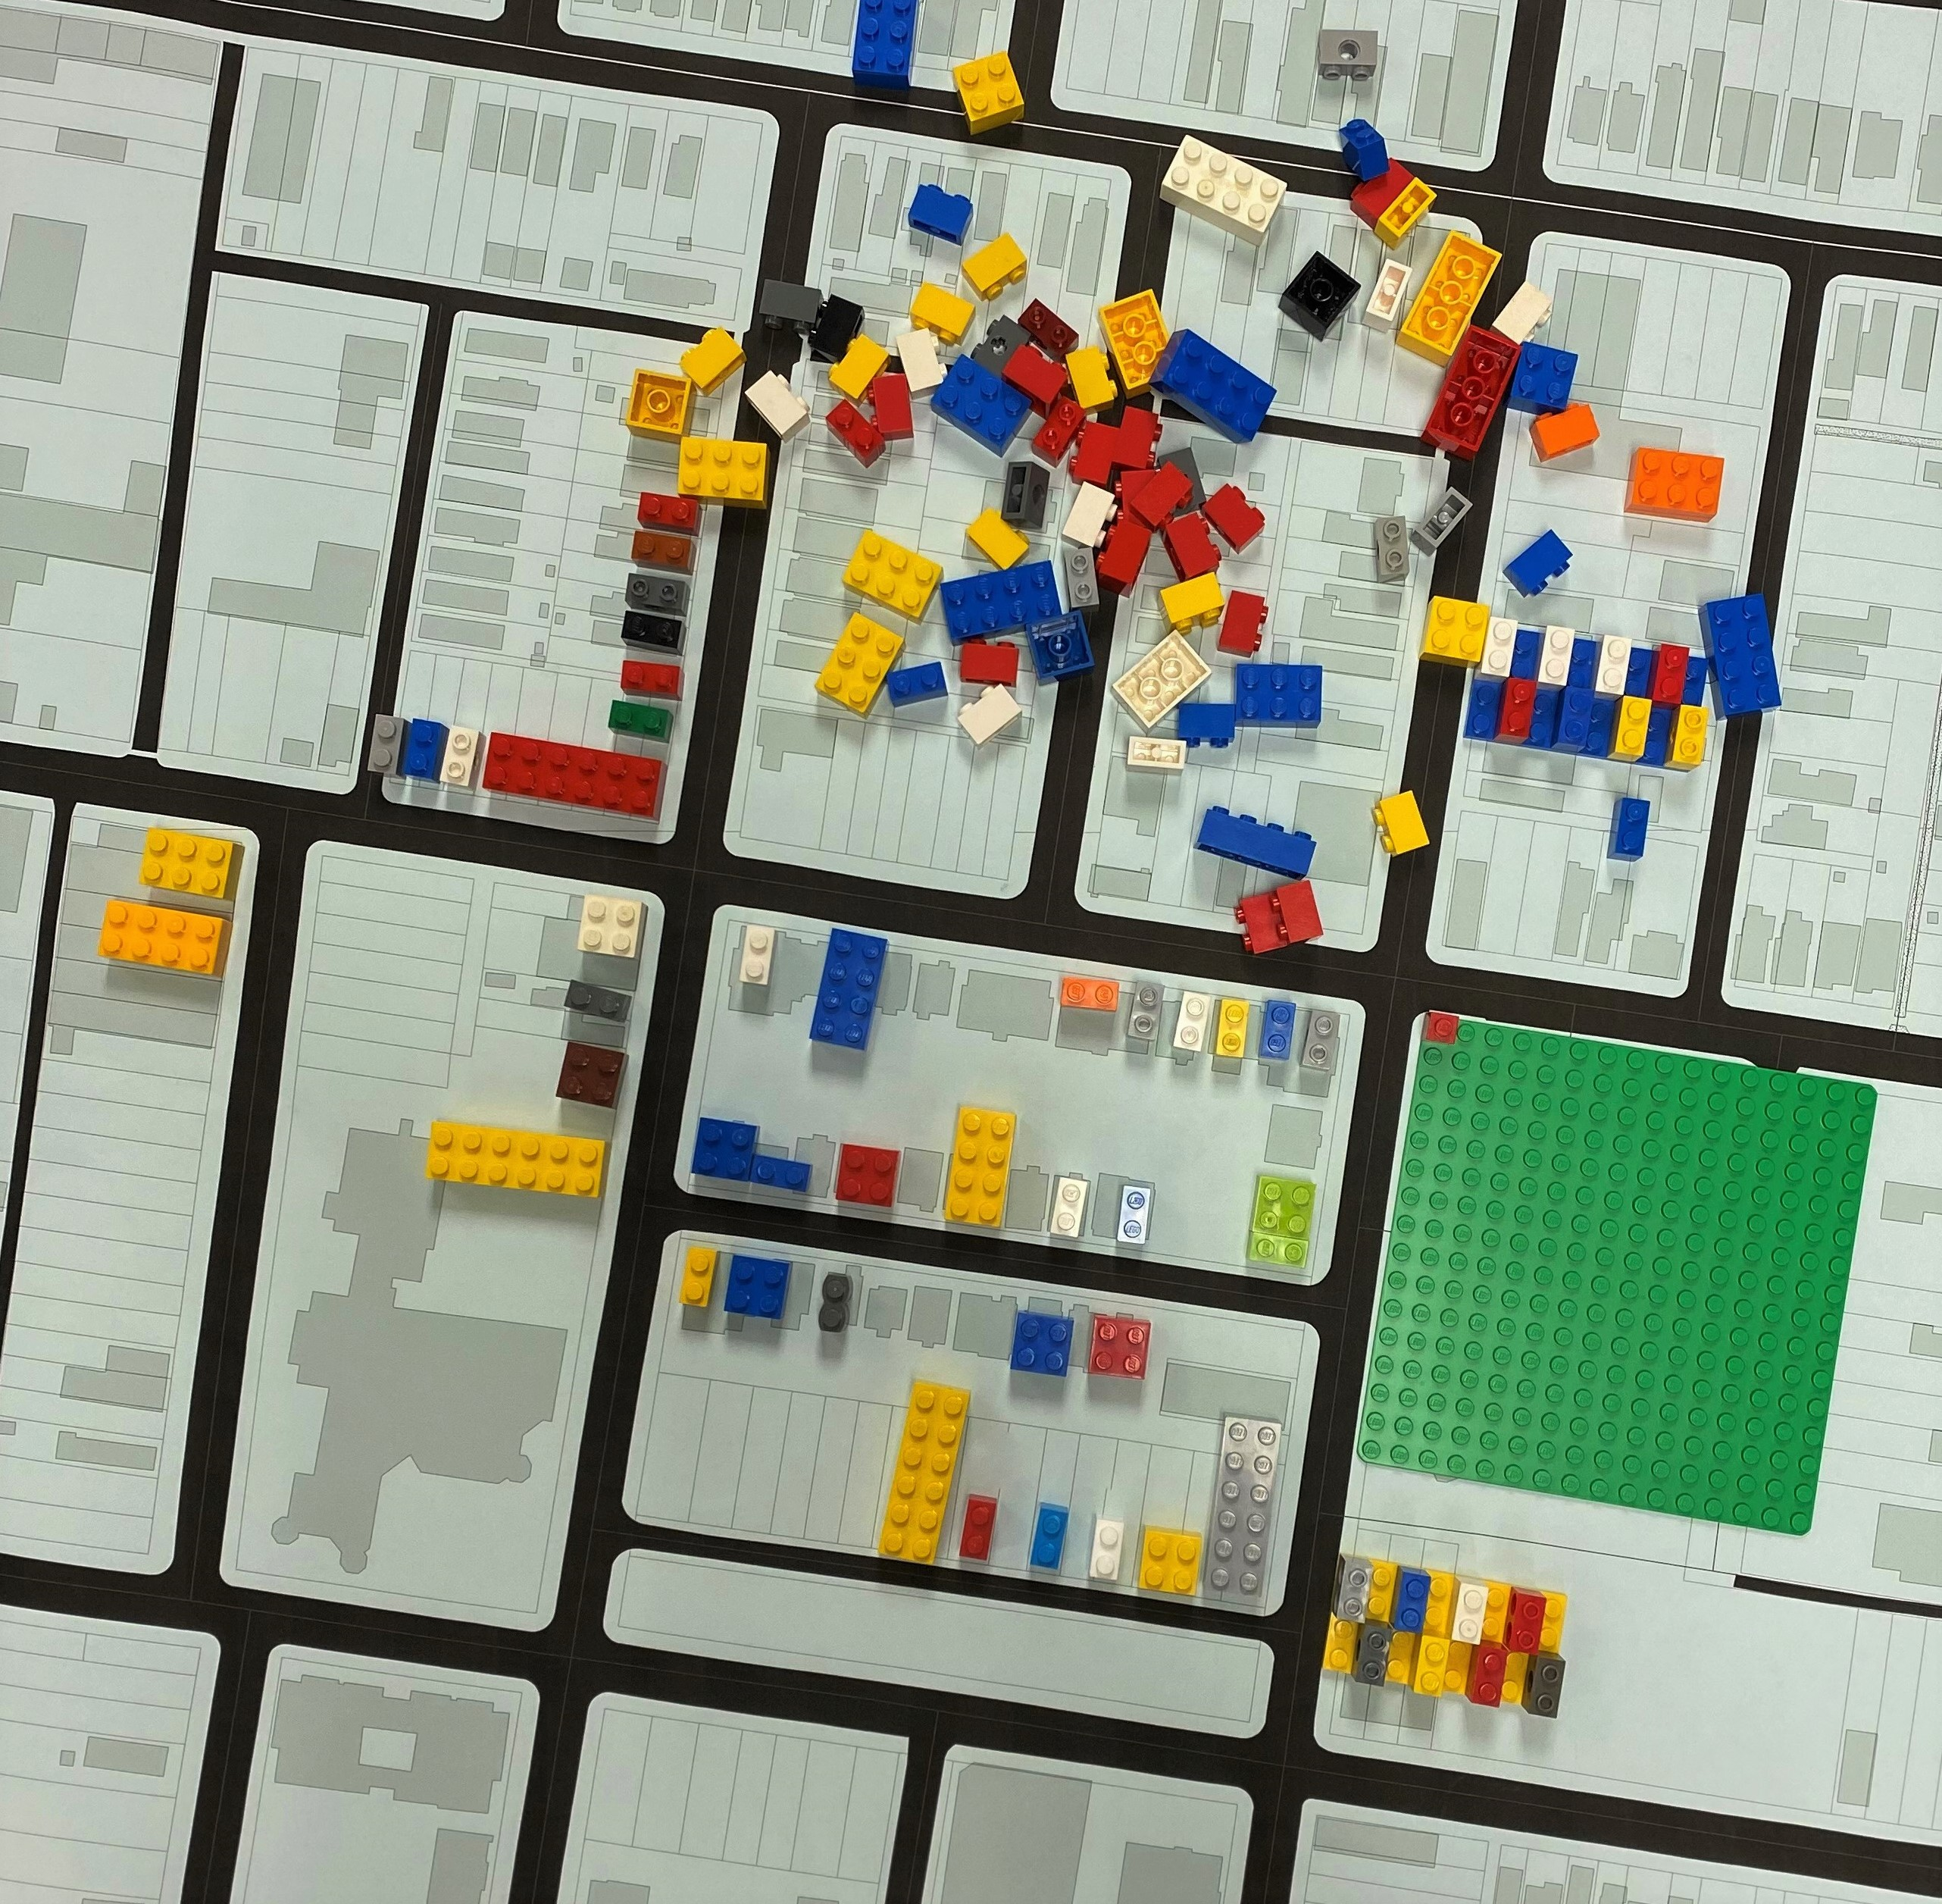
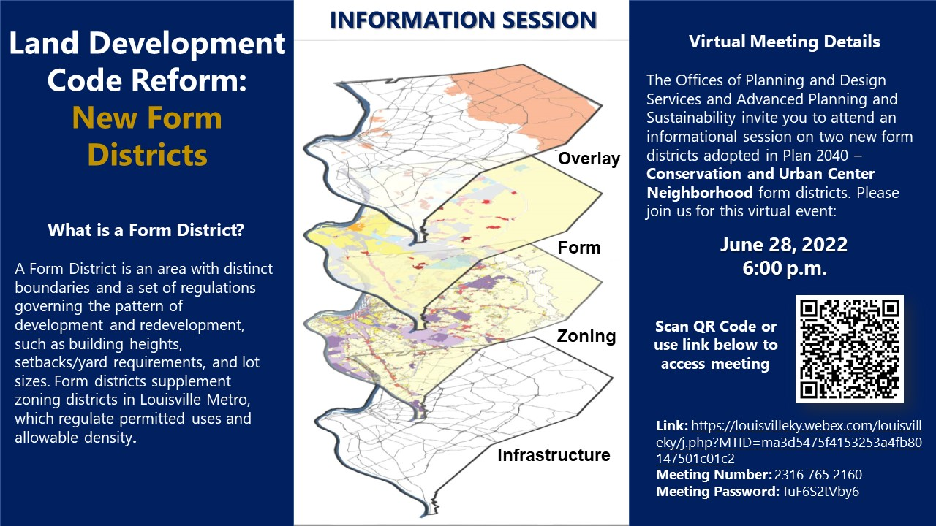
Land Development Code Reform: Where Are We Now?
Notes:
Following all of the research and public engagement conducted by staff, these are the phase I recommendations that are here to be heard today. These recommendations were first introduced to the Planning Commission February 4th of this year. Countless hours of work by the Planning and Design Services team have been put into this reform process. Every person involved has been volunteering their time in addition to their regular day jobs and have been driven by their passion to make Louisville a better, equitable city.

Slide 22
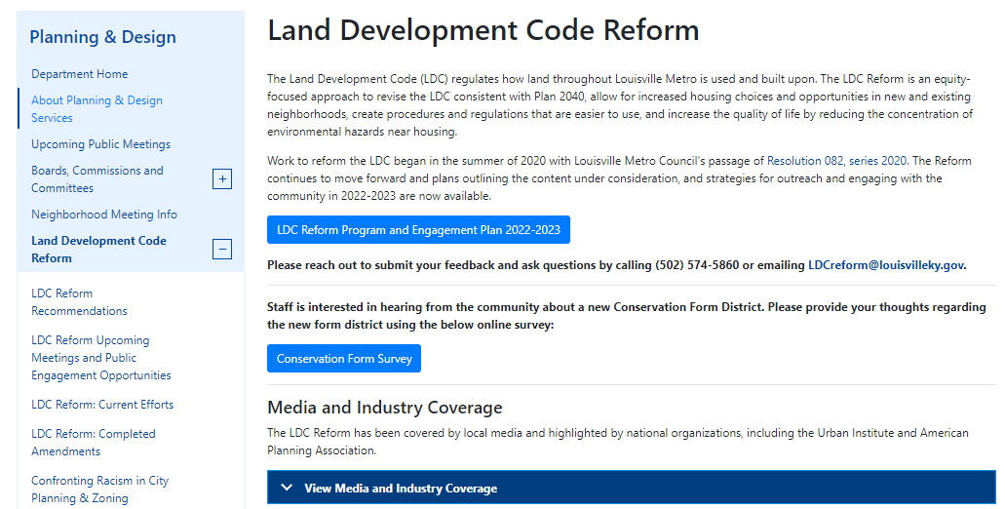
Check out the LDC Reform online:
https://louisvilleky.gov/ldcreform

Slide 23
Thank You!
Joel Dock
Louisville Metro Planning and Design Services
Joel.dock@louisvilleky.gov
502-574-5860

