Slide 1
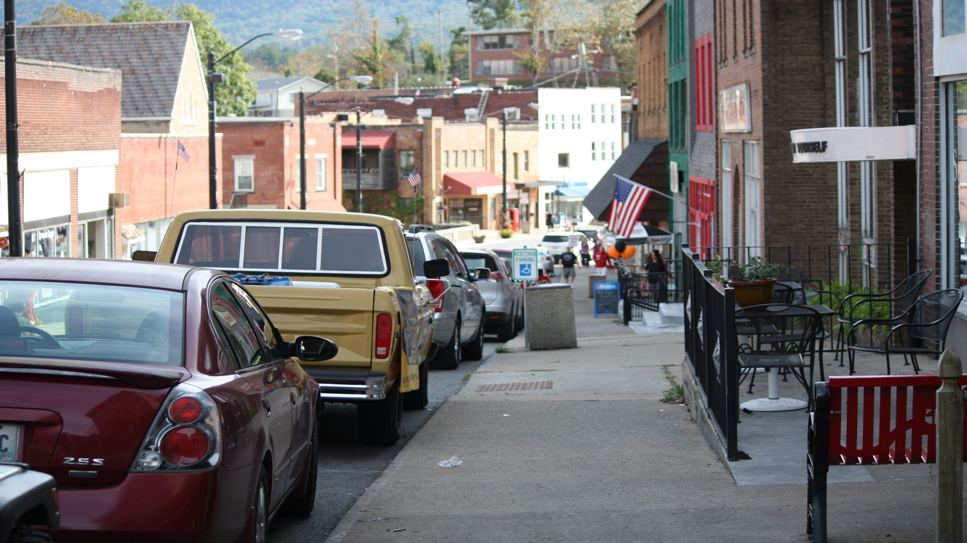

How can we Collaborate to Create Solutions to Climate Inequities:
Community Collaborations for Change
Daniel Kahl, PhD.
Associate Director, CEDIK,
Community and Leadership Development Department
University of Kentucky
Notes:
This is Whitesburg, Kentucky.

Slide 2

Community Change Involves Meaningful Action
Change in community can happen through natural events, serendipity, or planned action.
Planned actions can be the result of formal authority or voluntary initiatives
Voluntary initiatives can be started by any individual or organization

Slide 3
Conventional Wisdom
“Never doubt that a small group of thoughtful, committed citizens can change the world; indeed, it's the only thing that ever has.”
- Margaret Mead
“Being a part of community means that you feel you belong.
Belonging means you know how you fit into the structure of community.
We can provide structure…”
- Paraphrased from Mary Emery

Slide 4
Spectrum of Community Linkages by organization and function
Networks
Cooperation or alliance
Coordination or Partnership
Coalition
Collaboration
National Network for Collaboration (ND) Collaboration Framework for Addressing Community Capacity
https://web-gw1.uvm.edu/sites/default/files/media/Collaboration_Framework_pub.pdf

Slide 5
Spectrum of Community Linkages by organization and function
Networks (Loose structure of independent organizations connecting primarily for communication dissemination)
Cooperation or alliance (Independent organizations establish a Central hub of communication, to avoid duplication and match needs)
Coordination or Partnership (Clear center of action/ autonomous leadership working together on specific issue/ defined roles/ formalized links/ Sharing of resources)
Coalition (shared leadership/all members involved in decision making/ shared resources/longer term commitment)
Collaboration (Formal roles, formal assignments and shared evaluation to pursue common vision and goals.)
National Network for Collaboration. Collaboration Framework for Addressing Community Capacity
https://web-gw1.uvm.edu/sites/default/files/media/Collaboration_Framework_pub.pdf

Slide 6
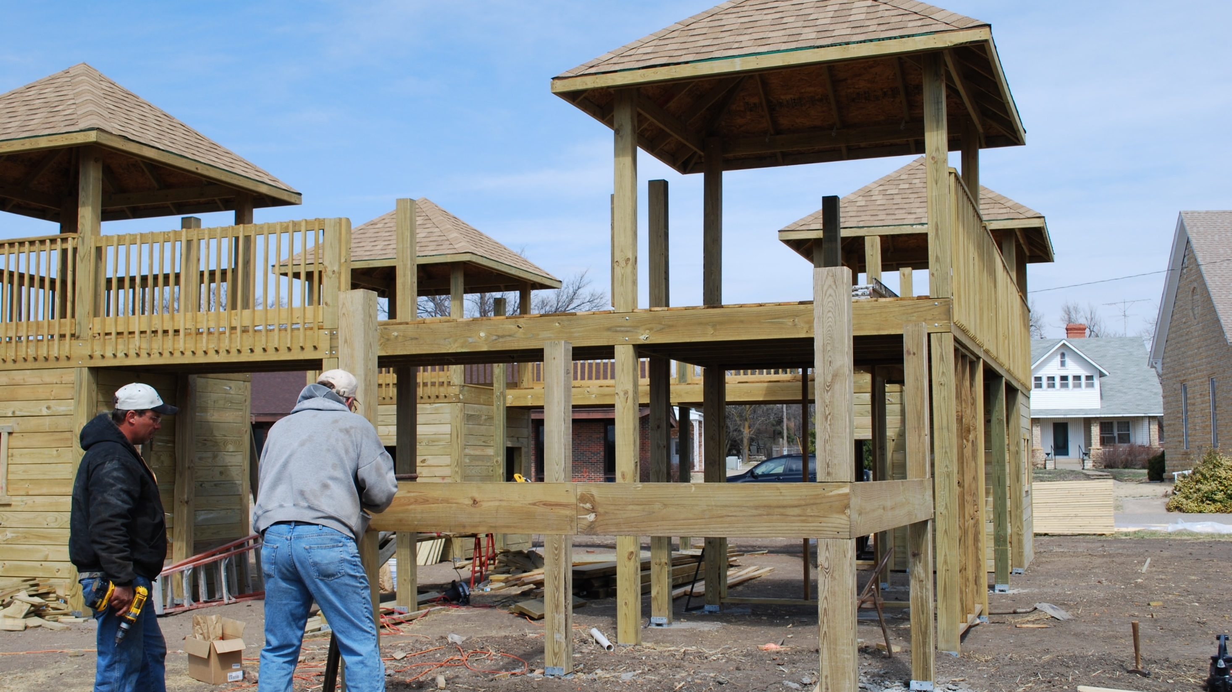
There is No one correct way
Coalitions that had success attended to:
Purpose - Having a clear agreed upon common purpose
Structure - Organized in ways that compliment existing power structure and support shared success and access to resources
Processes - Connect across community institutions/ organizations
- Focus on inclusion and broad engagement
- Engage in public education campaigns using both targeted audience messaging, and broad public awareness campaigns.

Slide 7
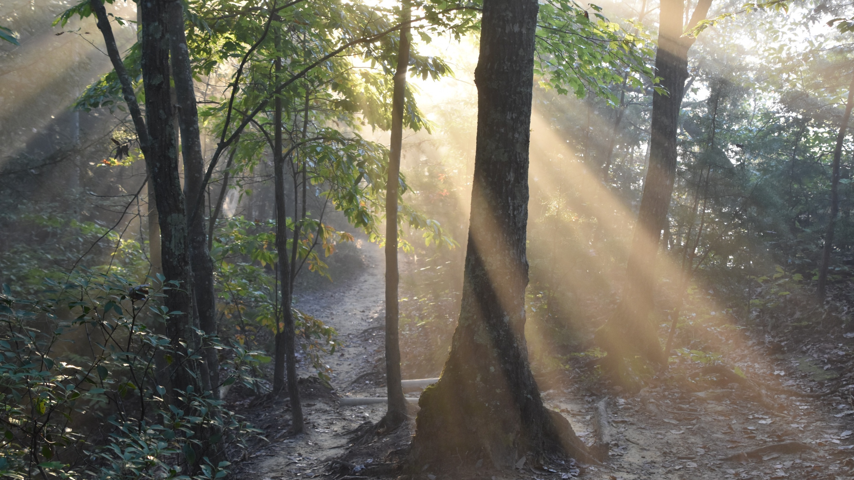
Examples of Local Action – Cooperative Extension
Campbell County Extension Environmental Stewardship Grants (ESG) to implement projects that improve the environment and increase community engagement.
Between 2017 and 2021, ESG supported 50 projects/$50,000 in environmental improvements
[tree planting, recycling, composting, pollinator gardens, and the development of multiple environmental education areas at local schools]
Local Citizen groups like ReNewport and the Westside Citizens Coalition (Newport, KY) have planted more than 500 trees to improve air quality, decrease stormwater runoff, and reduce urban heat island effect.
This example from Campbell County represents several ways that Extension promotes and facilitates community capacity building while creating meaningful environmental change.
Developing an on-going dedicated funding mechanism makes resources available.
Extension integrates leadership skill development for leading community change and working with others.
The projects provide continuous “quick wins” and visible outcomes to support public momentum.
The project provides recognition of successful environmental change to empower and sustain leaders.

Slide 8
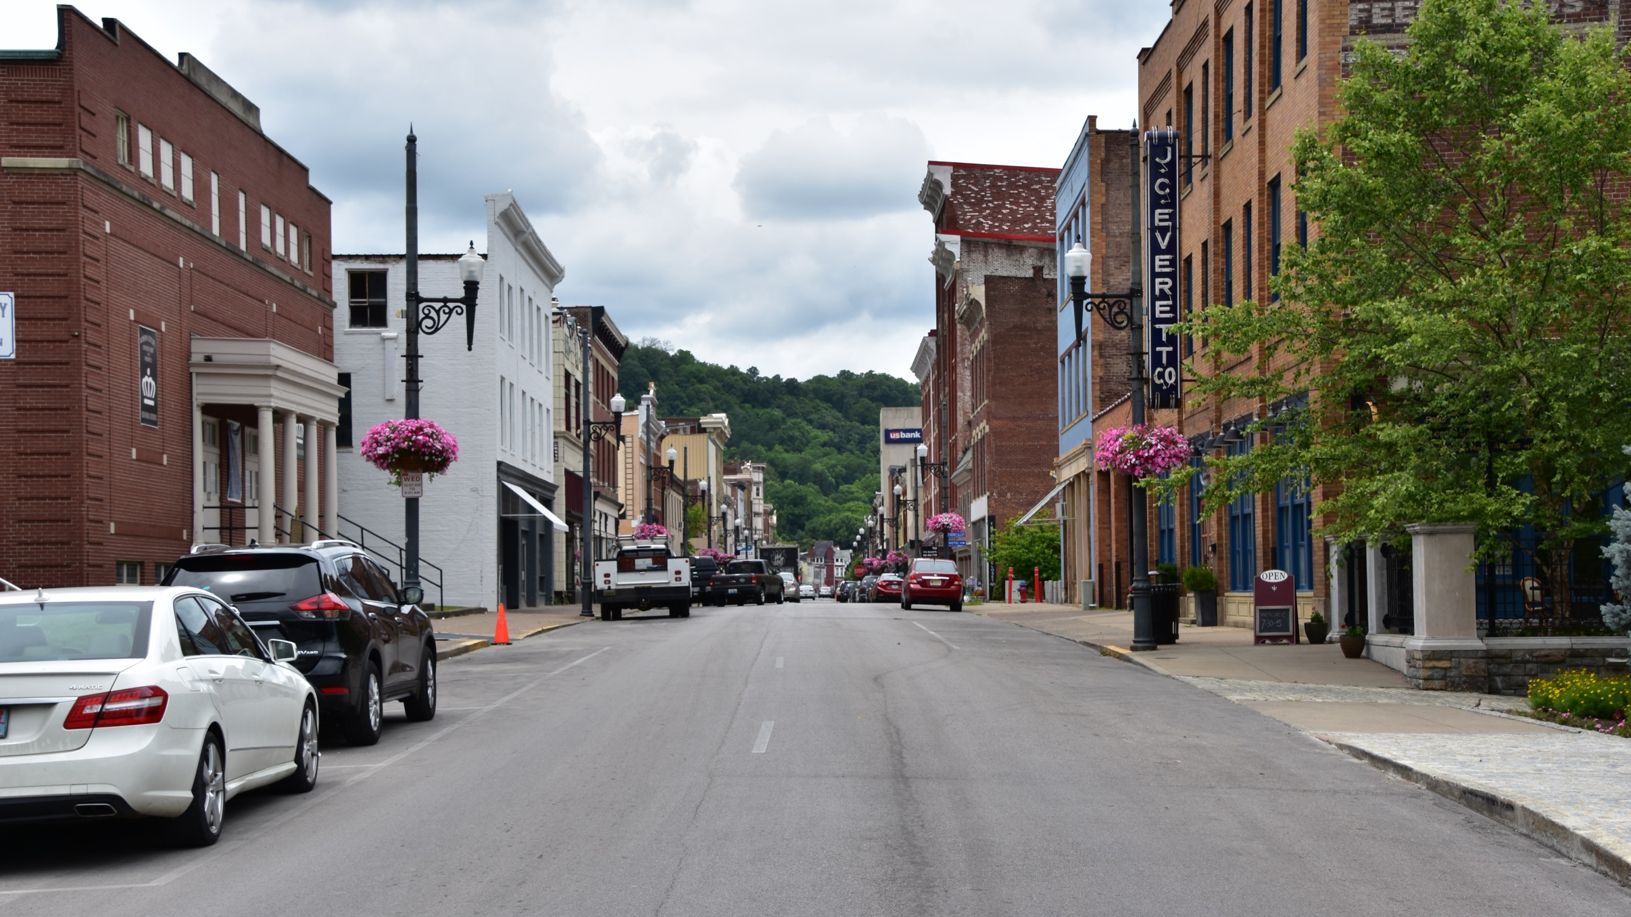
Examples of Local Action – Cooperative Extension
Meade County Extension Service and Meade County Area Chamber of Commerce partner to support a leadership development program that includes an applied community project.
One Example: When the need for improved signage was raised through an external community assessment report, a leadership class team designed directional signs to the downtown area. Going a step farther – they analyzed the Brandenburg signage ordinances. The team proposed recommendations to the mayor and city council suggesting uniformity for billboards and signage throughout the city. Several of the recommendations were adopted. The actions improved wayfinding and reduced the number and size of billboards in Brandenburg.

Slide 9
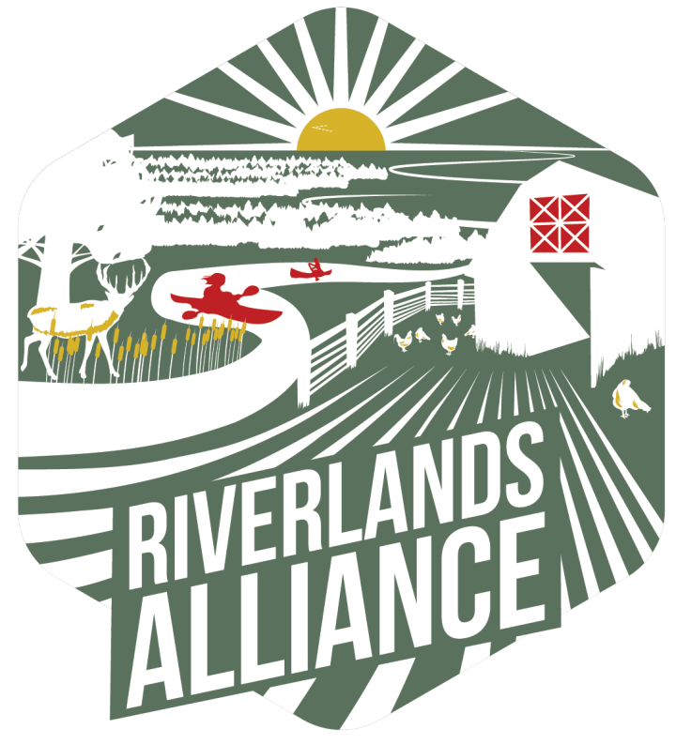
Examples of Local Action - Engaging Change through Regional Alliances
Mission
To collaboratively sustain regional capacity for natural resource stewardship and use to ensure a continued high quality of life for our Riverlands region.
Vision
The Riverlands region of western Kentucky and Tennessee will remain a top outdoor recreation destination in America, with working lands and communities flourishing with fish, wildlife, and natural resources supported by healthy forests, grasslands, wetlands, and rivers. The region will thrive economically through an emphasis on outdoor recreation, sustainable resource use, and a high quality of life, while promoting the heritage and proud sense of place important to residents and visitors to the area.
Riverlands Alliance https://riverlandsalliance.com/

Slide 10
Typical Processes for Getting Started
Assess who is impacted by the issue and how. Invite them to the solution finding process.
Identify Partners –individuals/organizations/institutions/networks invested in the topic.
Develop a shared purpose for all collaborators
Create a sense of importance in the effort.. Purpose, value, and the need for action.
Devise structure that allows shared investment to detail how each partner contributes and the roles of each.
Generate short term success- to bring credit to the organization and build momentum.
Codify renewable engagement opportunities and shared measurement (make it repeatable – not a one off)
Build and maintain momentum through high visibility actions and credit your partners
Monitor and track changes for desired change.

Slide 11
A Model for Driving Community Change; borrowing from John Kotter, Collective Impact, and Community and Organizational Change Concepts
Assess Status
Of the issue
Build
Continuous Communication
Continuous recognition of partners
Identify
Momentum through Recognition
Other partners for A Strong Guiding Coalition
Codify
Project or Initiative
Develop
Renewable engagement & measurement
A shared Vision and
Common agenda
Create
Generate
A sense of Urgency or importance
Short-Term Wins
Devise
Roles and structure for partner interaction
Continuous Reflection and adjustment
Monitor for desired change
Notes:
If you are seriously looking at this circle, you are trying to orchestrate change.
Creating a sense of urgency is the work of an Agitator
Building a coalition is the work of an innovator
If you provide technical assistance, when can you offer the most service?
If you provide group building capacity development – where does that best fit in?
Agitation?
Marshal County invites Erin Brockovich in…

Slide 12
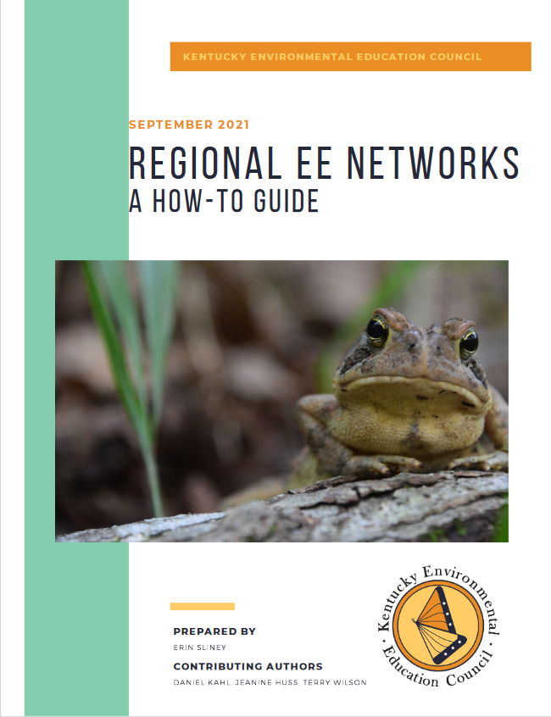
Resources for organizing
Community Leadership Development Resources http://cedik.ca.uky.edu/cld-resources
  - Facilitating community assessment,
  Mapping Local Networks
  Convenors Guide to Hosting a Public Forum
Regional Environmental Education Networks https://cld.ca.uky.edu/files/regional_ee_networks_a_how-to_guide.pdf
Improving partnerships in rural communities: Organizing approaches for improved effectiveness and reach of rural nutrition programs (2022). Local Development & Society, 3:2, 204-221, DOI: 10.1080/26883597.2021.1942166

Slide 13
Resources for Assessing Community Climate Risks
Headwaterseconomics https://headwaterseconomics.org/equity/rural-capacity-map/
Census.Gov – Identifies at risk communities https://www.census.gov/library/stories/2020/06/how-resilient-are-communities-to-disasters.html
NOAA – Community Climate Resilience https://www.noaa.gov/office-education/elp/climate-resilience-in-your-community-activity-book
Community resources through NECI : https://nationalextensionclimateinitiative.net/

Slide 14
Closing thoughts on the Sustainability of Community Change
We often frame sustainability in light of renewable resources. But sustainability of change requires continuous energy investment.
When purposeful actions to shape the present and future community end, the sustainability of the action is handed over to entropy.
Sustained change is the result of ongoing investment in change.
What will you do to sustain the change?

Slide 15
How can we Collaborate to Create Solutions to Climate Inequities:
Community Collaborations for Change
Daniel Kahl, PhD.
Daniel.kahl@uky.edu
Notes:
This is Whitesburg, Kentucky.

