Slide 1





Prioritizing and Engaging for Equitable Access to Parks

Slide 2
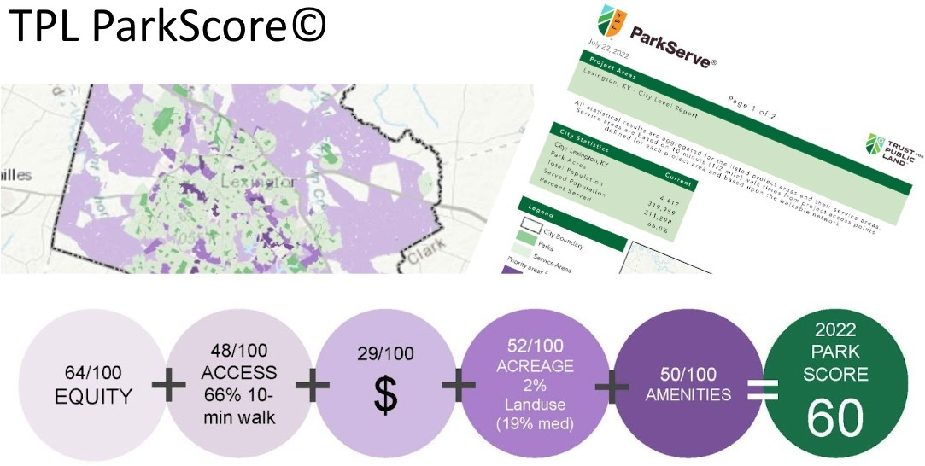

Background

Slide 3
Background
The Trust for Public Land “The Trust for Public Land creates parks and protects land for people, ensuring healthy, livable communities for generations to come.”
10-Minute Walk Park Equity Accelerator Lexington 1 of 6 cities chosen to participate in 12-18 month inaugural pilot

Slide 4
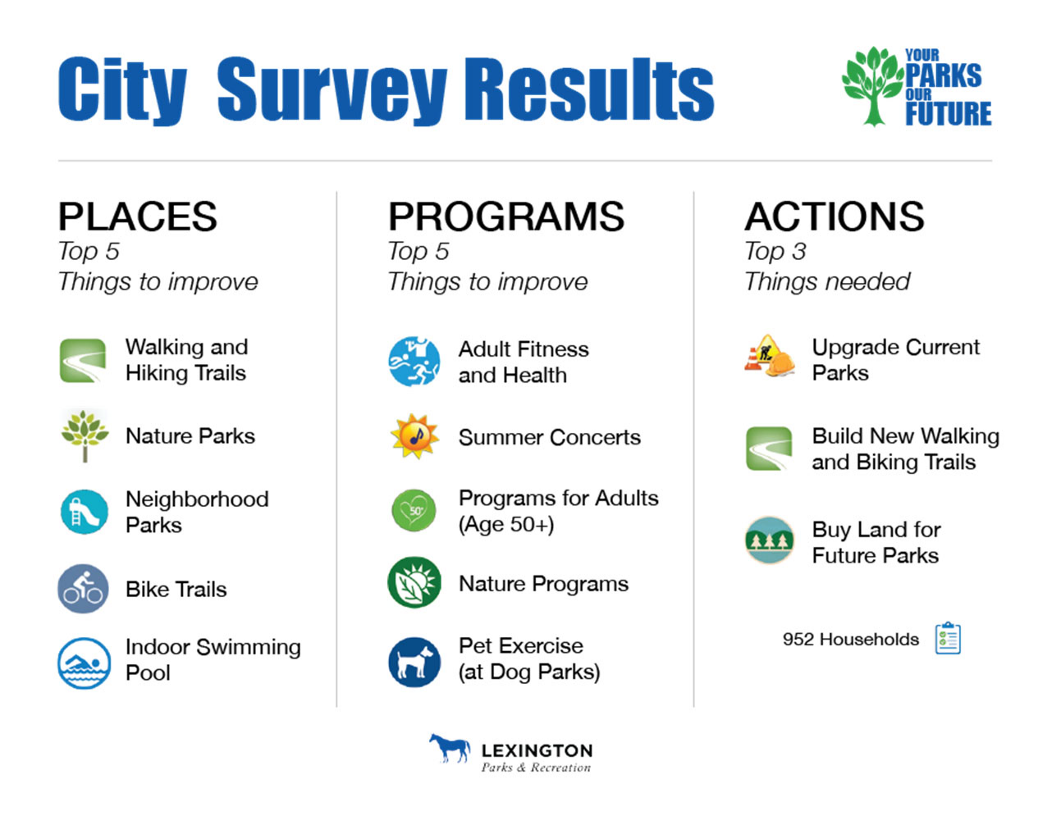
Background
“We want a city full of people- friendly, community- building parks
…. safe places for children to play and adults to
gather and exercise”
“Incorporate adequate greenspace
and open space into all development projects, which
serve the needs of the intended population.”
“Require sidewalks and green space in
every neighborhood.”

Slide 5

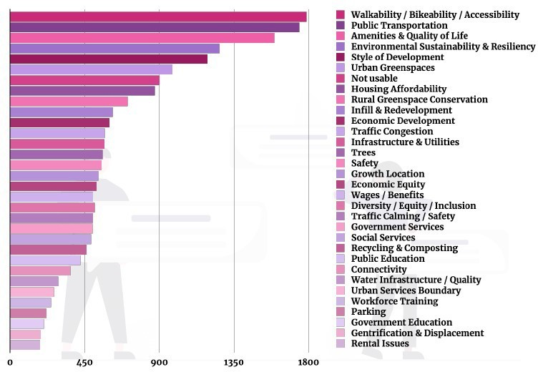
Background
#4 Environmental Sustainability & Resiliency

Slide 6
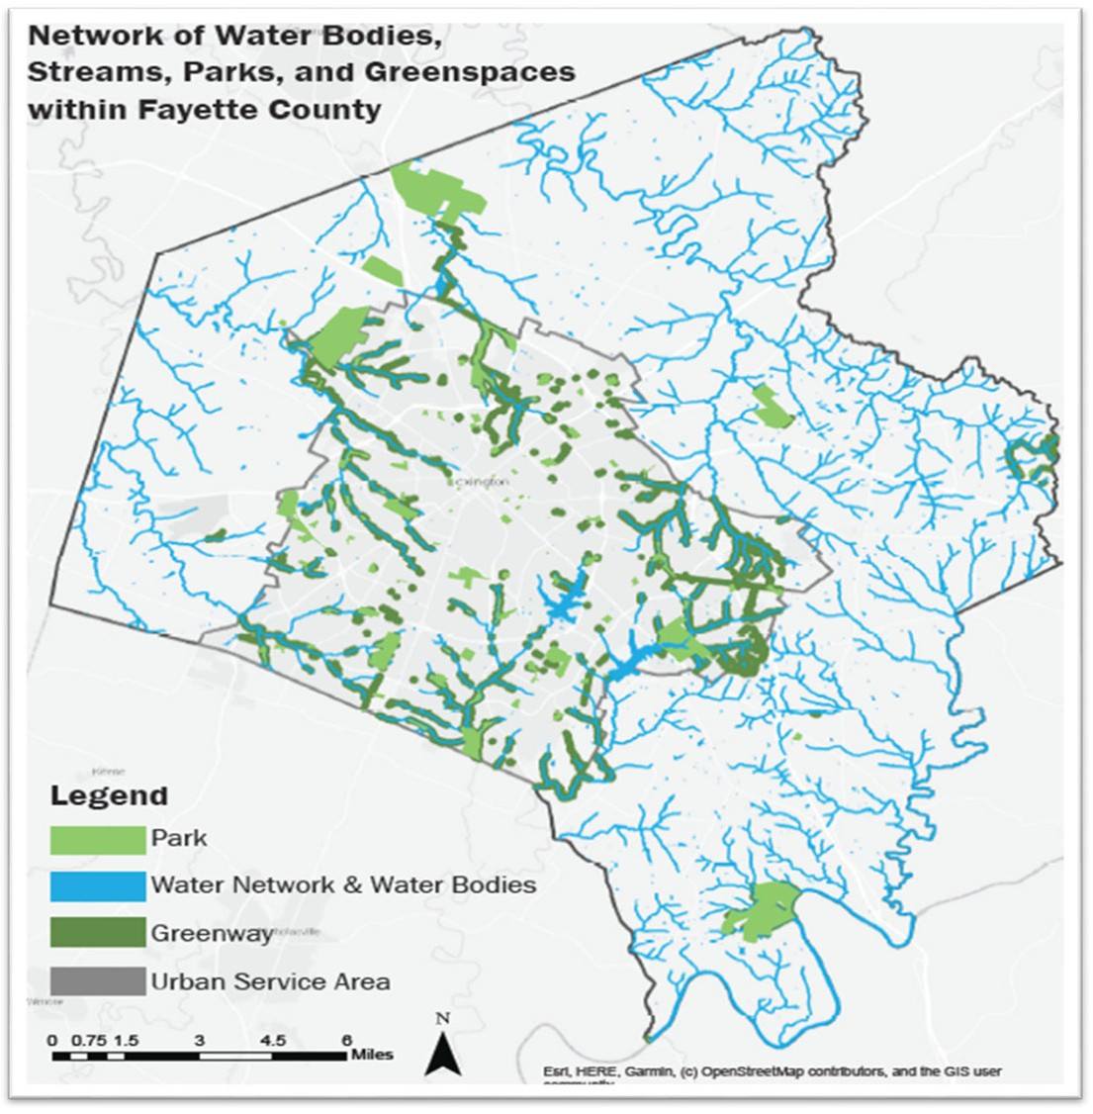
Background
Greenspace equity is not only equitable distribution of resources but equitable access to decision-making.

Slide 7
Background
Challenges to Greenspace Equity
Existing Neighborhoods
Redlining, disinvestment
Distribution of parks and amenities
Green gentrification
New Development
Lack of access to parks and greenspace
Existing Process for Public Input
Confusing, unwelcoming, non-accommodating

Slide 8
Background
Opportunities for Greenspace Equity
Existing Neighborhoods and New Development
Research, understand, acknowledge and address how past and current local policies have led to inequitable community outcomes across urban and
suburban neighborhoods.
Existing Process for Public Input
Connect residents most impacted by park disparity with the information and capacity to envision and advocate for policy change.

Slide 9
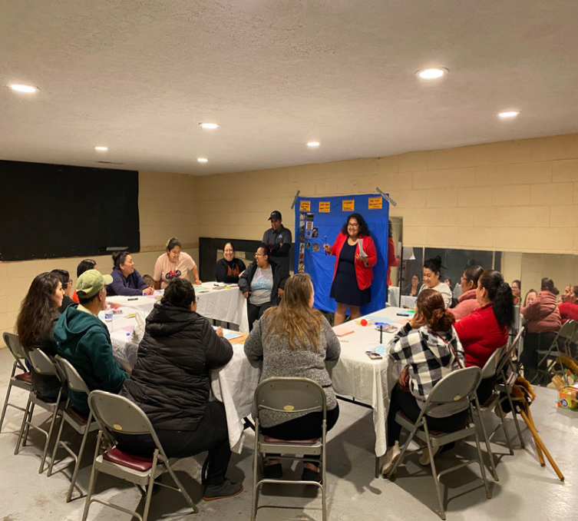
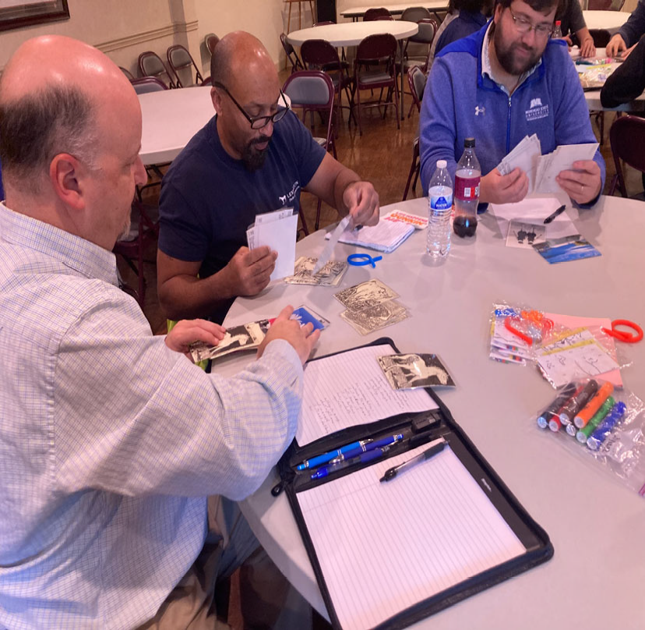
Phase I: Research and Community Coalition- Building
Summer/Fall 2022
CivicLex & Seedleaf
9 Focus Groups
4 Listening Sessions
Conversations about what participants what they thought could be better in access, amenities, and outreach
enjoy and regard to

Slide 10
Participants
Share Center
Woodhill Community Center / International Market Casa de la Cultura
Kentucky Refugee Ministries
LFUCG Greenspace Commission Lexington Health Department
Trees Lexington Fayette Alliance
Urban Forest Initiative Common Good
Tates Creek Presbyterian Church
Carter G. Woodson Academy
West End Community Empowerment Project BUILD/Open Door Church
LFUCG Parks & Recreation Staff

Slide 11
Phase I: Research and Community Coalition-Building
Summer/Fall 2022
LFUCG Division of Planning, Parks and Recreation & the Trust for Public Land
Lexington Updates Open Space Regulations
The new Open Space ZOTA guidelines are designed to: Ensure accessibility and walkability in open spaces
Optimize the quality of green spaces, including people-focused and habitat- focused areas
Incentivize sustainable infrastructure

Slide 12
Phase I: Research and Community Coalition-Building
Summer/Fall 2022
LFUCG Divisions of Planning and Parks & Recreation + the Trust for Public Land
Analysis of parks access points
10-Minute Walk access statistics update
Complete park data layer including privately-owned public park space created
Data dashboard depicting parks and recreation facilities with relative visitation created:
Will be able to use this tool to show underutilized greenspaces, as well as neighborhoods near parks that are not using them
Park Prioritization Analysis

Slide 13
Phase I: Research and Community Coalition-Building
Engagement Mechanisms
Surveys, Focus Groups, Open Houses Boards, Commissions, Meeting Groups
Plans: long term, strategic, developed with public input
Processes: educate, inform, listen on project-by-project basis

Slide 14
Phase II: Education Community Workshops
Winter/Spring 2023
Host community education workshops
Policy process training & input gathering Project marketing campaign

Slide 15
Phase II: Education Community Workshops
Topics
Parks locations
Access points
Neighborhood demographics when built and current History of inequitable practices and zoning
History of Parks investment

Slide 16
Phase II: Education Community Workshops
Format
CivicLex will lead a presentation with this information
Team members from Parks and Planning will talk about what access to parks and engagement with decision making processes look like today
All team members will join a conversation with the audience about how they would like to be included in the decision making process and what kinds of outcomes they would like to see
Audience members will be able to ask the group questions

Slide 17
Next Steps
Phase III: Transformation
Spring/Summer 2023
Launch demonstration projects Deploy new policy processes
Mini grants

Slide 18
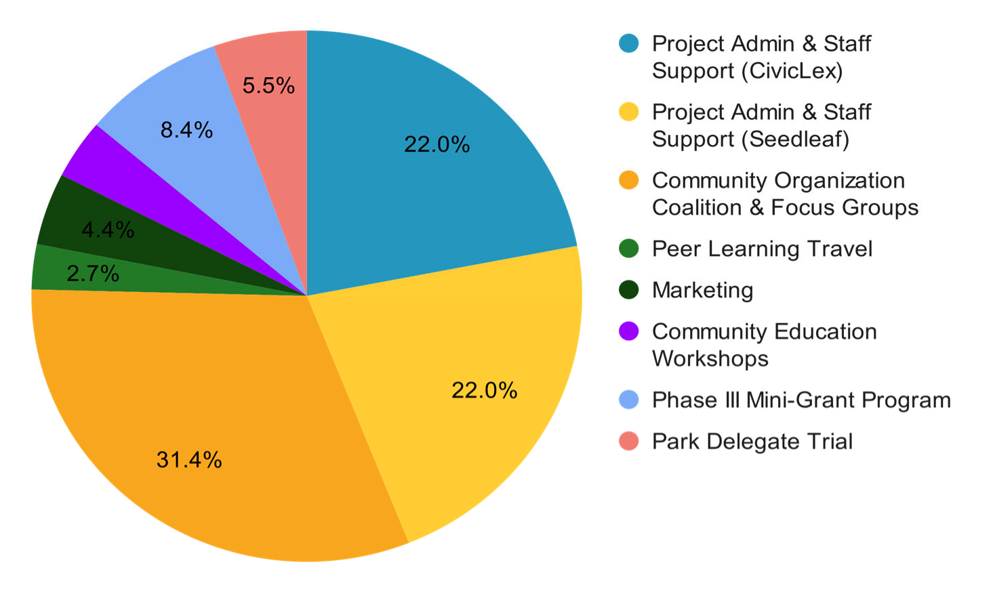
Where is the Money Going?

Slide 19
Resources
Trust for Public Land
www.tpl.org www.tpl.org/10minutewalk
www.tpl.org/national-walk-to-a-park-day
CivicLex
CivicLex
Seedleaf
Seedleaf
Lexington Parks Equity Accelerator
Lexington Park Equity Accelerator — CivicLex
Lexington-Fayette Urban County Government
https://www.lexingtonky.gov/index.php/about-parks-and-recreation-master-plan https://imaginelexington.com
https://www.lexingtonky.gov/boards/commission-racial-justice-and-equality Planning | City of Lexington (lexingtonky.gov)
Parks & Recreation | City of Lexington (lexingtonky.gov)

Slide 20
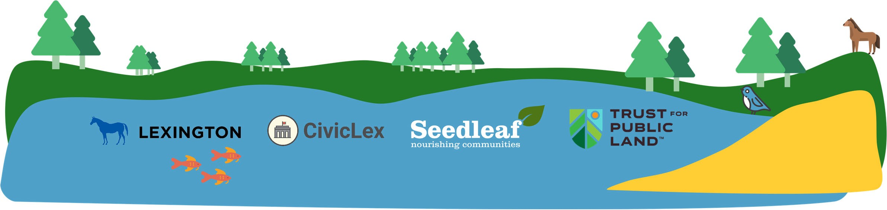
Questions?

