Slide 1

What Air Justice Means to Communities in West and Southwest
Louisville
SHAVONNIE R. CARTHENS, JD
ASST. PROFESSOR OF LAW
University of Louisville,
Brandeis School of Law
DR. MEGAN POOLE
ASST. PROFESSOR OF ENGLISH
University of Louisville

Slide 2
Agenda
Introduction
Students –Coalition Members
Translation
Work
On the Ground Conversations

Slide 3
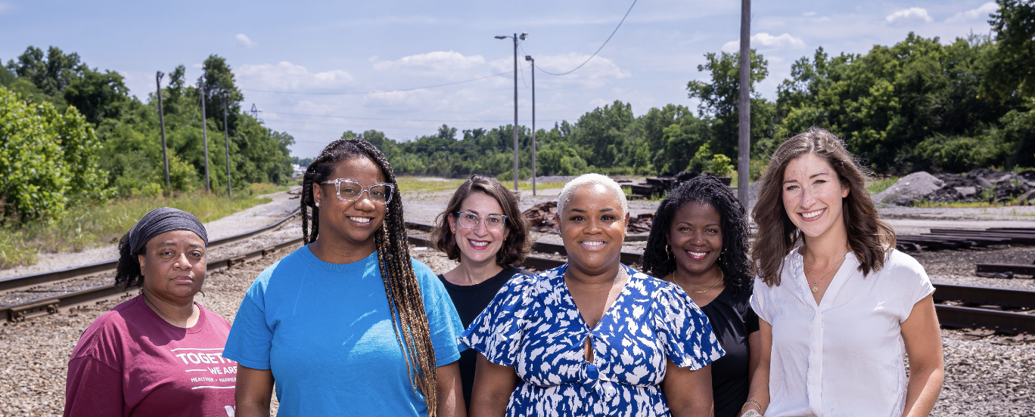
Introduction – Air Justice (EHLC)

Slide 4

Air Justice – The Question
“How might information about air pollution and the industries that contribute to this issue be made more accessible to public audiences?”

Slide 5

The EHLC Coalition Model
Community Partners
UofL Students
Strategic Collaborations
Politicians
UofL Academics

Slide 6
Air Justice – Research Goals
To determine baseline interest level in understanding the science around air pollution in West and Southwest Louisville
To test whether a central resource website boots residents’ engagement in environmental justice issues.

Slide 7
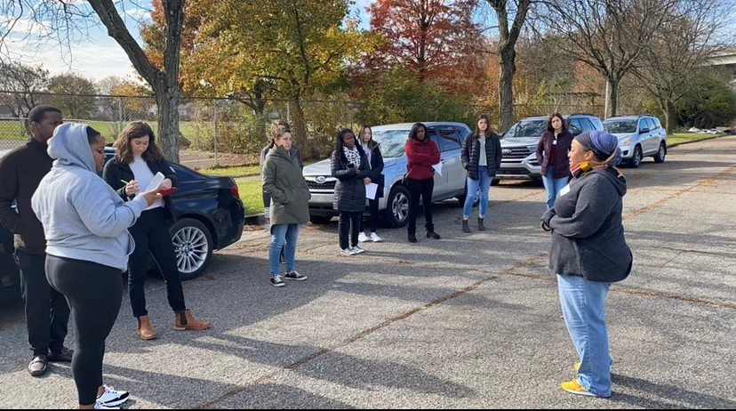
Student Coalition Members

Slide 8
Why “Coalition” Needs Students….
Investigation
Students Identify The Issues and Serve as Testers For Engagement
Innovation
Students offer Fresh Perspectives on Solutions
Investment
Students are a Part of The Community and Benefit from this Work

Slide 9
Student Translation Work
Infographics
Website
Research Presentations
Blogs

Slide 10
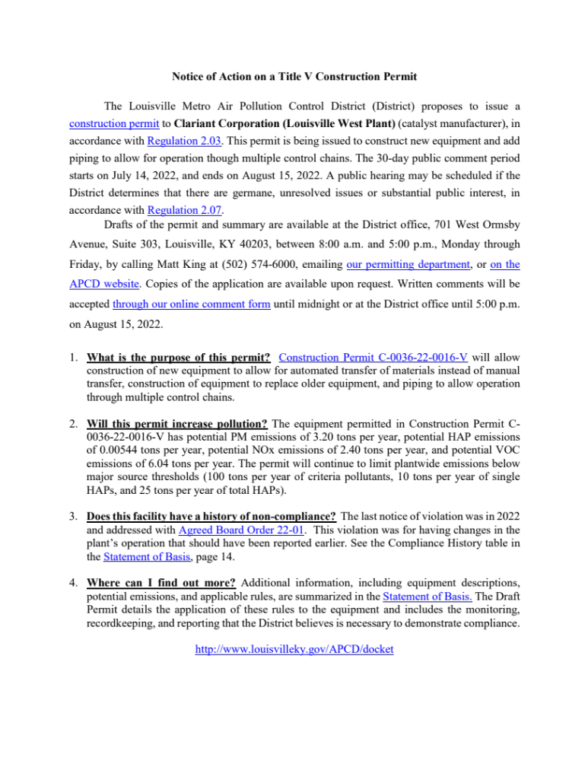
Infographics
BEFORE

Slide 11
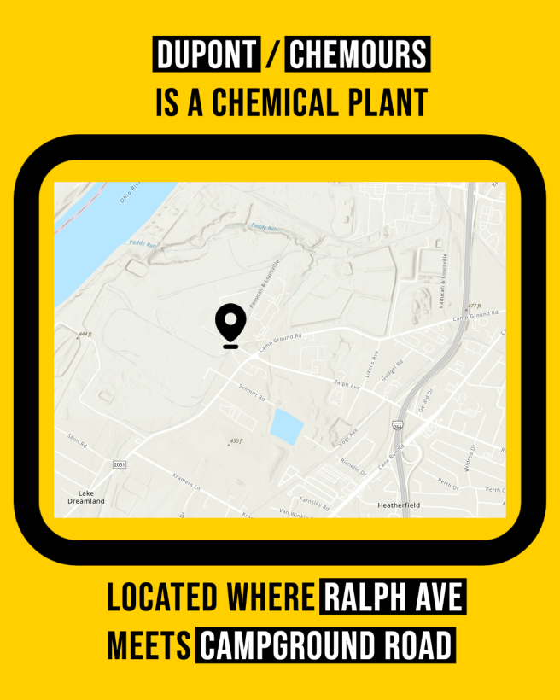
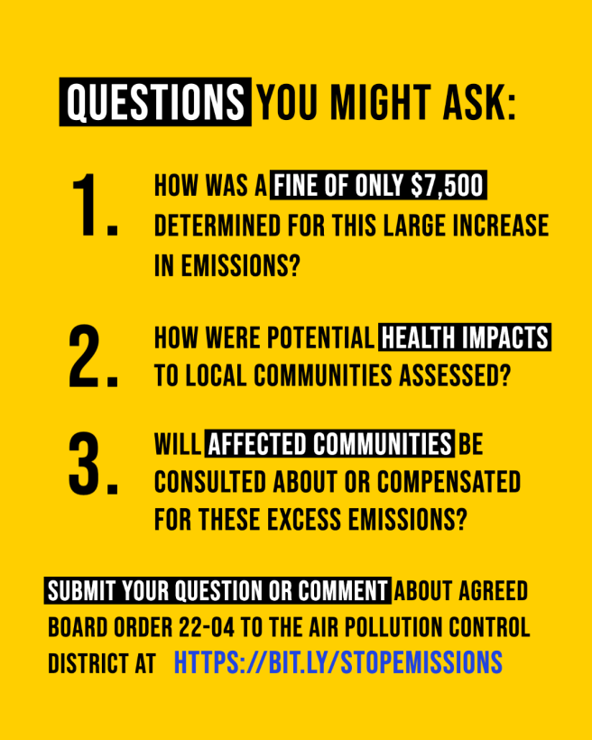
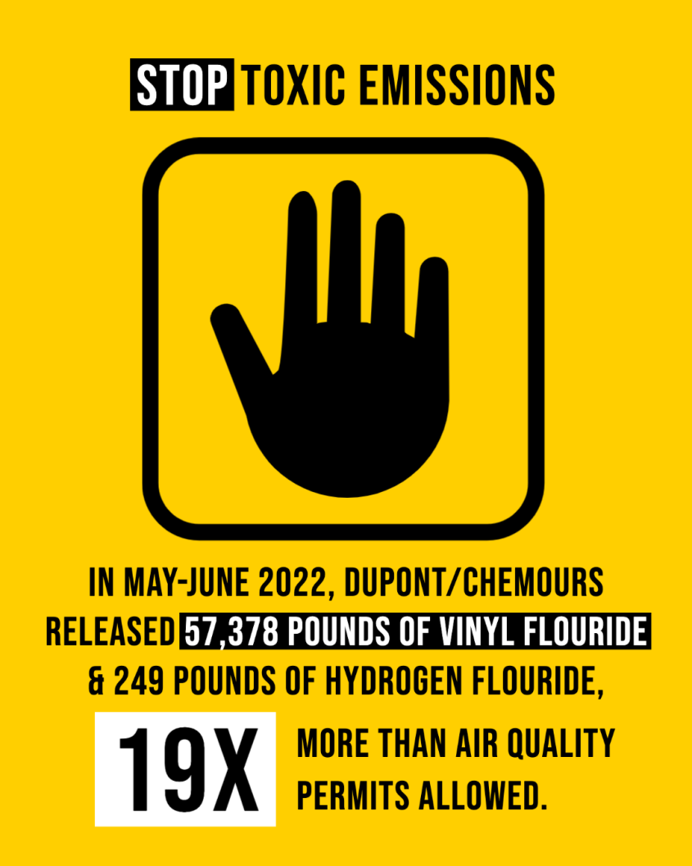
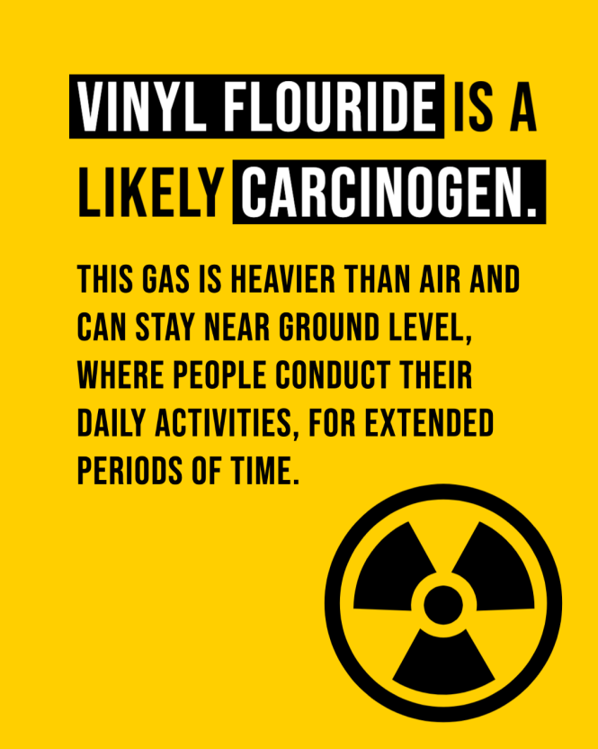
Infographics
AFTER

Slide 12
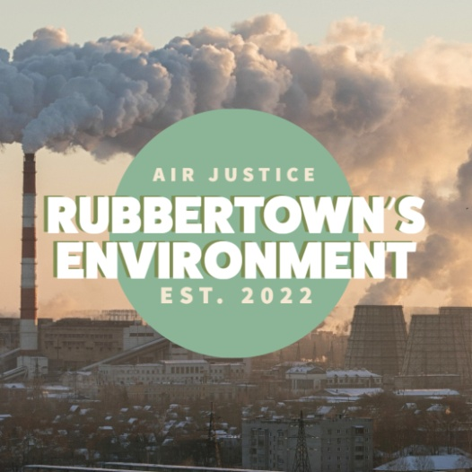

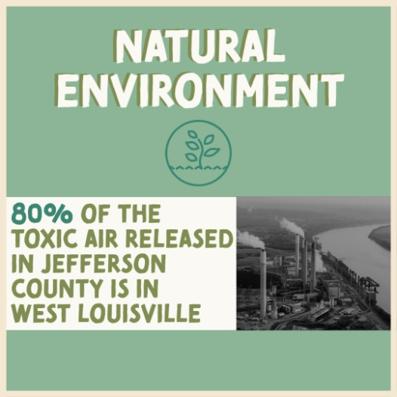
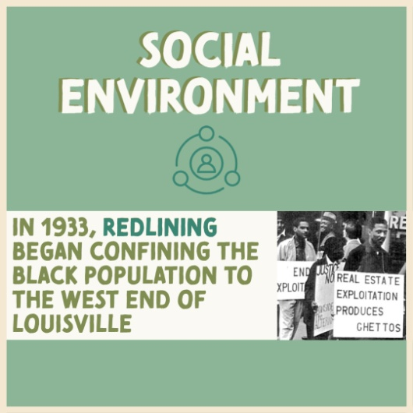
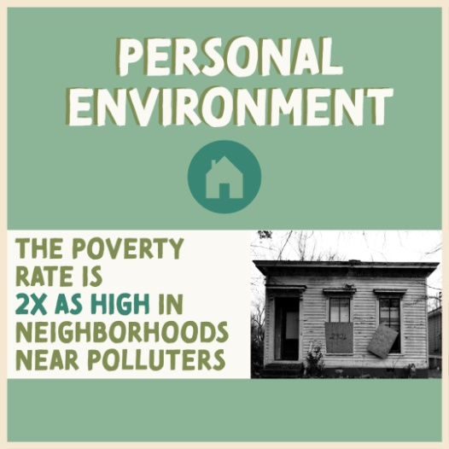
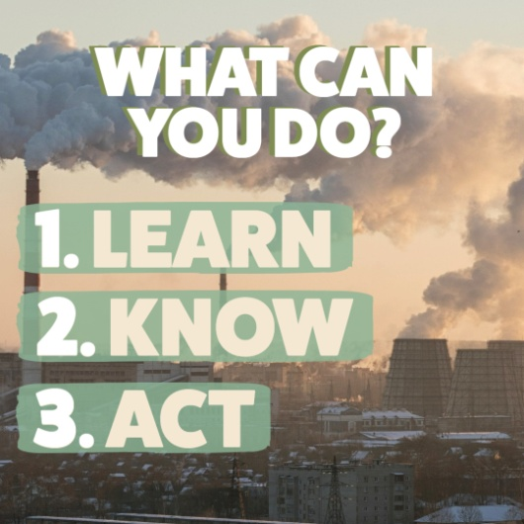
Blogs

Slide 13
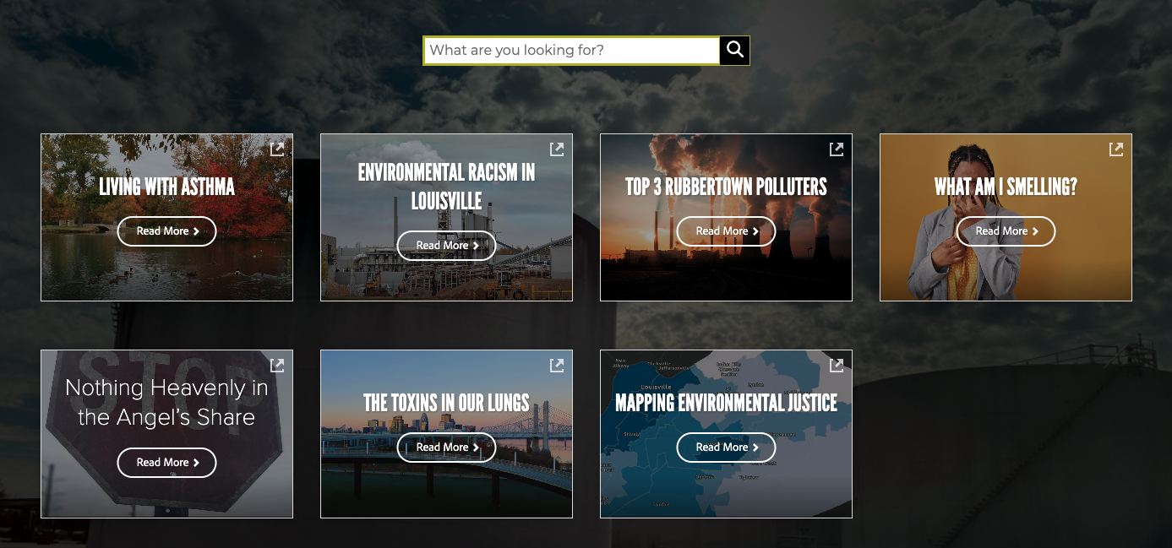
Blogs

Slide 14
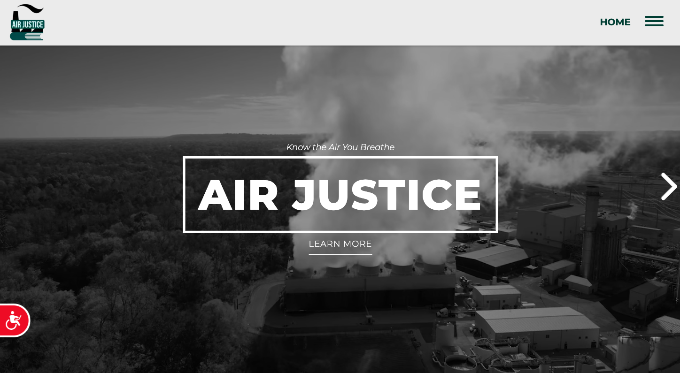
airjusticelou.org
Website

Slide 15

coming March 28th!
Website

Slide 16
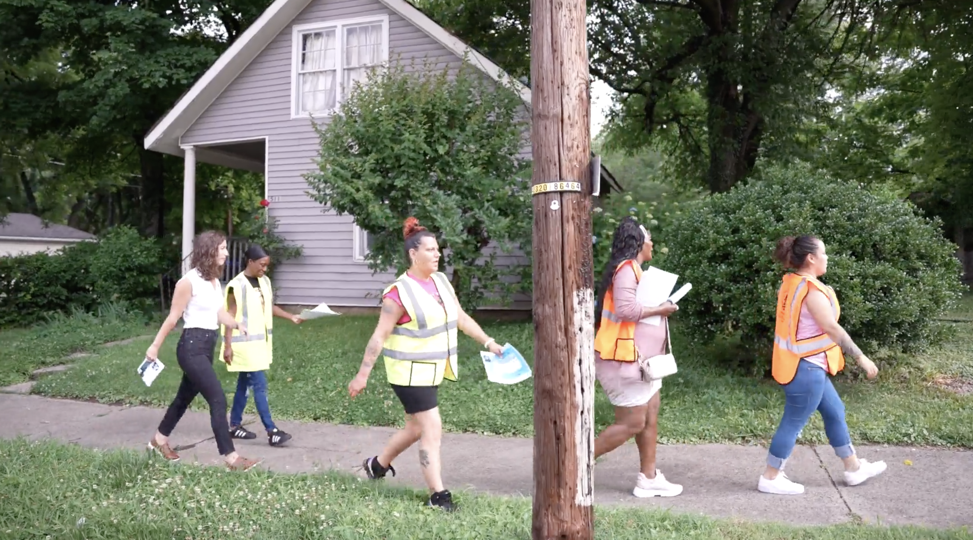
Air Justice – On the Ground
~2,000 surveys
30+ zip codes
15 community events
5 focus groups
50+ UofL students

Slide 17
Questions?
Please reach out to us!
Shavonnie R. Carthens, J.D.
Assistant Professor of Law
University of Louisville Brandeis School of Law
shavonnie.carthens@louisville.edu
Dr. Megan R. Poole
Assistant Professor of English
megan.poole@louisville.edu

