Slide 1
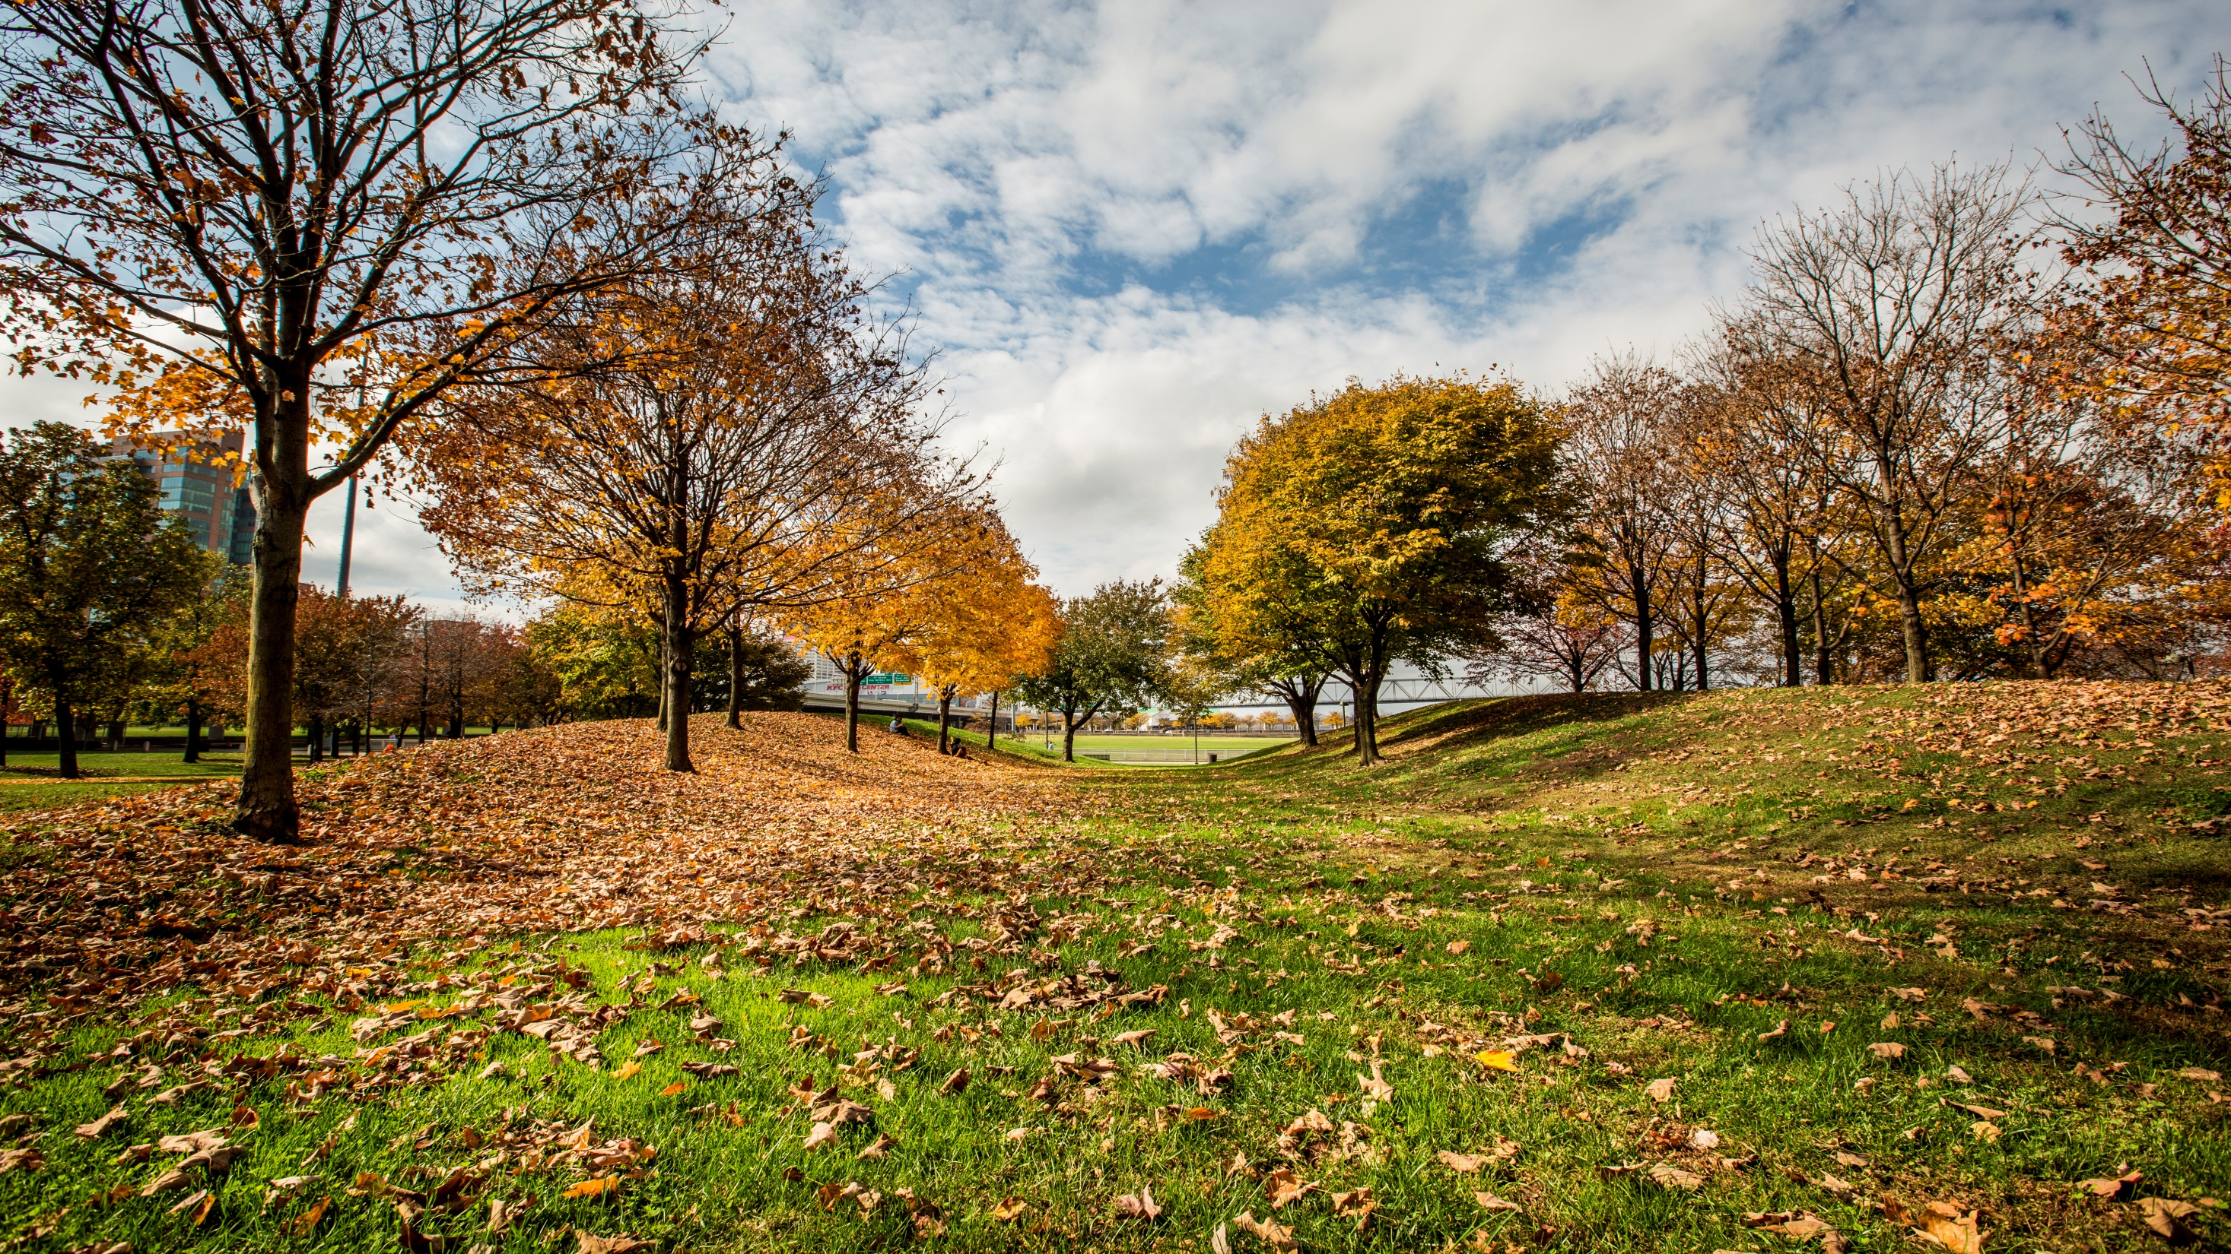


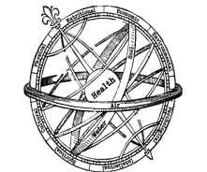
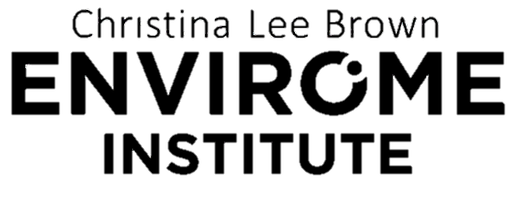
Green Heart Louisville: Evaluating the effects of neighborhood planting for better health
2023 Bluegrass Greensource Sustainability Summit
March 8th, 2023
Ray Yeager, PhD
Assistant Professor, Division of Environmental Medicine
Christina Lee Brown Envirome Institute
University of Louisville
Rayeag01@Louisville.edu

Slide 2

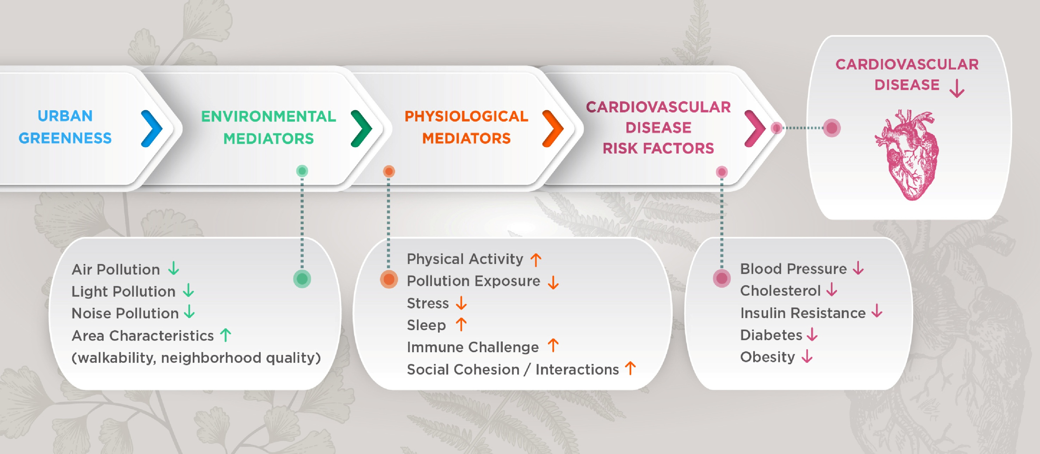


Slide 3
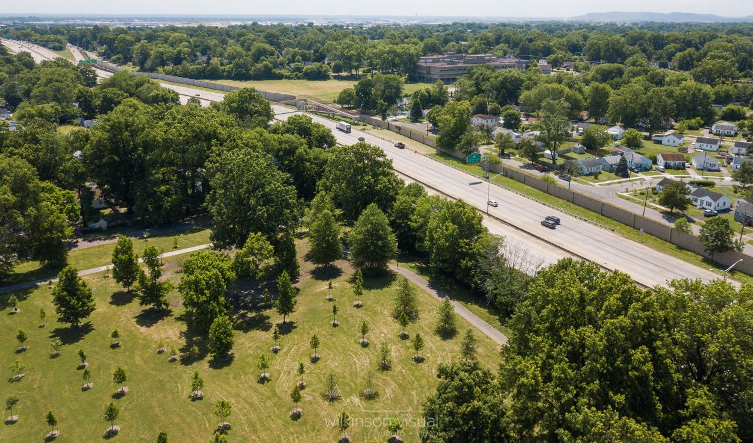
CENTRAL HYPOTHESIS
Exposure to neighborhood greenery diminishes the risk of cardiovascular disease by decreasing levels of air pollution

Slide 4
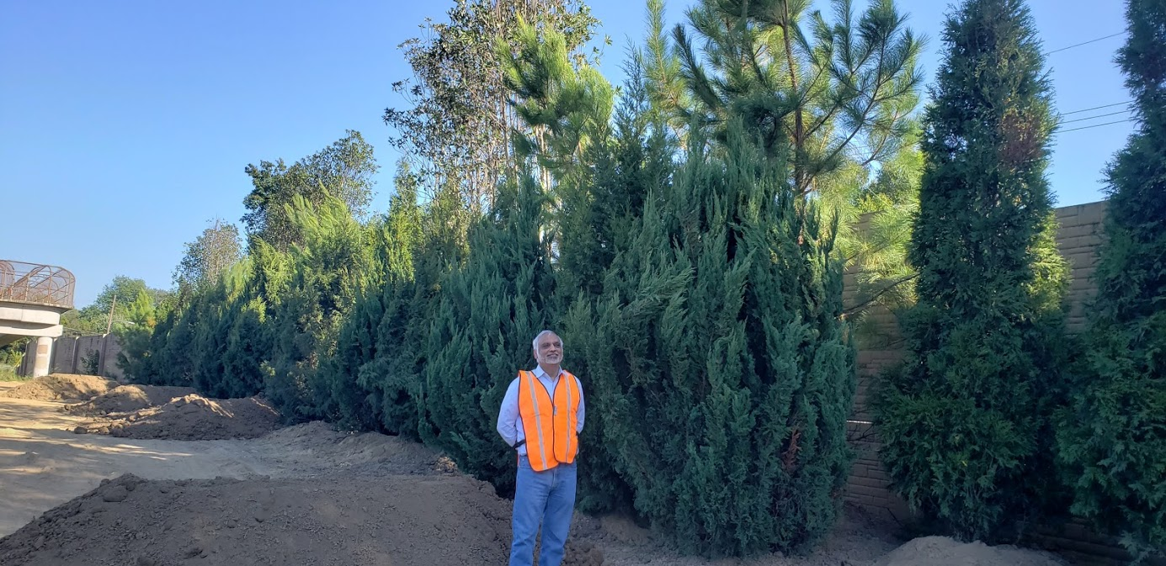
TRANSPLANT LARGE TREES

Slide 5
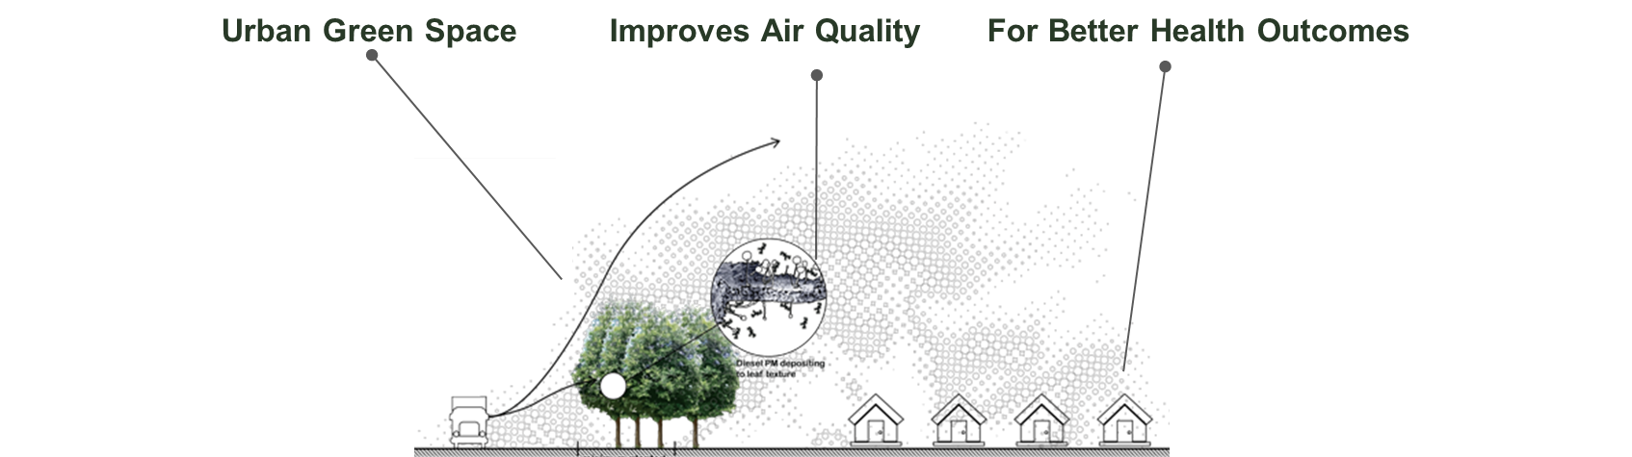
2018
Baseline
2019
Baseline
2021
Intervention Assessment
2022
Analyze Findings
2020
Intervention
(half of area planted)
2018
Baseline
2019
Baseline
2020
Initial Planting and
Cross-sectional
studies
2021
“Post”-COVID Baseline and Fall Planting
2022
Spring Planting and Follow-up Assessment
2023
Analyze Findings

Slide 6
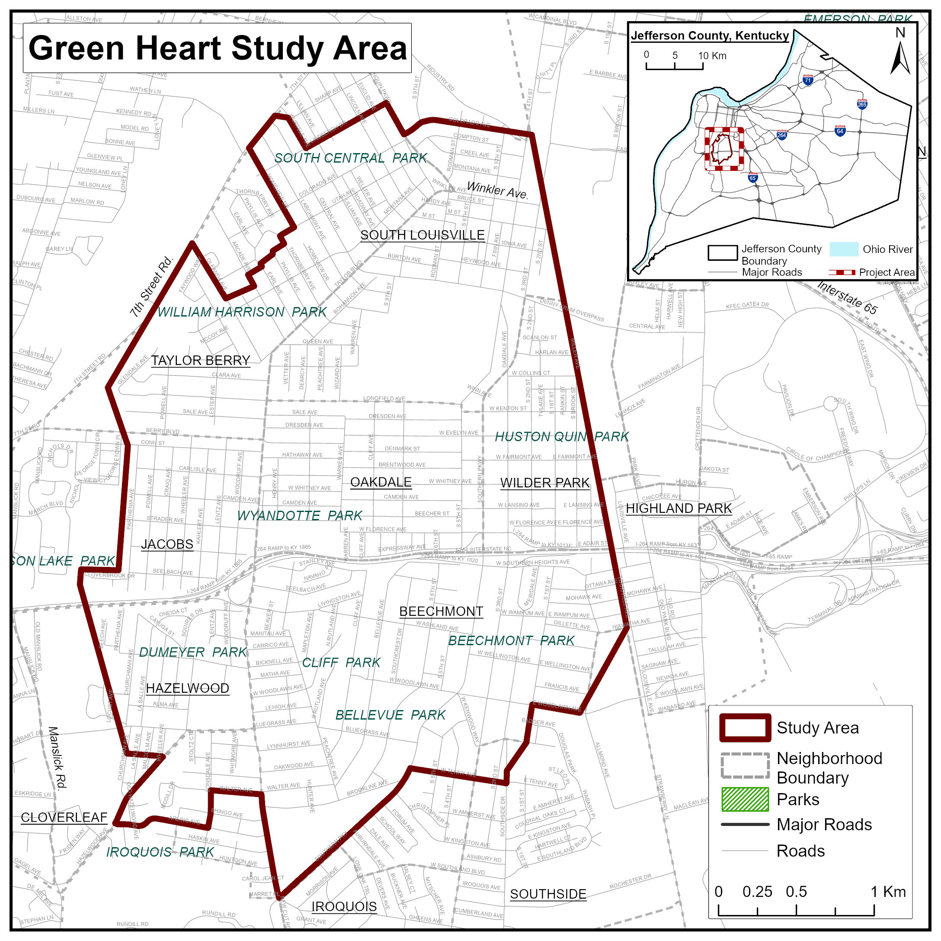
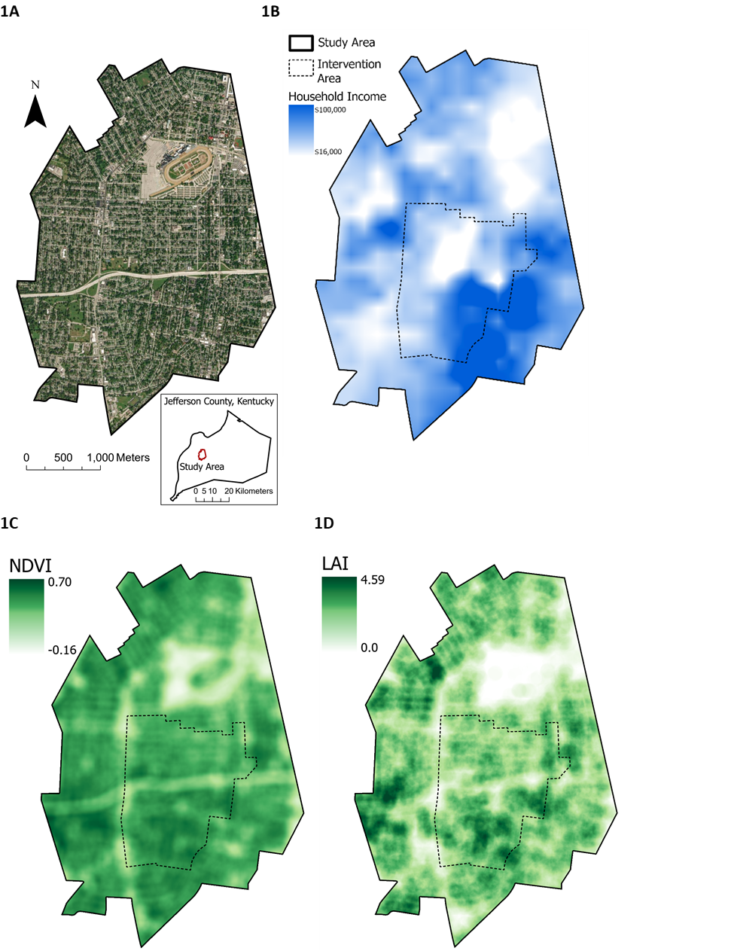
Dr. Yeager
Notes:
-Description of area and conditions
-Why did we select this area

Slide 7
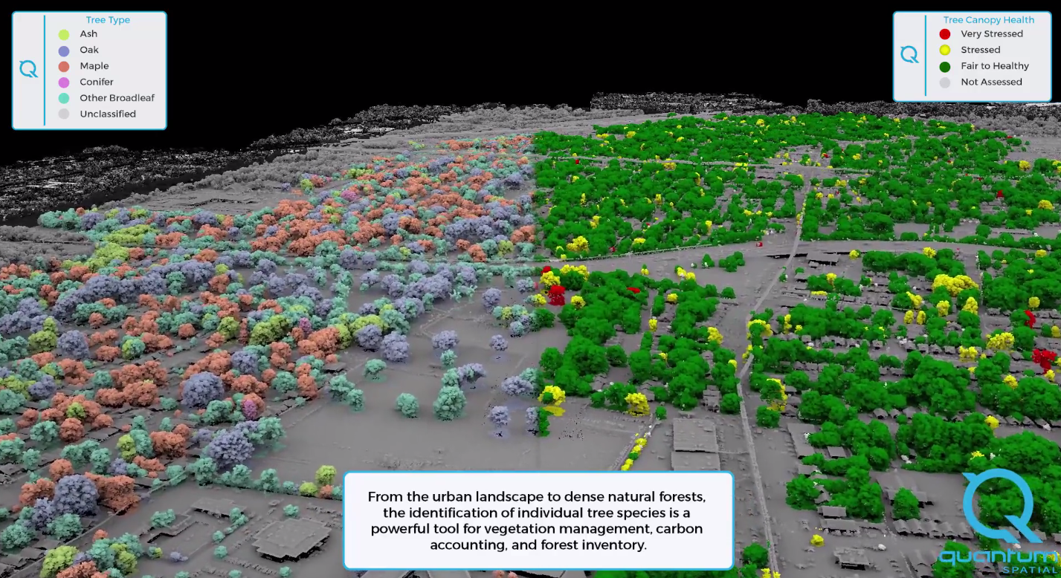
ENVIRONMENTAL SURVEY OF THE NEIGHBORHOOD

Slide 8
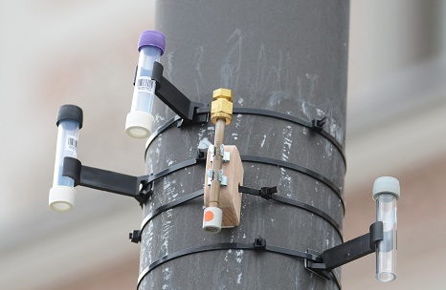
Pollution Exposure

Slide 9
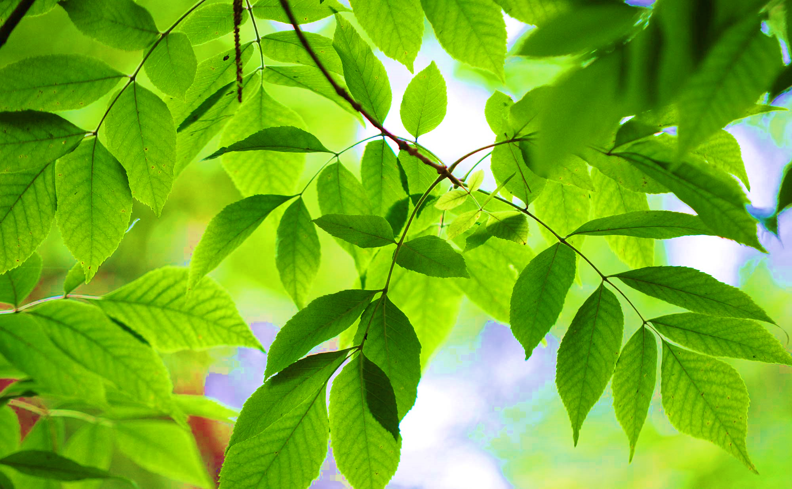
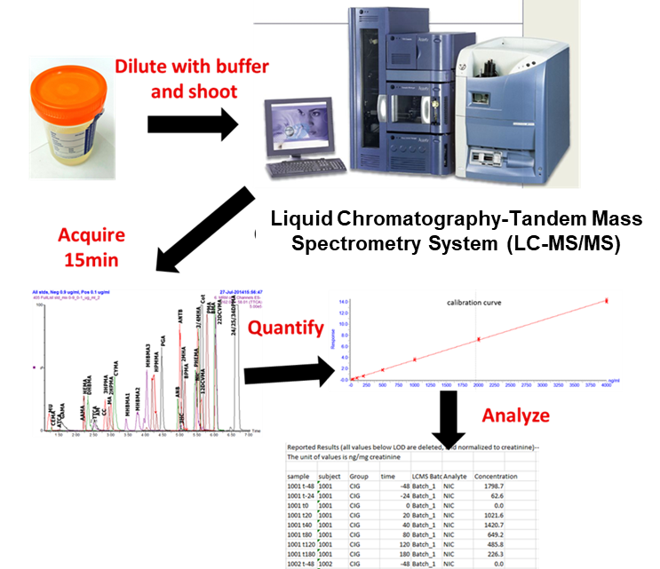
Measurement of VOC metabolites in the urine
Parent compound | Abbrev.
Acetaldehyde | ACETATE
Acrolein | CEMA
 | 3HPMA
Acrylamide | AAMA
 | GAMA
Acrylonitrile | CYMA
Acrylonitrile, vinyl chloride, ethylene oxide | HEMA
Benzene | PMA
 | MU
1,3-Butadiene | DHBMA
 | MHBMA1
 | MHBMA2
 | MHBMA3
Crotonaldehyde | HPMMA
Formaldehyde | FORMATE
N,N-Dimethylformamide | AMCC
Propylene oxide | 2HPMA
Toluene | BMA
Xylene | DPMA
 | 2MHA
 | 3MHA+4MHA

Slide 10

CARDIOVASCULAR HEALTH
Blood Pressure, Lipids, Obesity and Diabetes
Cardiovascular disease risk, biomarkers of cardiovascular injury

Slide 11
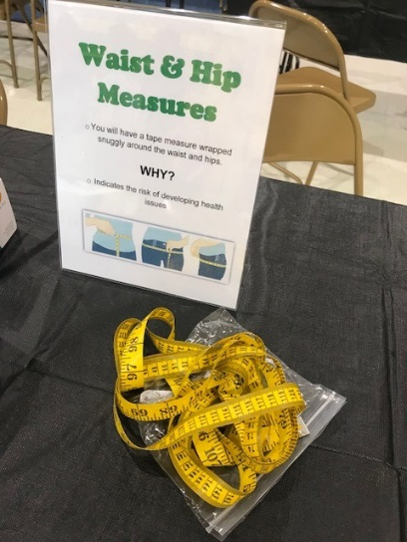
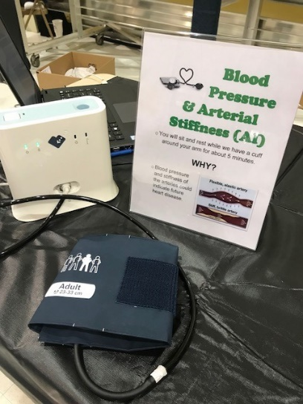
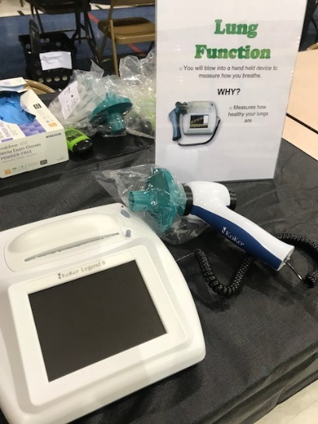
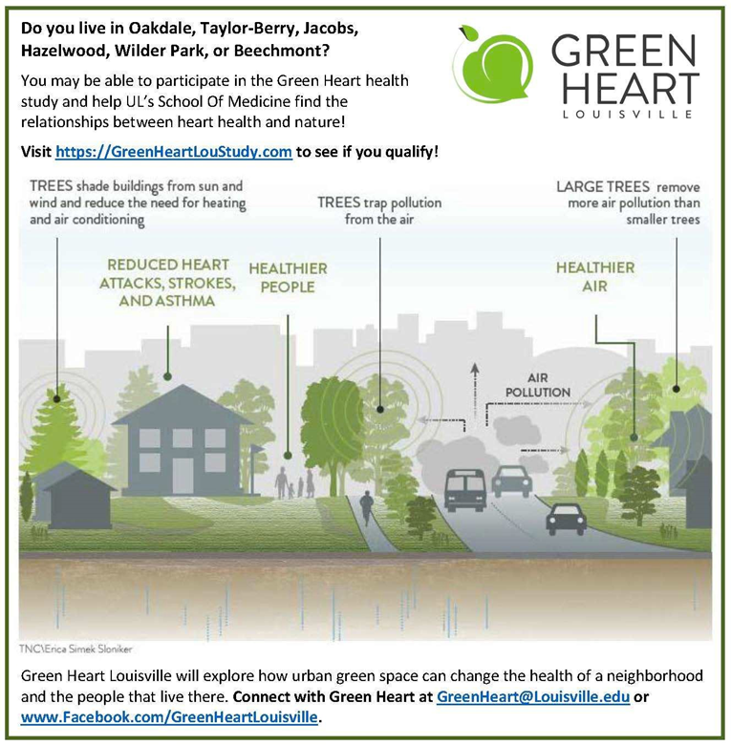
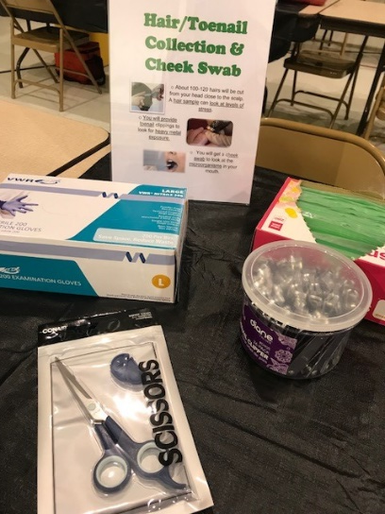
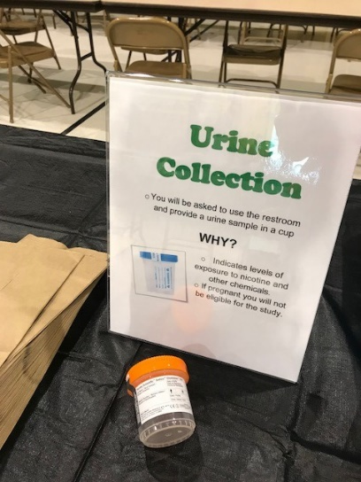
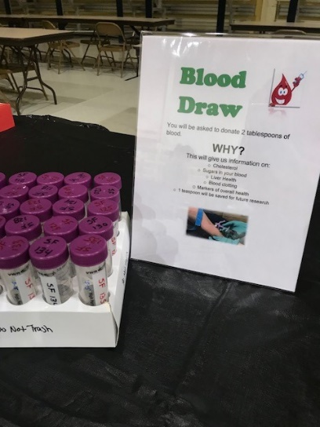

Recruitment and Enrollment

Slide 12
Community Collaborations for Planting
Community Collaboration
Green Heart Volunteer Days:
  Oct. 22: UPS
  Oct. 23: Arbor Day; General Volunteers in support of LG and TNC
  Oct. 29: GEA
  Nov. 5: GEA
AmeriCorps volunteers (8 total) have deployed to augment Louisville Grows in their community planting efforts
The Green Heart Coordination Center (GHCC) has hosted collaborative information sessions will multiple community stakeholders:
  Councilwoman Nicole George
  Louisville Metro Police Department (MAJ Tiffany Tatum)
  Louisville Parks and Recreation Leadership (Mesude Duyar, Steven Ashley, & Spencer Holt)
  Kentucky Transportation Cabinet (KYTC) (Kevin Bailey)
  Kentucky Nature Conservancy (David Phemister)
  The Nature Conservancy (Global Diversity, Equity & Inclusion) (Owen Burke) (Chief Global Diversity, Equity & Inclusion Officer-- James Page Jr.)

Slide 13
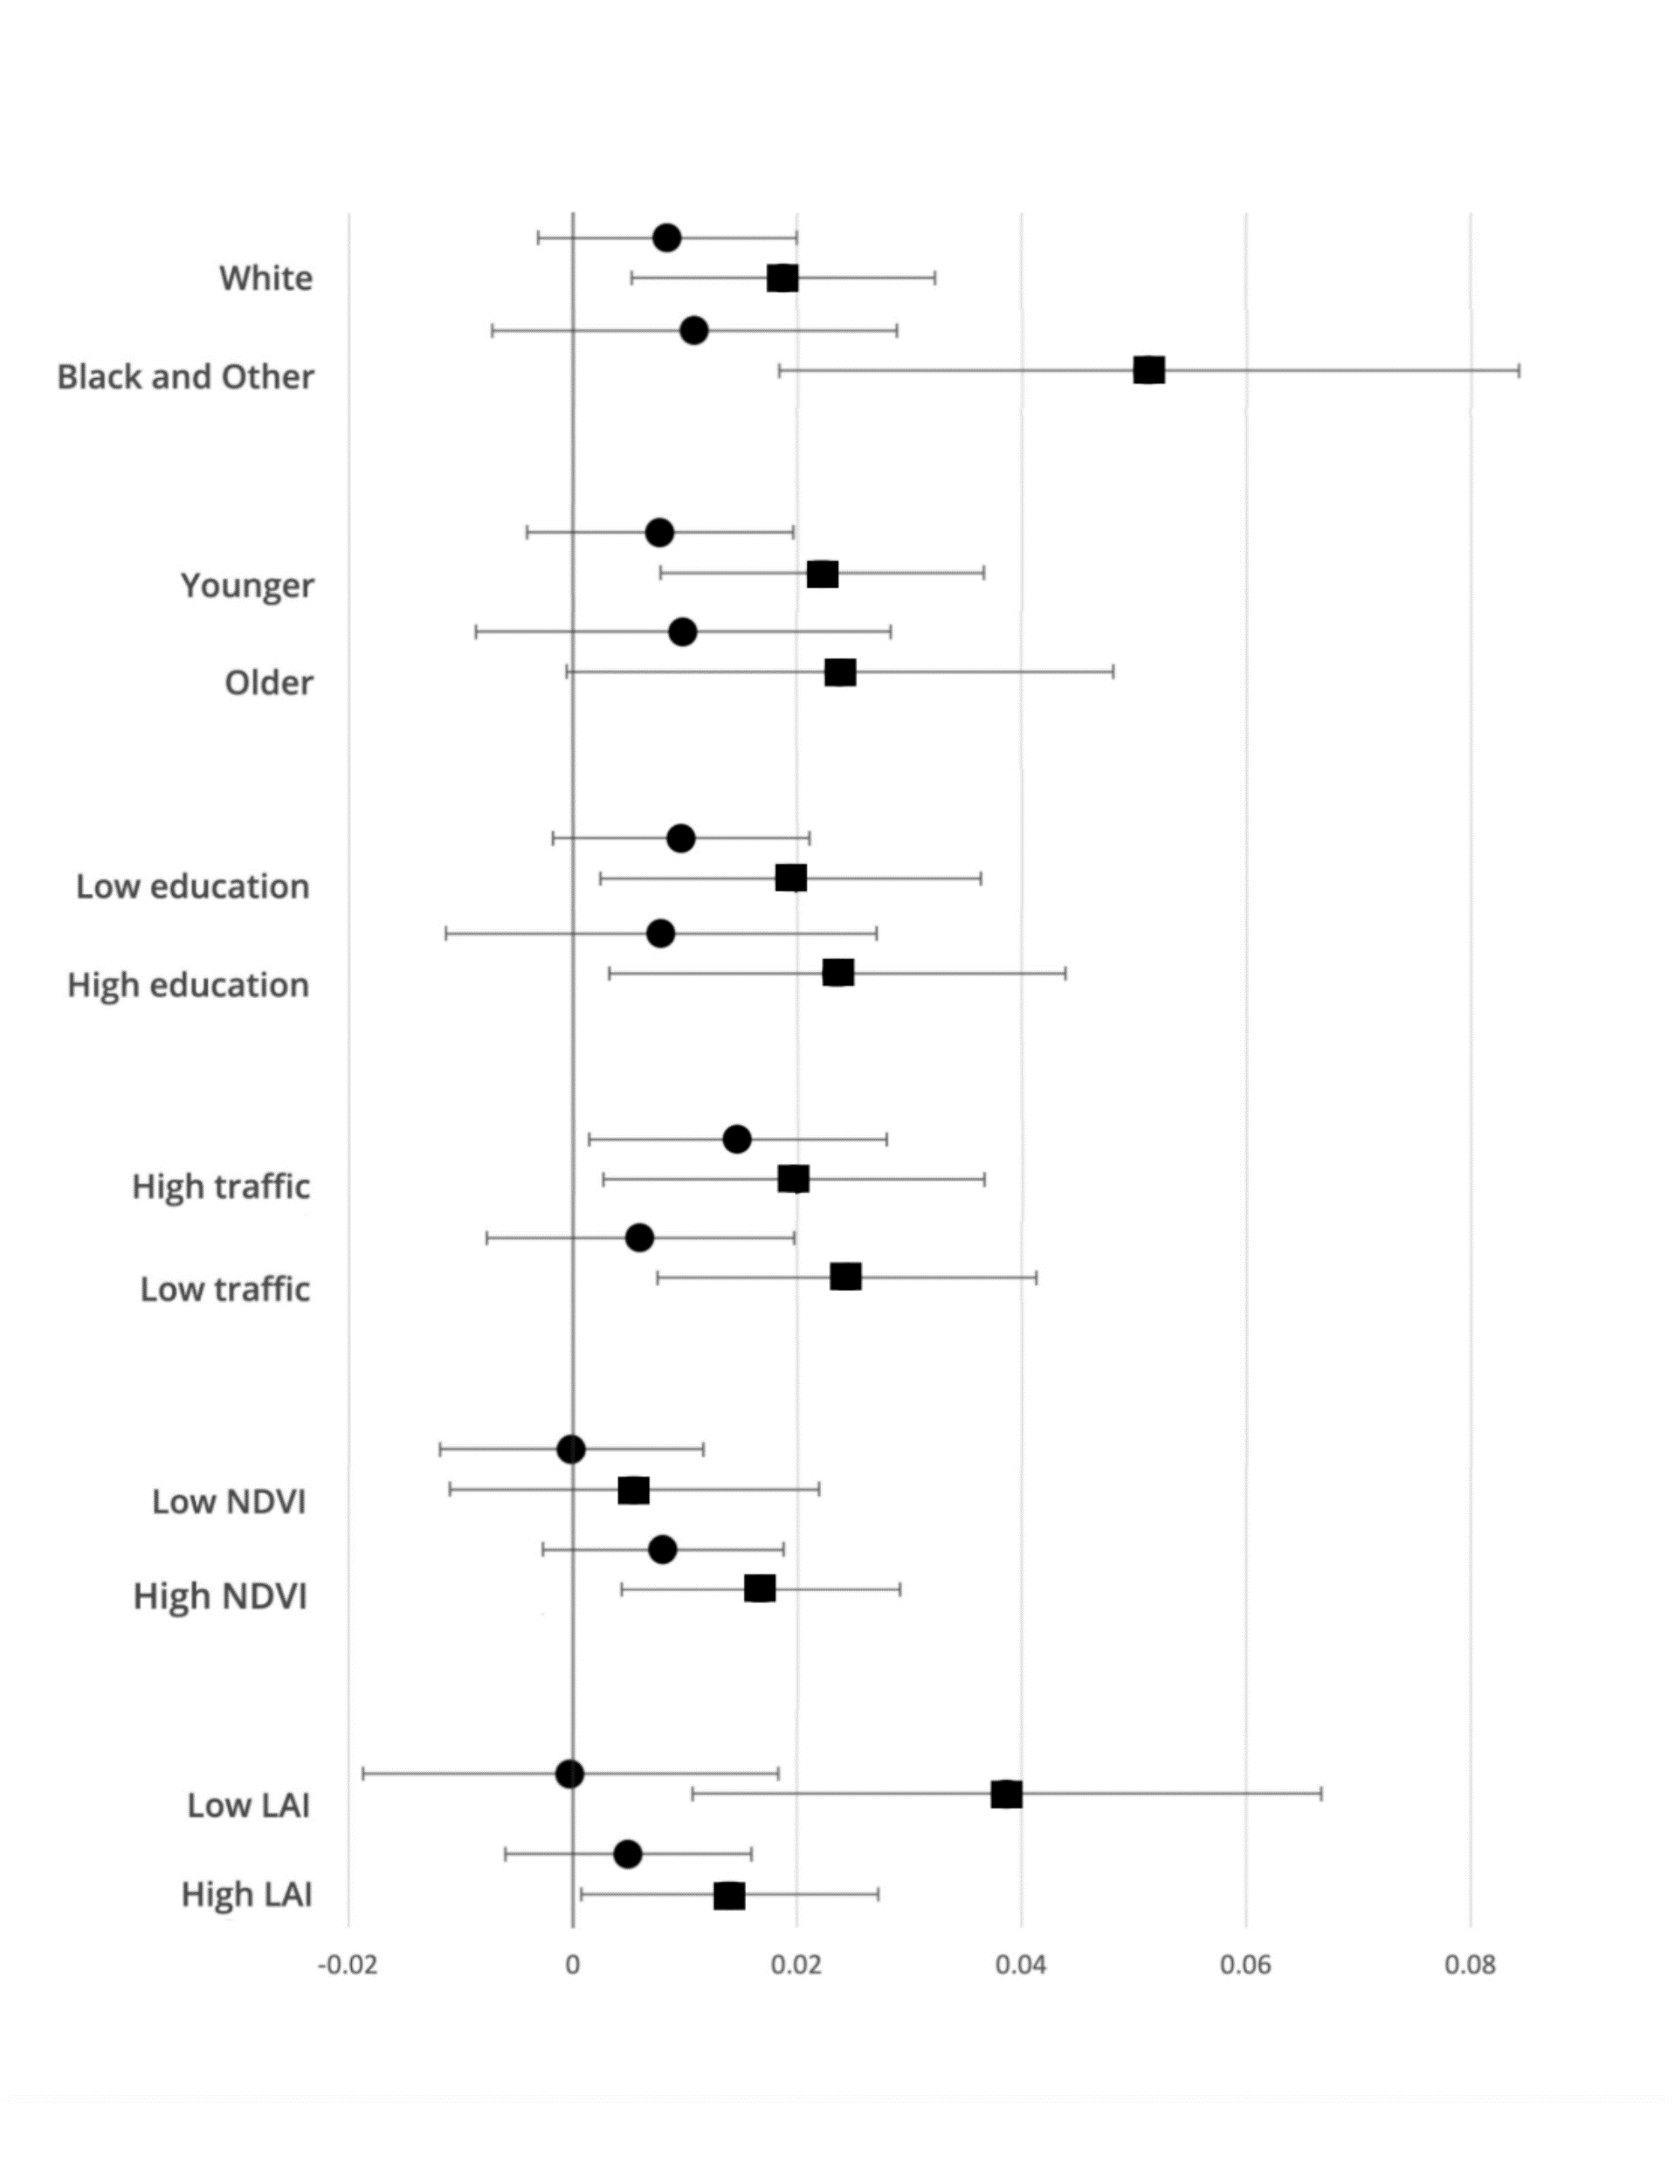
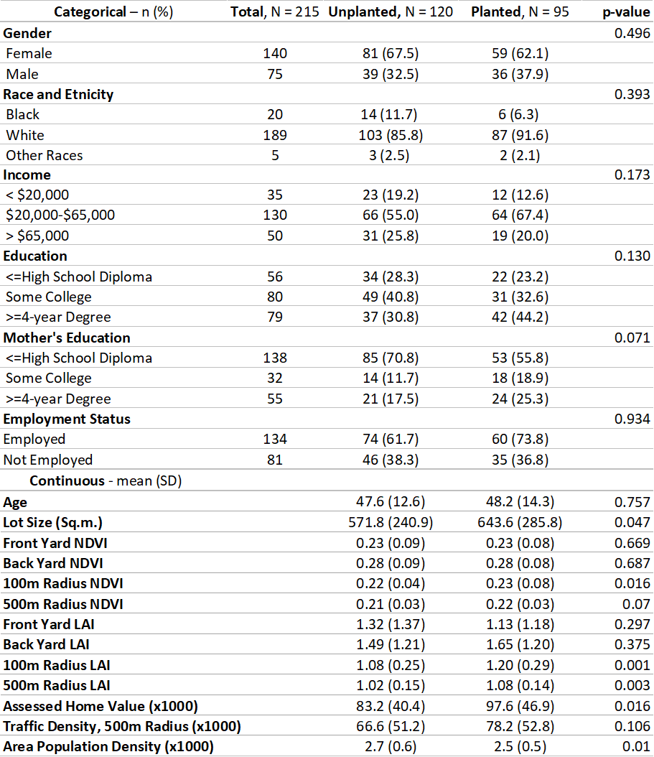
Planting Success (?)
Planting Success
LAI and Income

Slide 14
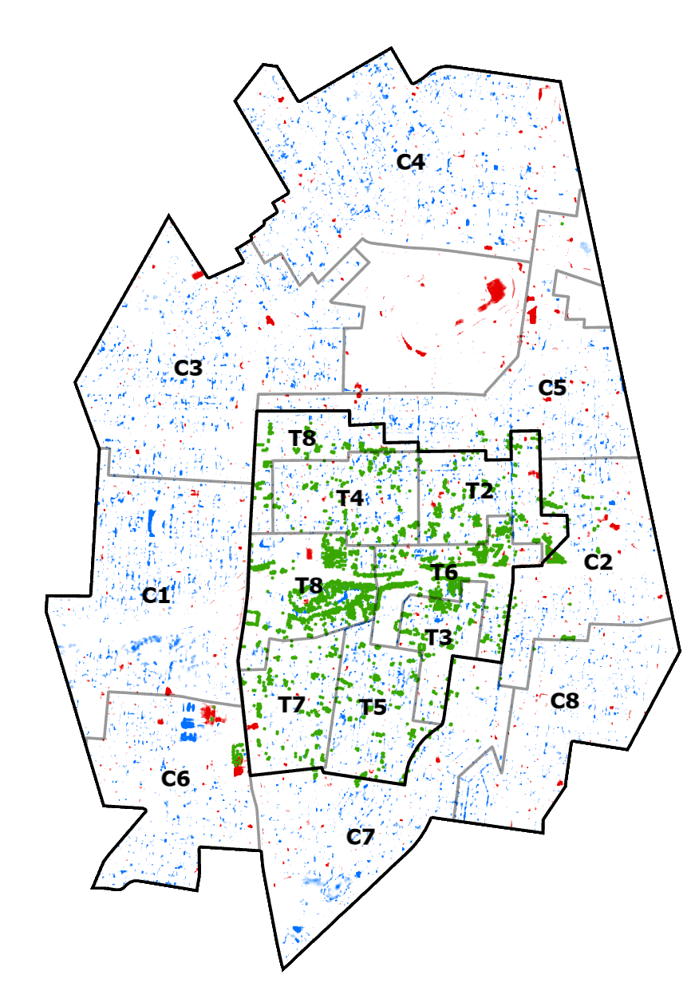
Planting Success

Slide 15
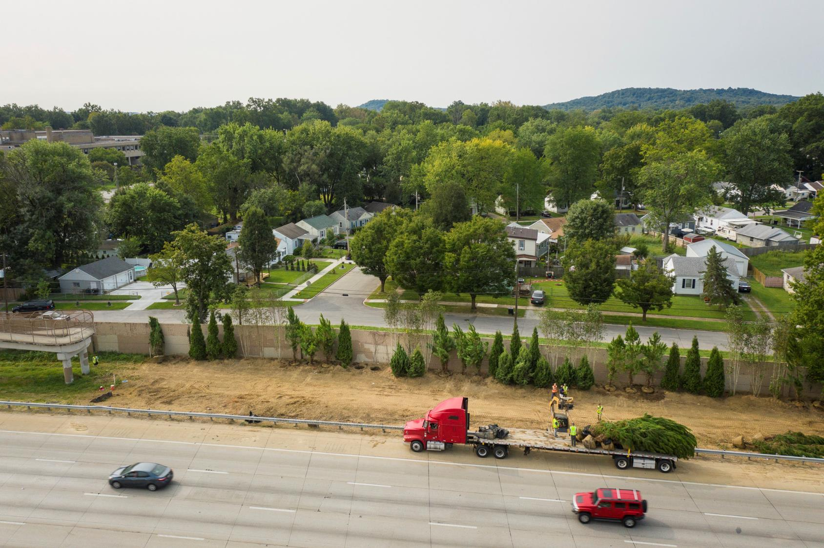
Notes:
Another bird's eye of the first planting zone copyright Mike Wilkinson

Slide 16
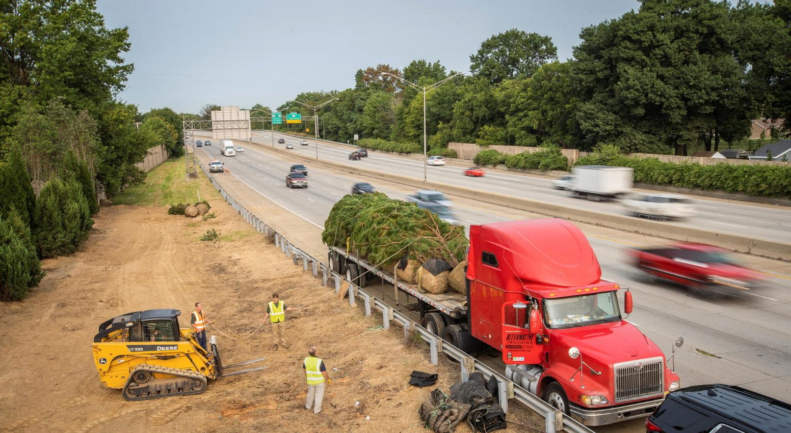
Notes:
unloading loblolly pine tree into the first planting zone along the Watterson copyright Mike Wilkinson

Slide 17
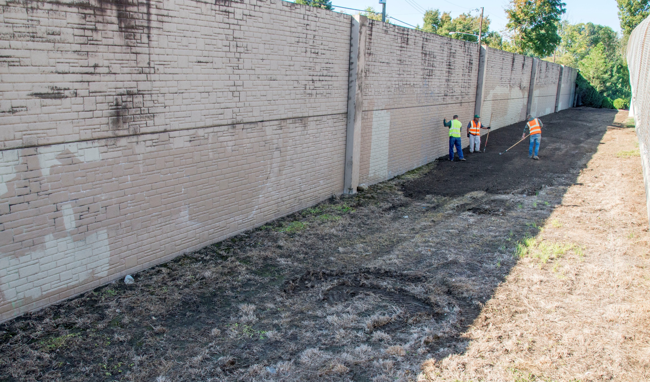

Slide 18
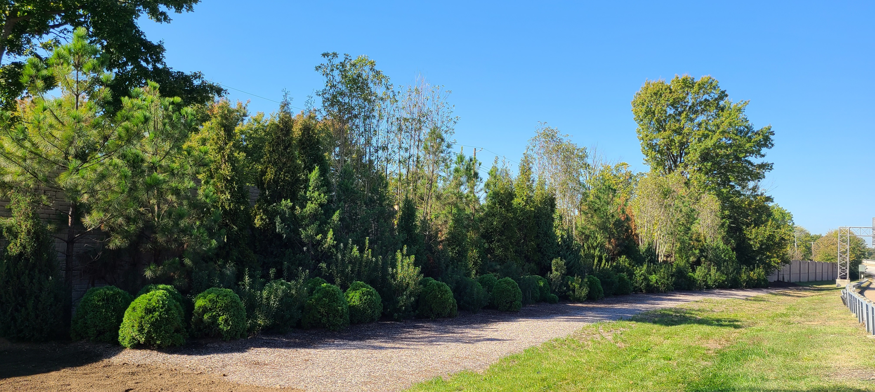

Slide 19
Challenges

Slide 20
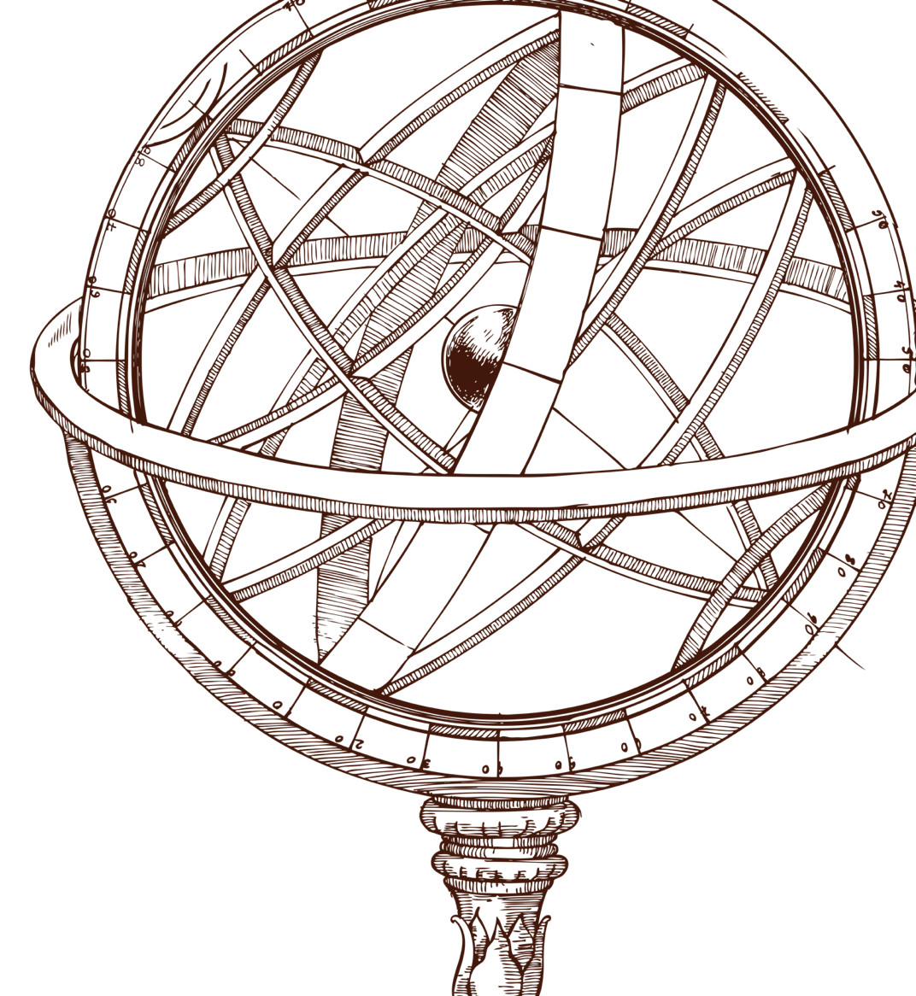
GLOBAL IMPACT
Creating Healthier Cities of Tomorrow
New nature-based ways to improve health of communities
Development of nature-based public health policies
Optimized approaches for climate adaptation and
co-benefits to health
Actionable evidence for efficacious interventions to promote environmental and health equity
Impact

Slide 21




















Partners and Collaborators
Supported by:
NIEHS 1R01ES029846
NIEHS 42ES023716
The Nature Conservancy
The Owsley Brown II Family Foundation

Slide 22
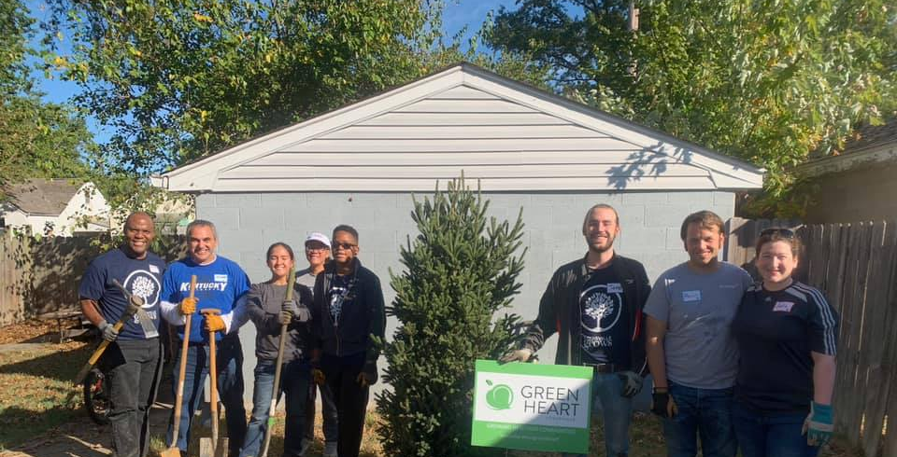
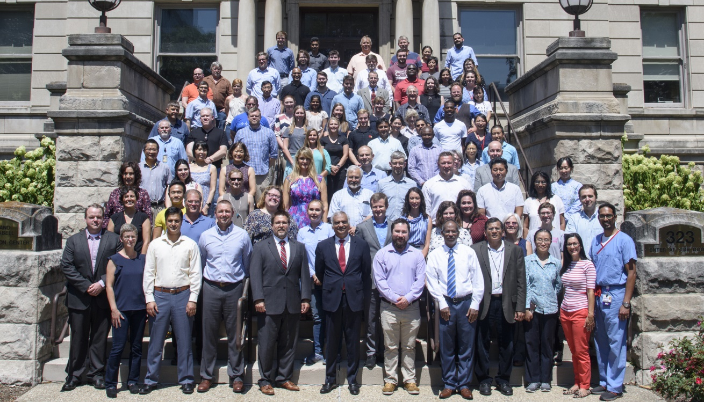
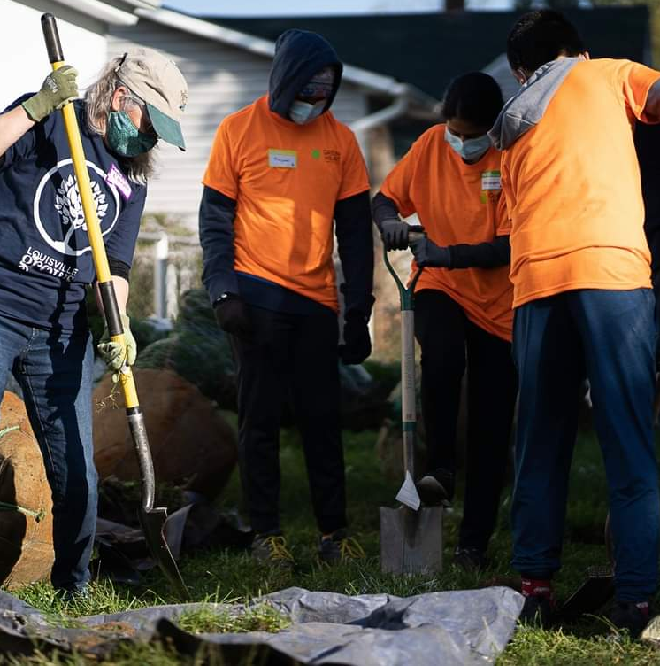
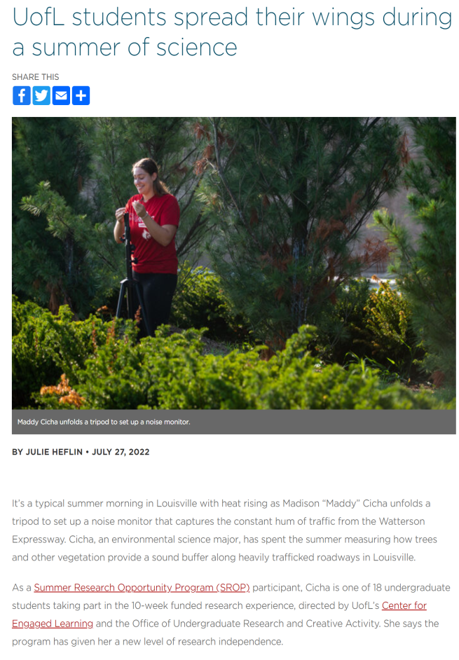
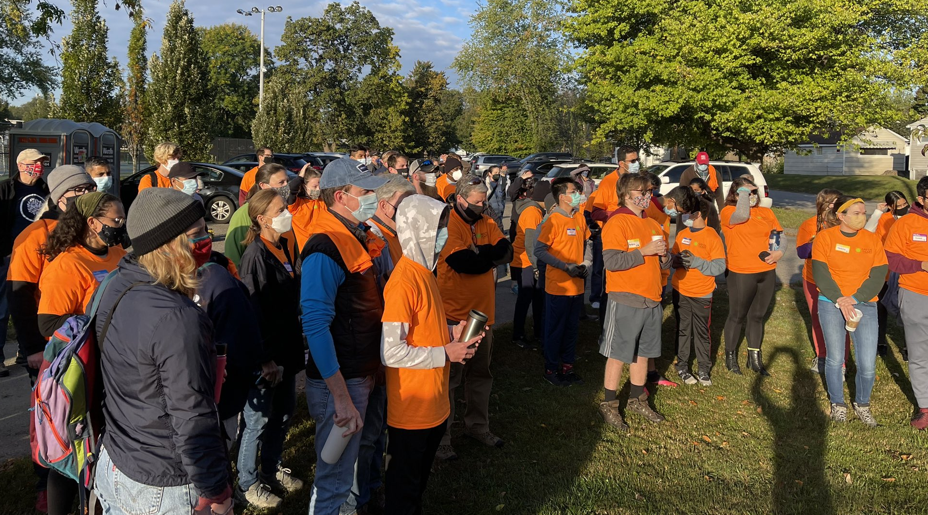
Community, Study Participants, Volunteers, Collaborators, Stakeholders, Students, Contractors, Funders, and Others

Slide 23
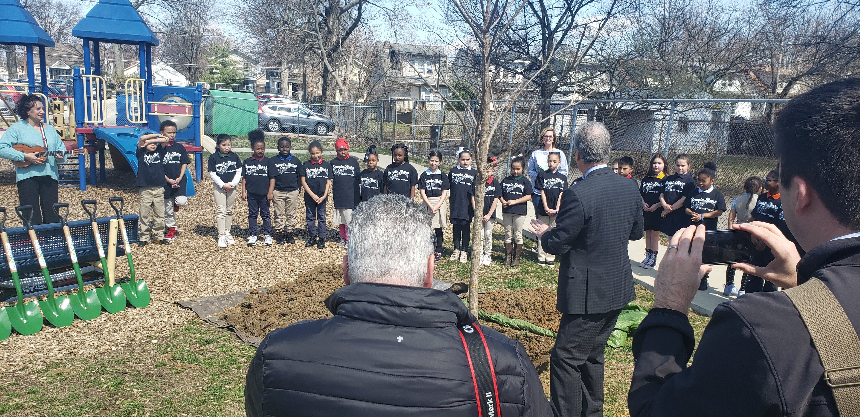

Slide 24
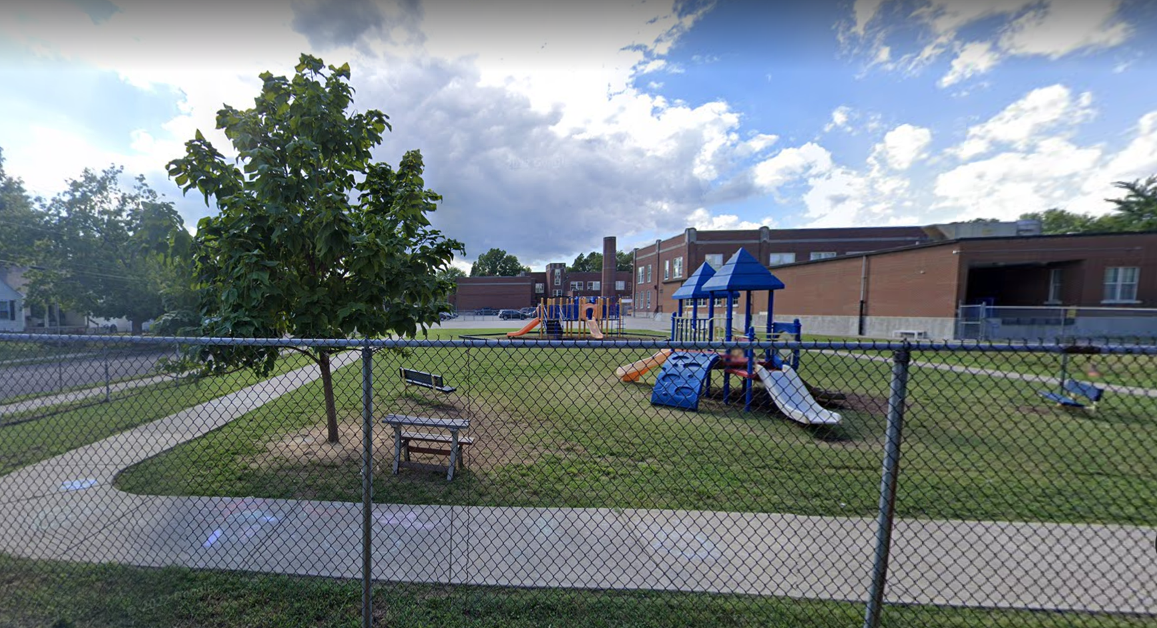
c. Google Streetview

Slide 25
THANK YOU!

