Slide 1

Louisville Metro Government
Mayor’s Office of Sustainability
Sustainability Overview
Sumedha Rao, LEED AP
Executive Director

Slide 2
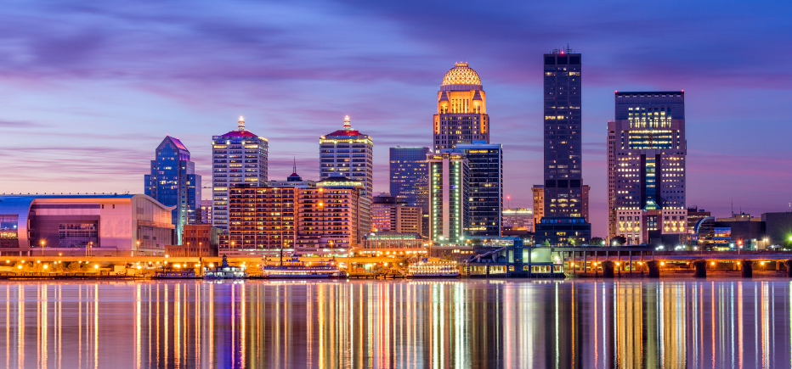
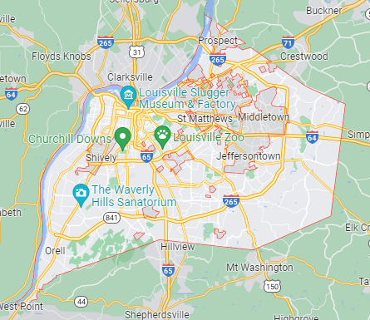
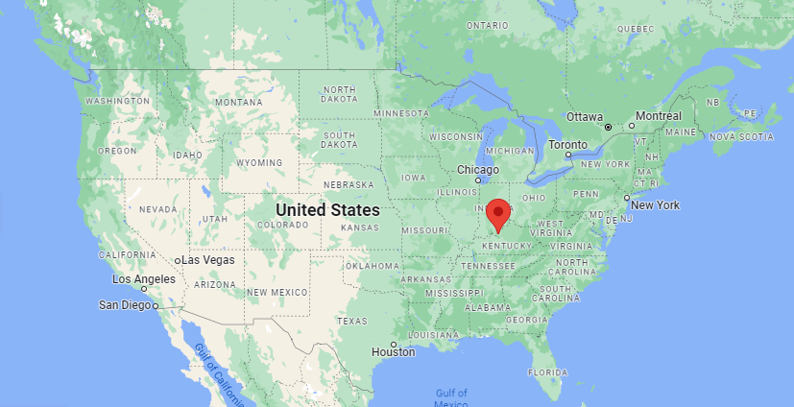
Hello from Louisville!
Louisville, KY
Population: ~780,000
MSA: ~1.3million
Merged city-county government

Slide 3

Overview of Louisville’s Sustainability Efforts

Slide 4
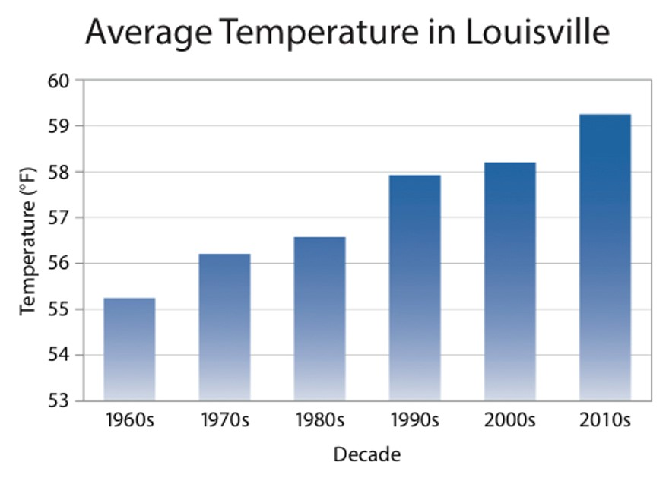
Louisville’s
Environment is Changing
Higher Temperatures
The average number of days per year above 90°F has increased by 12 days since 1960
Heavier Rain Events
The 3 largest rain events in Louisville happened in the last decade

Slide 5
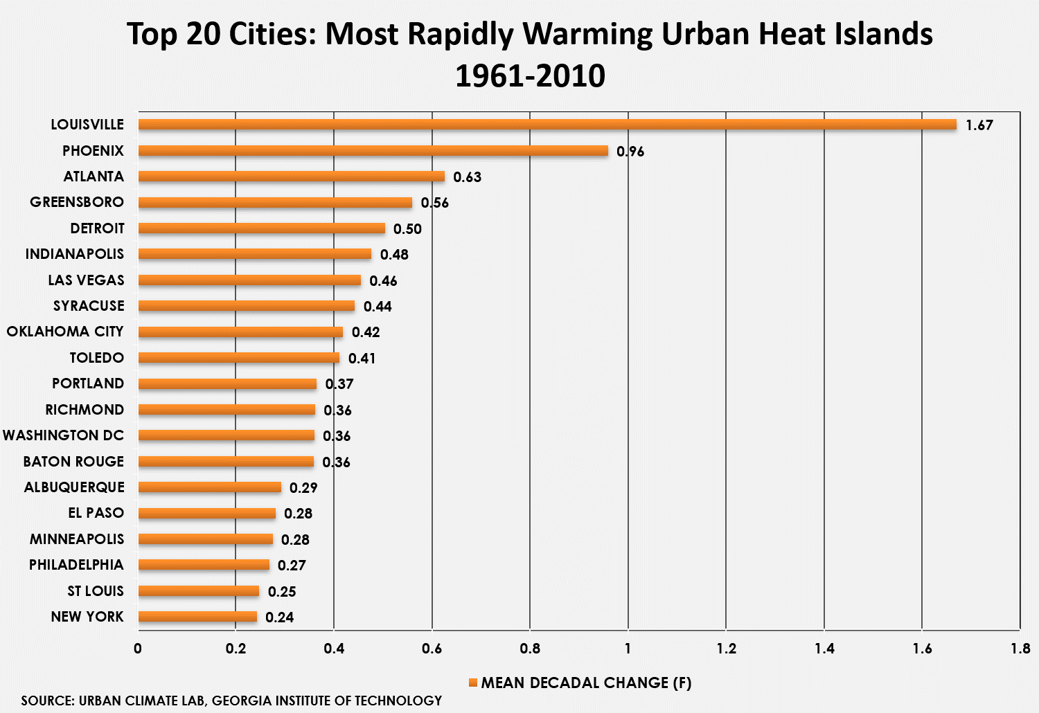
Louisville
is the
Nation’s
Fastest Warming
Urban Heat Island

Slide 6

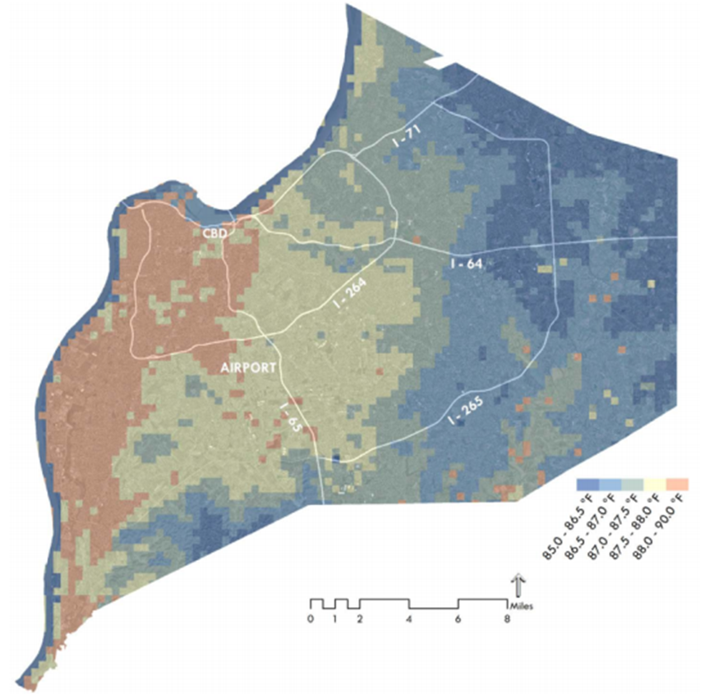
Environmental Crises
Impact Louisvillians Unequally
Warm season average daily
high temperature (2012)

Slide 7
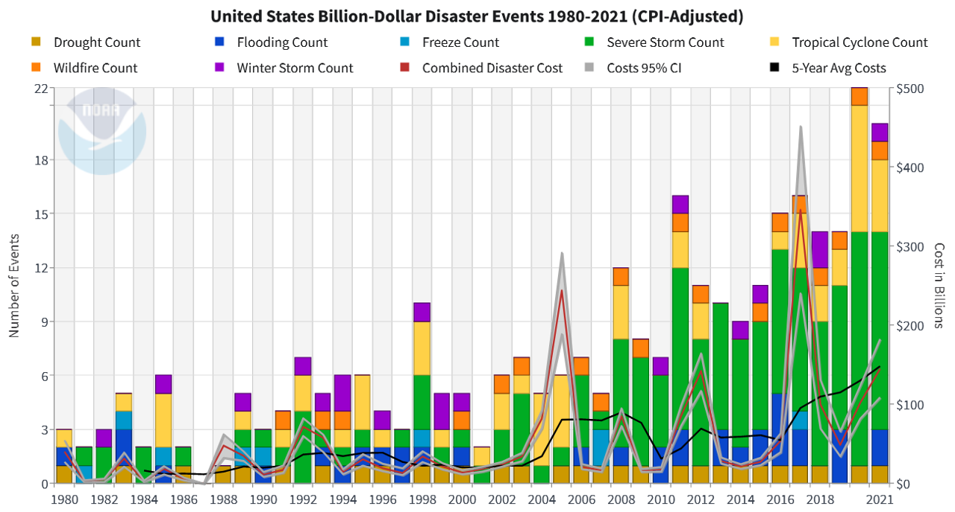
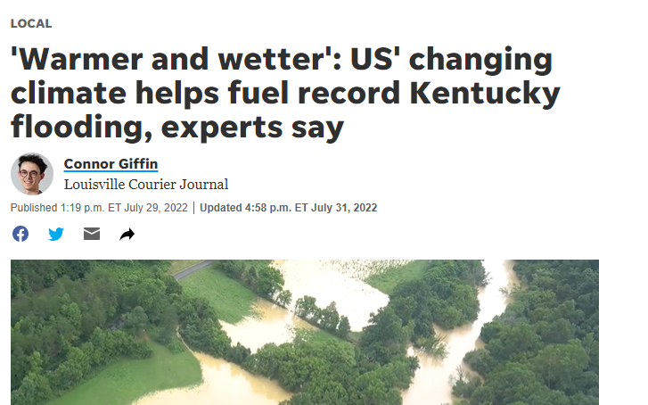
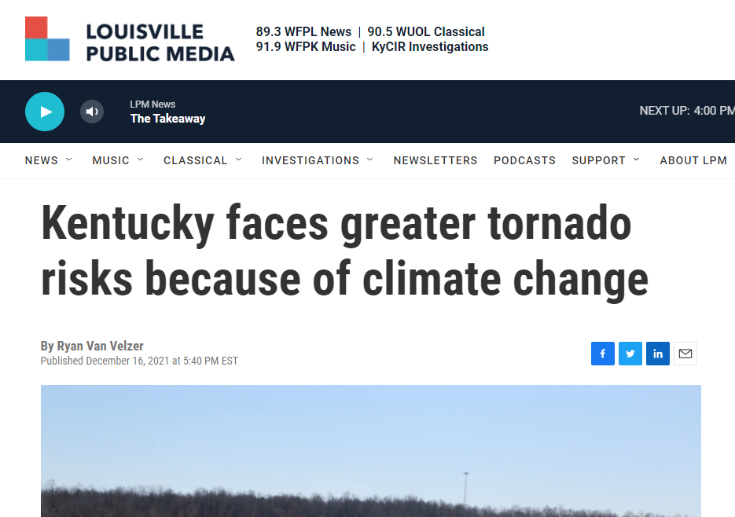
Billion Dollar Disasters are Becoming Increasingly Common
Notes:
Climate related disasters in 2021 alone costed the United States $145 billion (NOAA) and is expected to cost taxpayers another $14.5 trillion in the next 50 years (Deloitte). The south, central, and southeast U.S., which include Kentucky, have suffered the highest cumulative cost of damages, with Kentucky spending over 1% of its GSP, or over $1 billion on disasters in 2021. Louisville’s Climate Change Vulnerability Assessment report identifies flooding as the most expensive climate disaster, with large storms expected to continue to increase. The report estimates that reduced emissions could save $4 billion in flood damages at the national level.

Slide 8
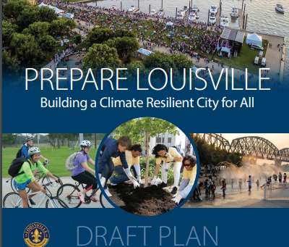
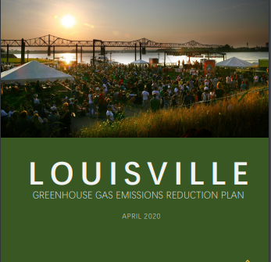

LMG’s Climate Plans and Studies
Sustain Louisville (2013)
Greenhouse Gas (GHG) Inventory (2016)
Plan 2040 (CHASE Principles) (2019)
Resilient Louisville (2019)
GHG Emissions Reduction Plan (2020)
Climate Change Vulnerability Assessment (2020)
Prepare Louisville (2020)

Slide 9
2016 Louisville Greenhouse Gas Inventory
City | Per Capita GHG Emissions
Columbus, OH | 13.2 tCO₂e
Austin, TX | 15.5 tCO₂e
US National Average | 16.5 tCO₂e
Nashville, TN | 20.1 tCO₂e
Louisville, KY | 20.9 tCO2e
Knoxville, TN | 21.7 tCO₂e
Memphis, TN | 22.0 tCO₂e
St. Louis, MO | 22.9 tCO₂e
16, 000, 537 tCO₂e

Slide 10
Louisville’s Guiding Sustainability Policies
R-102-19: Resolution for 100% Clean Energy
100% clean electricity for LMG operations by 2030
100% clean energy for LMG operations by 2035
100% clean energy community-wide by 2040
R-157-22: Resolution Establishing a Science-based Greenhouse Gas Emissions Reduction Target
Reduce emissions by half by 2030
Net zero emissions by 2040

Slide 11





How Do We Achieve 100% Clean Energy and
Net Zero Emissions?
Can we reduce demand for energy?
Can we clean up the energy supply?
Energy Demand
Energy Supply
Image: National Renewable Energy Laboratory (NREL)

Slide 12




Reducing Energy
Demand
Energy Management at LMG – Saving Louisville approximately $1 million per year through energy efficiency measures
Cool Roof Incentive Program - $1 per square foot incentive for Cool Roofs, with a majority of funds dedicated to high heat districts
Energy Project Assessment District (EPAD) – offered in partnership with Energize Kentucky
Communities Local Energy Action Program pilot – developing energy efficiency standards and best practices for affordable housing

Slide 13

Increasing Clean Energy Supply
What options can LMG consider to decarbonize the electricity supply?
Utility highly involved
Utility not involved
LG&E Green Tariff & Solar Shares Programs
Virtual Power Purchase Agreement
Utility and Policy Advocacy Activities
Municipalization
(LMG Only)
Municipalization
(Entire Community)

Slide 14

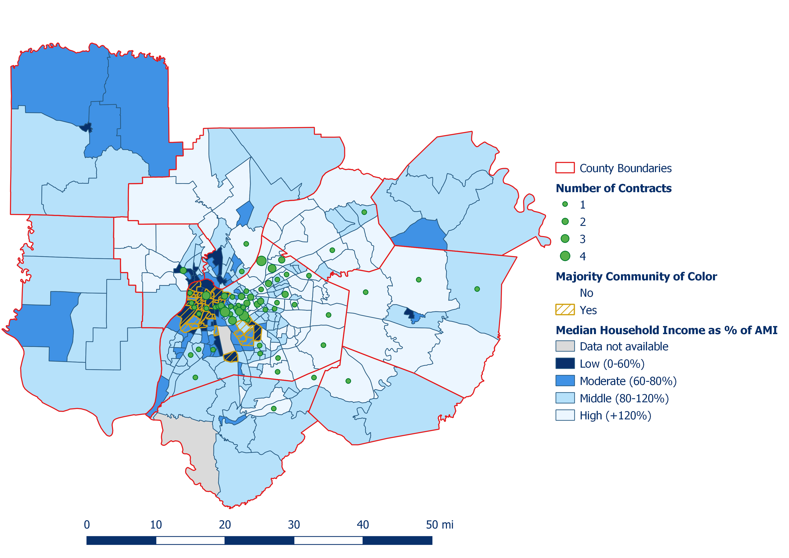

Advancing Clean Energy Community-wide

Slide 15
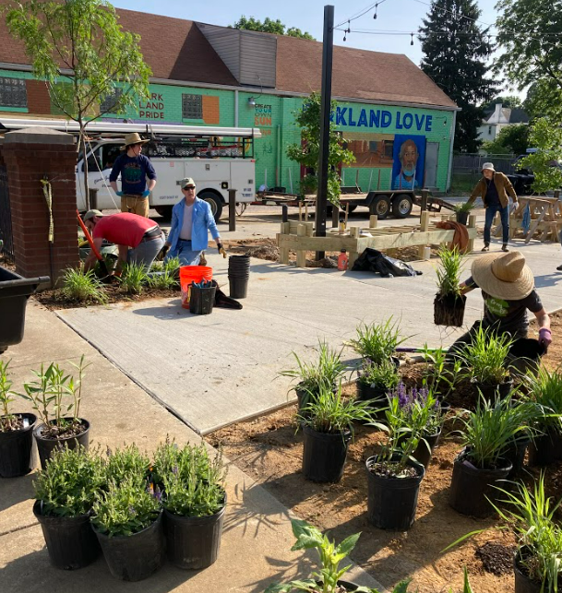
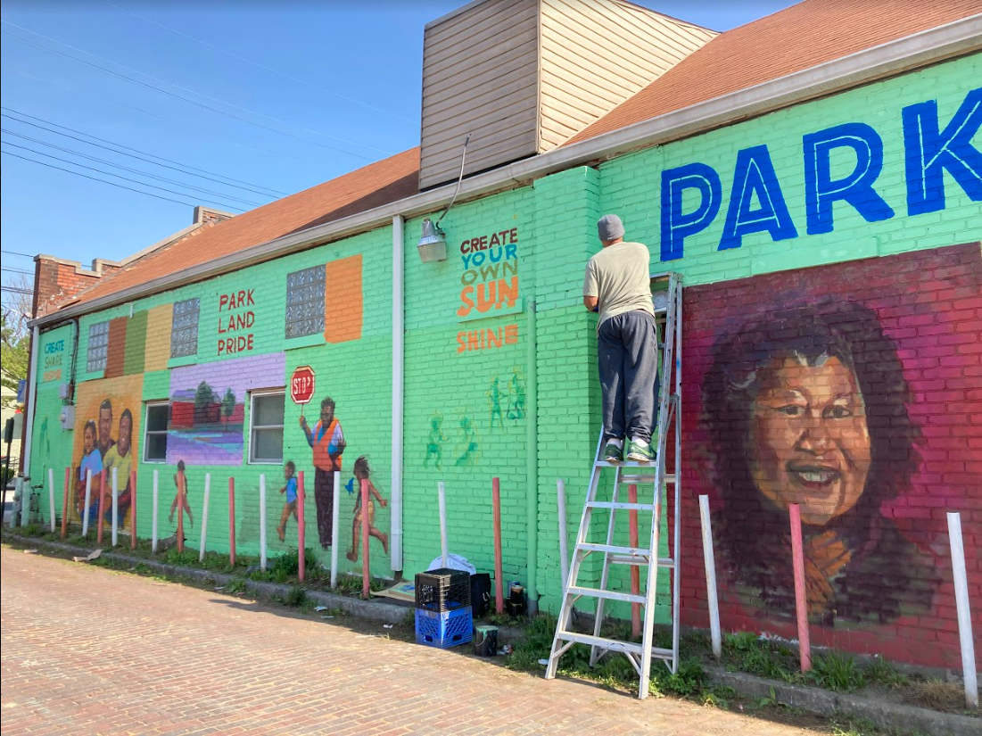
Other Efforts
OS also leads:
Integrating sustainability into the Mayor’s priorities
Net Zero Executive Order enforcement
Third party reporting
Metro Green Team
Federal grants

Slide 16
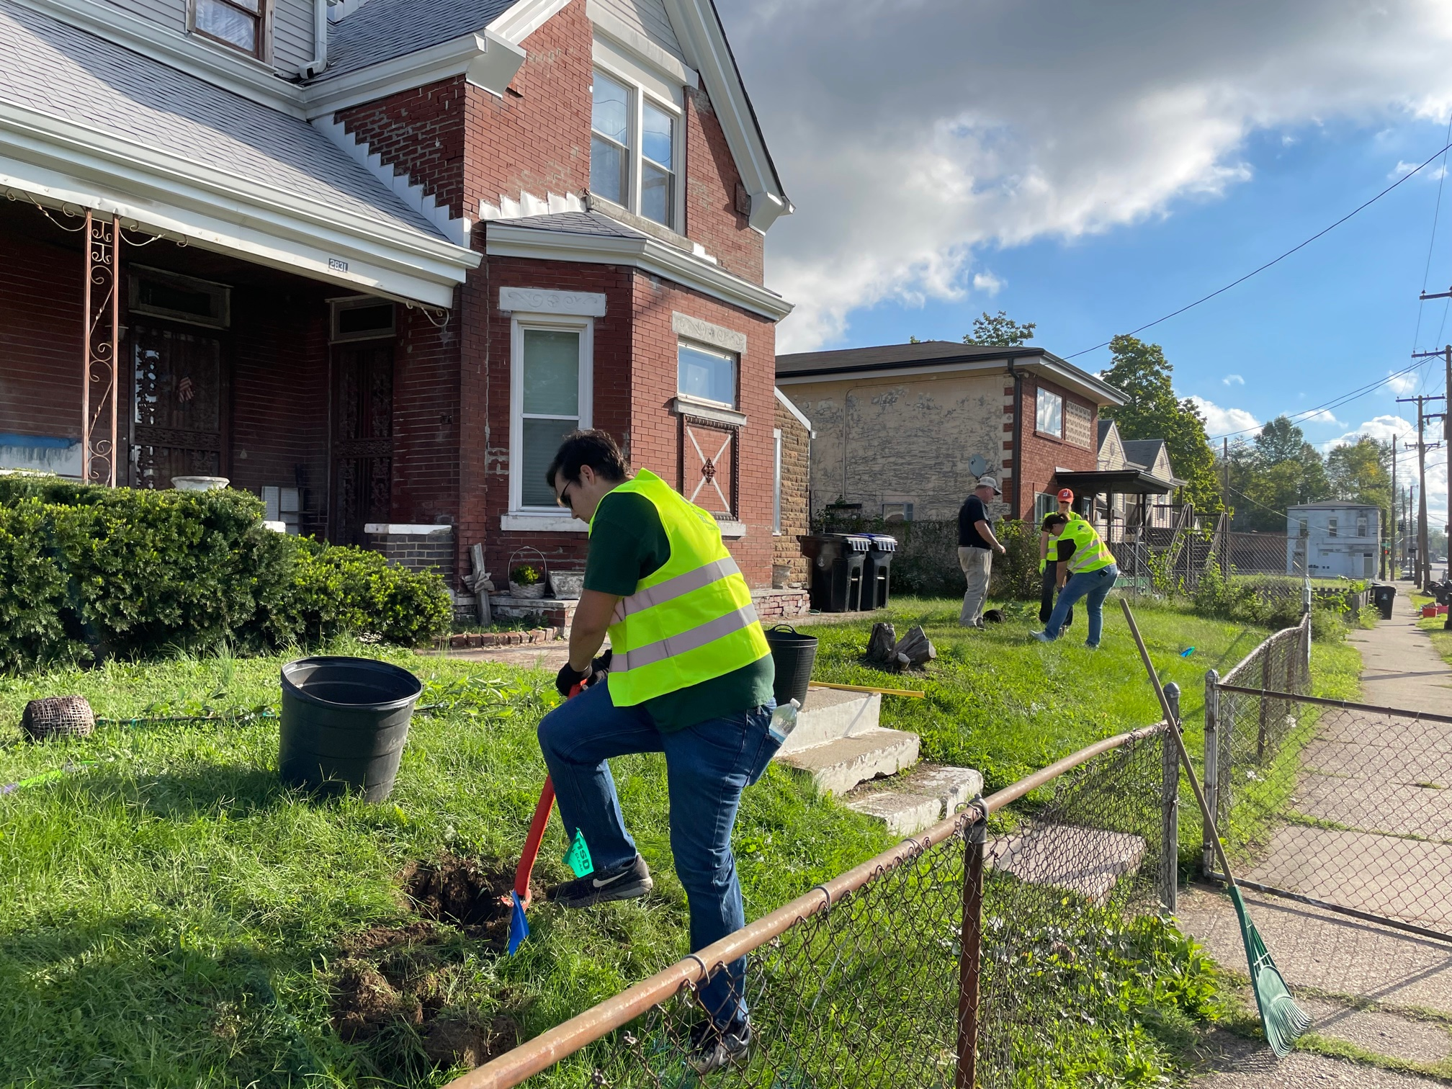
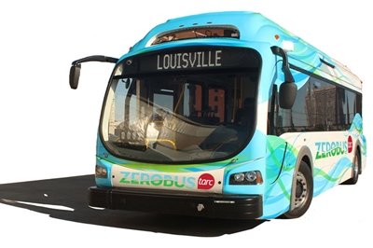
Other Efforts
OS works collaboratively with other agencies and organizations.
Natural areas (Parks, TreesLouisville, Louisville Jefferson County Environmental Trust, Bernheim)
Land use and development (Planning, Housing, Economic Development)
Sustainable transportation and vehicle electrification (Public Works, Fleet, KIPDA)
Waste management (SWMS)
Air quality (APCD)

Slide 17
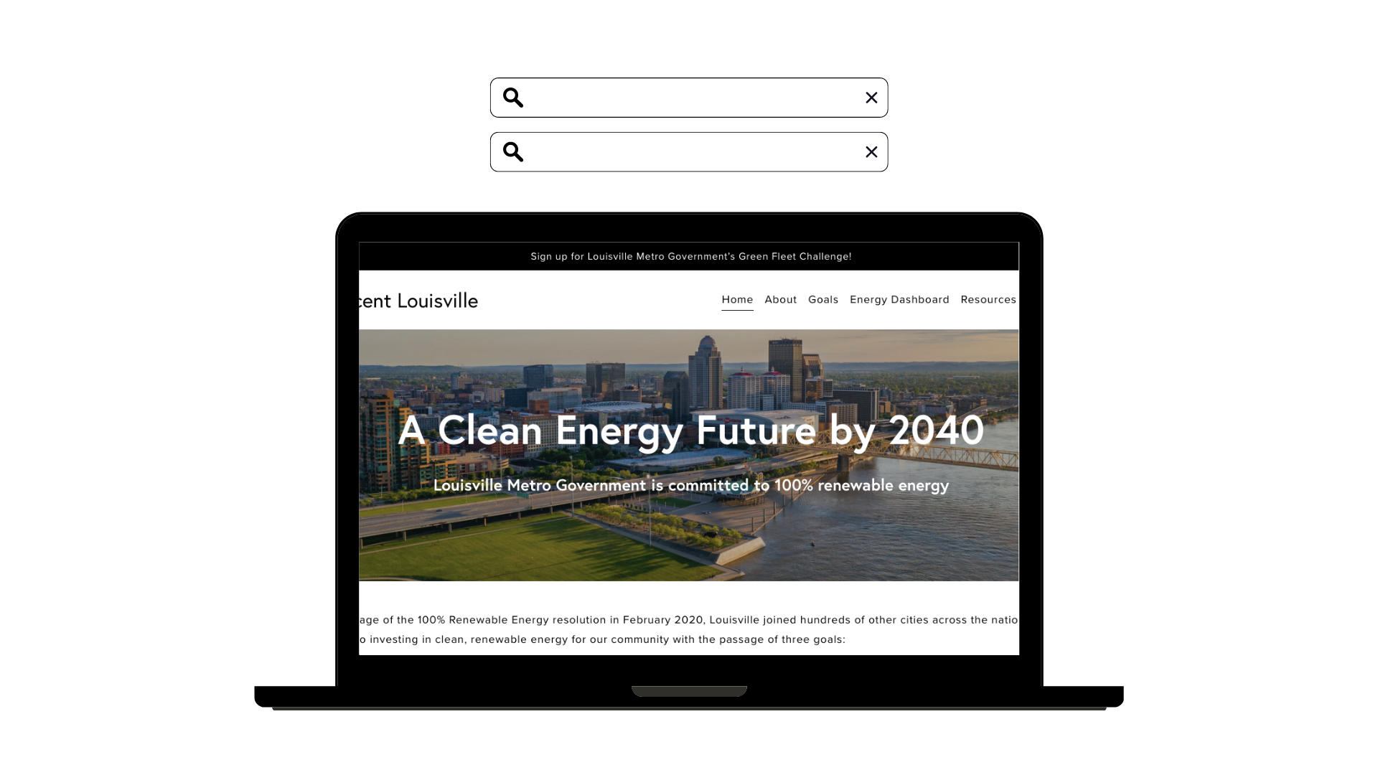

Stay
Connected
LouisvilleKY.gov/sustainability
Socials:
@SustainLouisville
@SustainLou
100PercentLou.com
Demand Side
Management
Contact: Sumedha Rao | sumedha.rao@louisvilleky.gov | 574-1910

