Slide 1

Energy 101: Understanding Your Electric Bill
And How to Lower It!

Slide 2
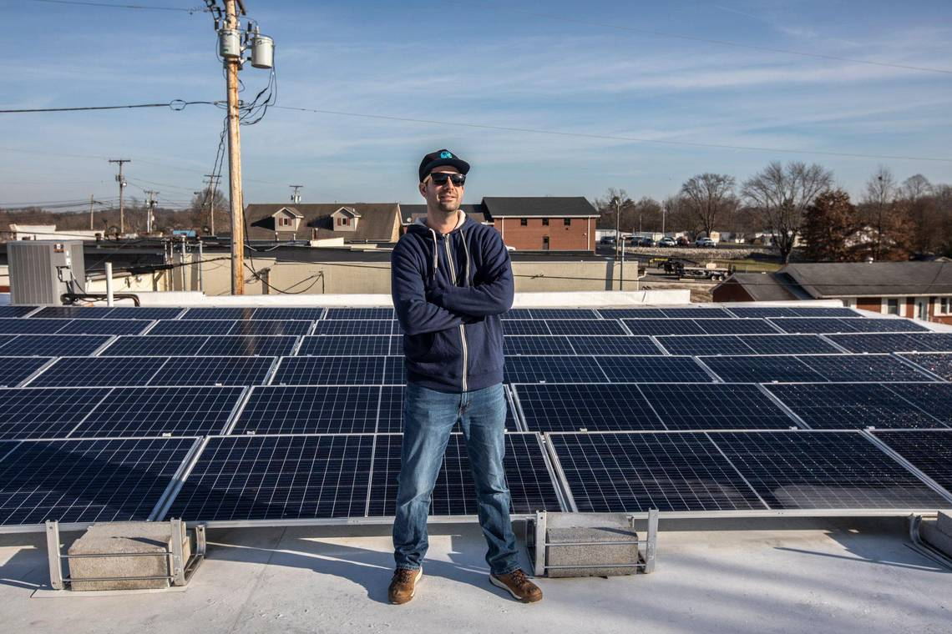
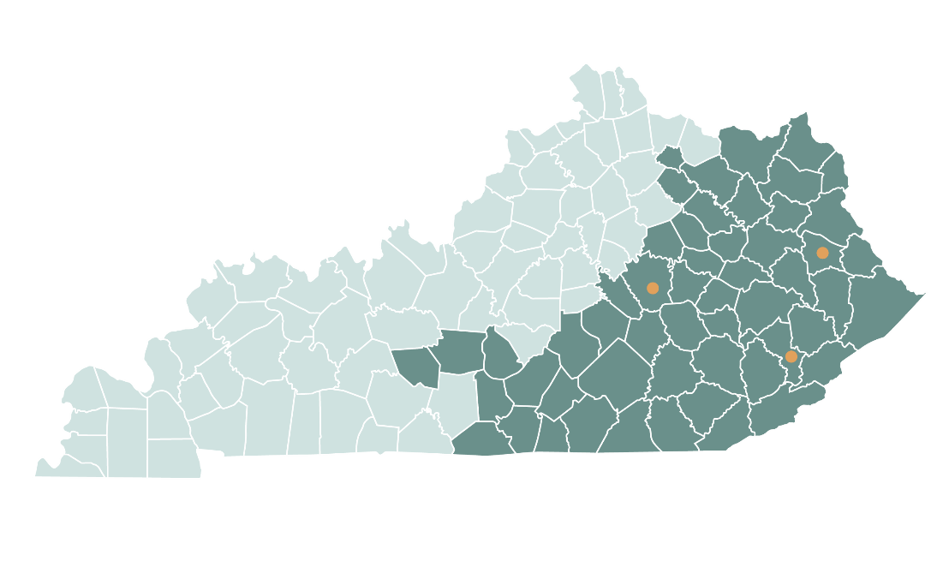
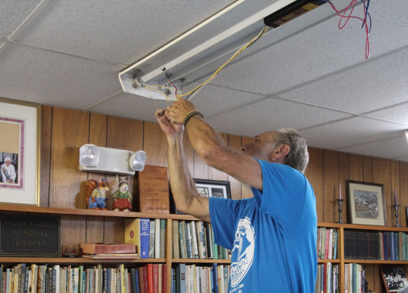
ENERGY
The Mountain Association invests in people and places in Eastern Kentucky to advance a just transition to a new economy that is more diverse, sustainable, equitable and resilient.
  Energy bills in Kentucky are too high.
  We help homeowners, businesses, nonprofits and public agencies in Appalachian Kentucky find much-needed energy savings. We do this through utility bill analysis, on-site energy efficiency and solar assessments, financing, and grant application support.

Slide 3
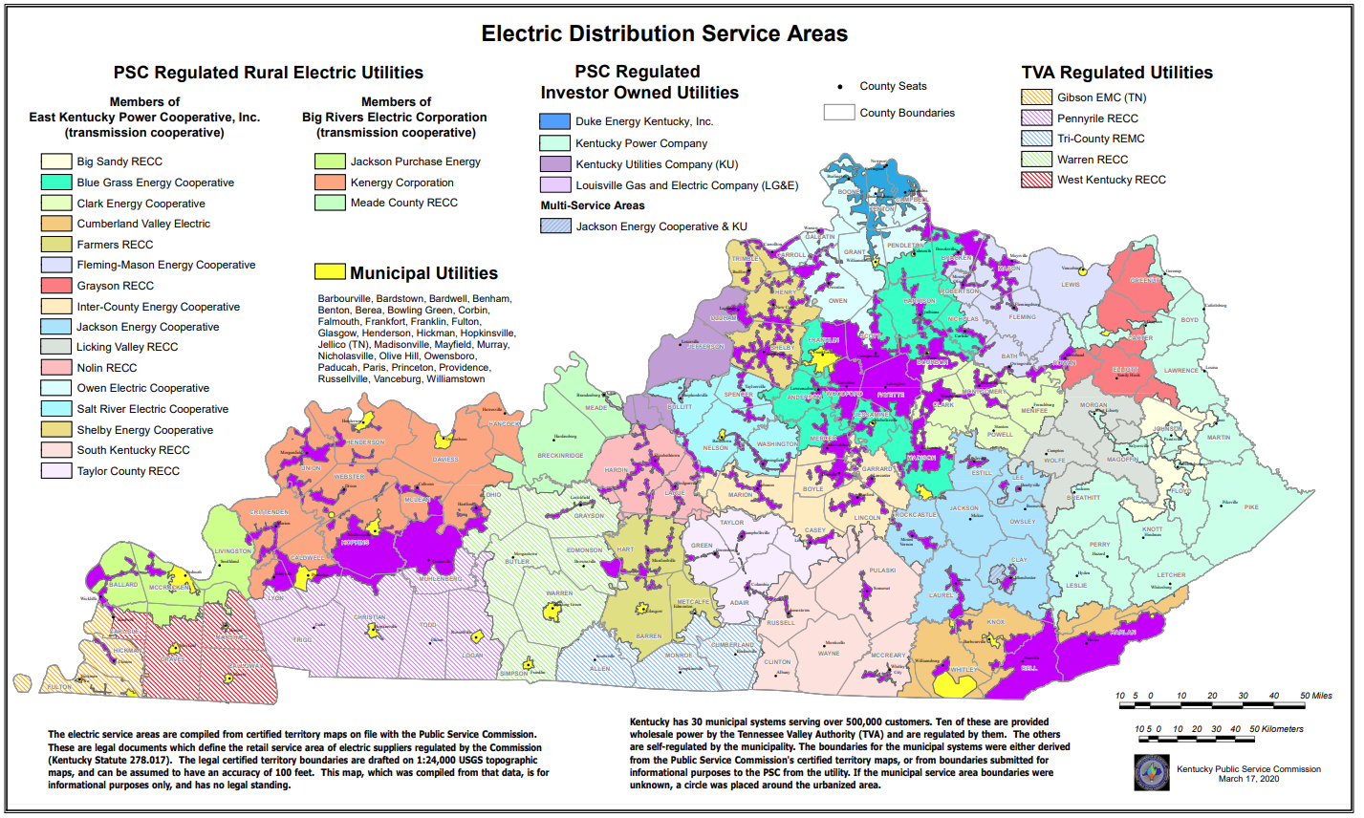
Kentucky’s Regulatory Landscape
In Kentucky there are:
4 investor-owned utilities
19 rural electric co-ops
30 municipally-owned utilities (“munis”)
5 TVA co-ops

Slide 4
Kentucky Public Service Commission (PSC)
  Regulates most electric, gas, water & telecoms
  In exchange for exclusive rights to sell power in their territories, electric utilities must have rates approved by PSC
  Investor-owned utilities are guaranteed a rate of return for their investors so they pass costs onto ratepayers in order to make profits
  RECCs & munis are non-profits
  Munis are not PSC regulated

Slide 6
Source: US Energy Information Agency

Slide 7

What’s In Your Electric Bill?
Usage Charge (kWh)
Customer Charge/Base Fee
Taxes
Surcharges & Fees
Demand Charge (kW)

Slide 8
A Little More about Demand…
Demand is the RATE at which you use power, measured in 15-minute increments. Your demand charge is for the peak 15-minute period during your billing cycle.

Slide 9

A Little More about Demand…
Demand is the RATE at which you use power, measured in the highest 15-minute period each month
Kentucky Utilities – Power Service rate class (over 50kW)
  $22.66/kW (winter)
  $25.30/kW (summer)
Kentucky Power – General Service & Large General Service
  General Service – all kW over 10kW, $8.36/kW
  Large General Service - $13.84/kW
RECCs – varies
  Applies at 25-50kW
  Charges range from $4.22/kW to $7.41/kW
KY Power: $10-$13
RECCs: $7-$13
KU: $34- $38

Slide 10
Surcharges & Fees
LG&E/Kentucky Utilities
RECCs
Kentucky Power
  Fuel Adjustment
  Environmental Surcharge
  DSM Charge
  Fuel Adjustment
  Environmental Surcharge
  Fuel Adjustment
  Environmental Surcharge
  DSM Adjustment
  Federal Tax Credit (credit)
  Kentucky Economic Development Surcharge
  Purchased Power Adjustment

Slide 11
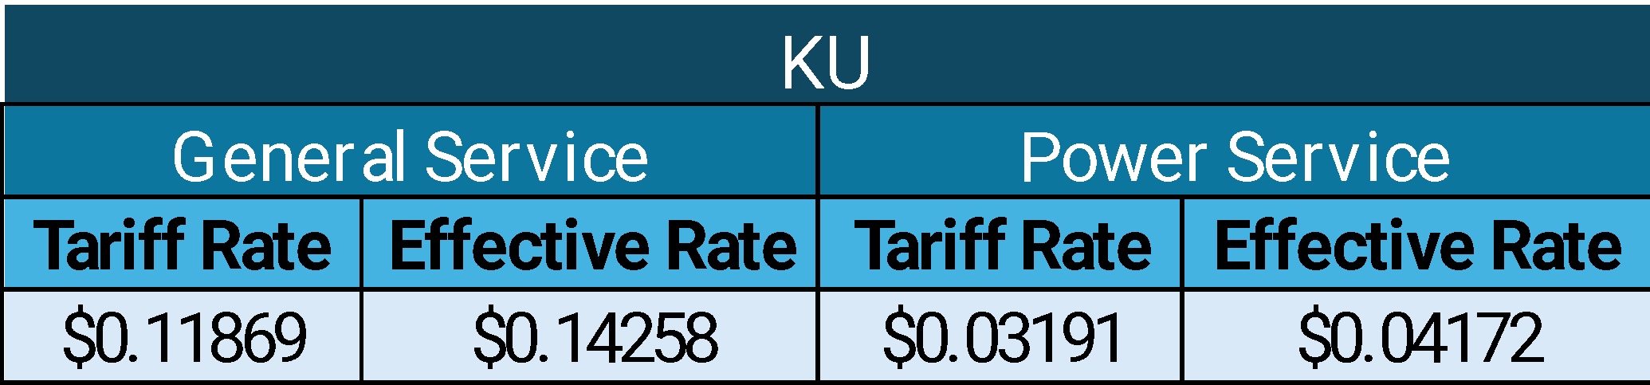
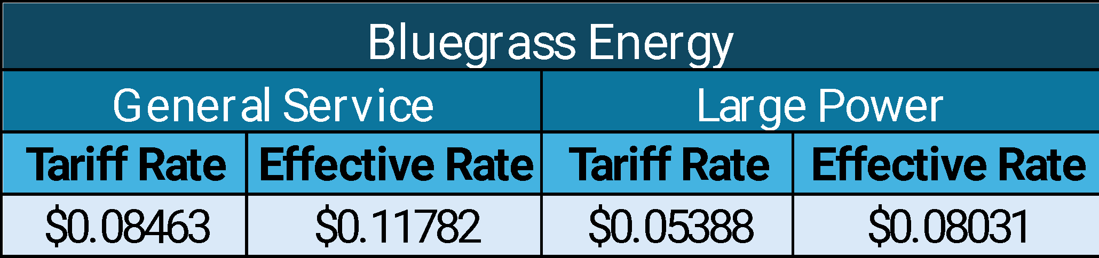
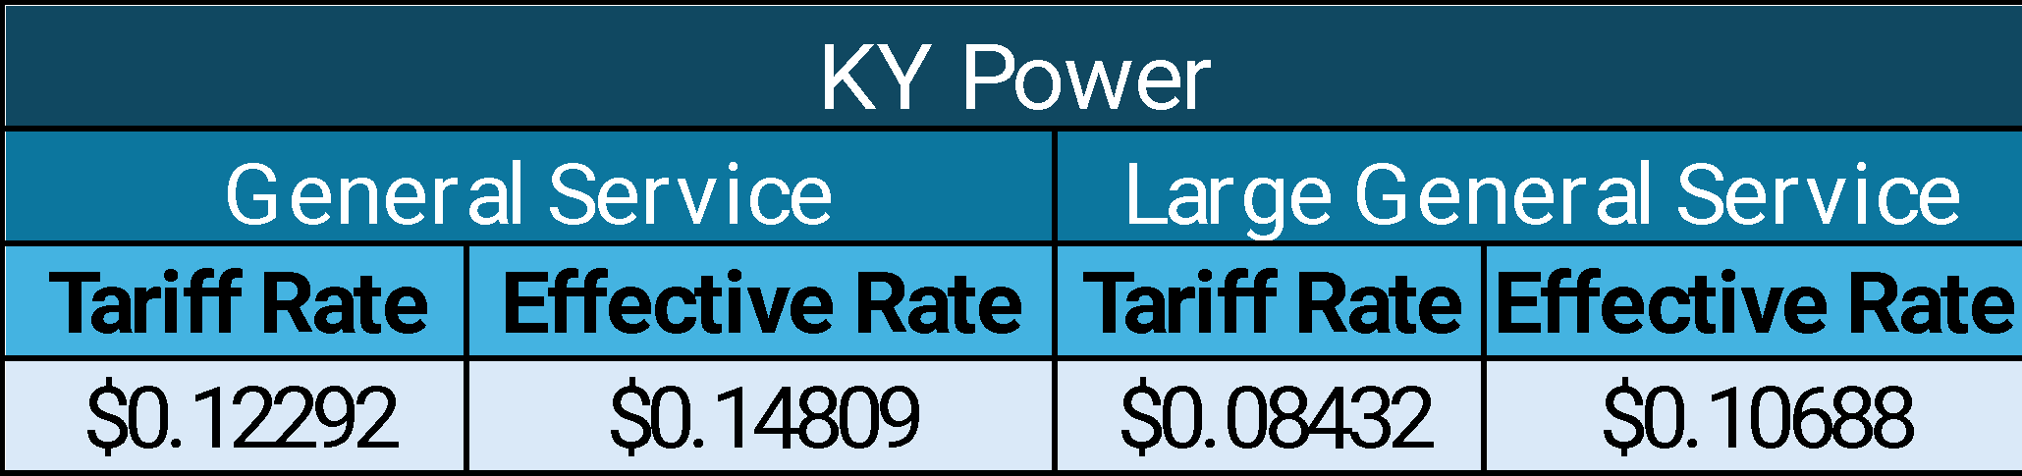
So What’s Your Actual Rate?

Slide 12
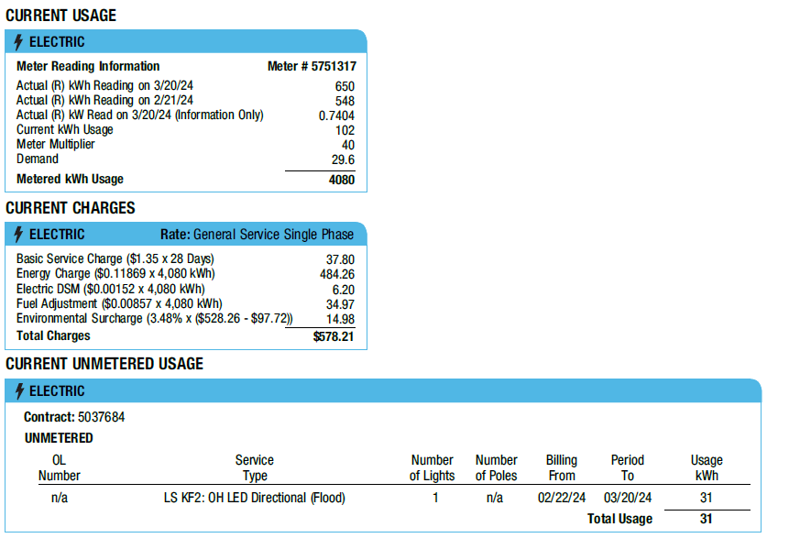


Slide 13

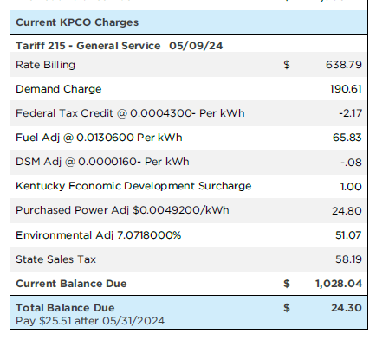
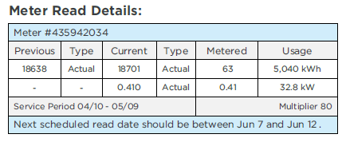

Slide 14

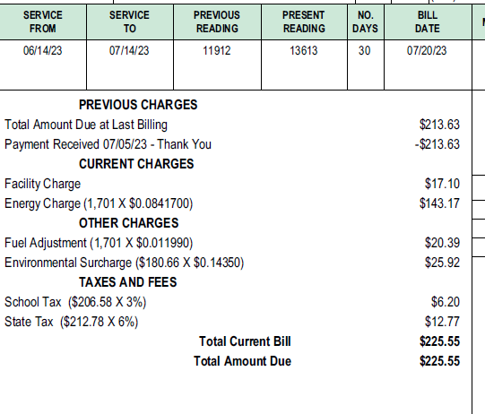

Slide 15
Paying attention to your bills can pay off!
Our clients have saved:
  Over $113,000 in sales tax removals and refunds
  Over $34,800 per year in rate class changes
  Over $55,000 per year in other billing corrections
All without spending a cent!

Slide 16
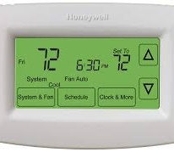


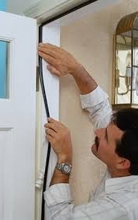
DIY Efficiency Measures
Air seal around doors and windows
Change out screw-in bulbs to LEDs
Install programmable thermostats
Have a heat pump? Don’t turn it up more than 2 degrees at a time in the winter!
Change your air filters – look for MERV ratings between 8-12

Slide 17




What can you do about demand?
Don’t turn everything on all at once!
Install programmable or wi-fi thermostats
In the winter, don’t turn up your thermostat more than 2 degrees at a time if you have a heat pump
Consider efficiency upgrades, especially if right on the rate class threshold

Slide 18
Demand rates vary
Kentucky Utilities – Power Service rate class (over 50kW)
  $22.66/kW (winter)
  $25.30/kW (summer)
Kentucky Power – General Service & Large General Service
  General Service – all kW over 10kW, $8.36/kW
  Large General Service - $13.84/kW
RECCs – varies
  Applies at 25-50kW
  Range from $4.22/kW to $7.41/kW

Slide 19
A little planning can go a long way!

Slide 20

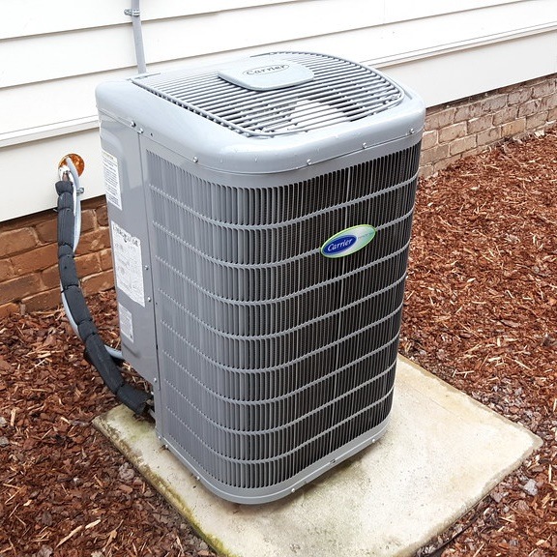
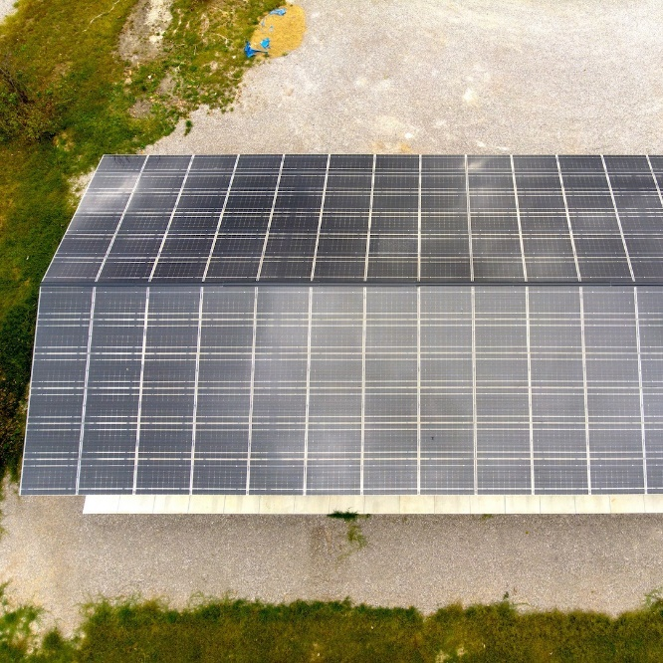
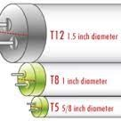
Typical Energy Upgrades
Lighting – typically pays for itself in under 2 years
HVAC – usually only if it’s failing
Insulation
Air sealing
Renewables

Slide 21
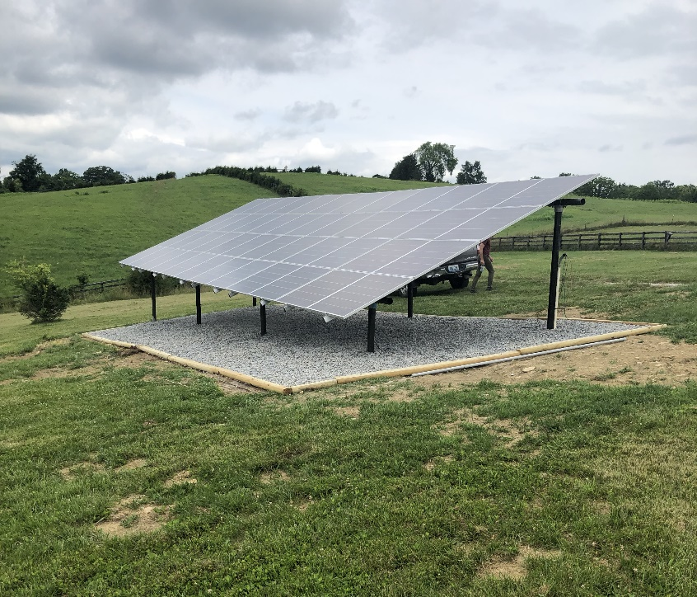
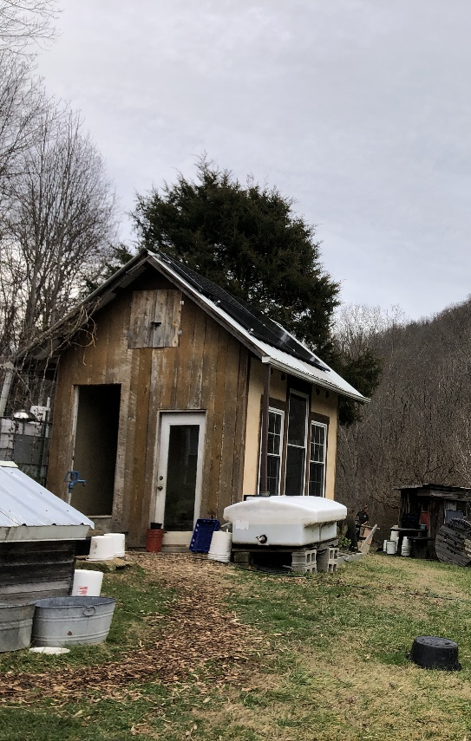
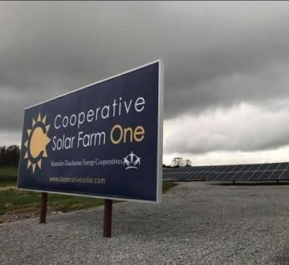
Solar
Grid-tied vs. off-grid
Behind the meter vs. utility “solar share”
Solar scams

Slide 22
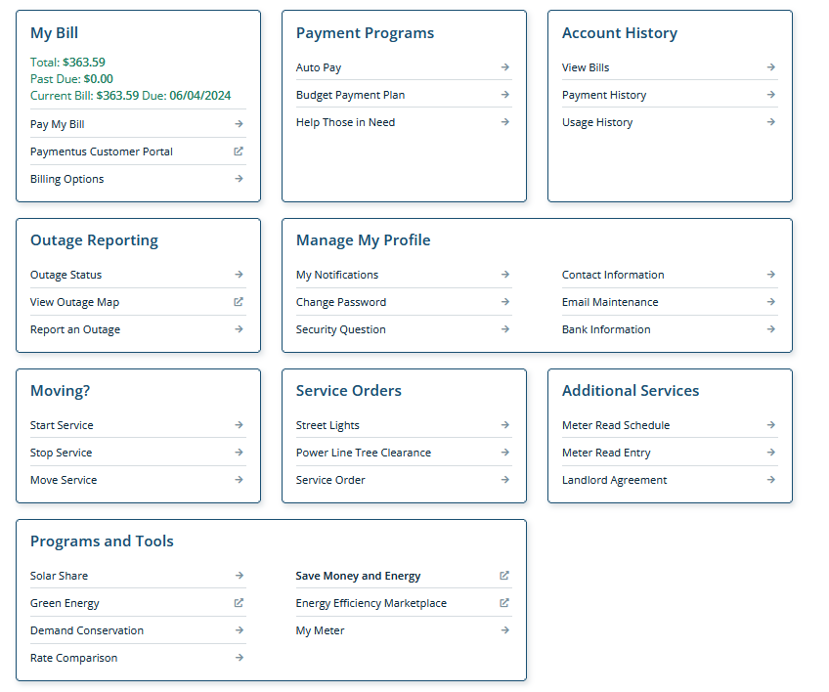
Incentives can lower the cost of your upgrades!
KU’s Small Business Direct Install (SBDI) Program
  Free energy audit
  Up to $675 of upgrades including lighting & smart thermostats
KU Commercial Rebates
  Lighting
  Chillers
  Motors & Pumps
  Efficiency Audits

Slide 23
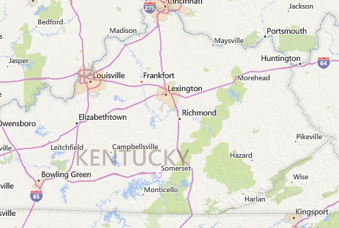
USDA Rural Energy for America Program (REAP)
50% cost-share (for now)
For-profit business in a rural area
Own your building or have a long-term lease
12 months of usage for efficiency upgrades
Grant is NOT retroactive – must apply first!

Slide 24
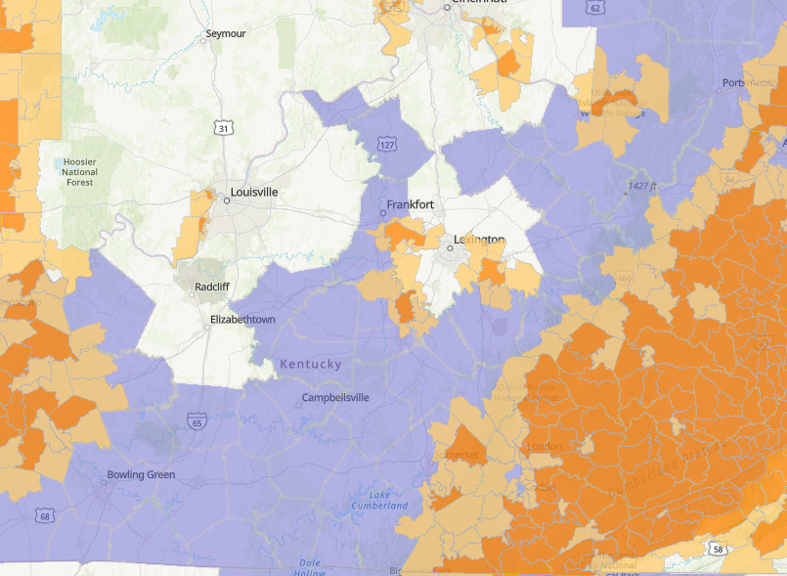
Solar Incentives
Investment Tax Credit & Elective Pay
  30% - 40% of project cost
Solarize programs
  Lexington – deadline August 9
  Frankfort – deadline July 31
  Boyle (includes surrounding counties) – deadline July 31
  Louisville (includes surrounding counties)

Slide 25
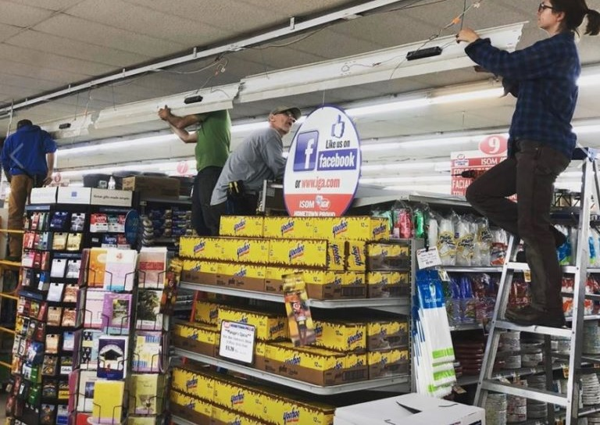
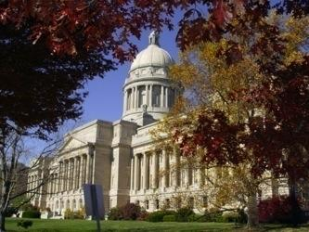
Businesses & Non-Profits are Saving
Wolf Gap Gardens, Berea –
$1,300 per year (solar)
Wolfe County Public Library –
$1,800 per year (lighting)
Centerfield Farm, Nicholasville –
$4,500 per year (solar)
AppalReD Legal Aid, Prestonsburg –
$4,700 per year (lighting)
Longview Estates, Lancaster –
$10,300 per year (insulation, lighting, HVAC & solar)
Isom IGA, Letcher County –
$67,000 per year (lighting, refrigeration & solar)

Slide 26
Are you in Appalachian Kentucky?
We can help!
We serve all 54 counties designated as “Appalachian” by the Appalachian Regional Commission.
1. Apply at mtassociation.org/energy
2. Utility bill analysis
3. On-site energy audit
4. Energy assessment report
5. Follow-up support
All at no cost to you!

Slide 27
Outside Our Service Territory?
Kentucky Utilities – Small Business Direct Install Program
East Kentucky Power Cooperative – Envision Energy Services
UK Industrial Assessment Center
Kentucky Pollution Prevention Center at U of L
Energy Services Companies

Slide 28

Contact Us
Carrie Ray
carrie@mtassociation.org
859-544-0023
Cameron Mott
cameron@mtassociation.org
859-544-5860
Berea Office
433 Chestnut Street
Berea, KY 40403
859-986-2373
Hazard Office
420 Main Street
Hazard, KY 41701
606-439-0170
Prestonsburg Office
268 Friend Street, Ste 101
Prestonsburg, KY 41653
606-264-5910
mtassociation.org | info@mtassociation.org | @mtassociationky

Slide 29
Questions?
Want to learn more?
Check out Energy 201 in the next session!

