Slide 1

PACE Financing in KY
2024

Slide 2


Energize Kentucky LLC
Assisted with legislative effort: EPAD Act of 2015
Statewide third-party EPAD Program Administrator
Public-Private Partnership: County & City Governments
Authored “EPAD Handbook for Local Governments” in conjunction with the state energy office in 2016
Total PACE closings: $800M+ total including OH partners
Chris Jones: 1993 UK Graduate; National PACE Leader; KY Colonel

Slide 3
WHAT IS PACE FINANCING?
Special assessment financing for energy efficiency & renewable energy building improvements; repaid via a special assessment added to a commercial private property owner’s tax bill.
WHAT IS EPAD?
Energy Project Assessment District
Authorized by local governments
Notes:
Explain Voluntary vs Involuntary Tax assessment

Slide 4
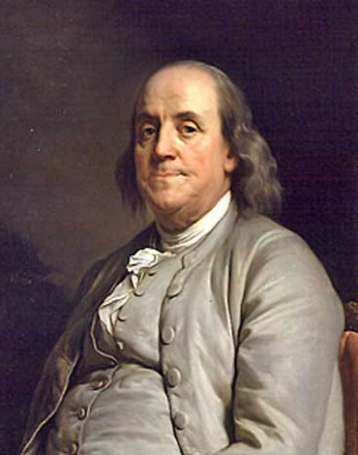
OLD CONCEPT / NEW APPLICATION
1736 – First Assessment District created in Philadelphia
Today – 37,000 Assessment Districts nationwide
Water & Sewer Service
Parks
Sidewalks & Lighting
Downtown Renewal
Energy Efficiency (PACE)
  Single Property Owner request
Notes:
Explain Voluntary vs Involuntary Tax assessment

Slide 5
Kentucky’s PACE law
In 2015, the General Assembly adopted KRS §65.205-209, authorizing local governments to:
Create an Energy Project Assessment District (EPAD),
Contract with a third-party administrator to manage the EPAD activity (no cost to the local government; all costs are paid by the property owners who participate),
Allow a single commercial property owner to voluntarily request an EPAD assessment,
Levy an EPAD assessment on the real property tax record upon the PACE loan closing.
Energize Kentucky can assist with the administrative servicing of the EPAD assessment.
Notes:
No Down Payment
No Personal Guarantee
Off Balance Sheet Treatment
Can be treated as an operating cost
Interest portion of assessment is tax deductible*
Fixed rate/ Fixed Payment over the entire term
Longest term available for capital projects (15-25 years)
Upon sale, stays with the property and NOT the business
Soft costs are included in the assessment

Slide 6
ELIGIBILE PROPERTY TYPES
Private commercial property
Includes non-profit commercial property
Includes residential multi-family (4+ units)
Excludes single-family residential property
Notes:
No Down Payment
No Personal Guarantee
Off Balance Sheet Treatment
Can be treated as an operating cost
Interest portion of assessment is tax deductible*
Fixed rate/ Fixed Payment over the entire term
Longest term available for capital projects (15-25 years)
Upon sale, stays with the property and NOT the business
Soft costs are included in the assessment

Slide 7
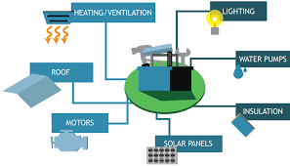
Eligible Improvements
Energy Savings, Renewable Energy or Water Efficiency
Heating/Ventilation
Lighting
Water Pump
Roof
Insulation
Motors
Solar Panels
Notes:
HVAC, Building automation, windows, air sealing, elevators, fans, motors, etc.

Slide 8
How pace is used
  Existing building upgrades (original intent for PACE)
  New construction or “gut rehabs”
  “Retroactive” PACE (i.e., refinancing with PACE)

Slide 9
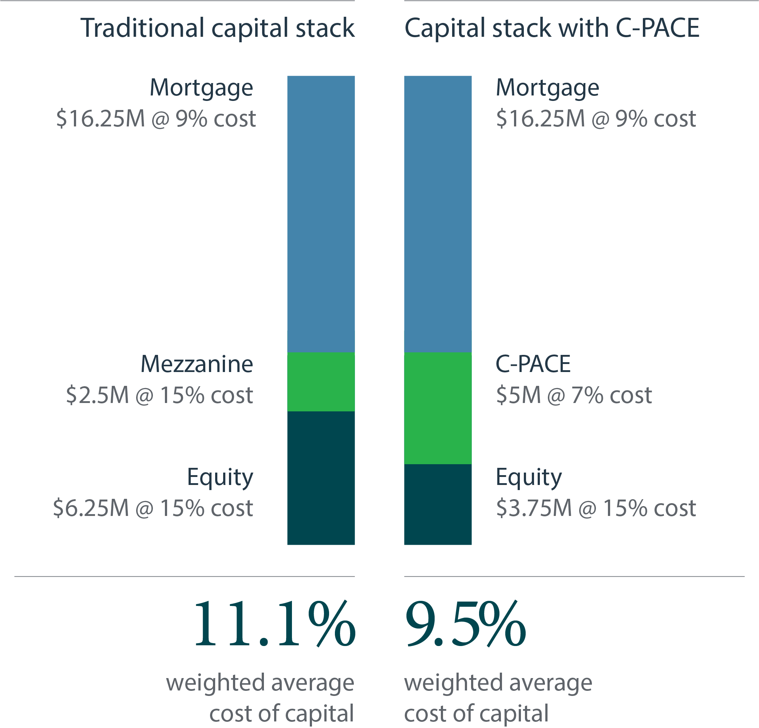


Slide 10
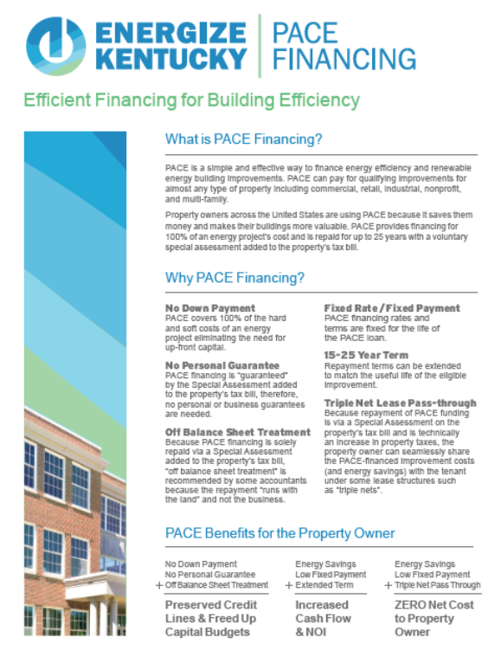
BENEFITS TO PROPERTY OWNERS
No Down Payment
No Personal Guarantee
Preserves Credit Lines
Fixed Rate/ Fixed Payment
Long term: 10-30 years
  Useful life of improvements
Solves Split Incentives
  Assessment pass-through
Transfers with Property Sale
Notes:
No Down Payment
No Personal Guarantee
Off Balance Sheet Treatment
Can be treated as an operating cost
Interest portion of assessment is tax deductible*
Fixed rate/ Fixed Payment over the entire term
Longest term available for capital projects (15-25 years)
Upon sale, stays with the property and NOT the business
Soft costs are included in the assessment

Slide 11
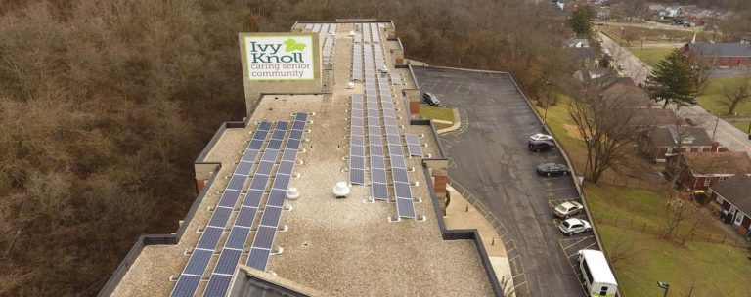
ROOFTOP SOLAR: Covington
Key Points:
$750,000 PACE Loan; 1st PACE project in KY (December 2015)
37% Annual Energy Savings along with other ECMs
20 Year EPAD Assessment
Notes:
First project in the state of KY

Slide 12
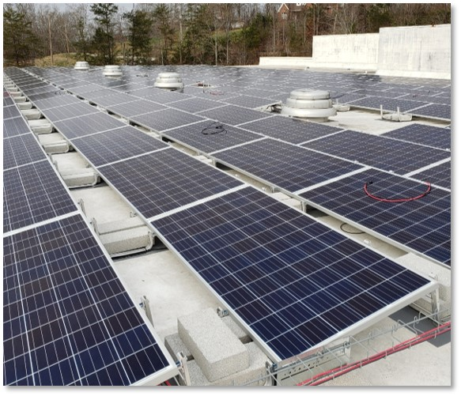
Rooftop solar: Morgan County
Key Points:
160 KW PV Array, 488 panels; LED Retrofit, 677 fixtures
Corporate Sustainability Goals was initial motivation
Reduced business operating expenses by lowering energy expense
Solar Financial Benefits: Federal ITC and Accelerated Depreciation

Slide 13

Property Type:
Fitness Center
Lender:
Imperial Ridge (FNA Lever)
Improvement Projects:
LED lighting retrofits
HVAC upgrades
Loan Amount:
$403,750.56 (15-year term)
Springhurst Tennis Club

Slide 14
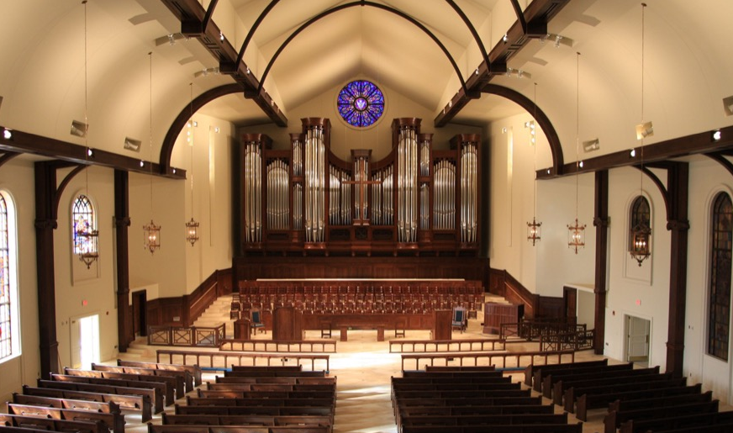
Property Type:
House of worship
Lender:
Citizens Union Bank
Improvement Projects:
High-efficiency HVAC system
LED lighting retrofits
Loan Amount:
$477,016 (20-year term)
Christ Church United Methodist

Slide 15

hospitality: woodford county
Key Points
Created the Woodford County EPAD
1st Retroactive PACE deal in KY
$3M PACE loan
Energy Improvements:
Building Envelope
LED Lighting
HVAC / Automation / Controls

Slide 16
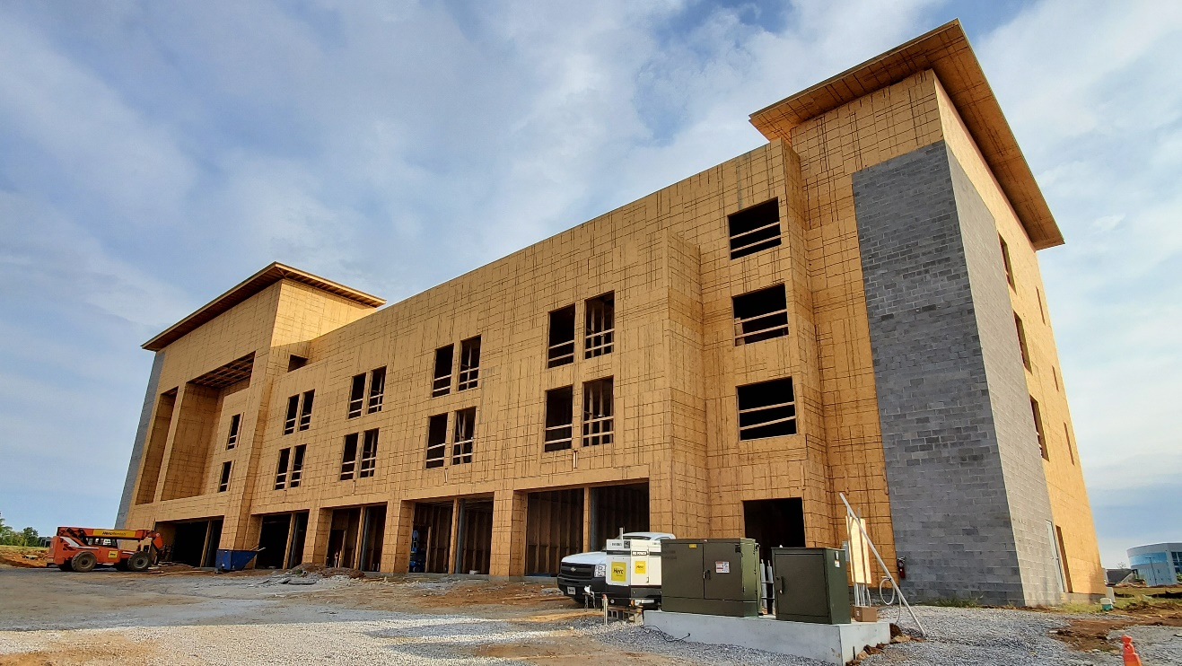
Property Type:
94-room hotel
Lender:
PACE Equity
Improvement Projects:
High-efficiency HVAC system
Building envelope
52 solar panels
20 windmills
Loan Amount:
$1,745,737 (25-year term)
La Quinta Del Sol

Slide 17
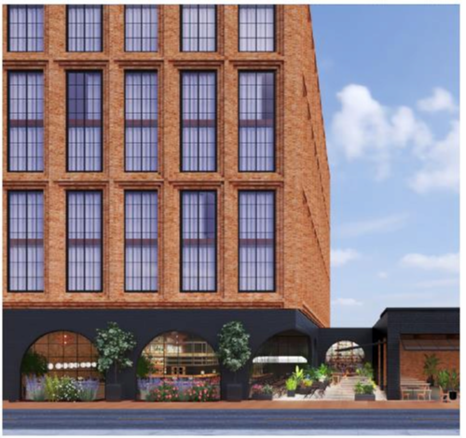
hospitality: Fayette county
Key Points
Largest PACE loan in KY to date
$8M PACE Loan ($40M total capital stack)
Combined with an Industrial Revenue Bond (IRB)
Energy Improvements:
Building Envelope (ICF construction)
LED Lighting
HVAC / Automation / Controls

Slide 19

Contact
  Chris Jones
  Program Manager
  859.468.5598
  cjones@kypace.org

