Slide 1
Zero Landfill Initiative
Maker’s Mark Distillery
Lindsey Downs
Environmental, Health, & Safety Manager

Slide 2
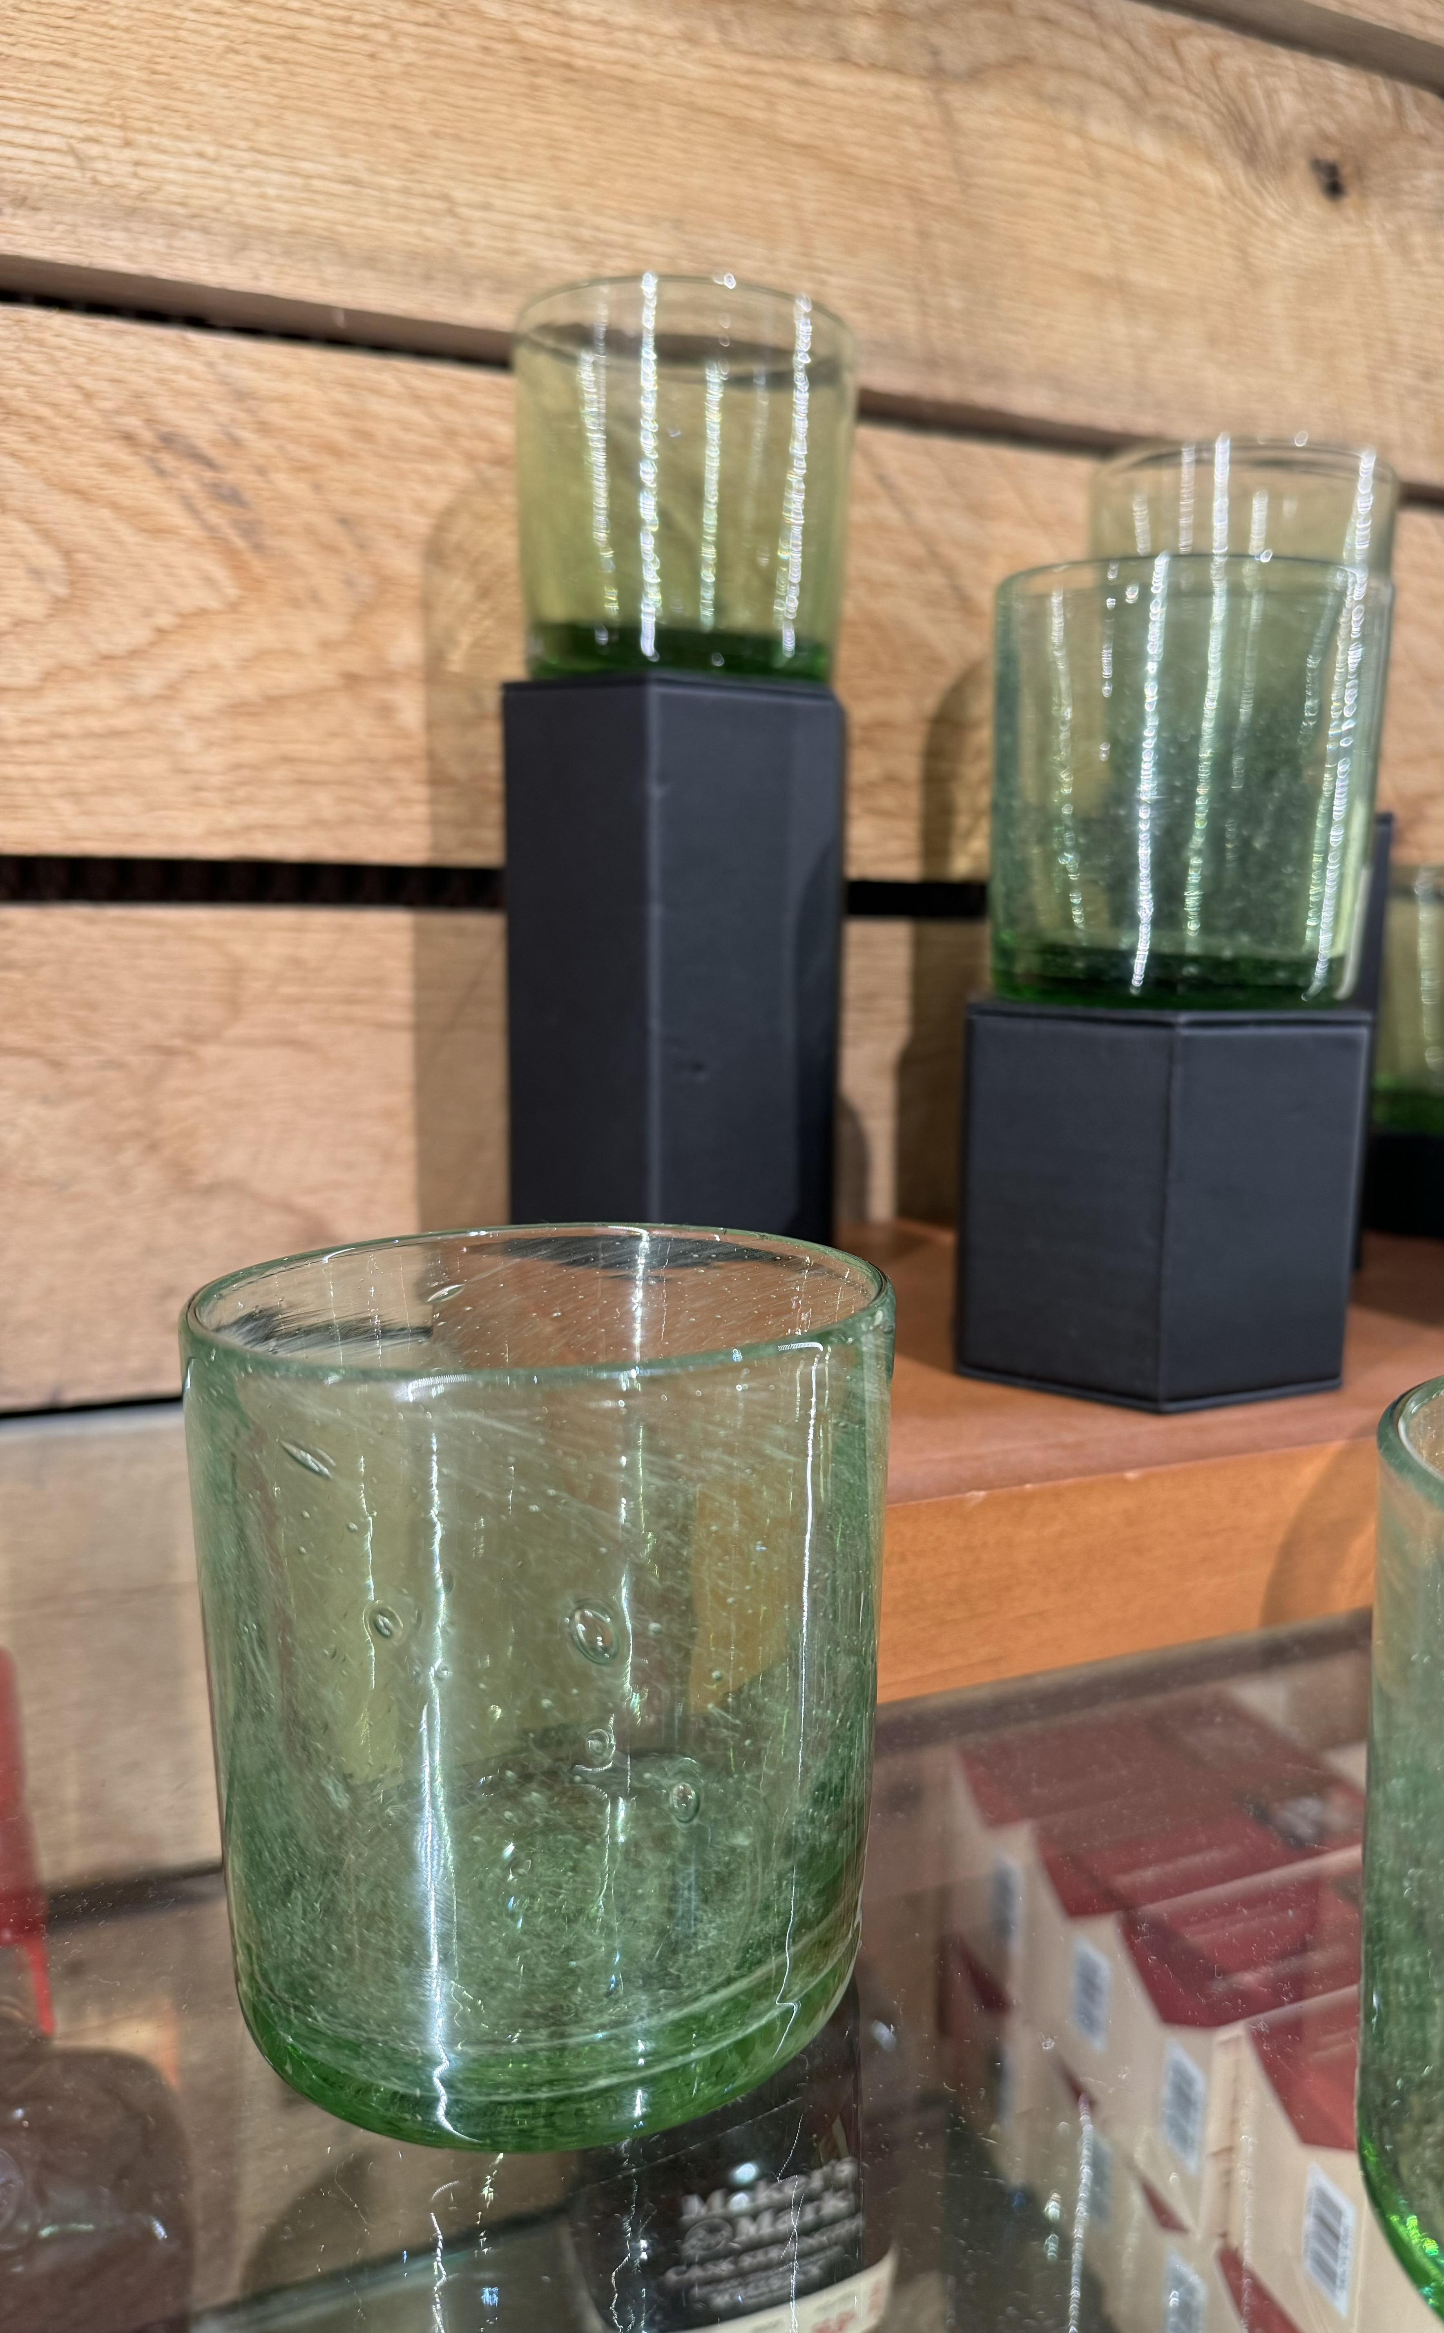
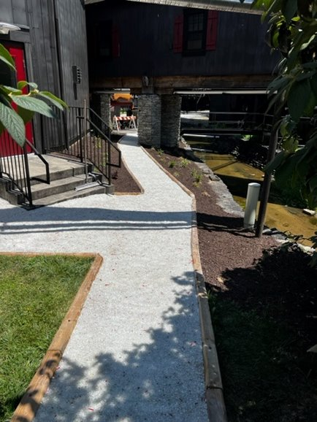
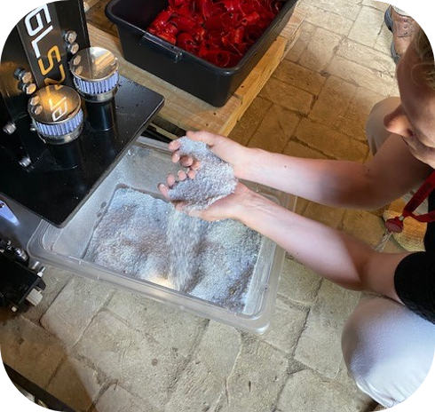
Glass to Sand Pulverizer
Maker’s Mark handles over 20 tons of waste glass per month. The glass-to-sand initiative was championed to create a resource from a waste, while reducing the transport to recycle waste glass.
Glass-to-sand pulverizers in multiple areas across the campus.
The sand is used on our nature trails across Star Hill Farm and the campus, along with unique glassware for the hospitality program.
Partnering with Marion County Road Department to use material for aggregate for road construction
Pulverized sand is available to our employees to use at their homes.
Generate approximately 130 tons of waste glass annually.
Glass to sand pulverizer

Slide 3
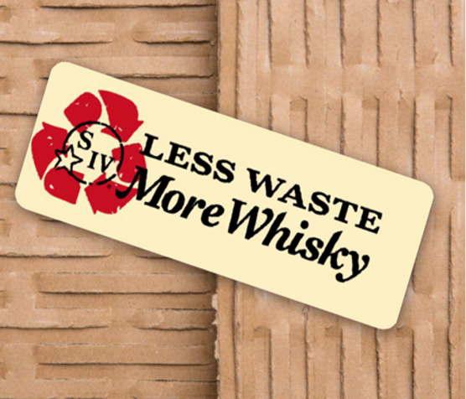
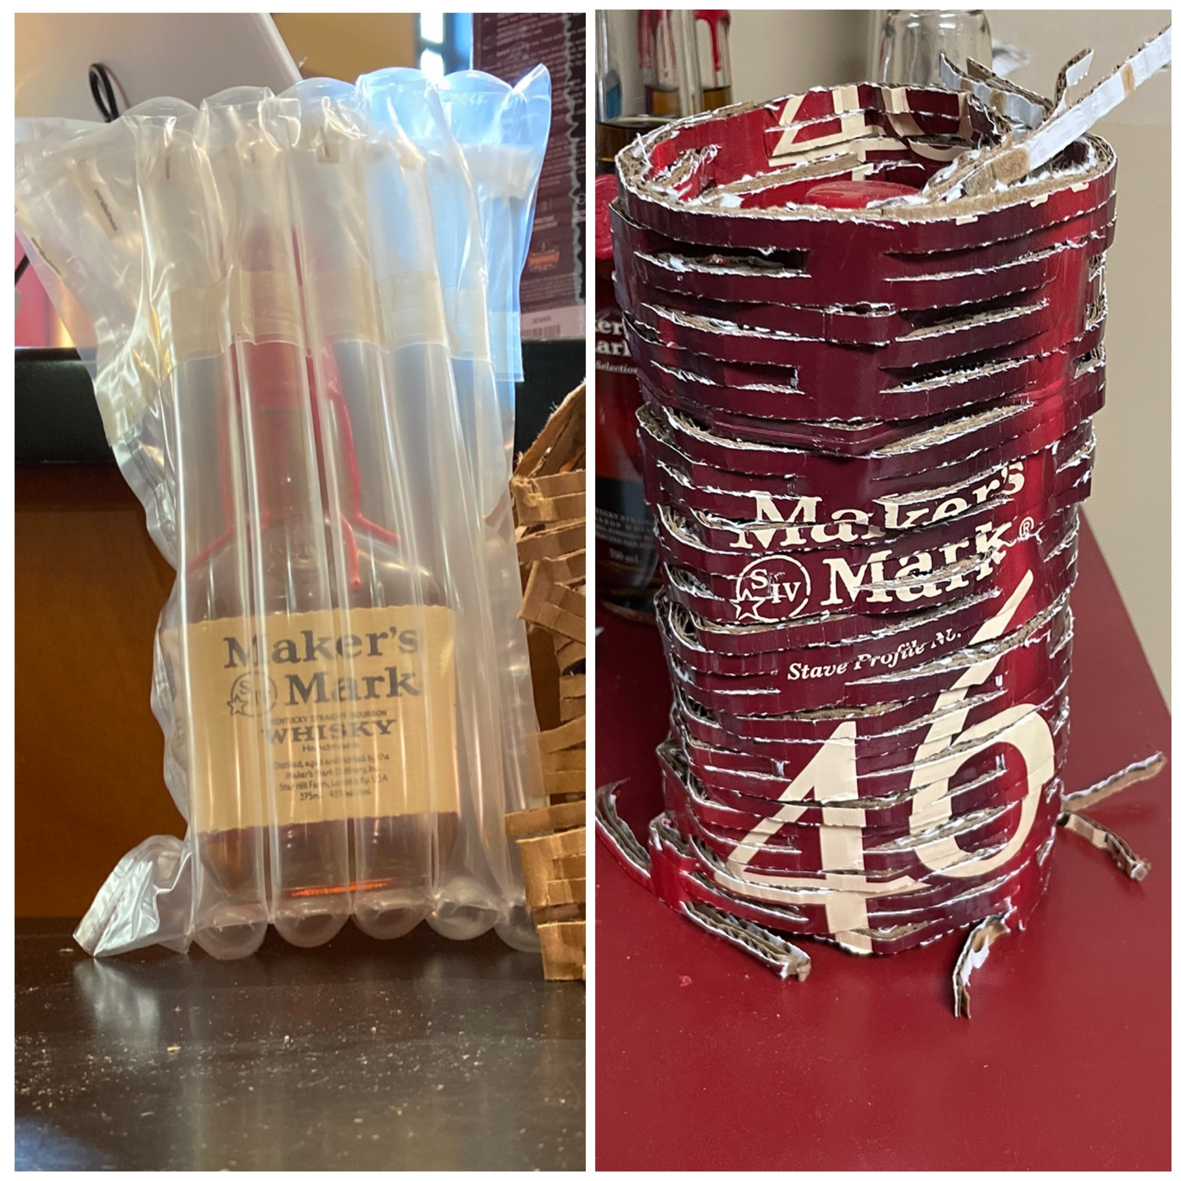
Cardboard Perforator
An initiative to reduce plastic packaging material utilizing an existing waste stream.
The initiative was initiated by a campus employee
The Hospitality team is using the cardboard they generate from whisky sales and merchandise versus recycling.
Perforated cardboard material can be used to wrap breakable items such as glassware and whisky bottles, in place of plastic.
Bringing employee suggestions to fruition promotes employee engagement and buy-in.
Before
After
Cardboard perforator

Slide 4
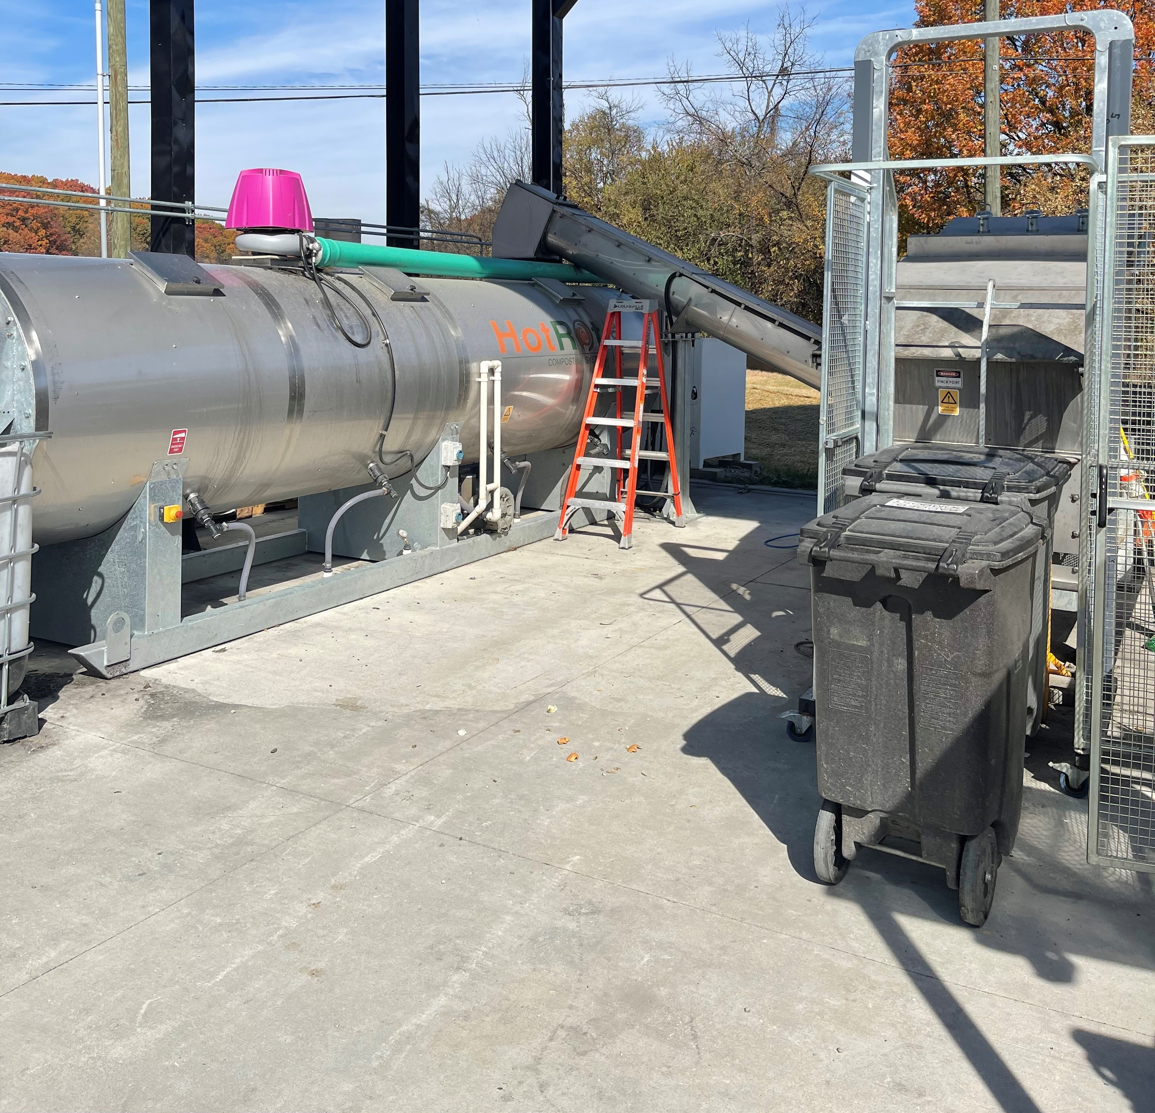
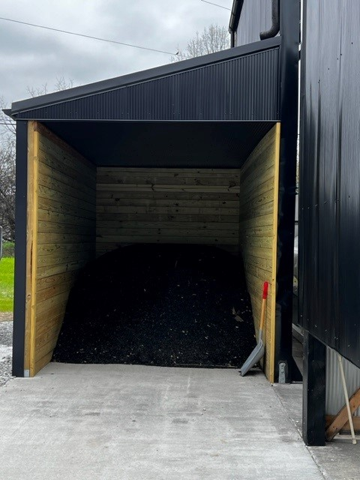
Composting
The Hot Rot 1206 is a closed composting system that accelerates the composting process.
We can compost restaurant waste, garden waste, grass clippings and leaves, grain dust, barrel char, and compostable wares.
Compost generated is used on the onsite garden and landscaping.
Created Compostable Purchasing policy for guidance in breakrooms and events.
composting

Slide 5
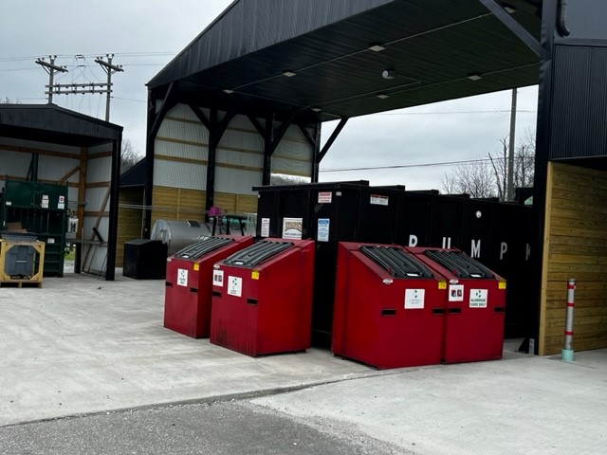
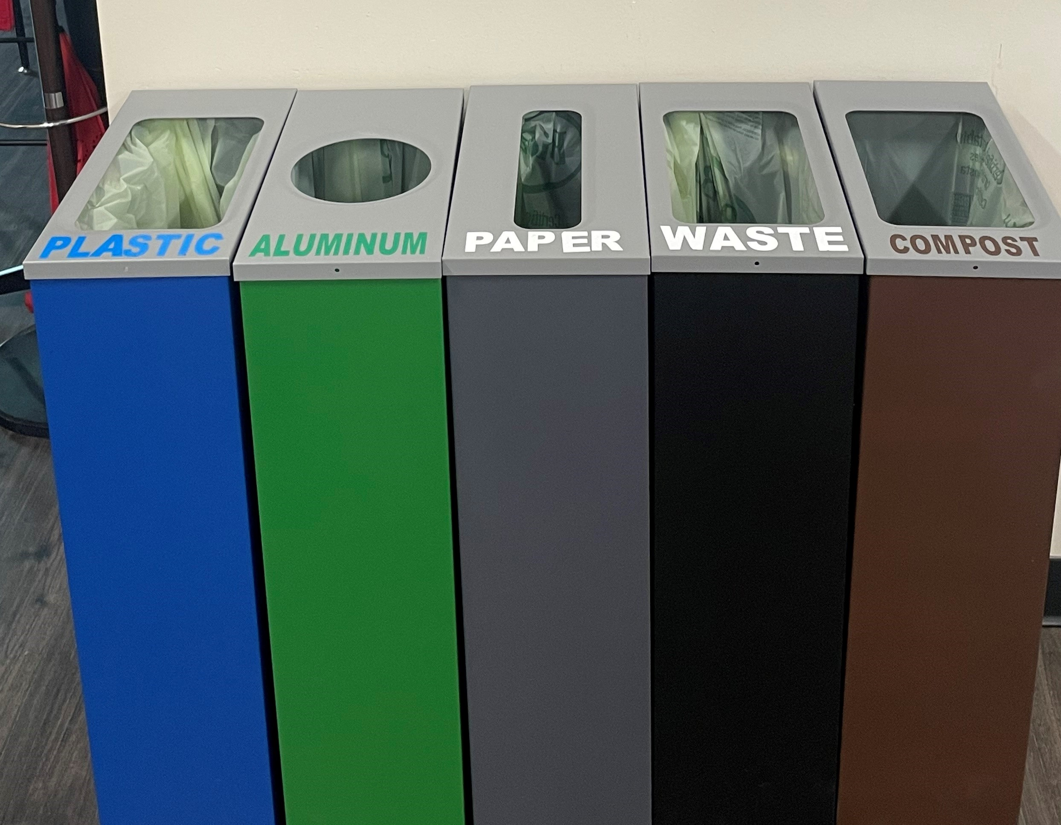
Recycling
We have an extensive recycling program at Maker's Mark for production use and employee personal use.
In 2023, we recycled 108 tons of material.
Because of the limited availability of recycling services in Marion County we encourage our employees to recycle plastic, aluminum, glass, and cardboard from home on campus.
Wood recycling (construction debris, broken pallets, shipping crates) used for animal bedding, mulch, & wood fuels
recycling

Slide 6
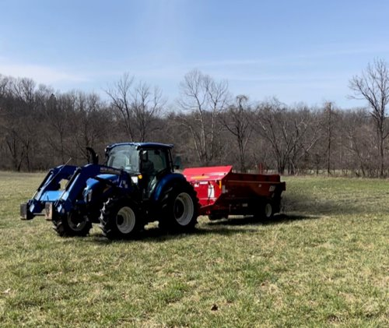
Land Application of Biosolids
We partnered with 10 employees to land apply biosolids generated by our onsite Wastewater Treatment plant.
Used as soil amendment for hay fields, pastures, and crop land.
Rich source of nitrogen, phosphorus, and potassium.
Purchased spreader & necessary equipment for employees to use.
Generate approximately 1013 tons per year
Land application

Slide 7
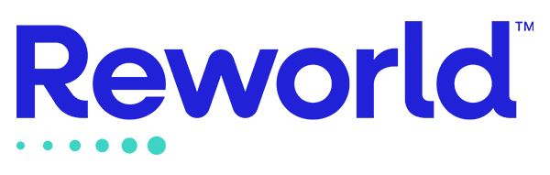
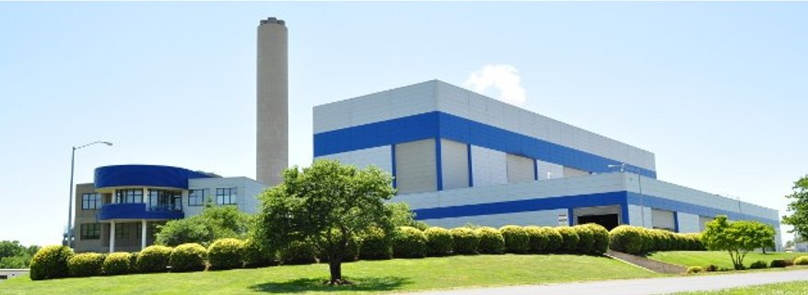
Reworld- Waste to Energy
Reworld is a waste-to-energy facility located in Indianapolis, IN. Waste that cannot be either recycled, reused, or composted is sent to Covanta for energy production.
Reworld 2023 data:
  Diverted 90 tons of waste from the local landfill (only 7.5% of all waste generated onsite)
  Generated 58,000 kwh of renewable energy
  Powered 5 residential homes for one year
Covanta- waste to energy

Slide 8
