Slide 1
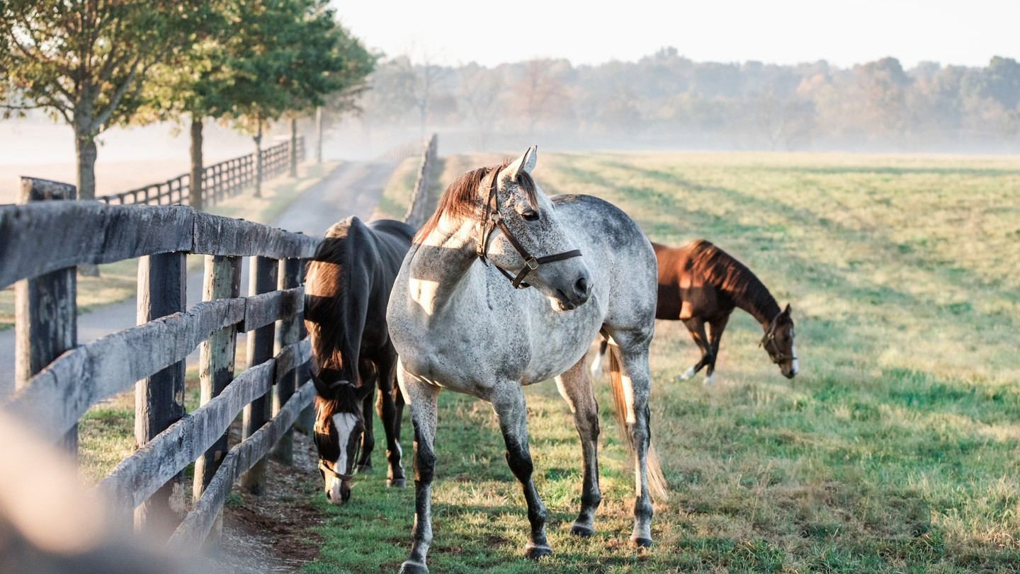

Sustainable Tourism

Slide 2


What is VisitLEX
VisitLEX is the destination marketing organization for the city of Lexington.
VisitLEX’s mission is to inspire travel to Lexington’s Bluegrass Region for business and leisure visitors to positively impact economic development and improve residents’ quality of life.

Slide 3

What is Sustainable Tourism
Sustainable tourism goes beyond environmental sustainability.
Economic| Environmental | Social

Slide 4
Environmental Sustainability in Tourism
Making a business case Current processes Partner needs Resource library

Slide 5

Creating a Brand

Slide 6
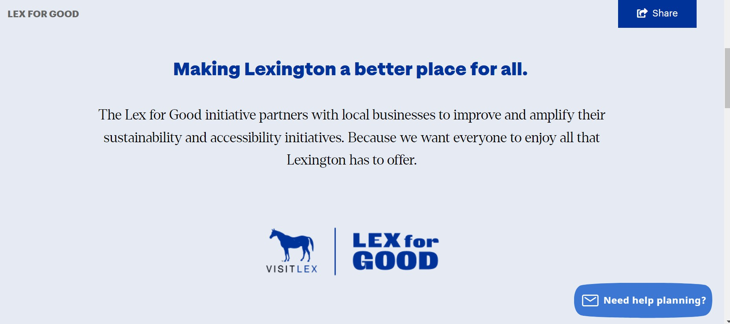

Slide 7
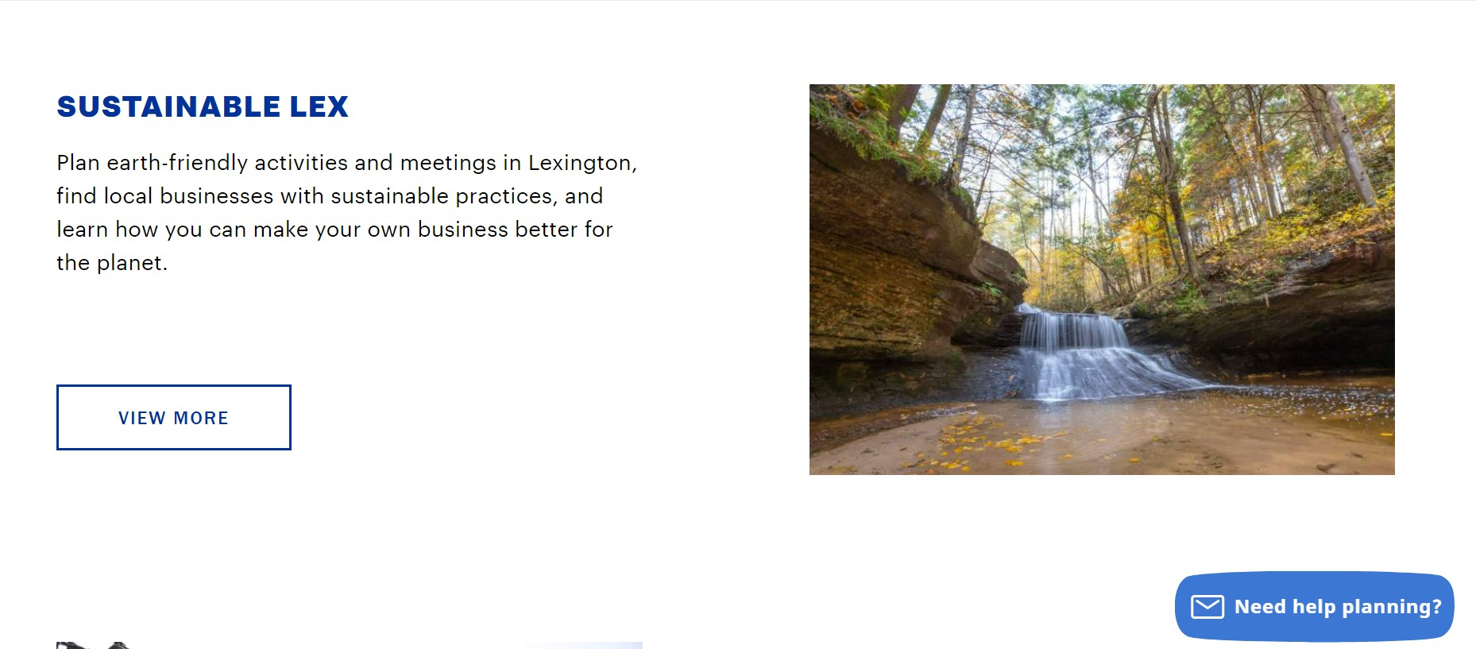

Slide 8
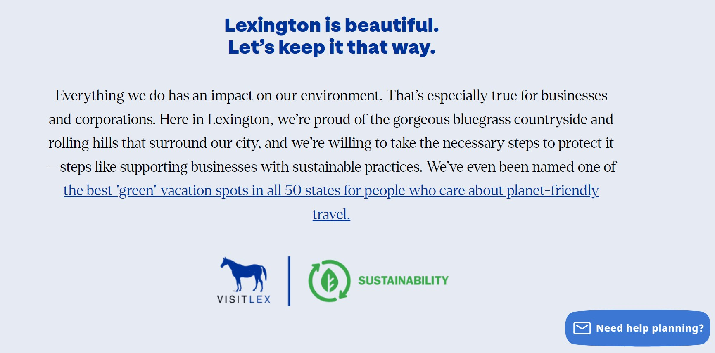

Slide 9
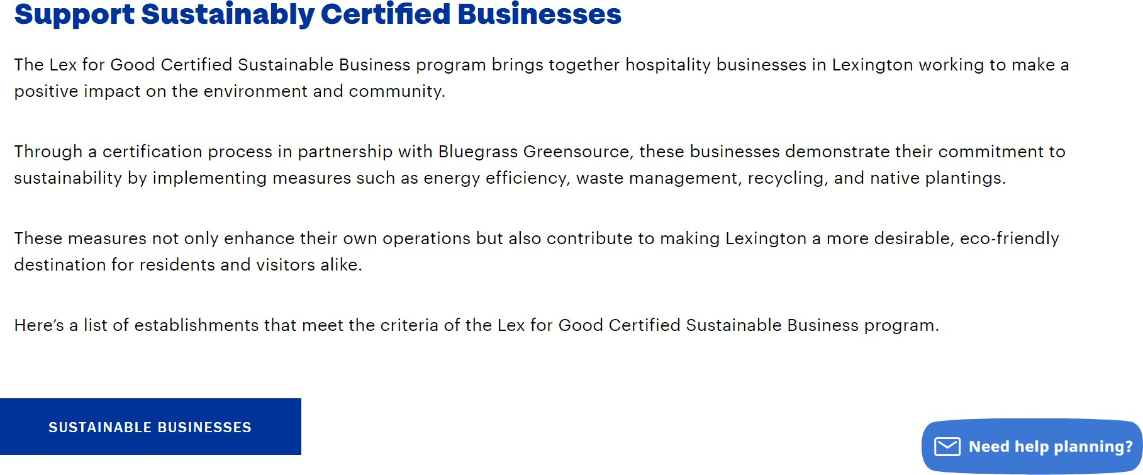

Slide 10
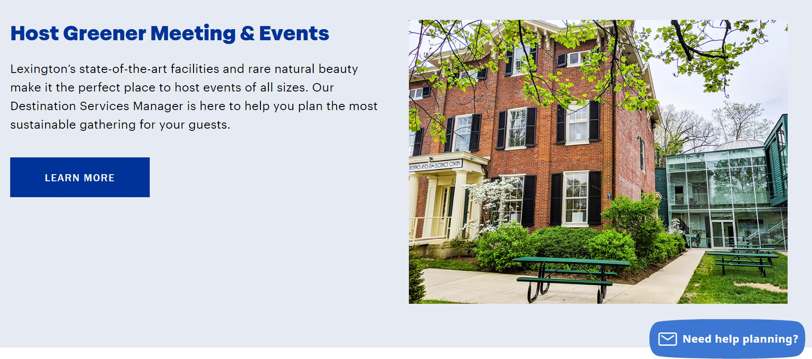

Slide 11
