Slide 1
Emissions
HOW DOES THE SMALL TO MID-SIZED BUSINESS TACKLE EMISSIONS?

Slide 2










What is your industry?

Slide 3
When you hear “emissions reduction”,
what’s your first reaction?

Slide 4

Take Away
01
Demystify what emission reductions really mean
02
Demonstrate a process
03
Leave with credible resources to help you learn more

Slide 5
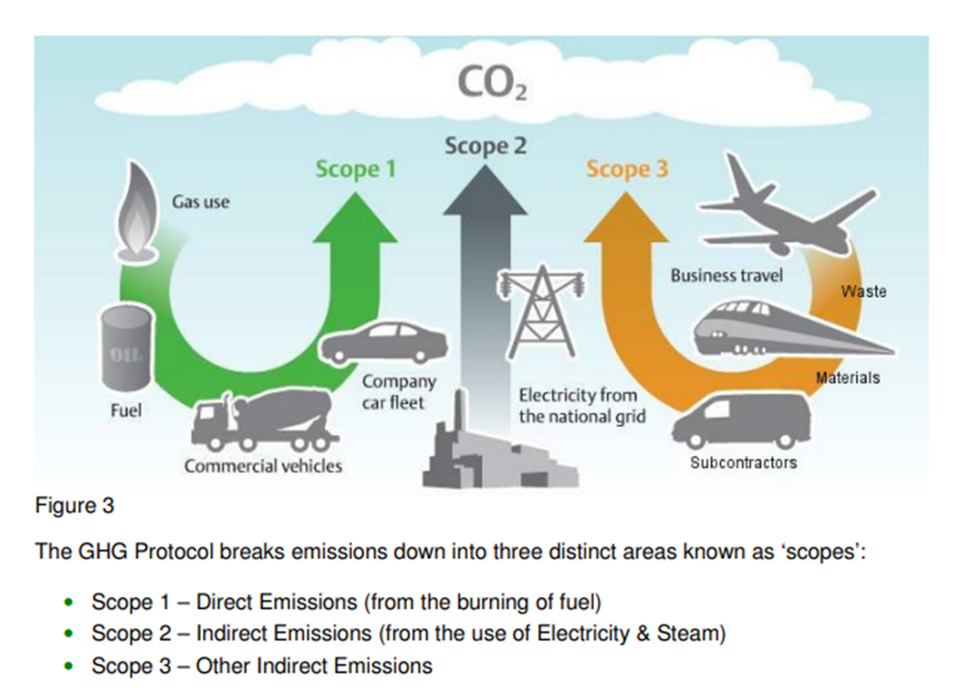
What Are Emissions?
The GHG Protocol breaks emissions down into three distinct areas known as “scopes”:
Scope 1
Scope 2
Scope 3
Direct Emissions
(from the burning of fuel)
Indirect Emissions
(from the use of Electricity + Steam)
Other Indirect Emissions

Slide 6
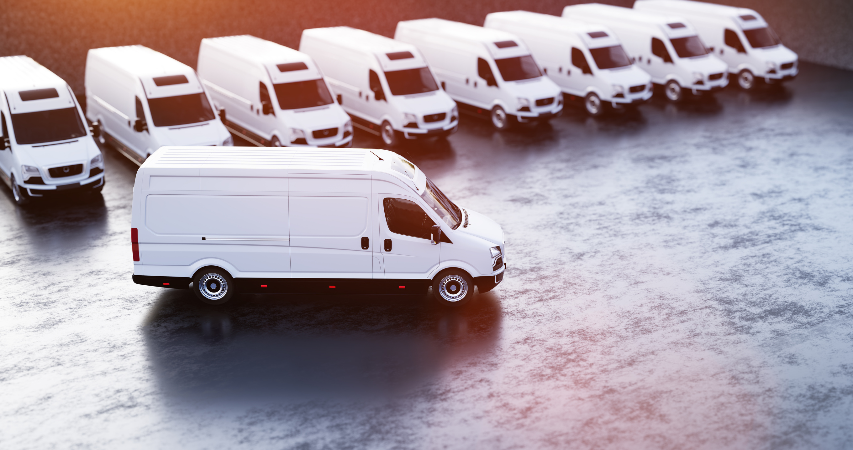
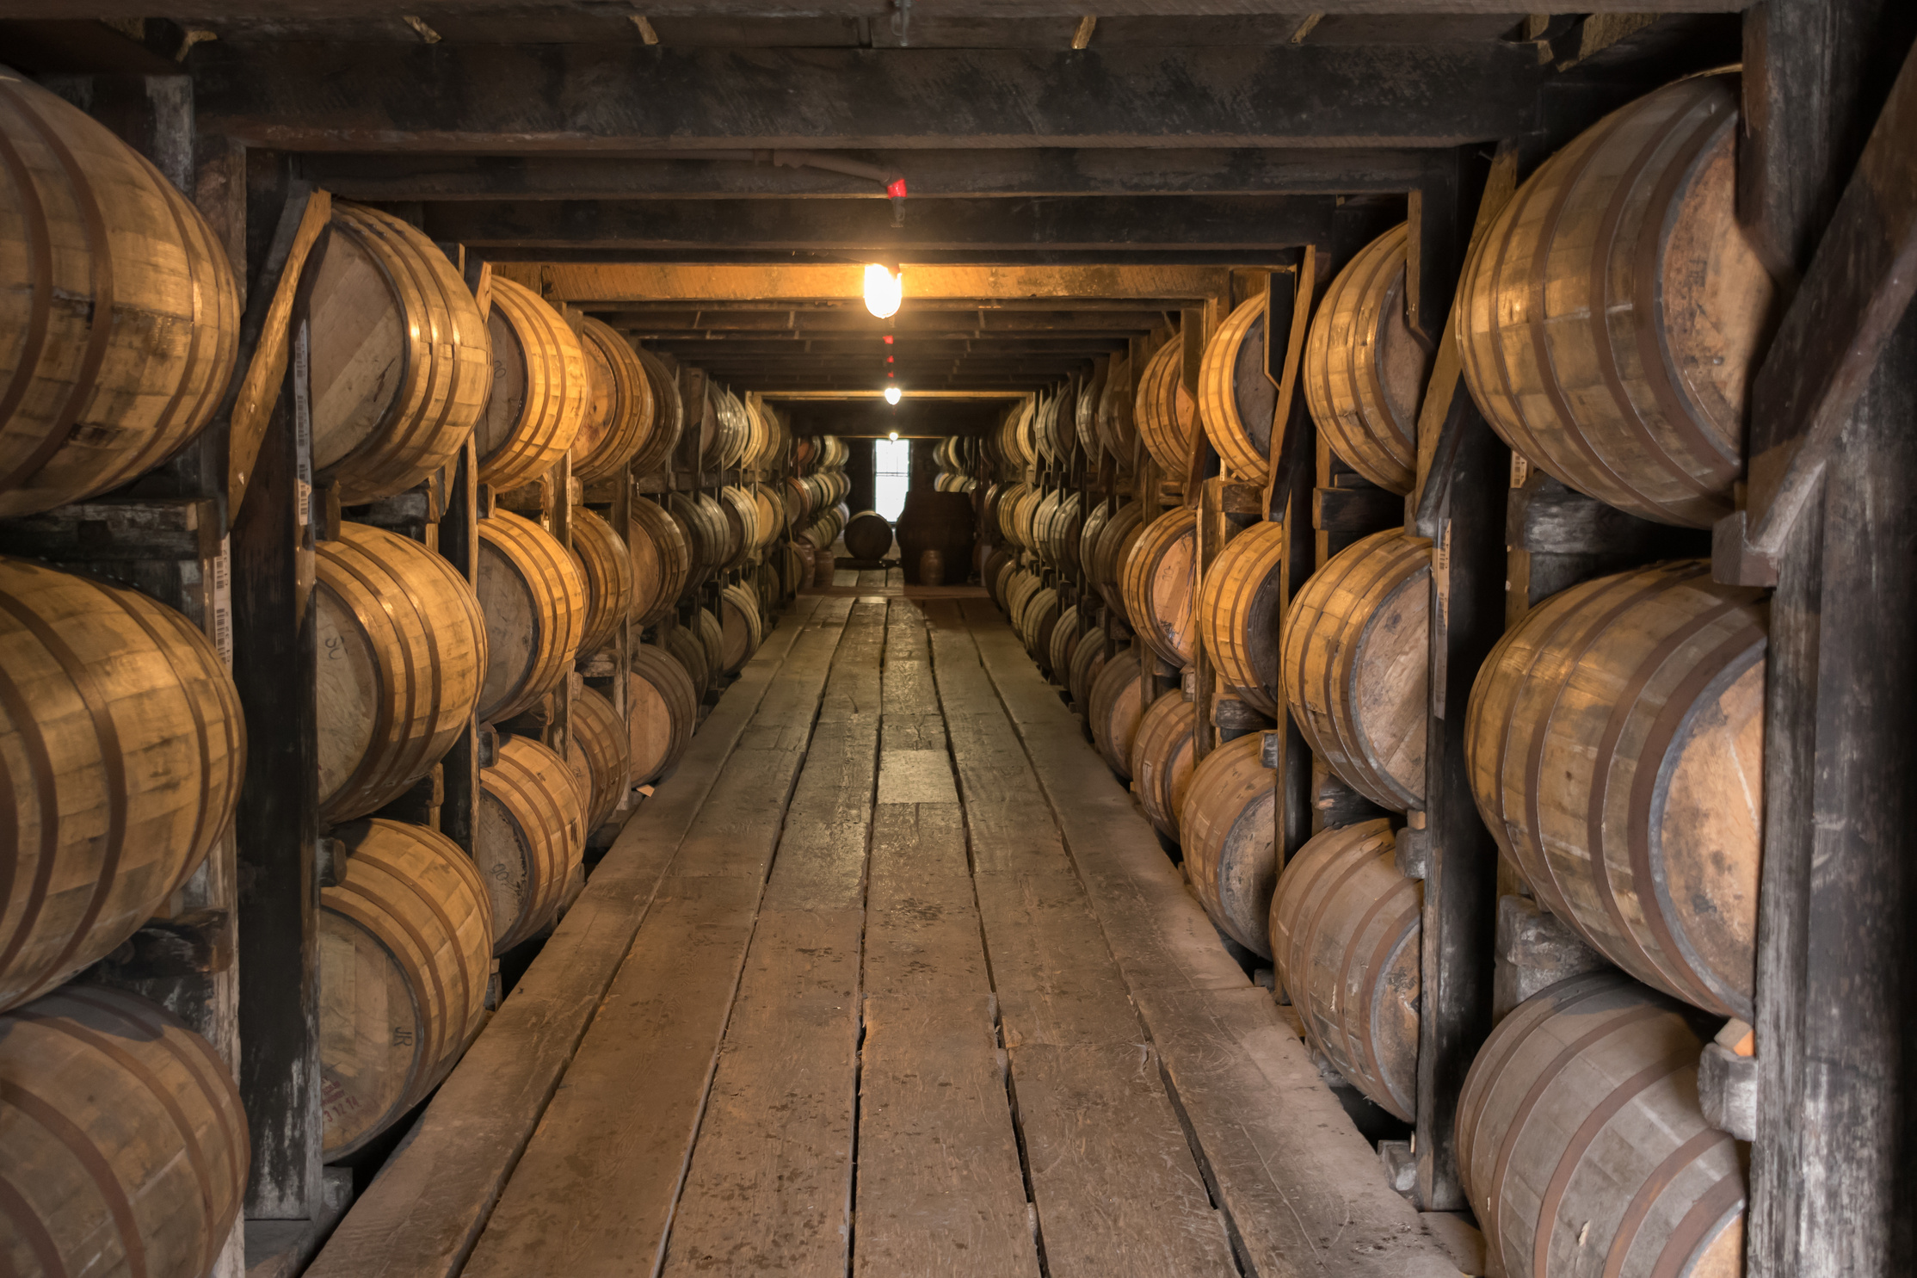
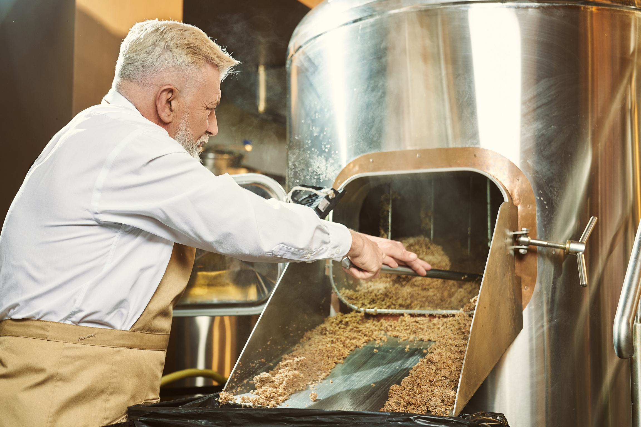
Example: Food + Beverage Manufacturing
Scope 1
Scope 2
Scope 3
Fuel-Burning Equipment
Any Fleet Vehicles
Waste -
Manufacturing By-Products
Product Life-Cycle
Anything Leased
Employee Commuting
Suppliers
Non-Owned Goods Transport
Purchased Utilities

Slide 7
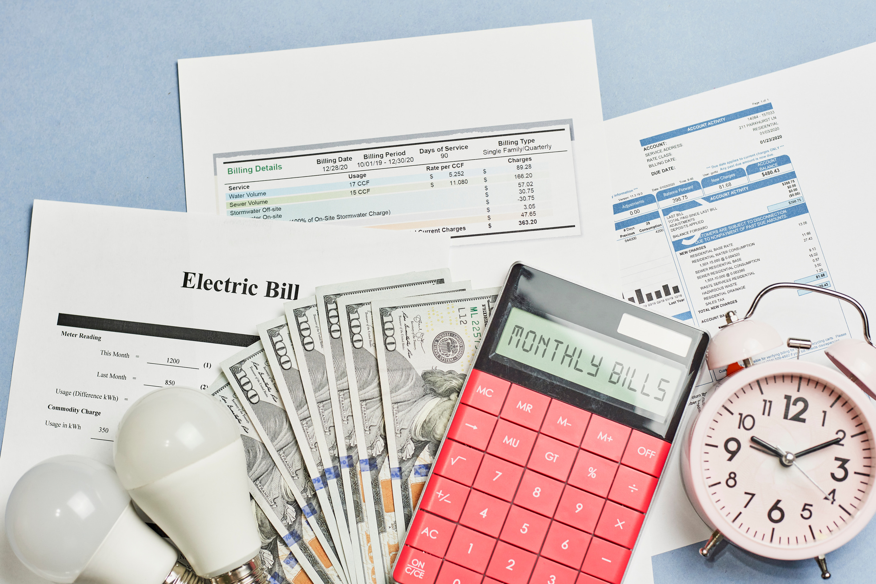
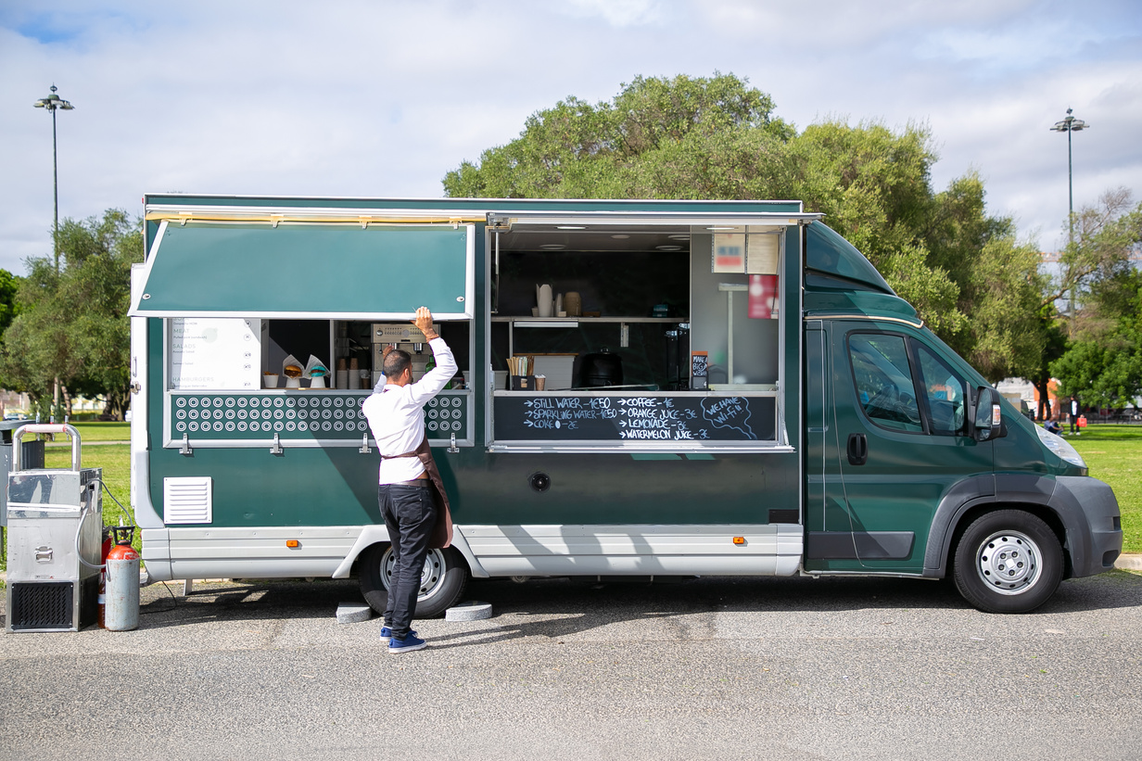

Example: Food Service Industry | Leased
Scope 1
Scope 2
Scope 3
Combustion equipment
Any fleet vehicles
(delivery, food trucks, etc.)
On-site fuels (propane/sterno/patio heaters)
Waste
Lease Agreements - Utilities
Employee Commuting
Suppliers
Non-owned Goods Transport
Purchased Utilities

Slide 8
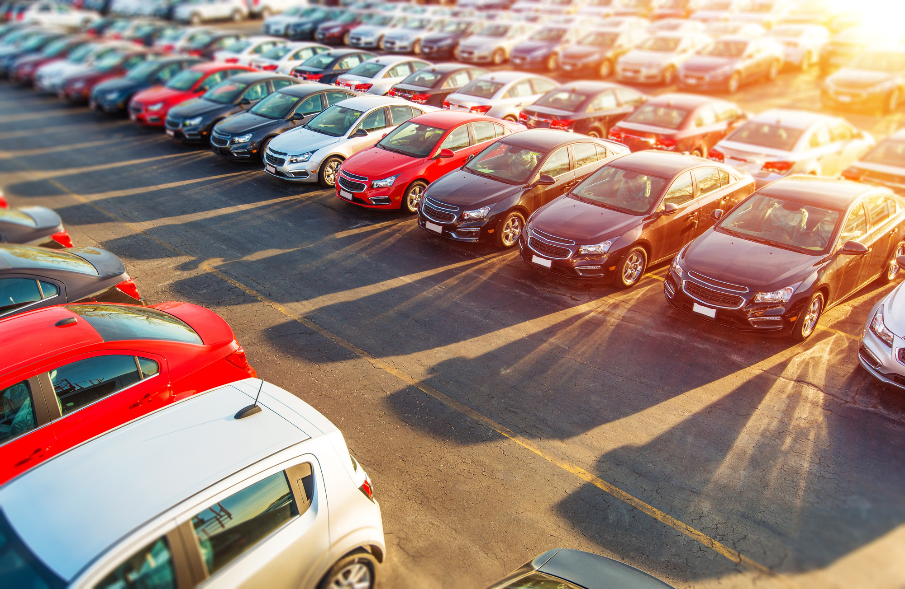
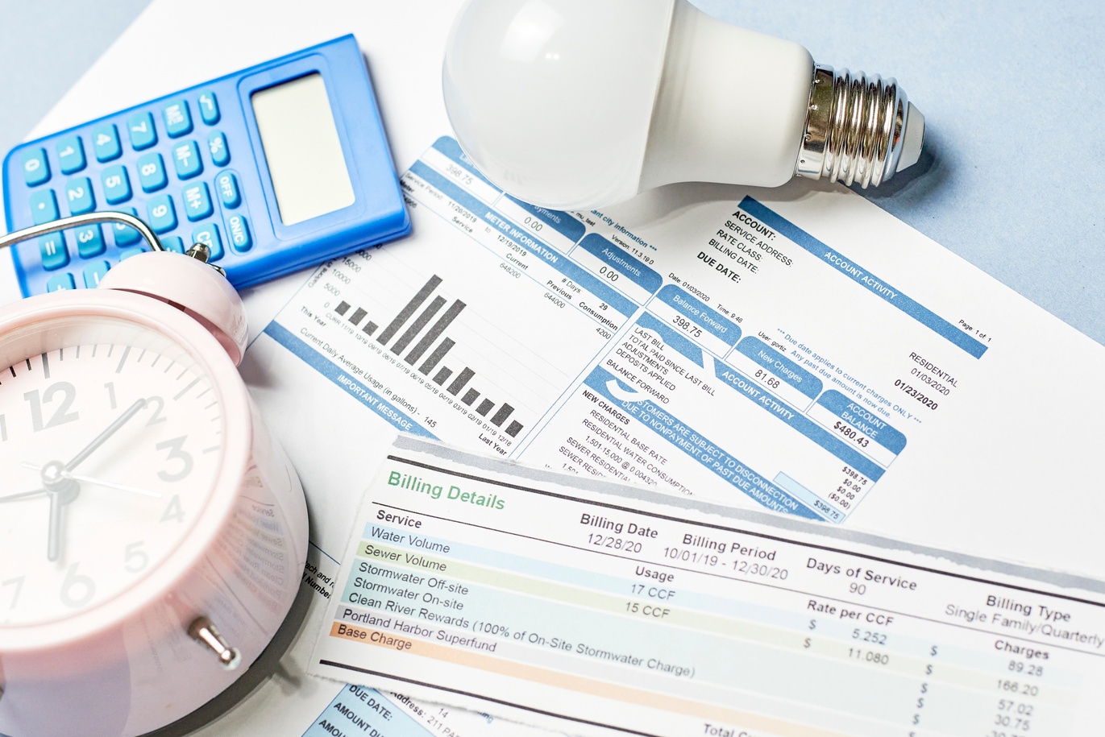

Example: Professional Services | Owned
Scope 1
Scope 2
Scope 3
Waste
Employee Commuting
Vendors/Suppliers
Business Travel
Company Cars
Purchased Utilities

Slide 9





Process for Reductions
Define
Data Capture
Analyze
Implement
Results
Outcomes
Team
Work
What
How
Who
Ideas
Plans
Budgets
Vendors
Policies
Projects
Measure
Report
Adjust

Slide 10
Process for Reductions
Define
Data Capture
Analyze
Implement
Results
Outcomes
Team
Work
What
How
Who
Ideas
Plans
Budgets
Vendors
Policies
Projects
Measure
Report
Adjust

Slide 11
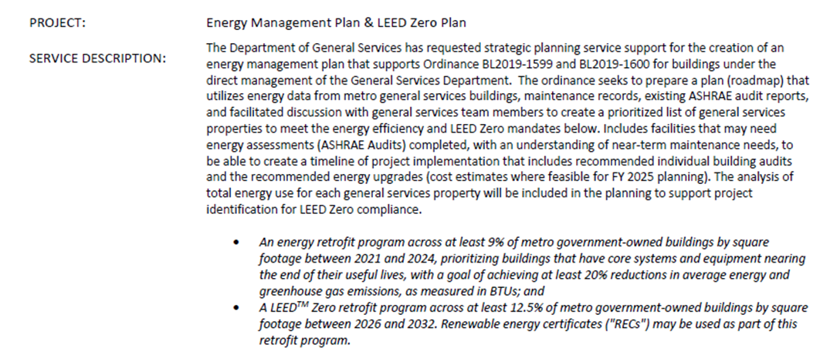
Define Phase
Known Outcomes
01
Support in their initiatives to reduce carbon emissions
02
Support in similar groups in their initiatives to reduce carbon emissions
03
Support alignment in external practices and internal practices

Slide 12
Define Phase
Outcomes from the define phase are going to let you know:
WHY you are even doing this
WAYS that you will know you are successful
BACKGROUND into the situation so that everyone knows who and how to fund
WHAT you want to measure and how that information is stored
WHEN certain milestones need to be reached

Slide 13
Process for Reductions
Define
Data Capture
Analyze
Implement
Results
Outcomes
Team
Work
What
How
Who
Ideas
Plans
Budgets
Vendors
Policies
Projects
Measure
Report
Adjust

Slide 14
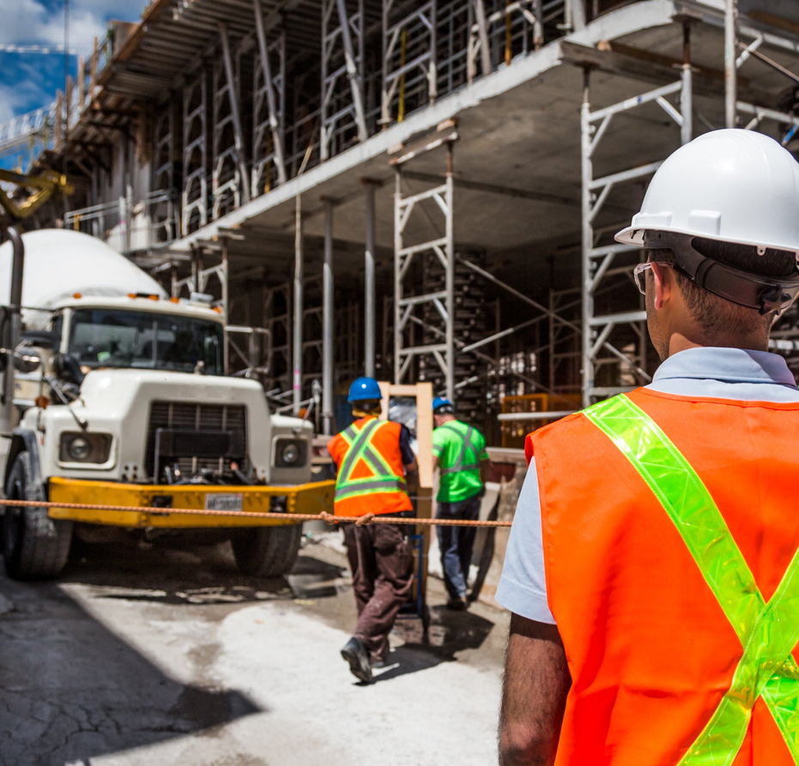

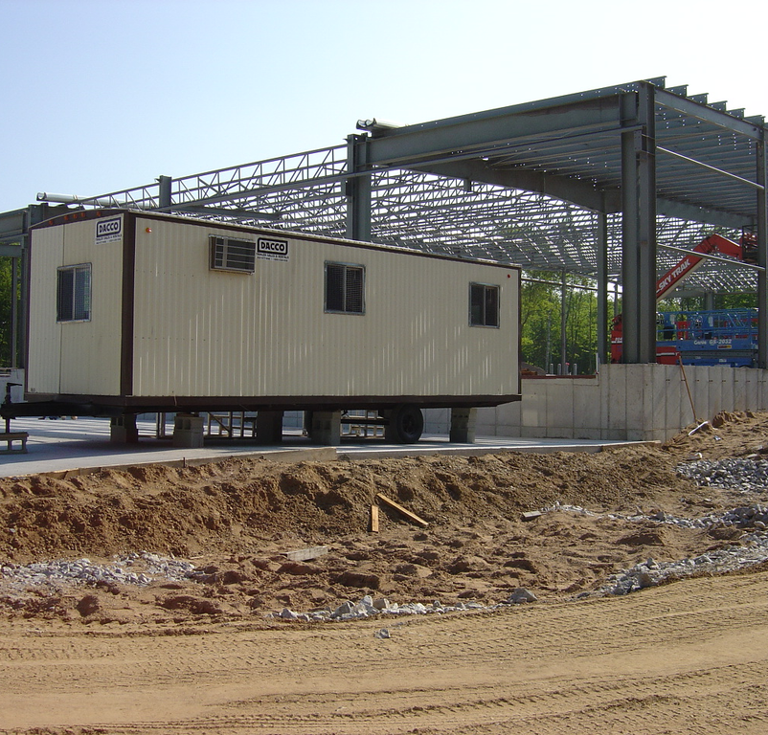
Example: Construction Company

Slide 15












Data Phase | Categorize Emissions
Scope 1
Scope 2
4. Electricity
(Offices)
1. Fuel (Offices)
5. Electricity
(Jobsite)
2. Fuel (Jobsite)
7. Vehicle
Fuel
3. Process + Fugitive
6. Imported Heat
9. Subcontractors
8. Public Transport
10.Waste
11.Materials
12. Product
Scope 3

Slide 16
Data Phase | Categorize Emissions
Scope 1
Scope 2
4. Electricity
(Offices)
1. Fuel (Offices)
5. Electricity
(Jobsite)
2. Fuel (Jobsite)
7. Vehicle
Fuel
3. Process + Fugitive
6. Imported Heat
Owned or Long-Term Vehicles
Utilities – Office Jobsites
Jobsite Power + Temporary Heat
9. Subcontractors
8. Public Transport
10.Waste
11.Materials
12. Product
Scope 3

Slide 17
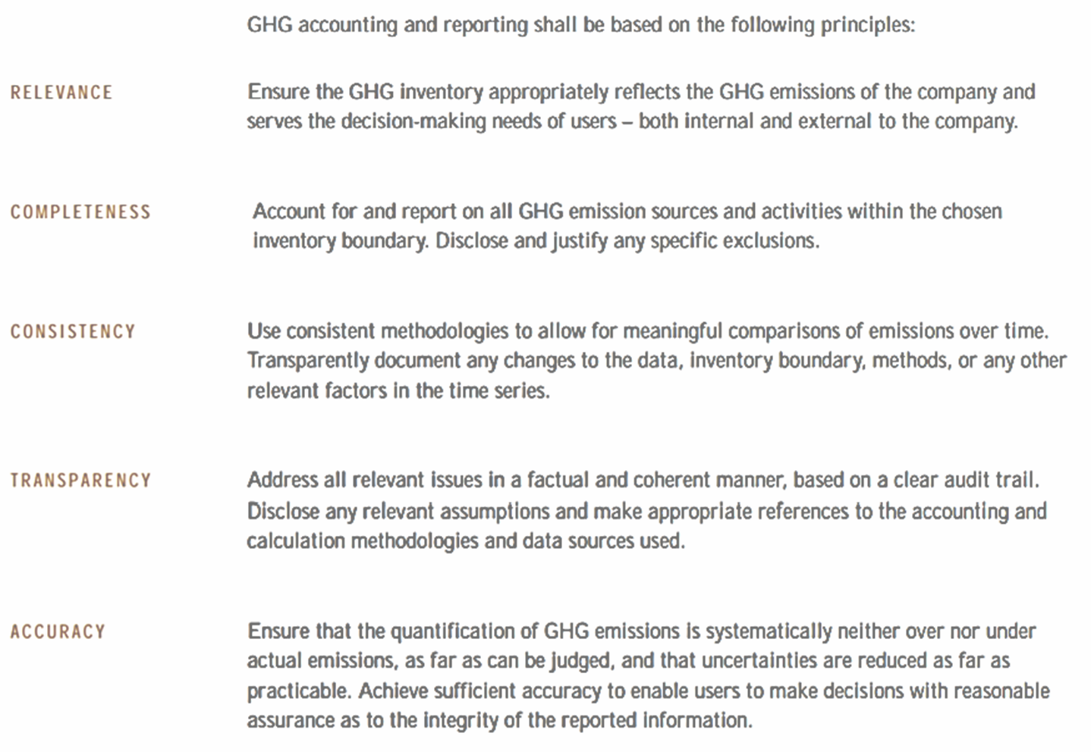
Data Phase | GHG Protocol

Slide 18
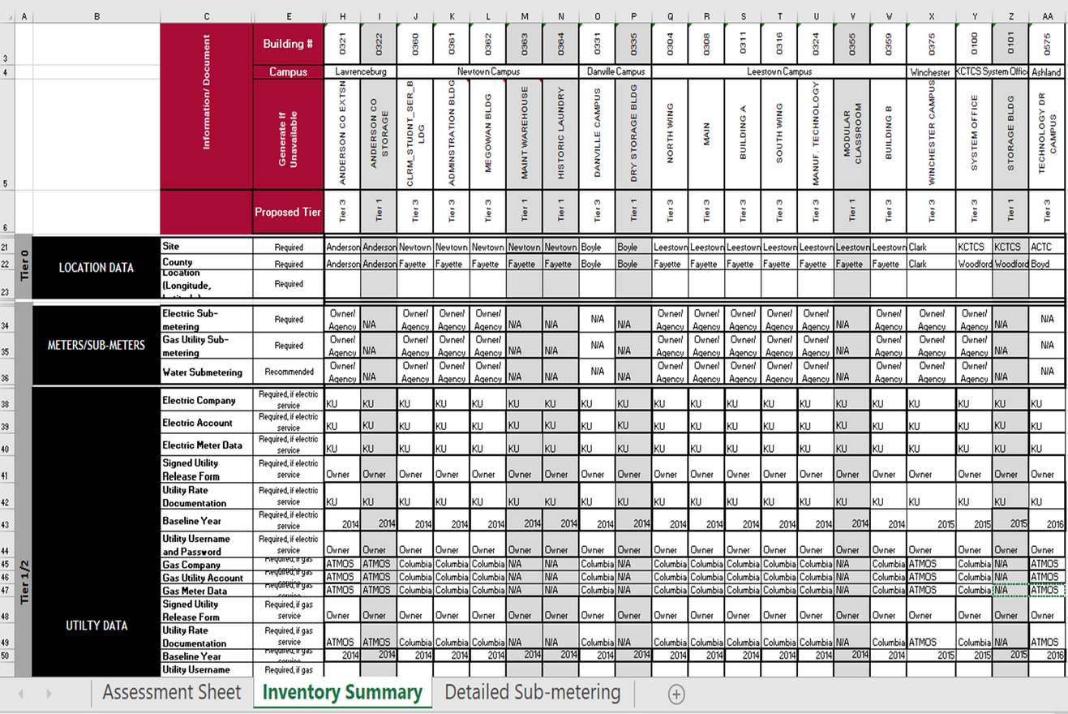
Data Phase | Scope 1 +2
Inventory + Templates
  Identify

Slide 19
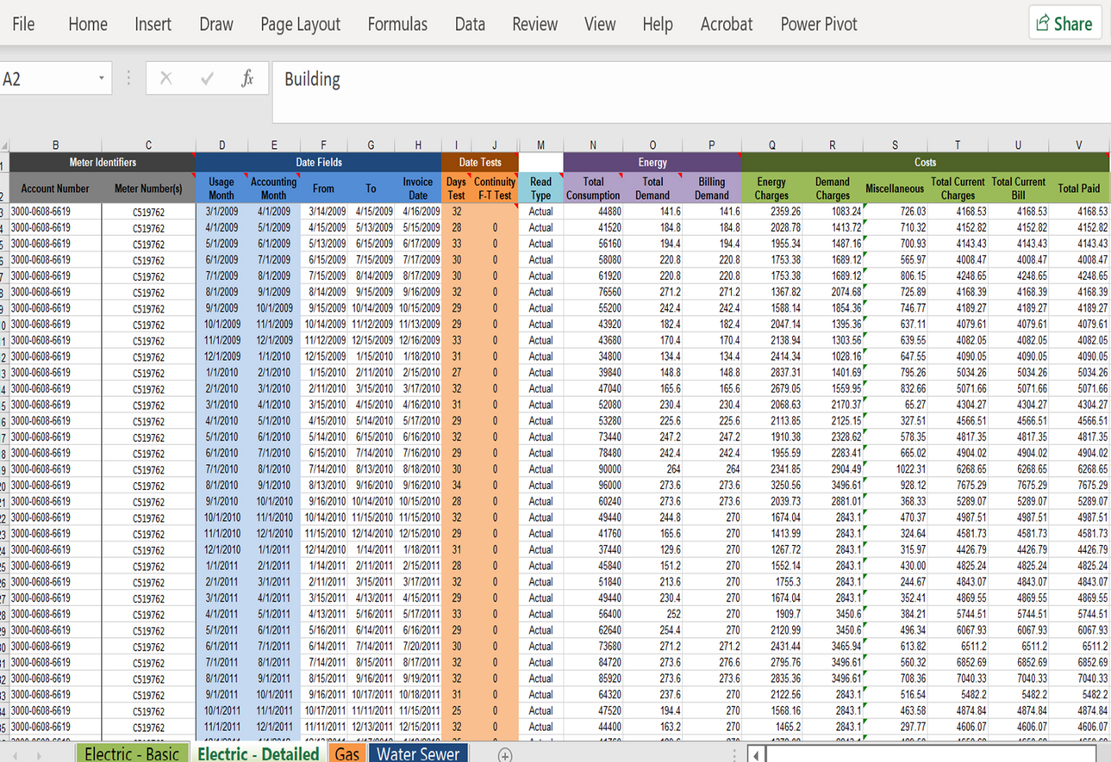
Data Phase | Scope 1 +2
Inventory + Templates
  Identify
  Measure

Slide 20
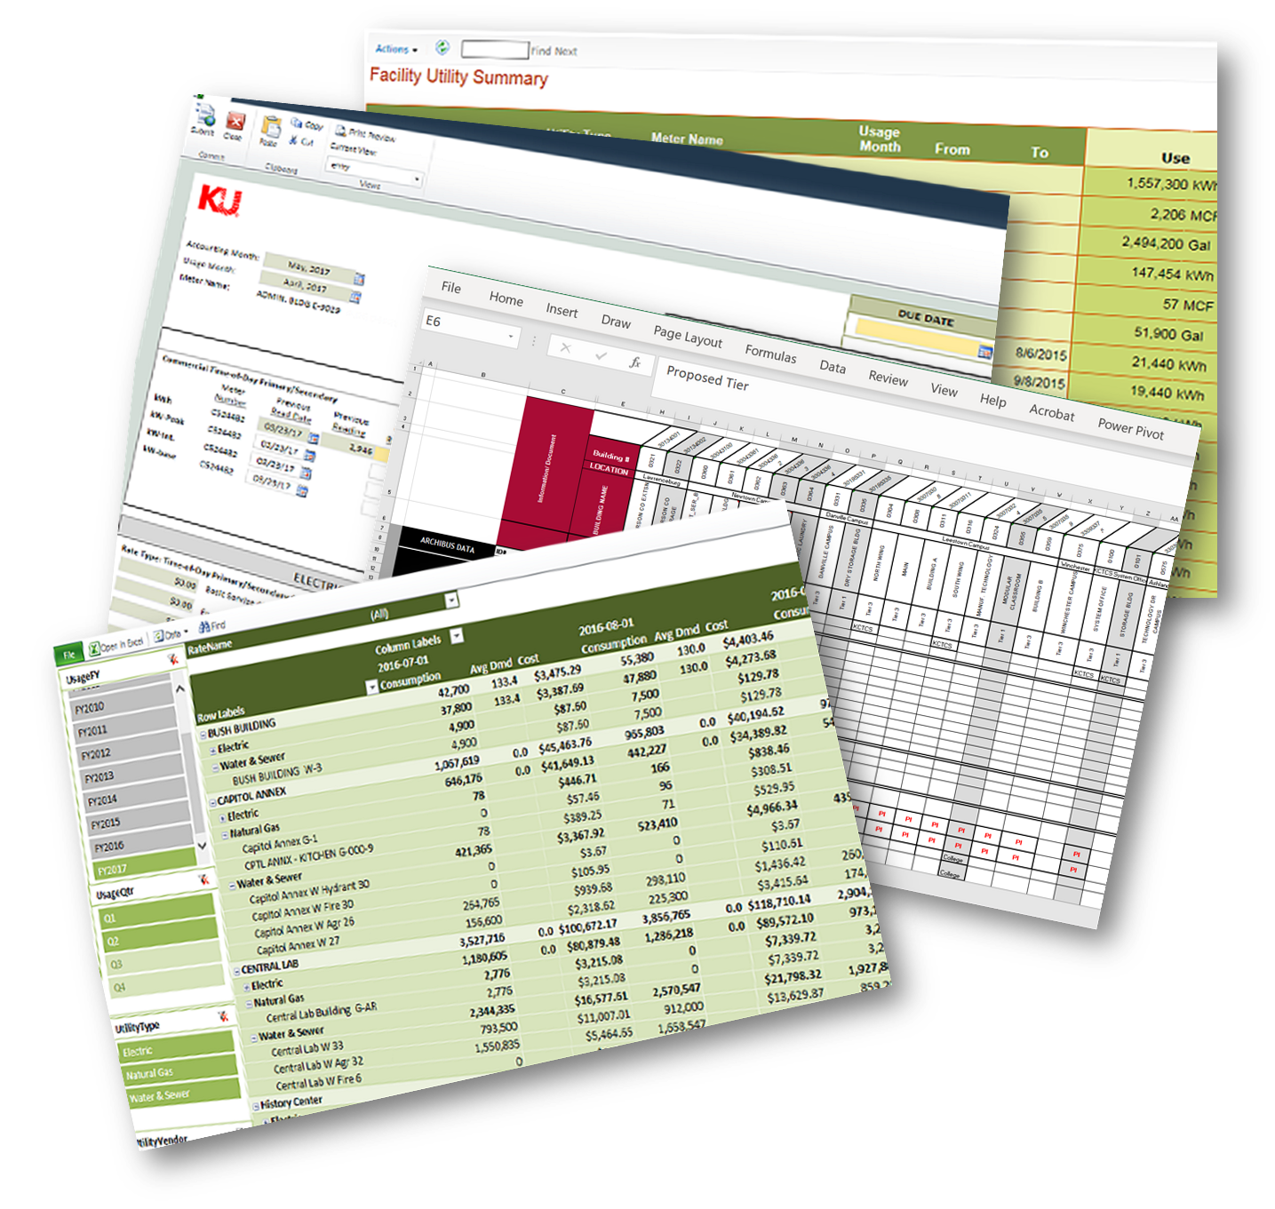

Data Phase | Scope 1 +2
Inventory + Templates
  Identify
  Measure
SOFTWARE SOLUTION

Slide 21
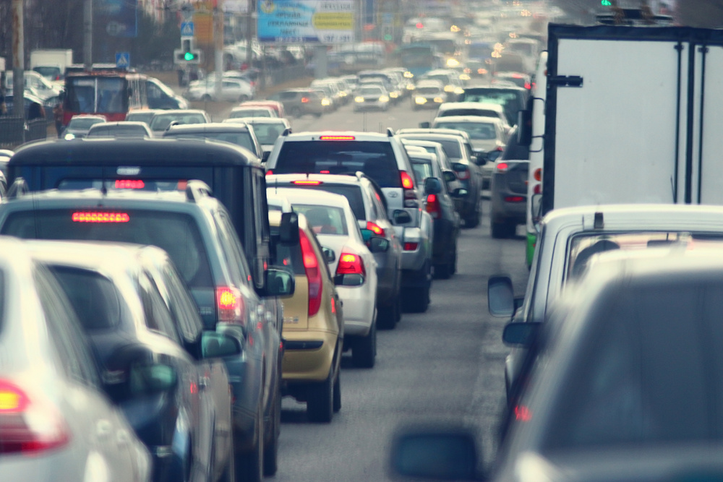
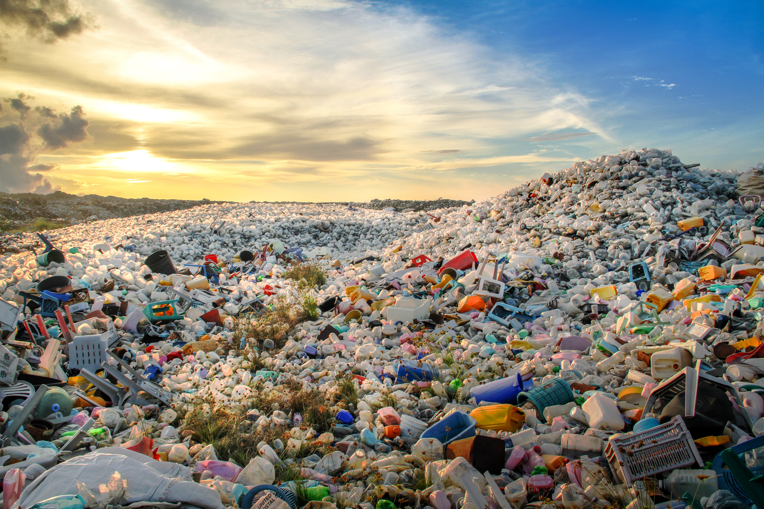


Data Phase | Scope 3
Employee Commuting
Waste
Business Travel
Purchases of Goods + Services

Slide 22
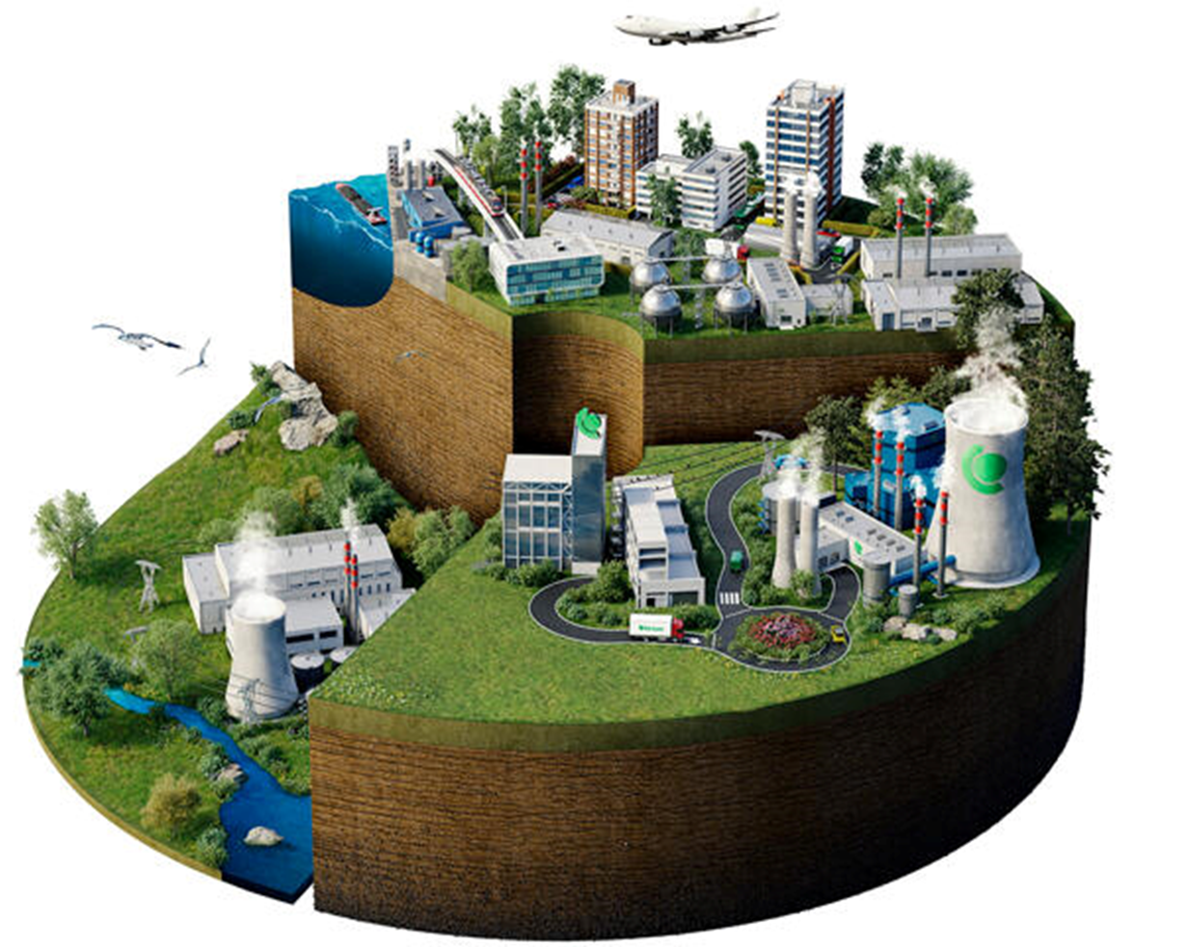
Data Phase | Scope 3
Scope 3 Supply Chain Emissions account for
5.5x more than
Scope 1 + 2 combined

Slide 23
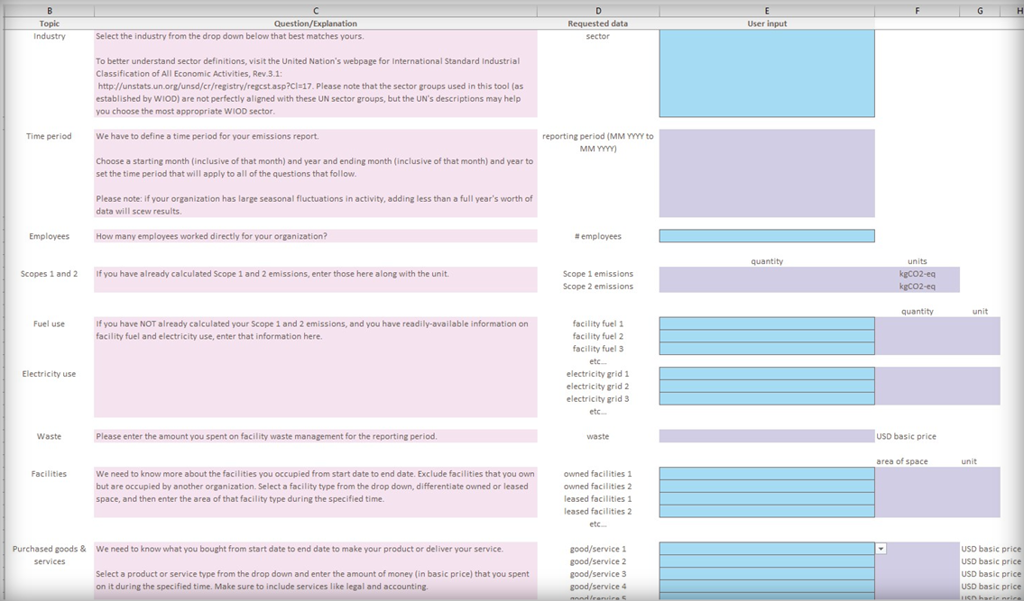
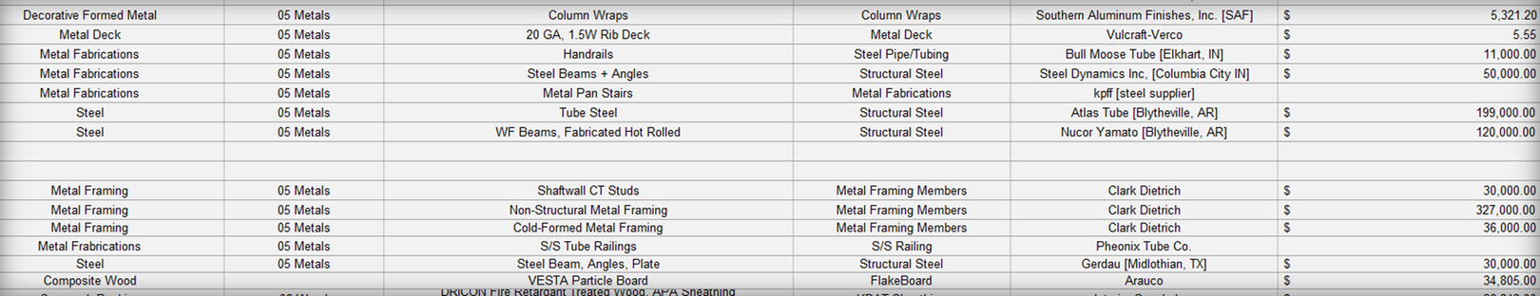
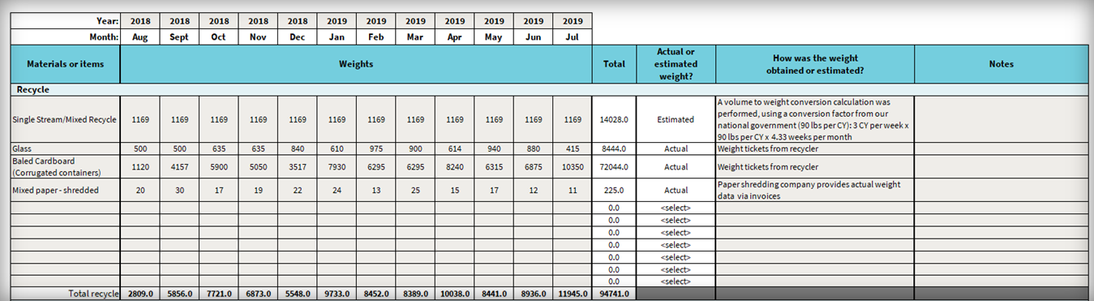
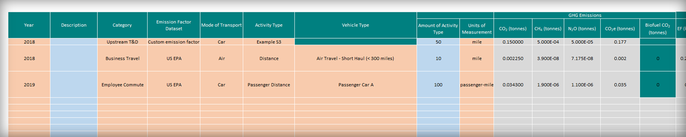
Data Phase | Identify + Measure
Accounting Reviews
Waste Audits
Travel Reviews
Fuel Audits

Slide 24
Process for Reductions
Define
Data Capture
Analyze
Implement
Results
Outcomes
Team
Work
What
How
Who
Ideas
Plans
Budgets
Vendors
Policies
Projects
Measure
Report
Adjust

Slide 25



Analyze Phase
Tackle Emissions Target
1st: Scope 1 + 2
2nd: Scope 3 - Your Direct Control
(lease agreements, waste streams)
3rd: Scope 3 - Out of Your Control
(subcontractors, some types of material transport

Slide 26
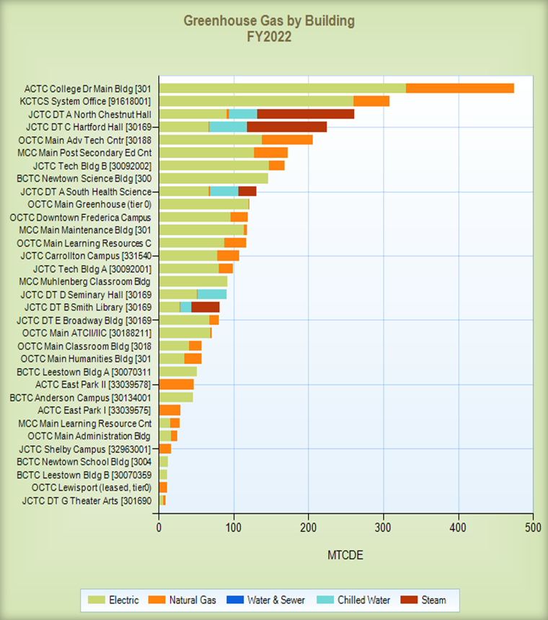
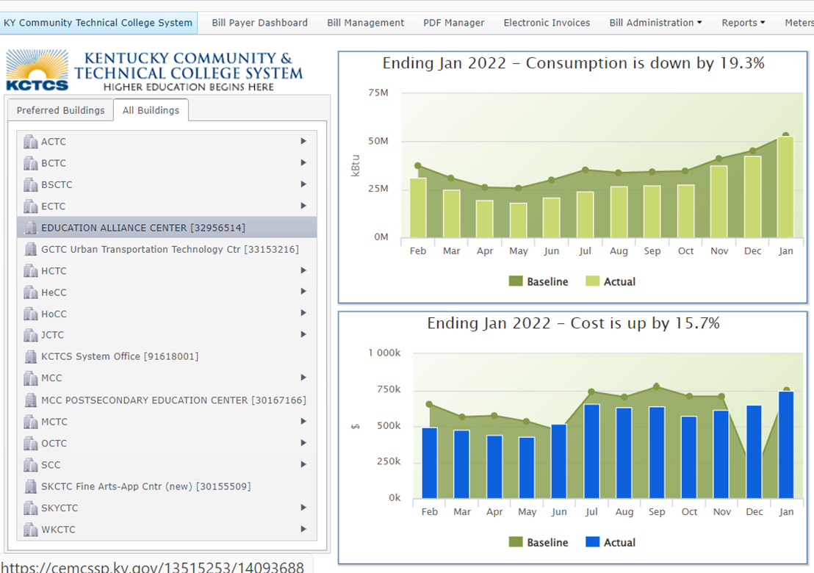
Analyze Phase

Slide 27
Analyze Phase | Scope 1 + 2
Scope 1
Scope 2
4. Electricity
(Offices)
1. Fuel (Offices)
5. Electricity
(Jobsite)
2. Fuel (Jobsite)
7. Vehicle
Fuel
3. Process + Fugitive
6. Imported Heat
9. Subcontractors
8. Public Transport
10.Waste
11.Materials
12. Product
Scope 3

Slide 28
Analyze Phase | Scope 1 + 2
 | Offices | Client Sites
Public Transportation + Vehicle Fuel | Operational Policies Air Travel Frequency Employee Incentive Programs | Subcontractor Fleets Green Lease Policy for Equipment
Waste | Waste Categorization Waste Reduction Programs Community Opportunities | Standardize WM Plans Scalable across sites Identify Diversion Partners
Materials | Office Supplies Consumables Shop local | Construction materials Selected Regional materials

Slide 29
Process for Reductions
Define
Data Capture
Analyze
Implement
Results
Outcomes
Team
Work
What
How
Who
Ideas
Plans
Budgets
Vendors
Policies
Projects
Measure
Report
Adjust

Slide 30
Implement Phase
Low Cost + No Cost Solutions | Operational Costs | Capital Costs
Change of Purchasing Pattern | Maintenance Budget | Equipment Change-Overs
Implement a Ride-Share Program | Leased Solar Agreements | Fleet Vehicle Modifications

Slide 31
Process for Reductions
Define
Data Capture
Analyze
Implement
Results
Outcomes
Team
Work
What
How
Who
Ideas
Plans
Budgets
Vendors
Policies
Projects
Measure
Report
Adjust

Slide 32
Results Phase
People
Processes
Tools
Stabilization
Reporting + Measurement
Team
Reporting Standards + Operating Procedures
Software + Collateral Formats
Action
Measure Implementation Team
Measure Implementation Team
Technology + Innovations

Slide 33
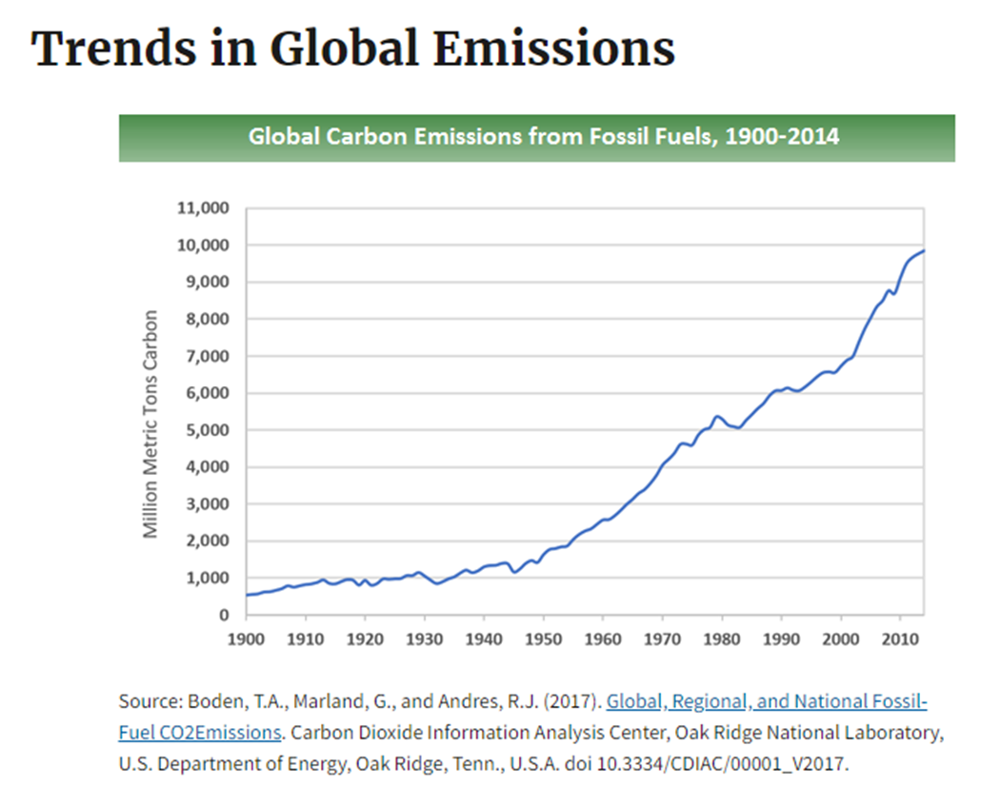
Trends in Global Emissions
Global Impact on GHG Emissions

Slide 34

Questions?

