Slide 1
IS SOLAR RIGHT FOR YOUR ORGANIZATION?
Cost analysis, Incentives Available, Sustainability and Resilience

Slide 2
Agenda
How to determine real energy usage
Financial analysis
Incentives available
Types of Installations
Timelines
Reimbursement
Q&A

Slide 3
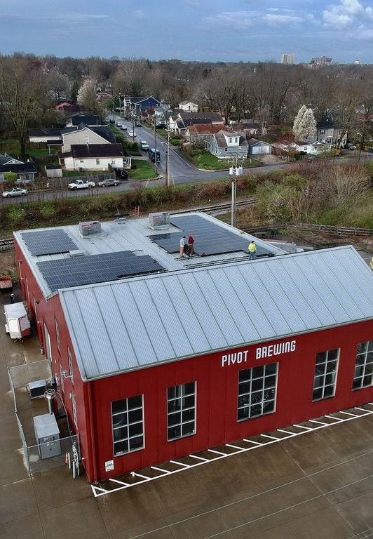
GETTING STARTED

Slide 4
Where do i start?
Goals and Objectives Discussion
Collect Power bills – 12 months with Interval Data if available
Initial Quote & Financial Analysis
Site Evaluation
Final Quotation

Slide 5
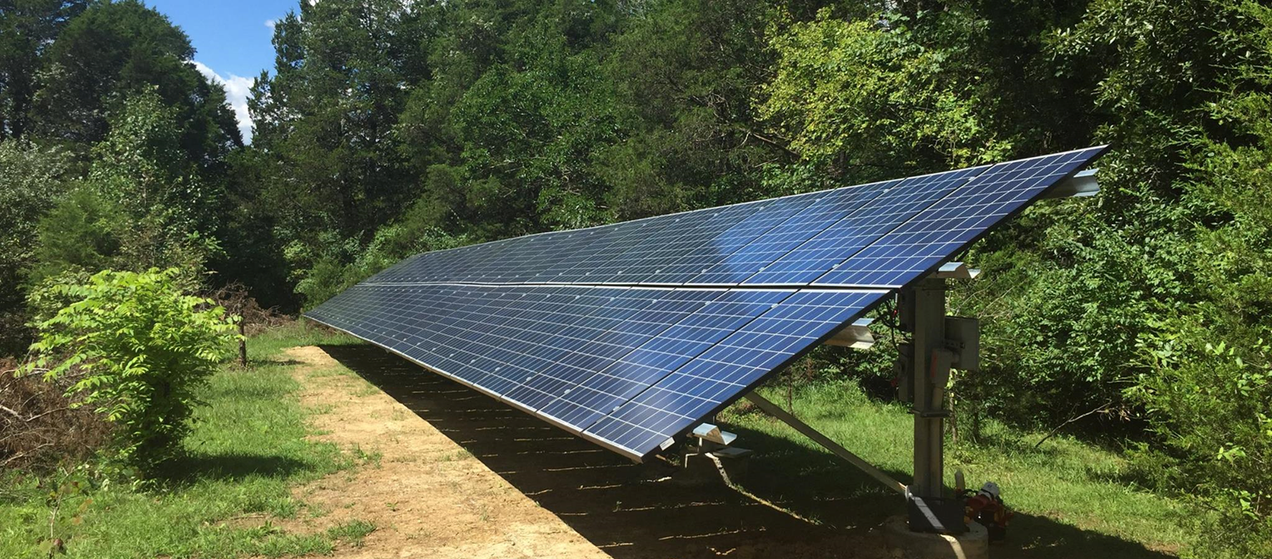
Ground Mounted ARray

Slide 6
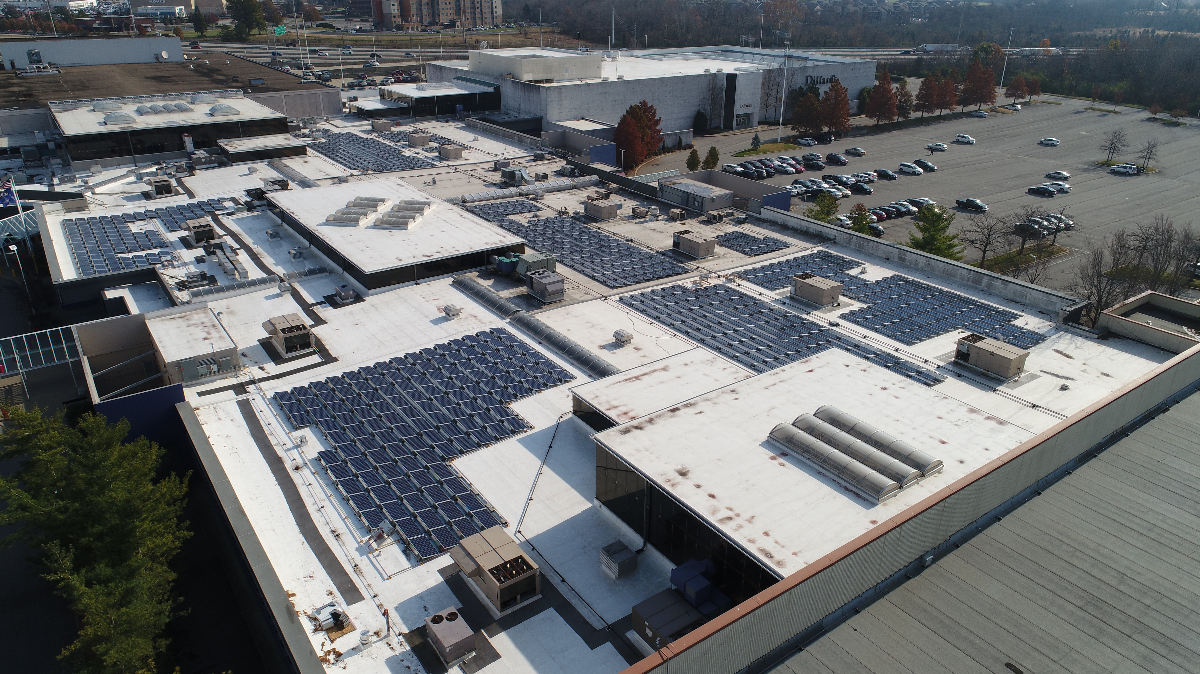
Rooftop Mounted ARray

Slide 7
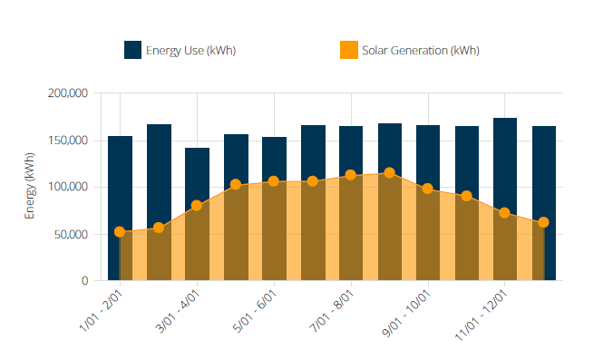
Importance of Interval data

Slide 8
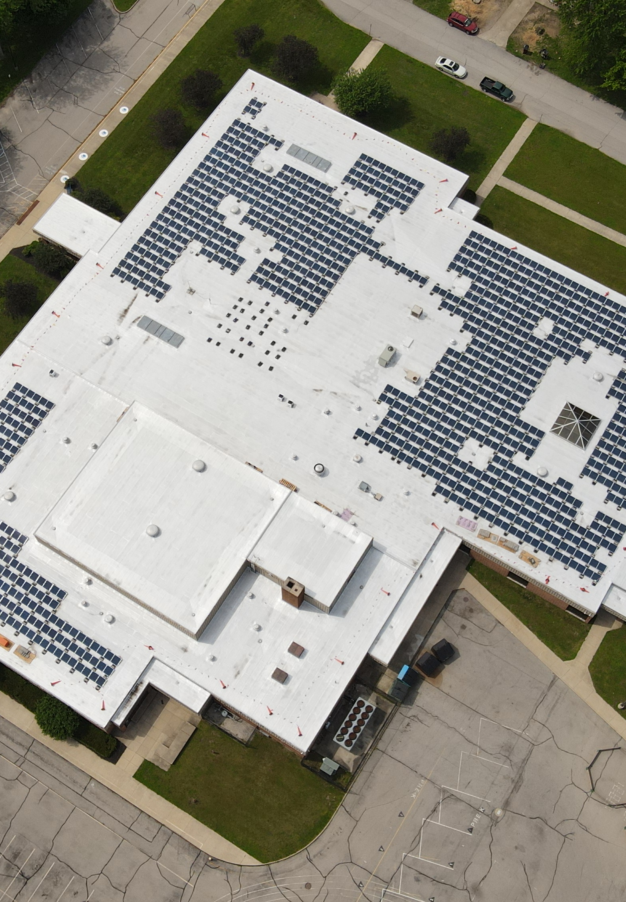
Incentives
Community and government programs available

Slide 9
INCENTIVES THAT MAY APPLY TO YOU
Standard available incentives include:
  ITC tax credit
  REAP
Additional opportunities to offset costs may include:
  MACRS depreciation

Slide 10
ITC Tax credit
30% Tax Credit
10% Energy Community
10% American Content – This was recently relaxed and we're digesting implications for our customer set

Slide 11
REAP Process
Qualification map - https://eligibility.sc.egov.usda.gov/eligibility/welcomeAction.do
Process
< $80,000 – Lower barrier to award
> $80,000 – Higher barrier to award. Go as large as possible to improve the ROI of the application

Slide 12
Additional opportunities
MACRS Depreciation
The MACRS depreciation schedule starts at 80% of the depreciable basis for 2023, and declines by 20% until reaching 0% by 2027 (i.e. in 2024 the percentage will be 60%). To calculate the bonus depreciation for a solar PV system in 2023, multiply $85,000 by.80 = $68,000.

Slide 13
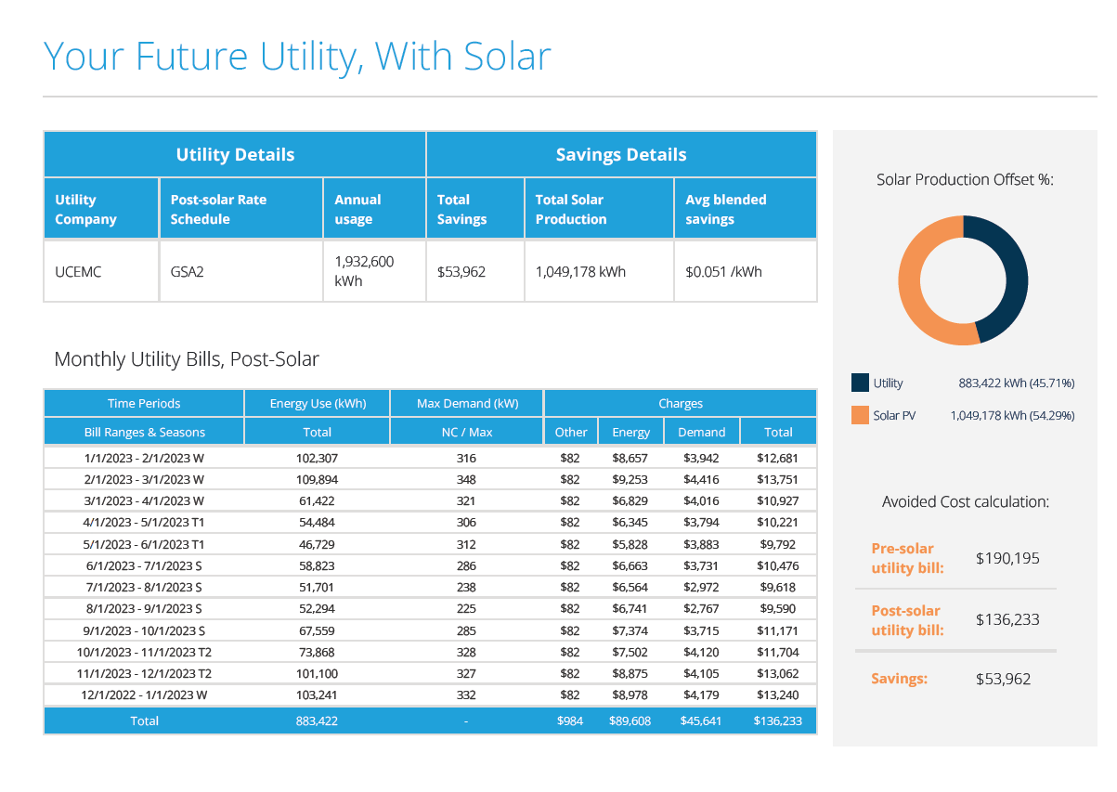
Design and Finacial Analysis

Slide 14
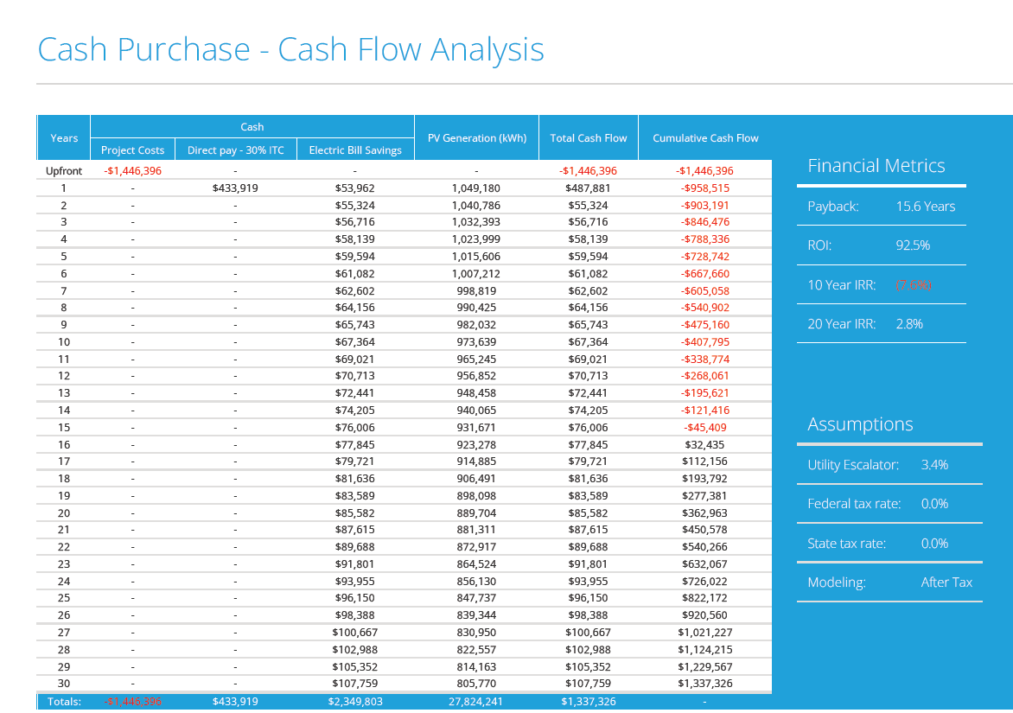
Design and Finacial Analysis

Slide 15
TIMELINE
What to expect on your solar journey

Slide 16
Timeline
Quotation and Financial Analysis
Decision to Go Solar!
Initial Down Payment
Engineering
Permitting
Build
Inspection and Permission to Operate
Reimbursement

Slide 17
Thank you
Jeffrey Nazarko
Vice President, Sales & Marketing
jeff@sesre.com

