Slide 1
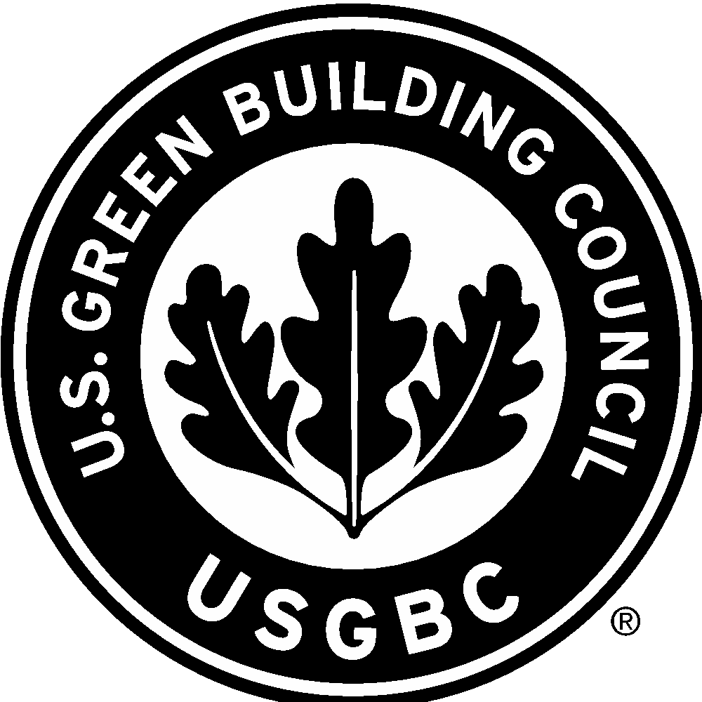
Overview of USGBC & LEED
David Abell, Senior Manager
U.S. Green Building Council
dabell@usgbc.org

Slide 2
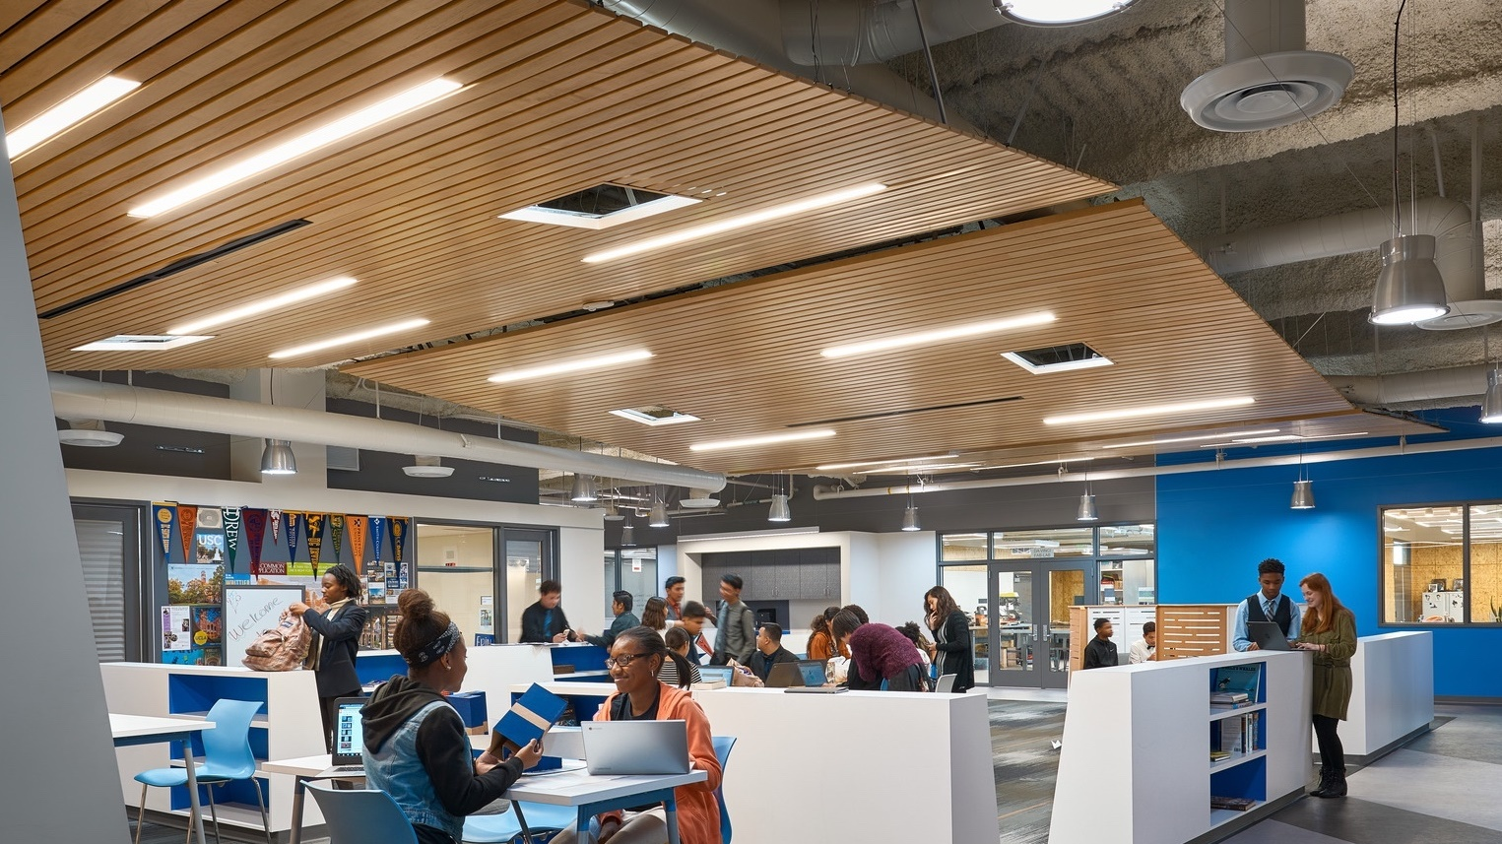
Wiseburn High School | Segundo, California, LEED Silver | Image credit: Ryan Gobuty, Gensler.

Slide 3
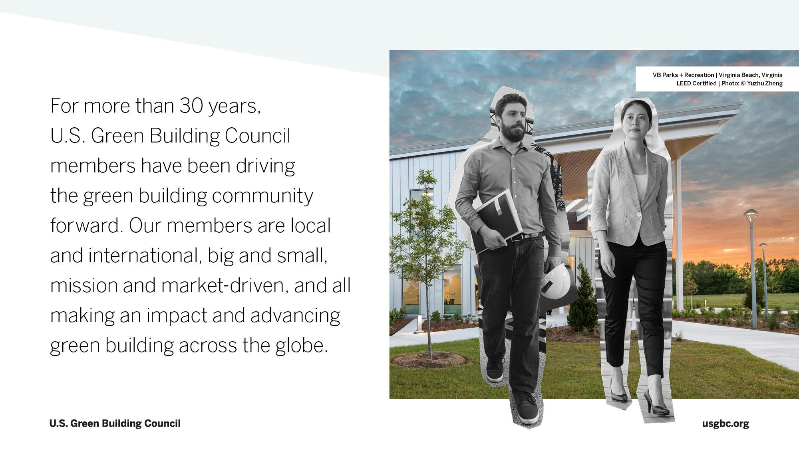

Slide 4
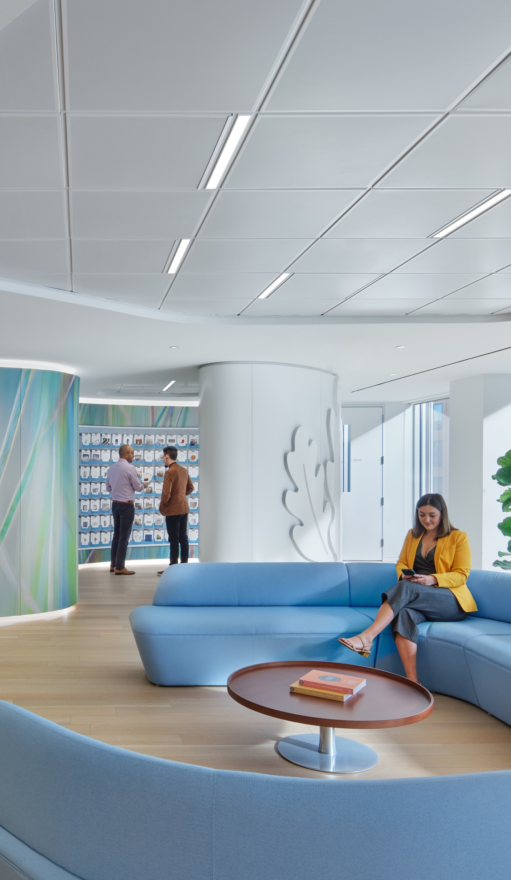
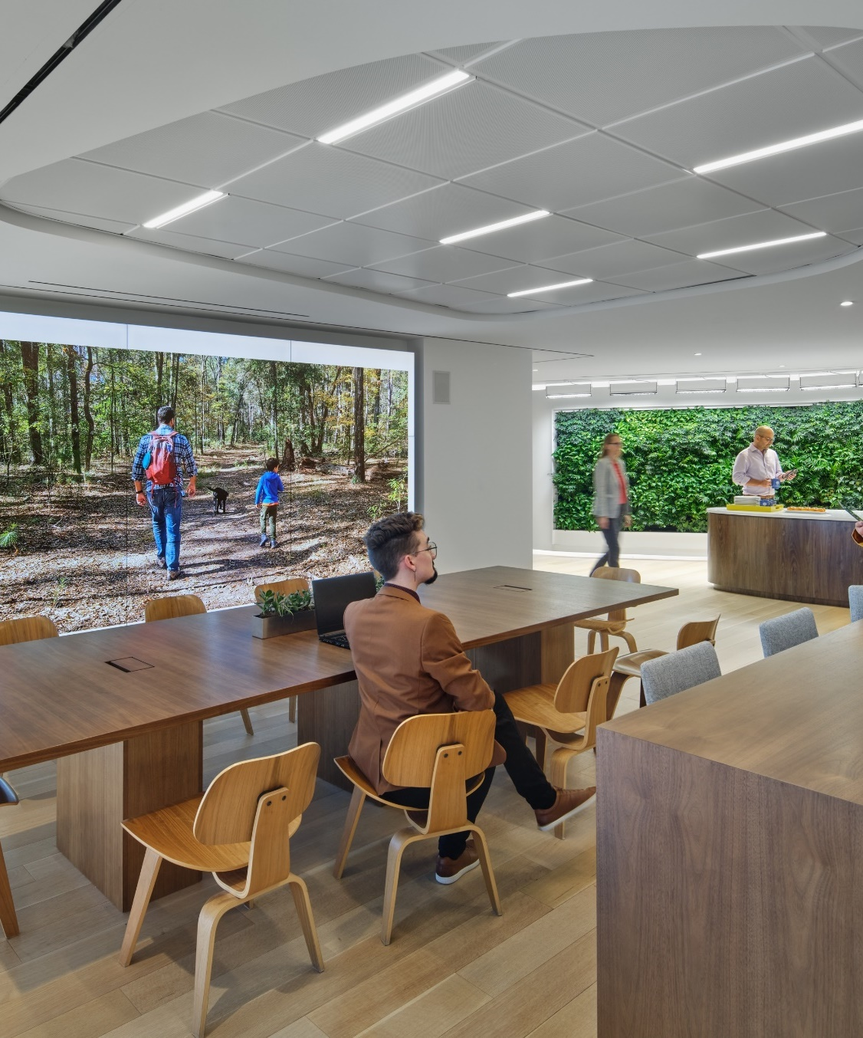
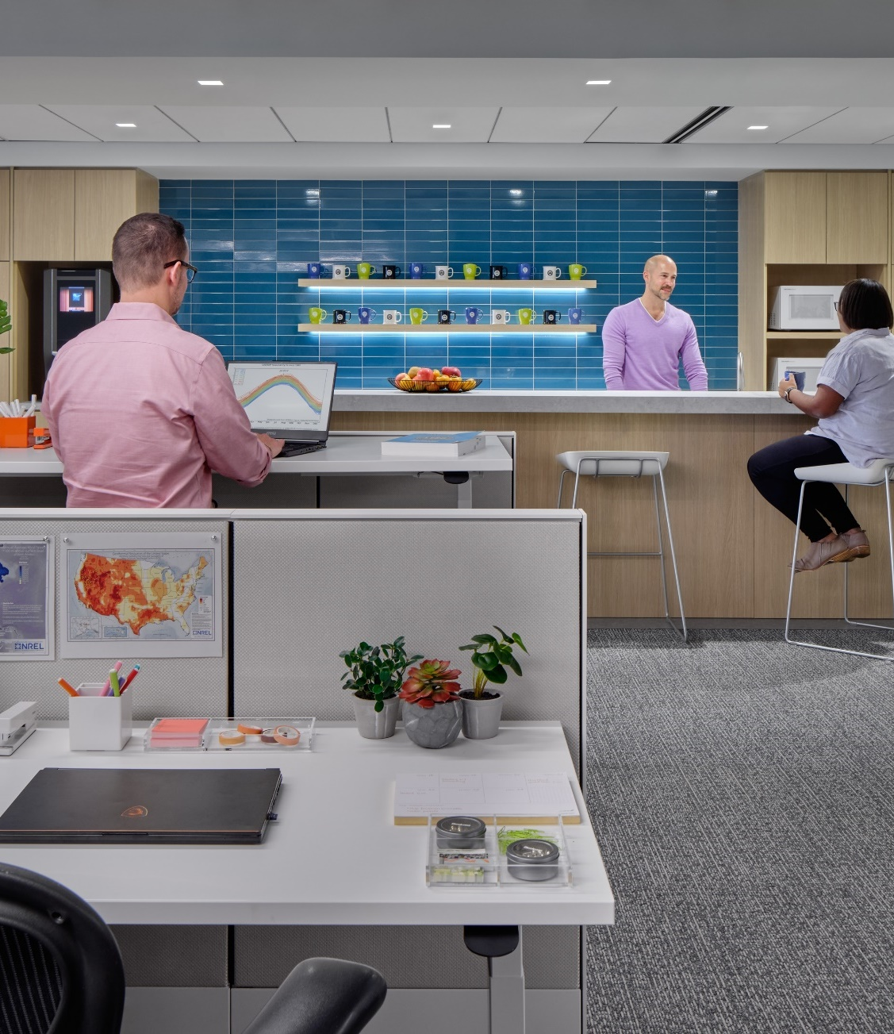
Green building for everyone within a generation.
At USGBC, our vision is that buildings and communities will regenerate and sustain the health and vitality of all life within a generation. Our mission is to transform how buildings and communities are designed, built and operated, enabling an environmentally and socially responsible, healthy, and prosperous environment that improves the quality of life.
USGBC HQ | Washington, D.C. | LEED Platinum | © Halkin Mason Photography
Notes:
At USGBC, our vision is that buildings and communities will regenerate and sustain the health and vitality of all life within a generation. Our mission is to transform how buildings and communities are designed, built and operated, enabling an environmentally and socially responsible, healthy, and prosperous environment that improves the quality of life.

Slide 5
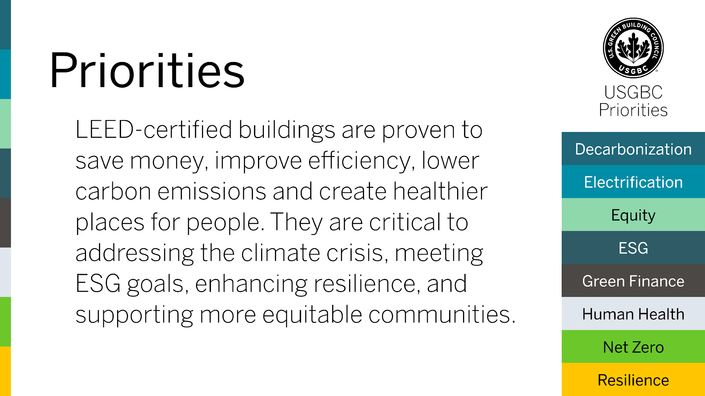

Slide 6
Why
do buildings matter?
Source: usgbc.org/articles/role-leed-climate-change-mitigation

Slide 7
Buildings are responsible for
almost 40%
of global CO₂ emissions
Source: usgbc.org/articles/role-leed-climate-change-mitigation

Slide 8
What
is LEED?
Source: usgbc.org/articles/role-leed-climate-change-mitigation

Slide 9
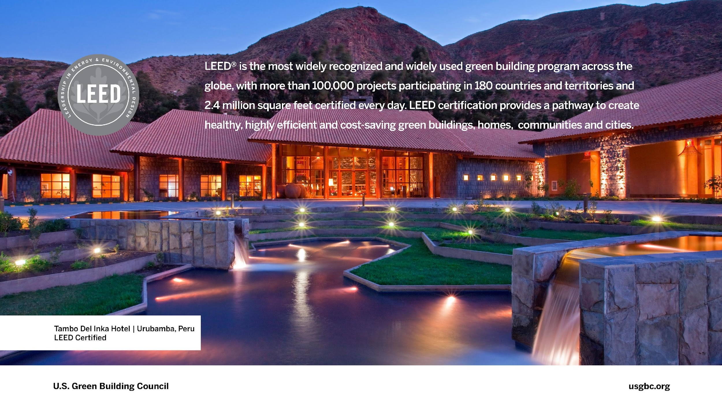
Notes:
Today, we are excited to say that LEED is a full-scale global movement. The numbers speak for themselves—LEED is everywhere, with projects in 180 countries and territories…and growing.

Slide 10
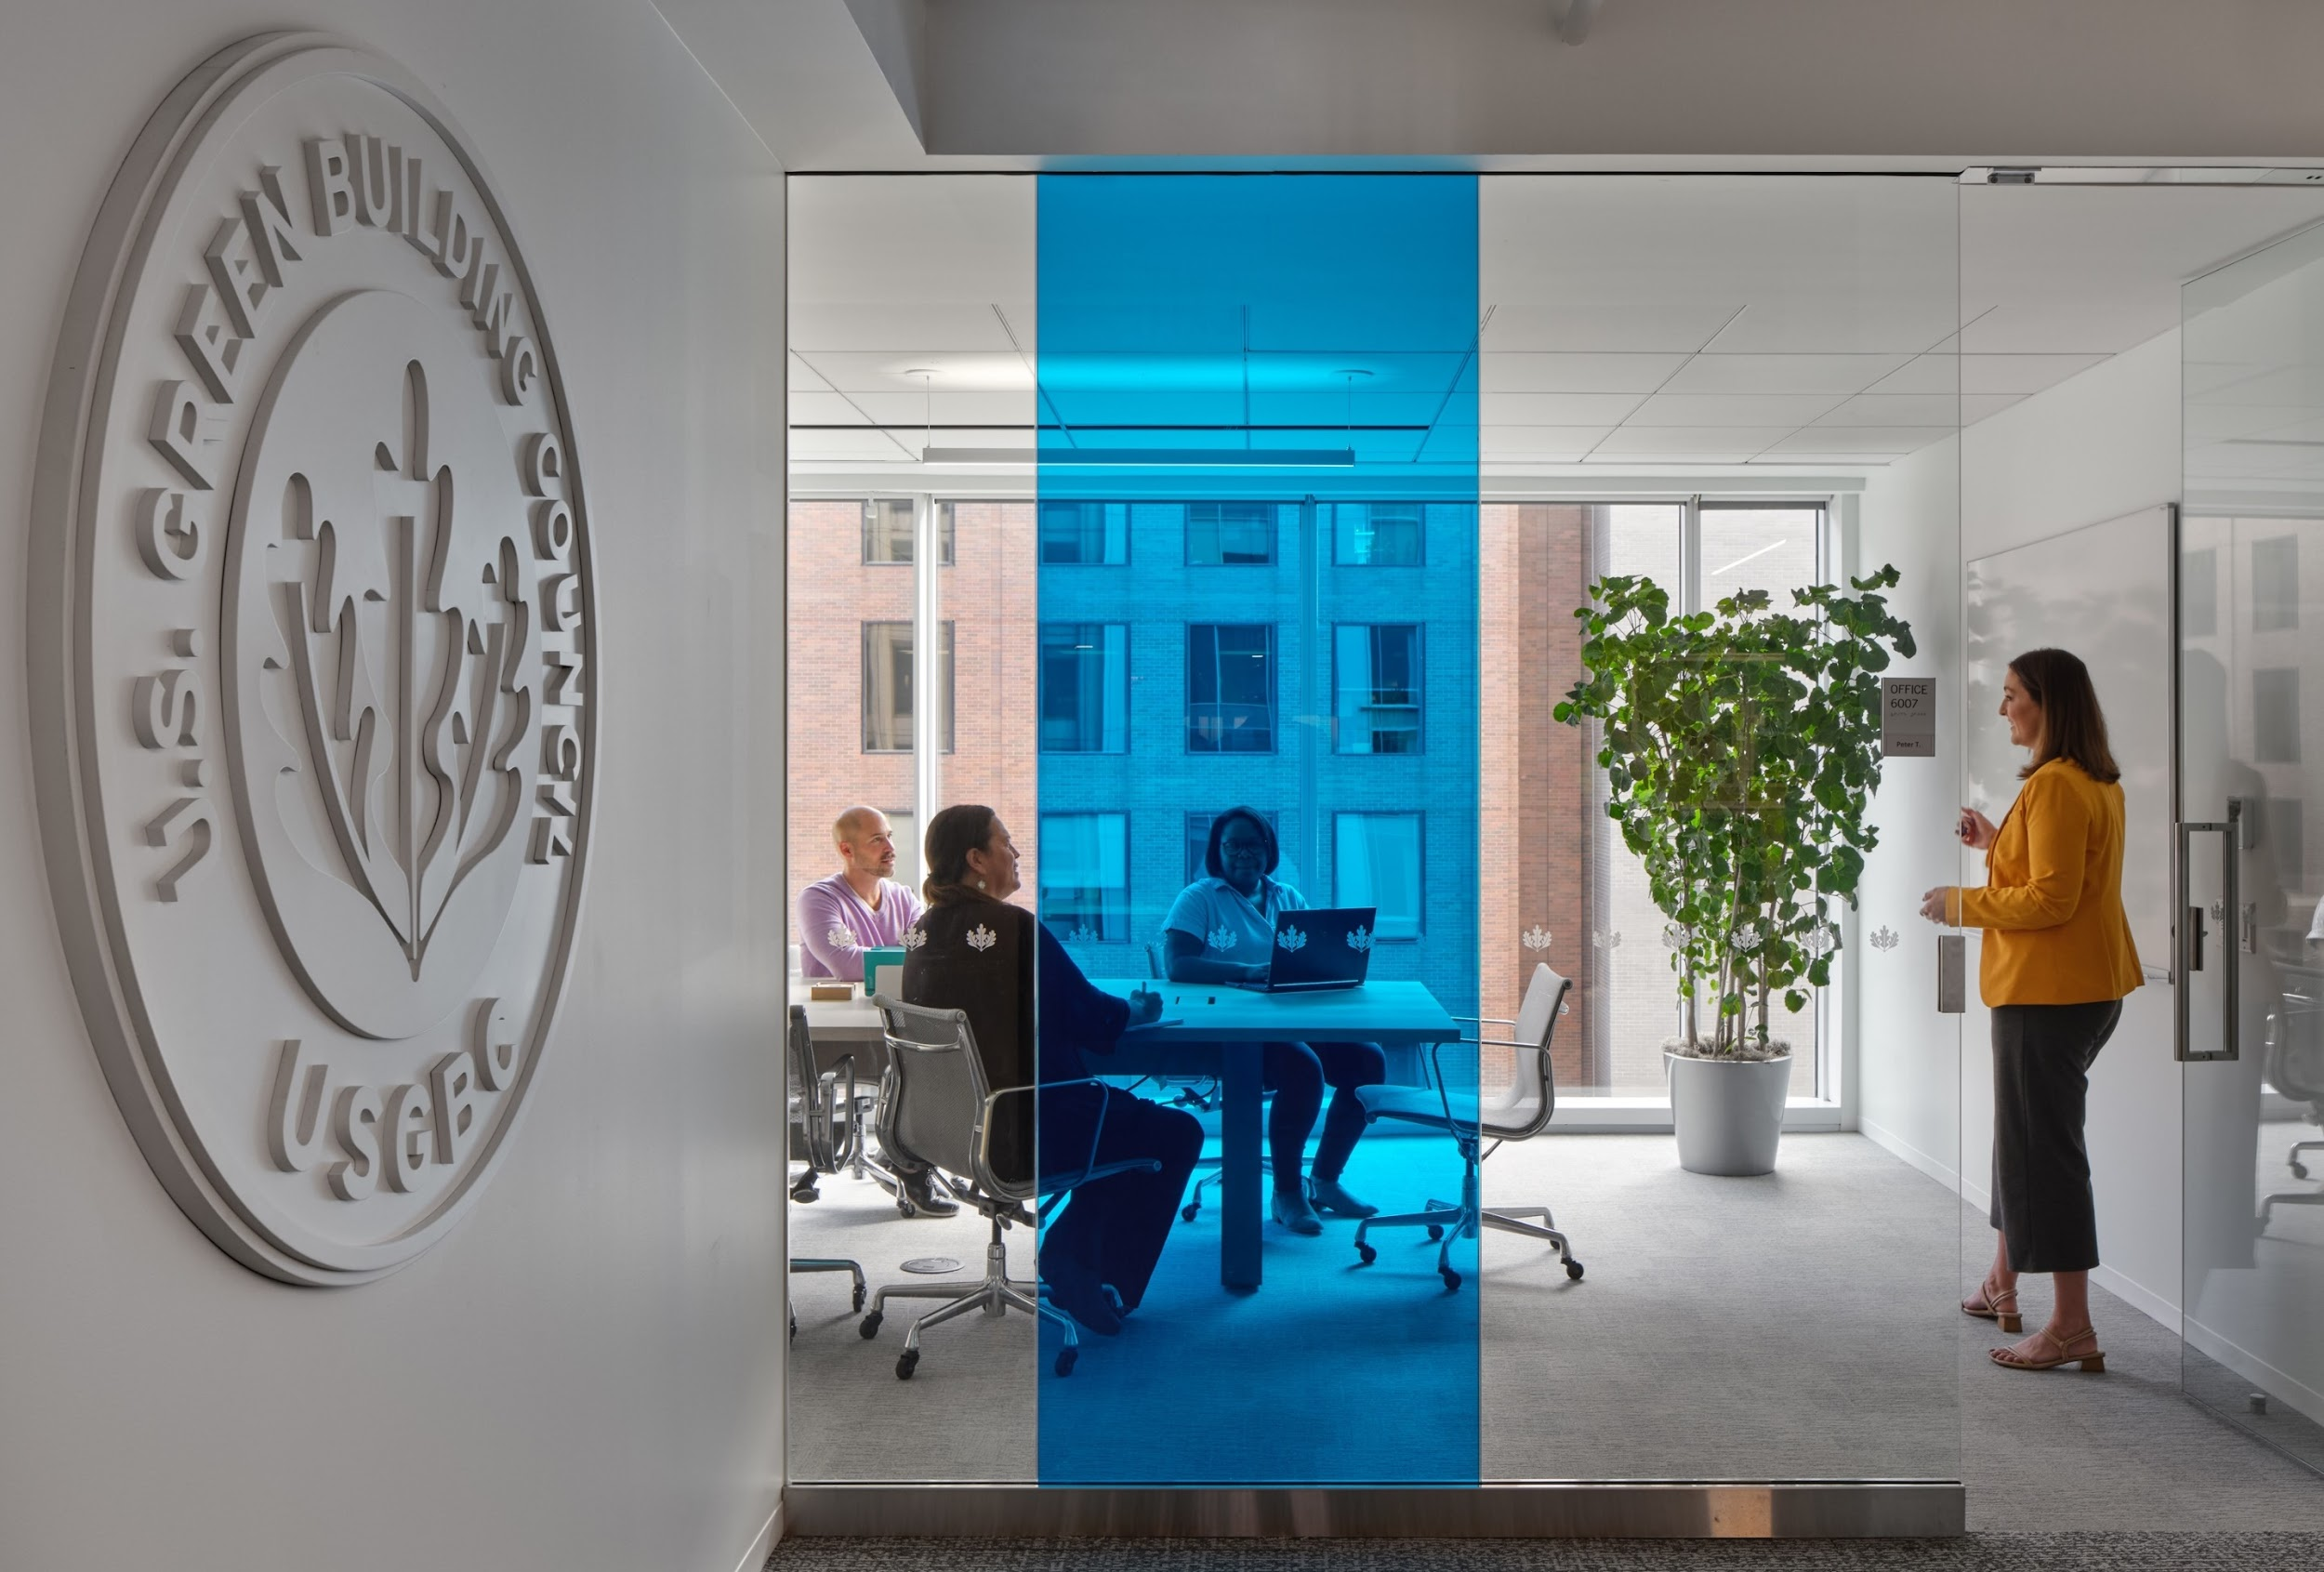
LEED-certified green buildings are better buildings.
LEED (Leadership in Energy and Environmental Design) is the world's most widely used green building rating system. LEED certification provides a framework for healthy, highly efficient, and cost-saving green buildings, which offer environmental, social and governance benefits. LEED certification is a globally recognized symbol of sustainability achievement, and it is backed by an entire industry of committed organizations and individuals paving the way for market transformation.
USGBC HQ | Washington, D.C. | LEED Platinum | © Halkin Mason Photography

Slide 11
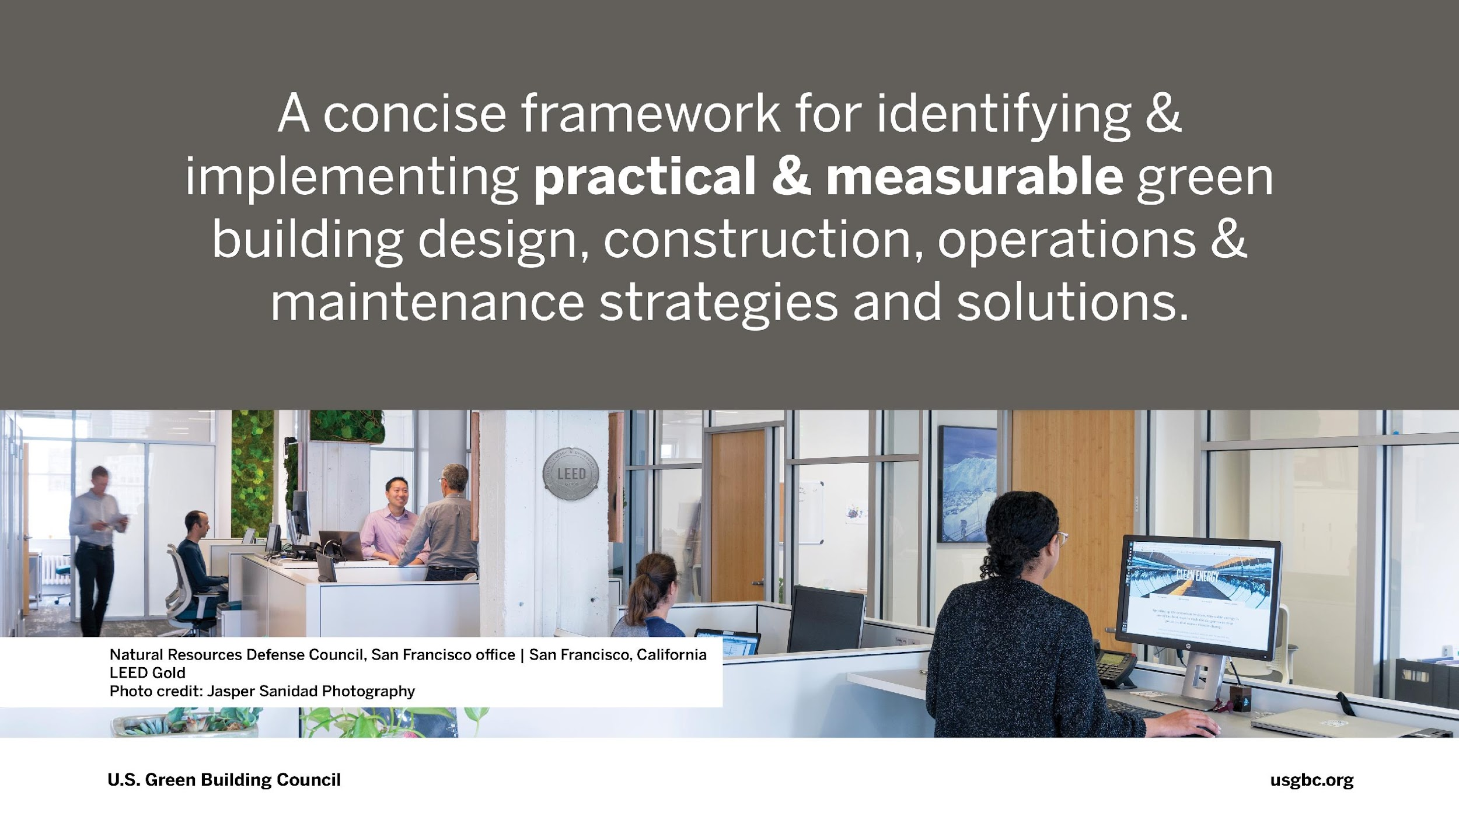
Notes:
LEED is a concise framework for identifying and implementing practical and measurable green building design, construction, operations & maintenance strategies and solutions.

Slide 12
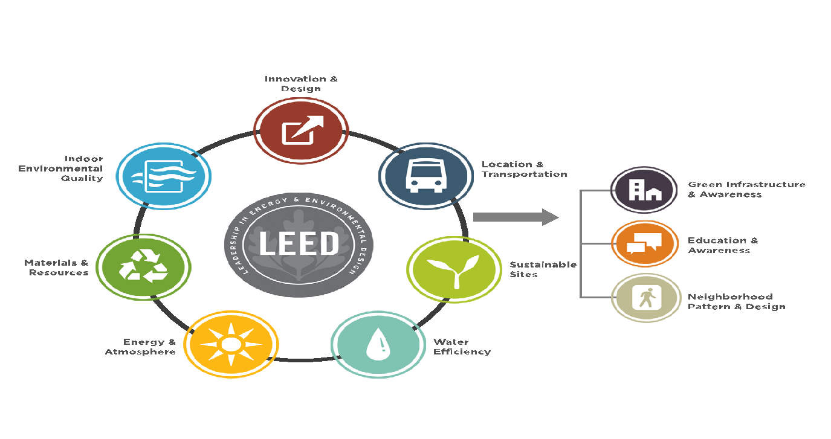
Organization of LEED
Notes:
Green buildings are driving resilience-enhancing designs, technologies, materials, and methods. To support these efforts, green buildings often include practices such as the use of durable materials, thoughtful site selection, rainwater collection, demand response, grid , maximal energy efficiency, on-site renewable energy generation and more.
Design Planning: Proactive design planning and construction for potential impacts of reasonably expected natural disasters with minimal damage.
Healthy Site: Creation and execution of a site development plan that promotes healthy vegetation, soils, and aquatic ecosystems to provide ecosystem services such as flood control.
Maintaining Project Site: Design, building, and maintaining of the project site and adjacent landscapes to reduce risk of wildfire.
Catastrophic Event: Support for community recovery during catastrophic events and extended bulk power grid outages by enabling islanding and power reliability to essential services.

Slide 13
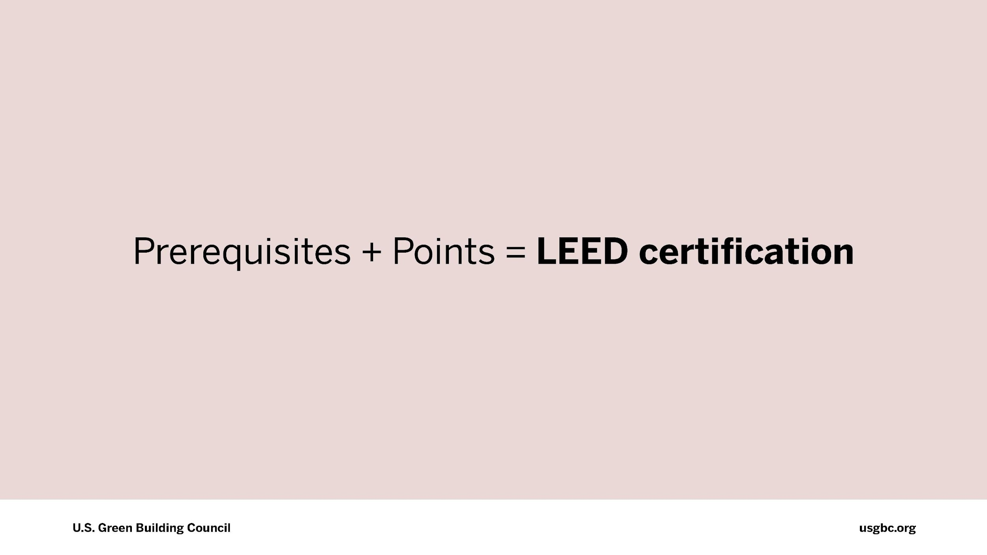

Slide 14
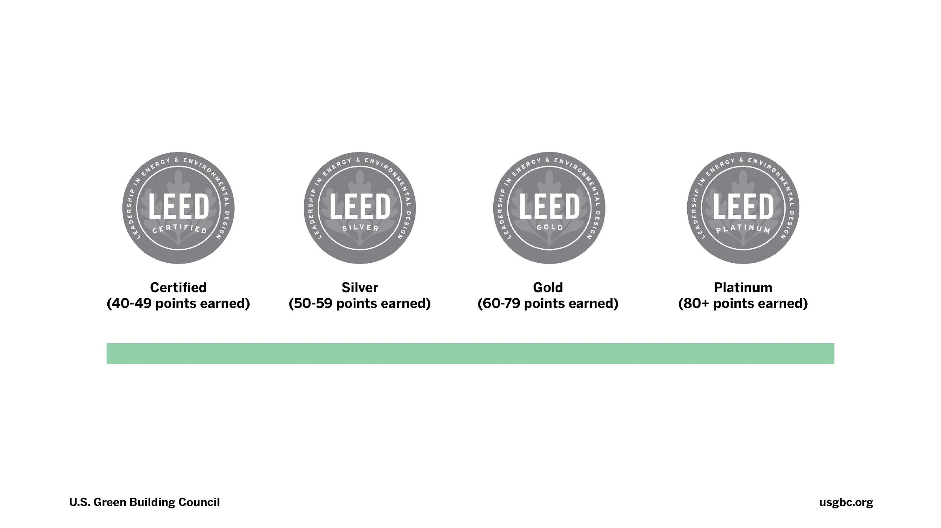
Notes:
Projects pursuing LEED certification earn points for various green building strategies across several categories based on the number of points achieved, a project earns one of four LEED rating levels: Certified, Silver, Gold or Platinum

Slide 15
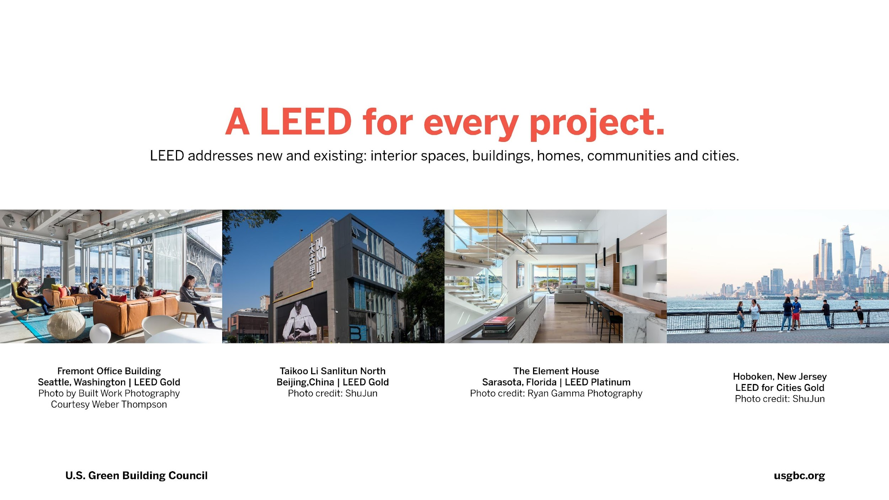
Notes:
The rating system works for all buildings at all phases of development, from new construction to existing buildings, and all building sectors, from homes to hospitals to corporate headquarters.
LEED addresses homes, offices, hotels, hospitals, schools, retail spaces, banks, factories, stadiums, college campuses, neighborhoods… every building type at every lifecycle phase in any climate or region.

Slide 16
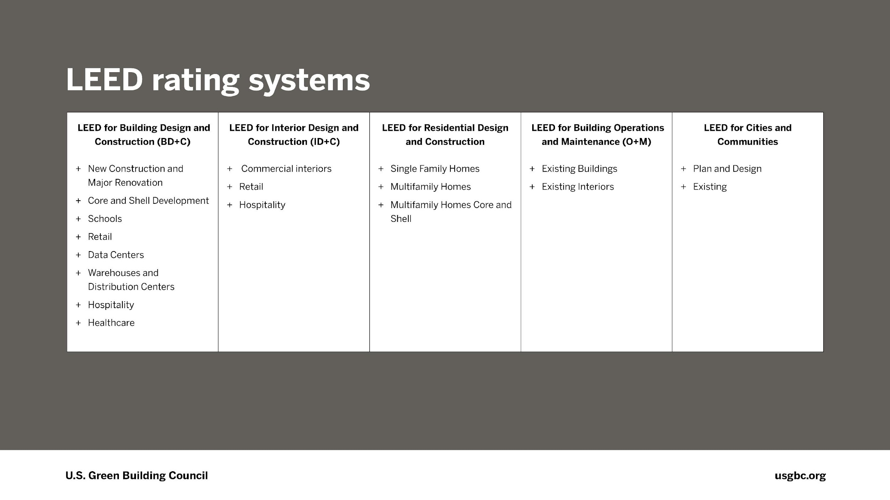

Slide 17
Why
get LEED certification?
Source: usgbc.org/articles/role-leed-climate-change-mitigation
Notes:
Why certify?
We stand for accountability, and we translate that accountability through the LEED third-party certification process. Behind LEED is an infrastructure developed by industry leaders that supports project teams as they innovate and create high performing buildings, homes and neighborhoods. USGBC invests more than $30 million annually to maintain, operate and improve LEED and its customer delivery.
The LEED plaque stands for leadership, and demonstrates that a building has been designed, built and is operating as intended. Being "built to LEED” or “LEED equivalency” doesn’t exist—there is no substitute for LEED certification.

Slide 18
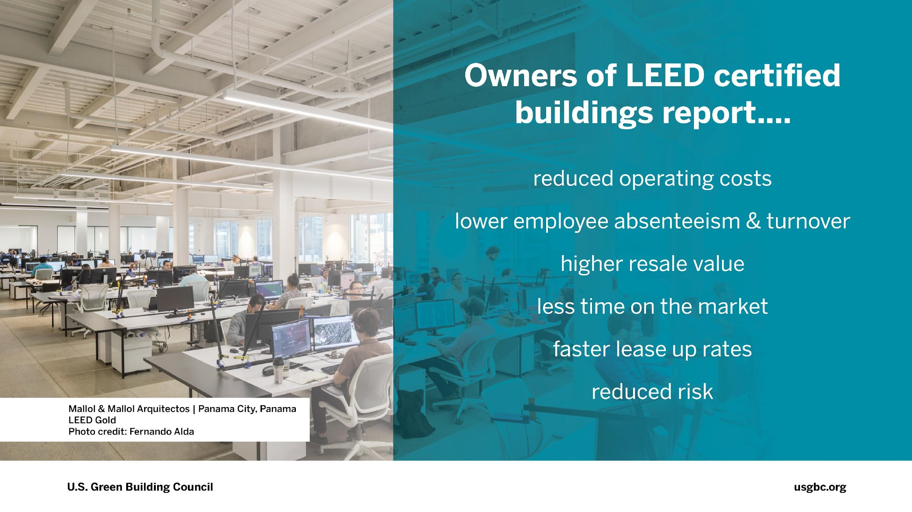
Notes:
LEED building owners report reduced operating costs, lower employee absenteeism and turnover, higher resale value, less time on the market, faster lease up rates and reduced risks compared to traditional buildings.

Slide 19
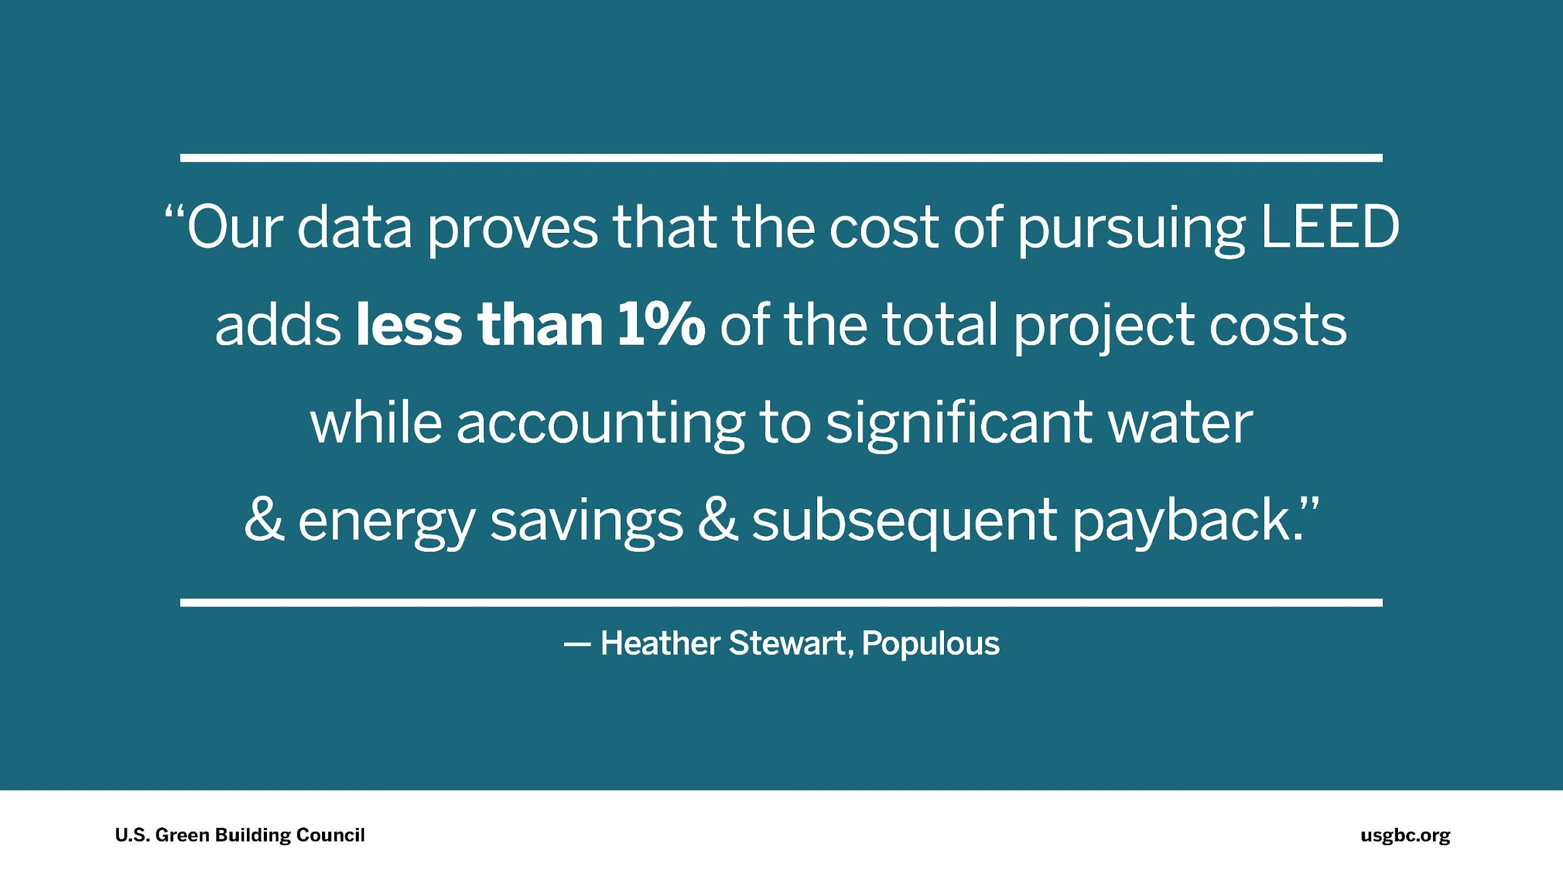
Notes:
Populous, which has been a USGBC member since 2008, and has worked on LEED-certified projects worldwide, reports that pursuing LEED has allowed them to enjoy significant payback. Heather Stewart states: “Our data proves that the cost of pursuing LEED adds less than 1% of the total project costs while accounting for significant water and energy savings and subsequent payback.”
Stat from USGBC’s LEED in Motion: Venues report, https://www.usgbc.org/resources/leed-motion-venues

Slide 20
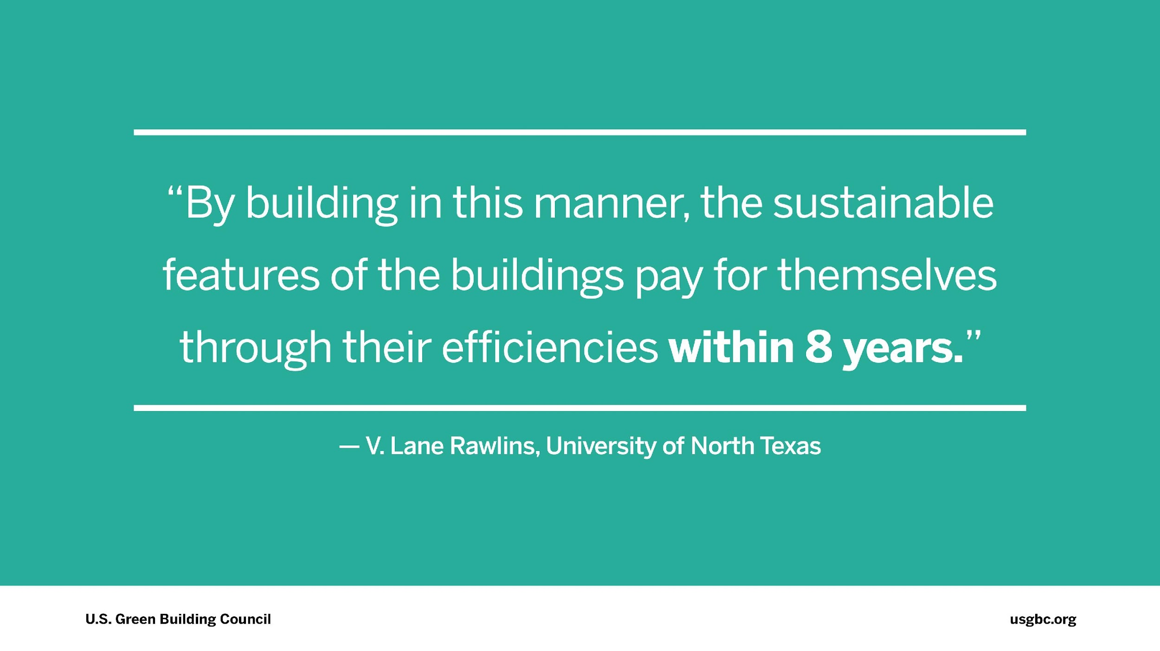
Notes:
The University of North Texas President reports that the sustainable features of their LEED-certified football stadium pay for themselves within eight years. In 2011, their 31,800-seat football stadium became the first LEED Certified sports arena in the world. President V. Lane Rawlins said afterward: “By building in this manner, the sustainable features of the buildings pay for themselves through their efficiencies within eight years.”
Stat from University of Texas press release, https://www.cdrecycler.com/news/university-north-texas-stadium-leed/

Slide 21
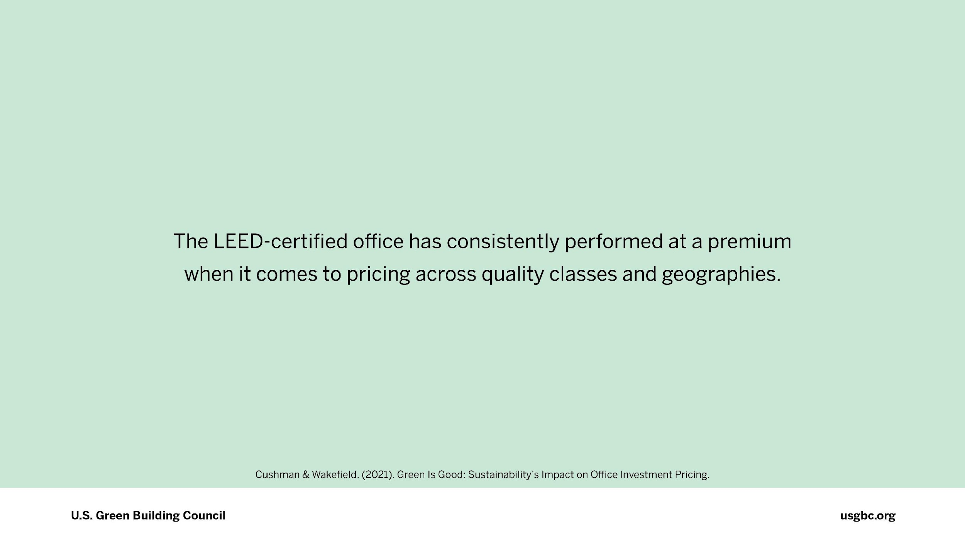
Notes:
The LEED-certified office has consistently performed at a premium when it comes to pricing across quality classes and geographies.
Cushman & Wakefield. (2021). Green Is Good: Sustainability’s Impact on Office Investment Pricing.

Slide 22
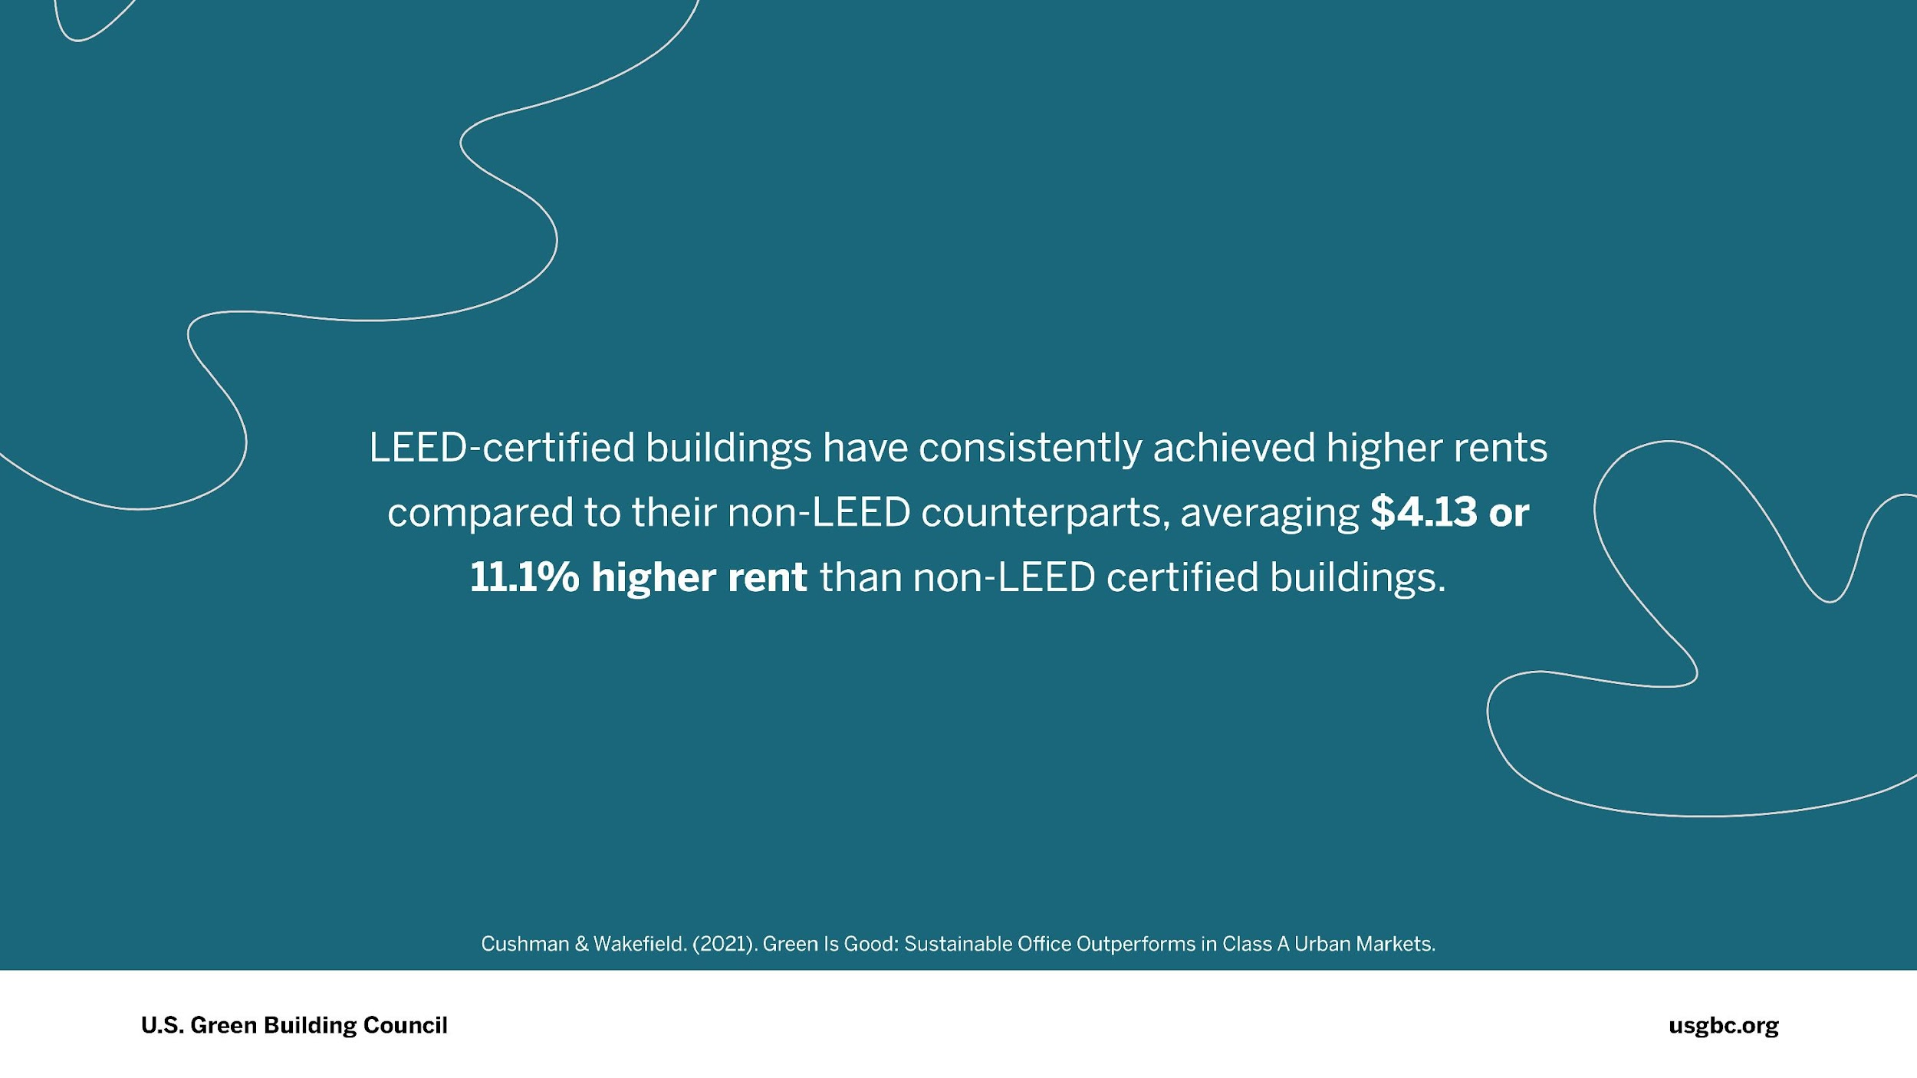
Notes:
Cushman & Wakefield reported that LEED-certified buildings have consistently achieved higher rents than their non-LEED counterparts, averaging $4.13 or 11.1% higher rent than non-LEED certified buildings.
Cushman & Wakefield (2021). Green Is Good: Sustainable Office Outperforms in Class A Urban Markets.

Slide 23
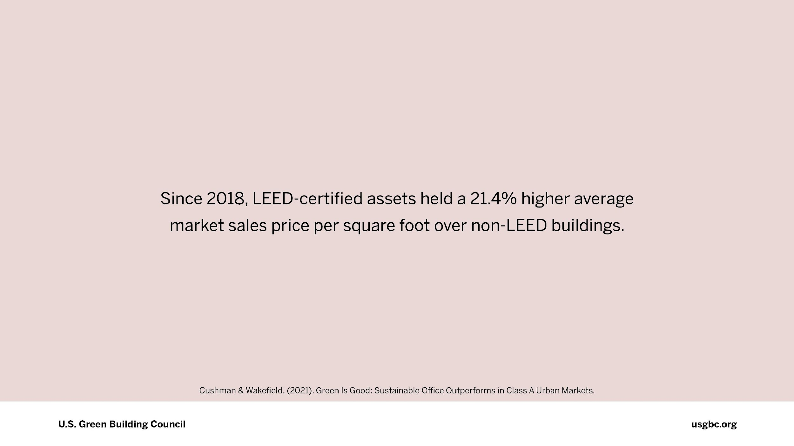
Notes:
Cushman & Wakefield’s report also found that since 2018, LEED-certified assets held a 21.4% higher average market sales price per square foot over non-LEED buildings.
Cushman & Wakefield (2021). Green Is Good: Sustainable Office Outperforms in Class A Urban Markets.

Slide 24
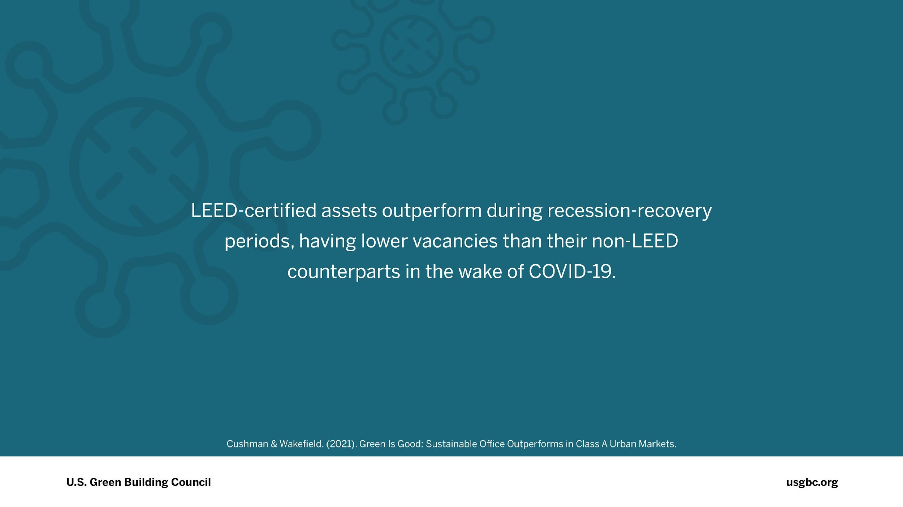
Notes:
LEED-certified assets outperform during recession-recovery periods, having lower vacancies than their non-LEED counterparts in the wake of COVID-19.
Cushman & Wakefield. (2021). Green Is Good: Sustainable Office Outperforms in Class A Urban Markets.

Slide 25
How
do we scale?
Source: usgbc.org/articles/role-leed-climate-change-mitigation
Notes:
Why certify?
We stand for accountability, and we translate that accountability through the LEED third-party certification process. Behind LEED is an infrastructure developed by industry leaders that supports project teams as they innovate and create high performing buildings, homes and neighborhoods. USGBC invests more than $30 million annually to maintain, operate and improve LEED and its customer delivery.
The LEED plaque stands for leadership, and demonstrates that a building has been designed, built and is operating as intended. Being "built to LEED” or “LEED equivalency” doesn’t exist—there is no substitute for LEED certification.

Slide 26
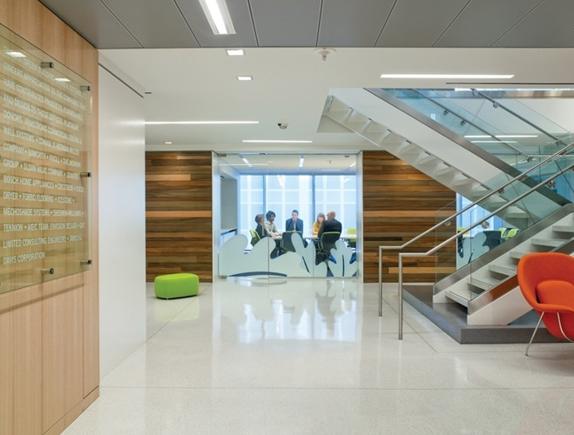
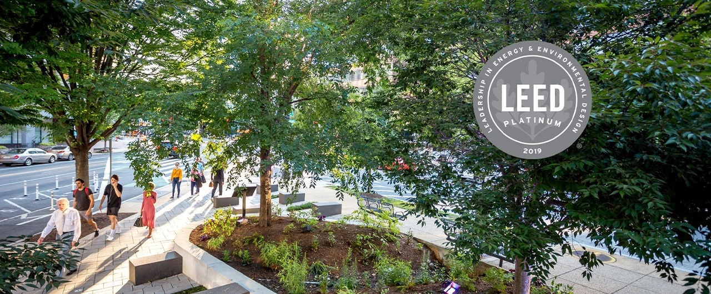
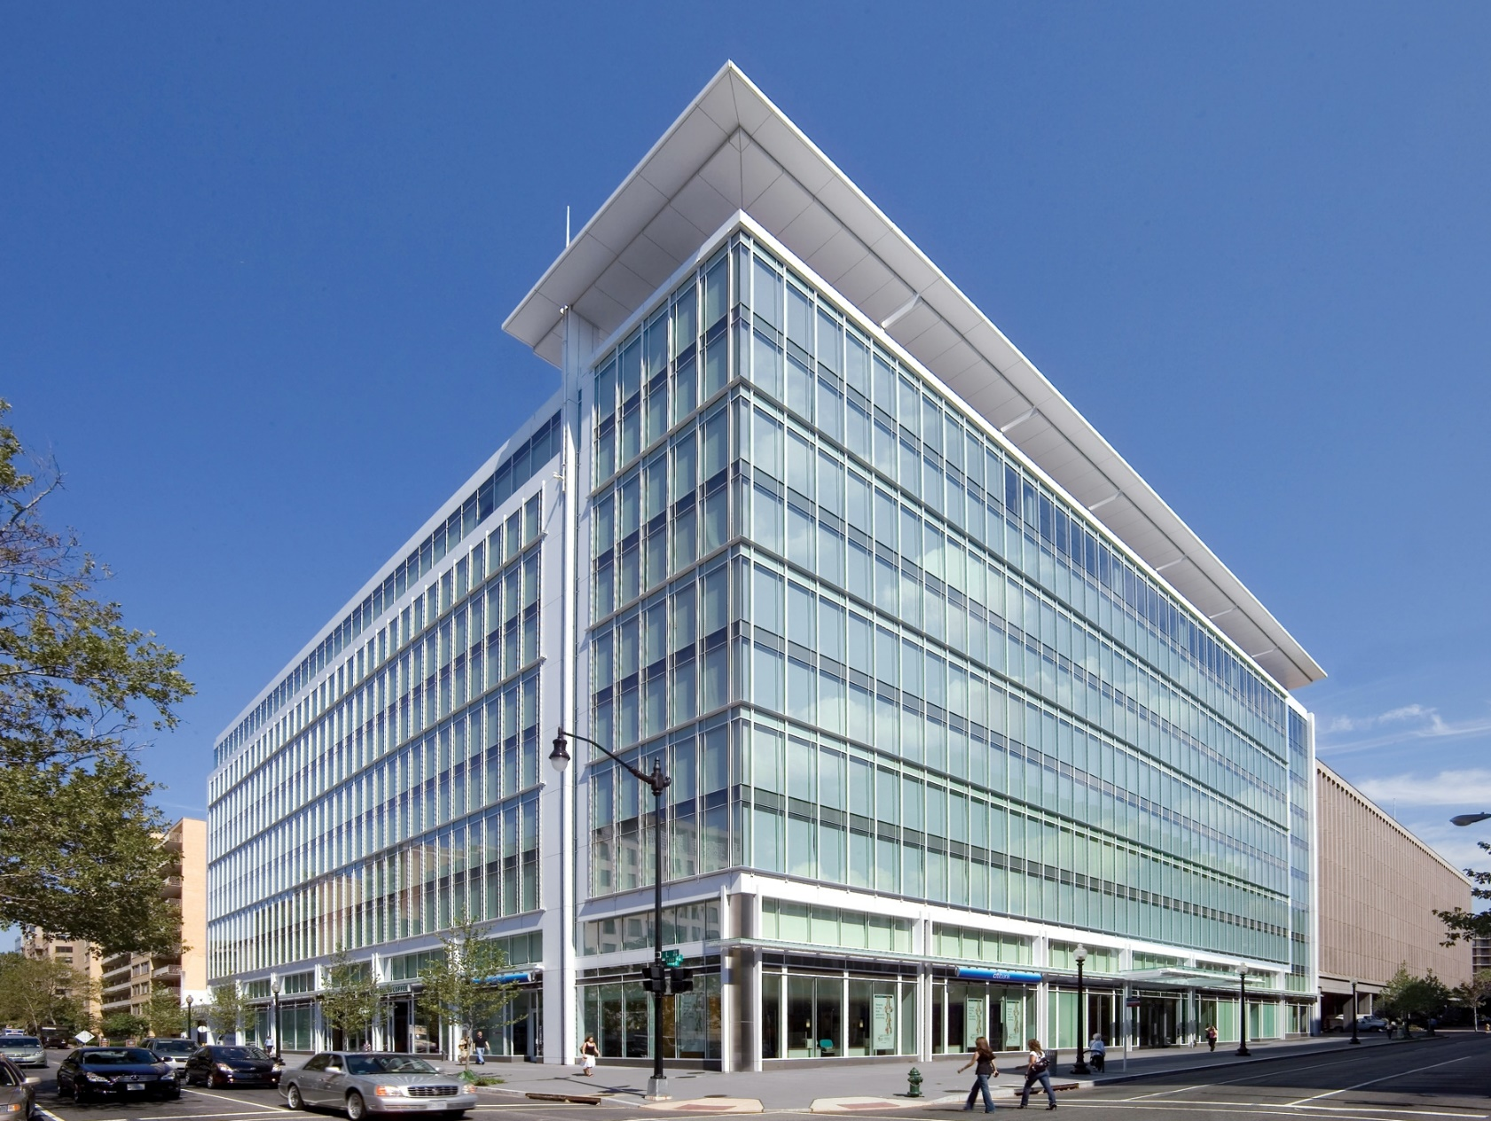
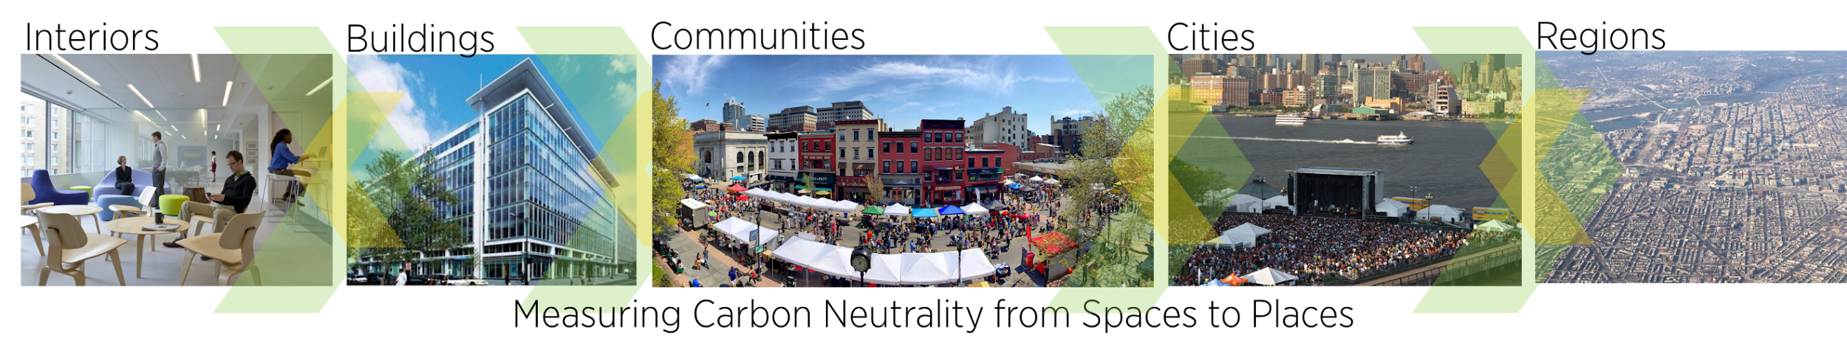
LEED can be applied at the building, community and city scale
Example: USGBC Headquarters, Golden Triangle BID and the District of Columbia

Slide 27
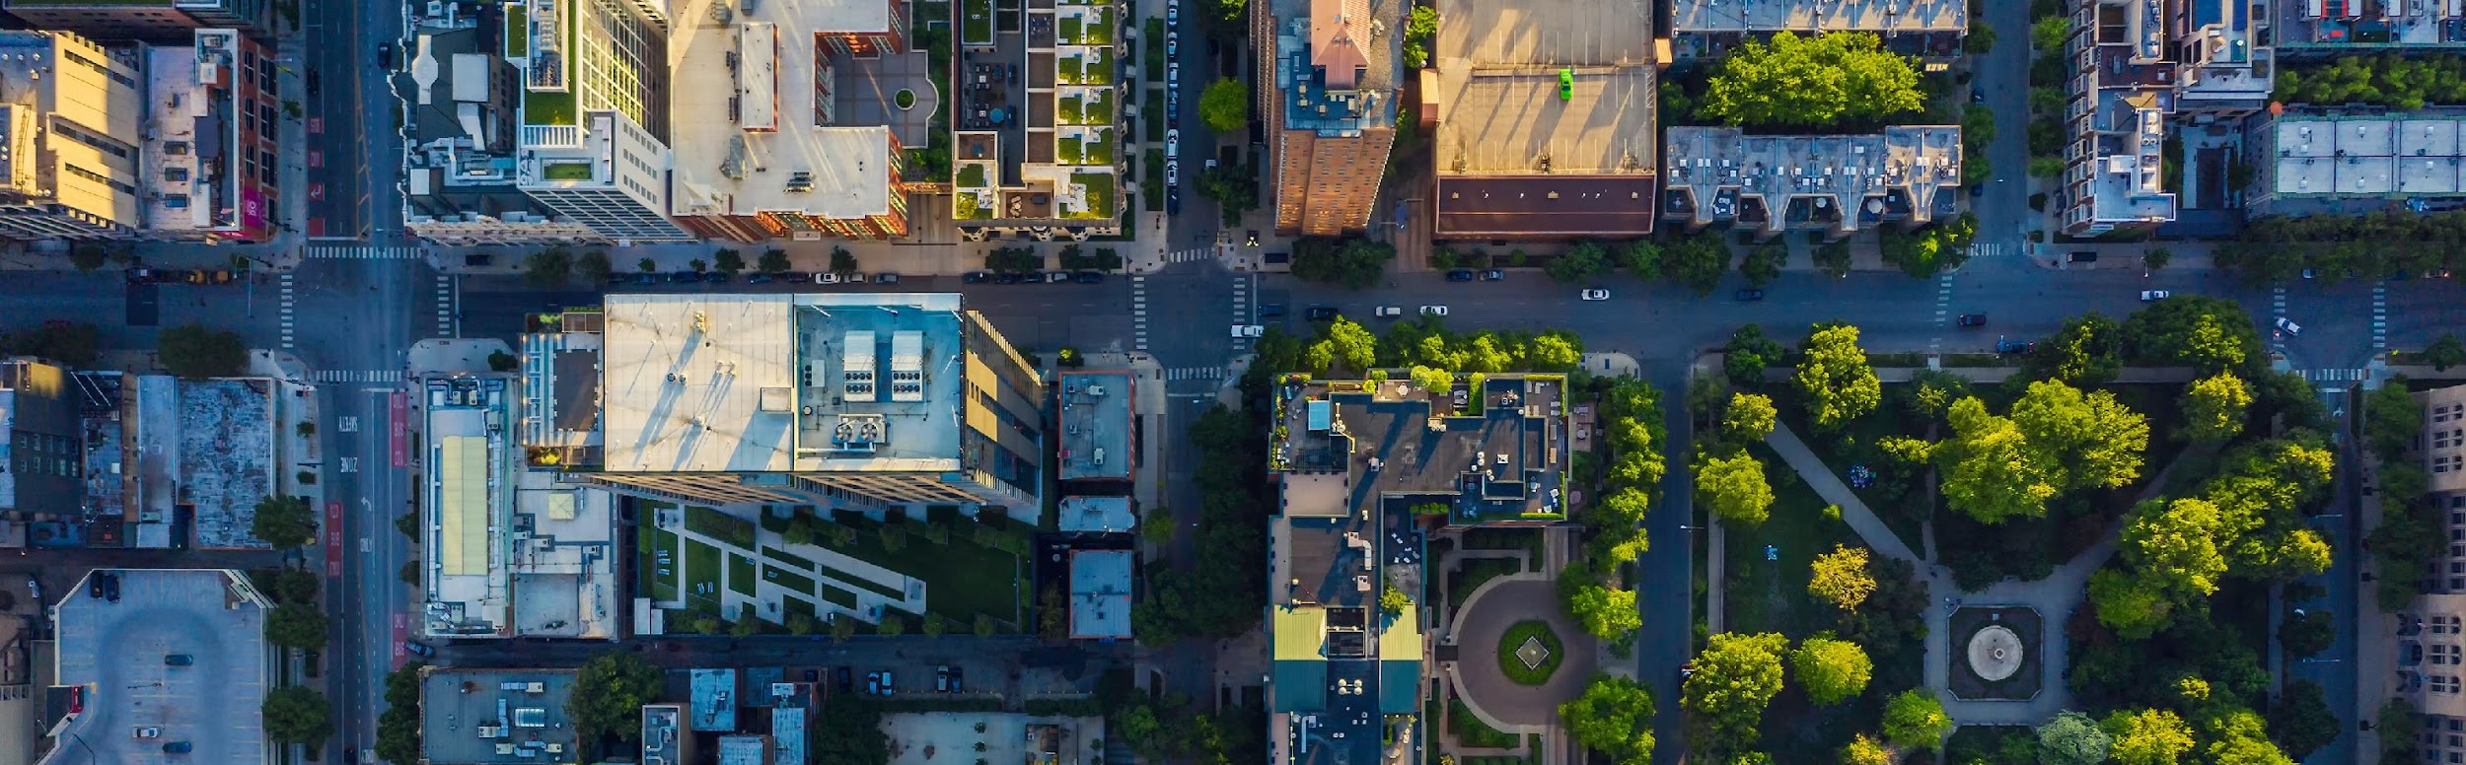
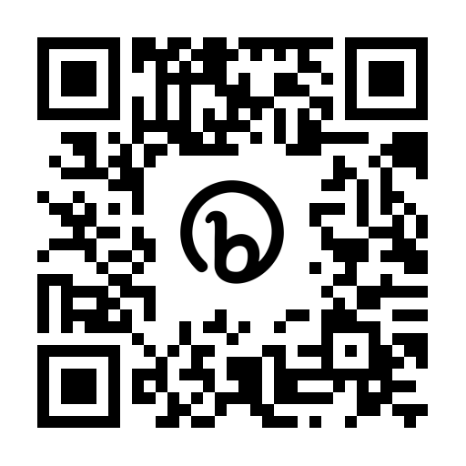




Driving Performance at Scale
Portfolio Accelerator Pilot
Sign up for key updates!
4
5
Plan Guidance
Plan Assessment
Performance
Verification
Notes:
Our second big announcement from Greenbuild has to do with driving performance at scale. Our leadership has been listening to the market, and we know if we are to accelerate the adoption of LEED - at a scale needed to achieve our climate imperatives - we have to think bigger.
The vision behind our Portfolio Accelerator Pilot is to create a new approach to support continuous improvement, to verify the performance of real estate portfolios, and to recognize an organizations’ achievement – across a broad scope of sustainability and equity goals.
Under this approach, commitments and actions would be made at the organization level rather than the Individual or project level. This is fundamentally different from how we have worked with buildings in the past. We cannot expect every asset within a portfolio to meet the requirements of LEED certification, but we can provide a pathway at the organizational level.
You will see more from us in the coming weeks regarding our Performance at Scale Initiative. In the meantime, get out your phones. We want to connect with you, listen to your needs, and activate solutions through the design of our new suite of products and services. We invite you to fill out our interest form so you can stay in touch and get updates. If you would like to be an Early Adopter – or just to learn more and receive updates – scan this QR link!

Slide 28
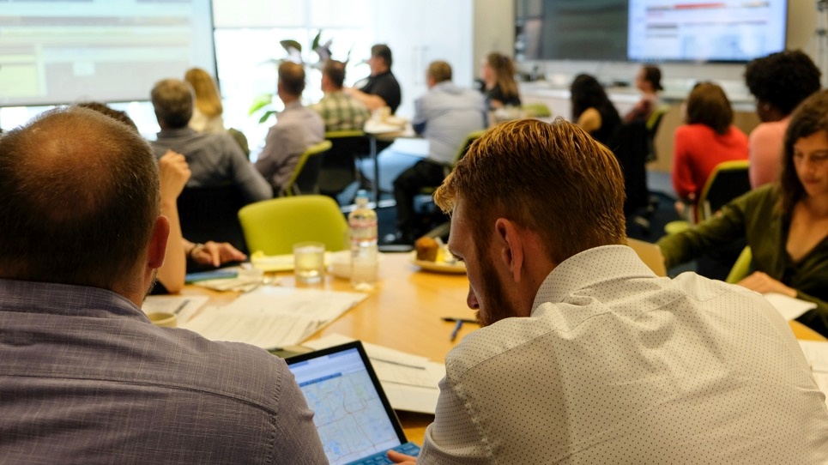
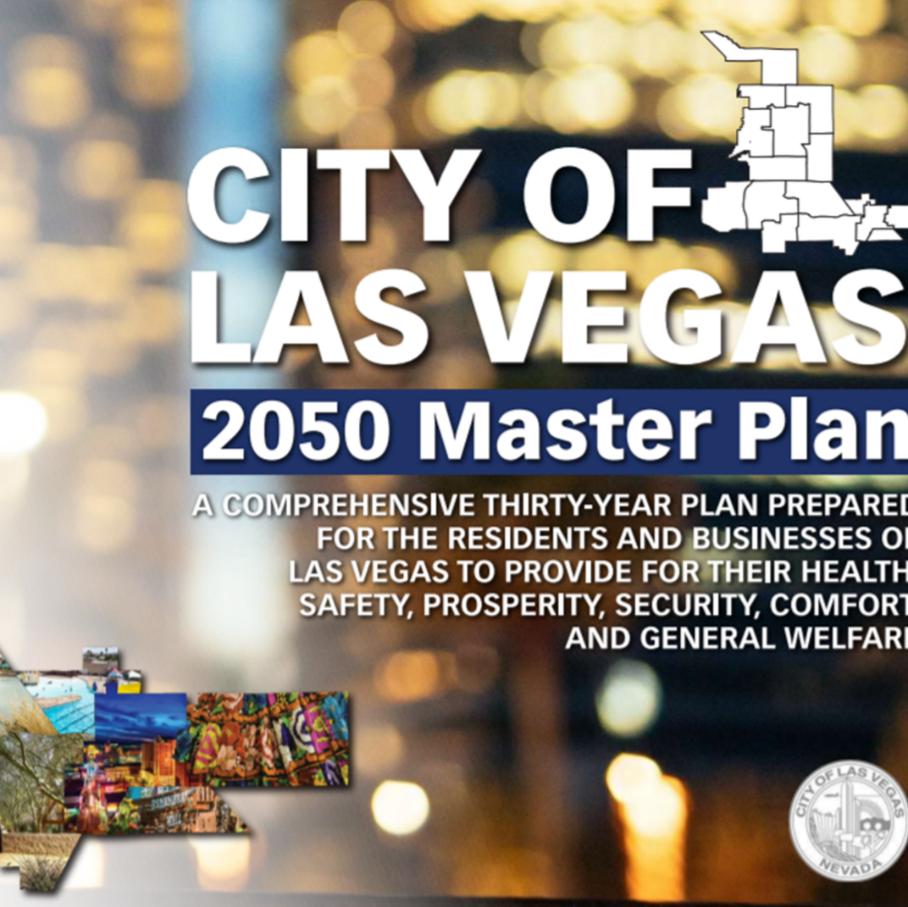
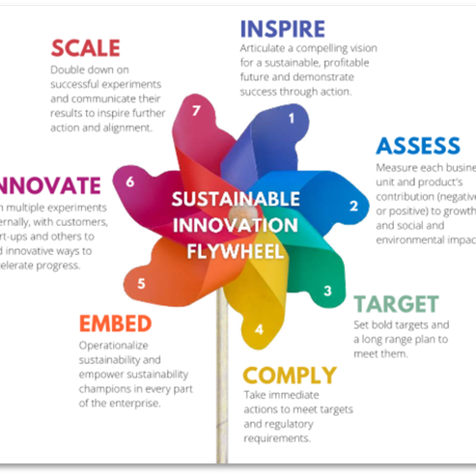
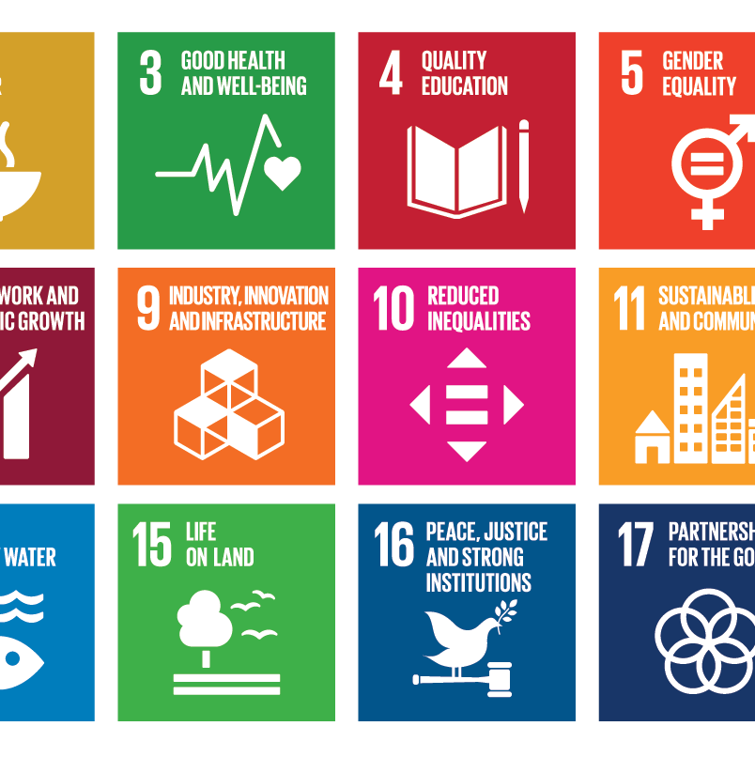
LEED for Cities provides a comprehensive management framework for sustainability.
Notes:
Roadmap and guide for sustainability practitioners

Slide 29
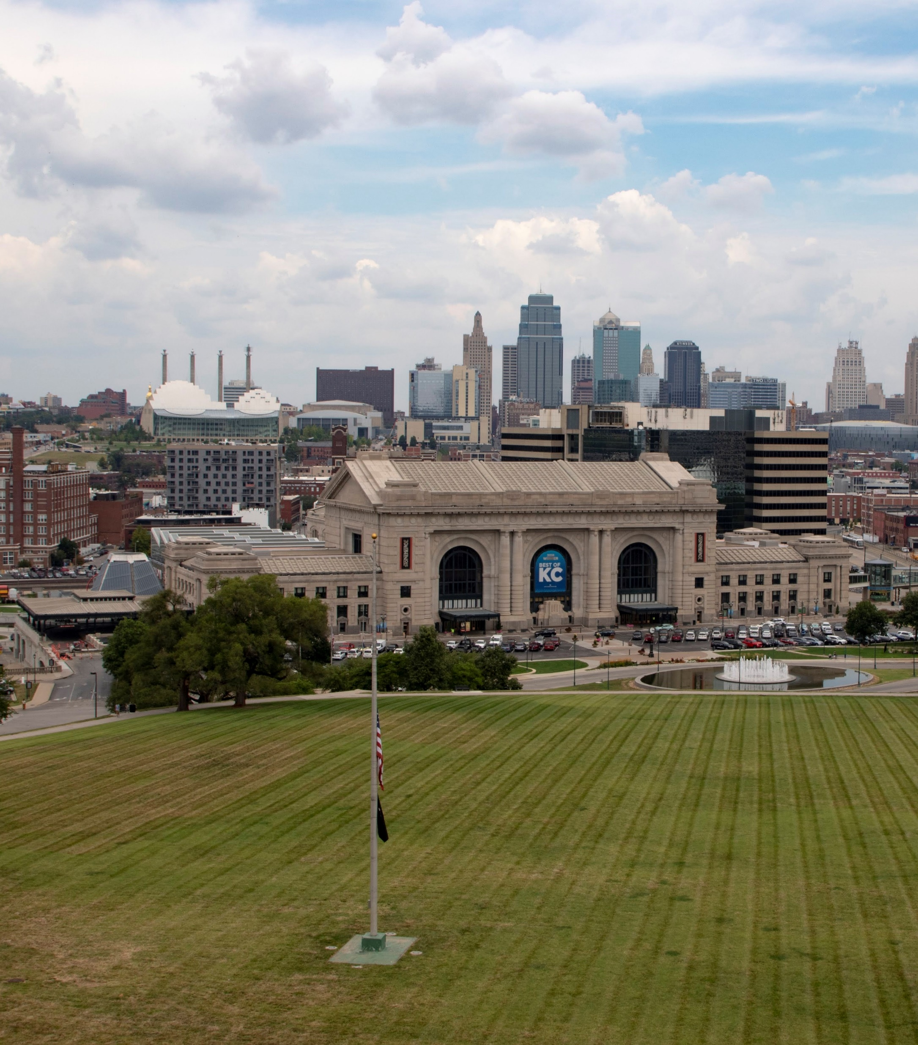









Integrative Process
Natural Systems & Ecology
Transportation & Land Use
Water Efficiency
Energy & GHG Emissions
Materials & Resources
Quality of Life
Innovation
Regional Priority
Notes:
Categories that address the triple bottom line – environmental, social and economic performance

Slide 30
What
is next?
Source: usgbc.org/articles/role-leed-climate-change-mitigation
Notes:
Why certify?
We stand for accountability, and we translate that accountability through the LEED third-party certification process. Behind LEED is an infrastructure developed by industry leaders that supports project teams as they innovate and create high performing buildings, homes and neighborhoods. USGBC invests more than $30 million annually to maintain, operate and improve LEED and its customer delivery.
The LEED plaque stands for leadership, and demonstrates that a building has been designed, built and is operating as intended. Being "built to LEED” or “LEED equivalency” doesn’t exist—there is no substitute for LEED certification.

Slide 31
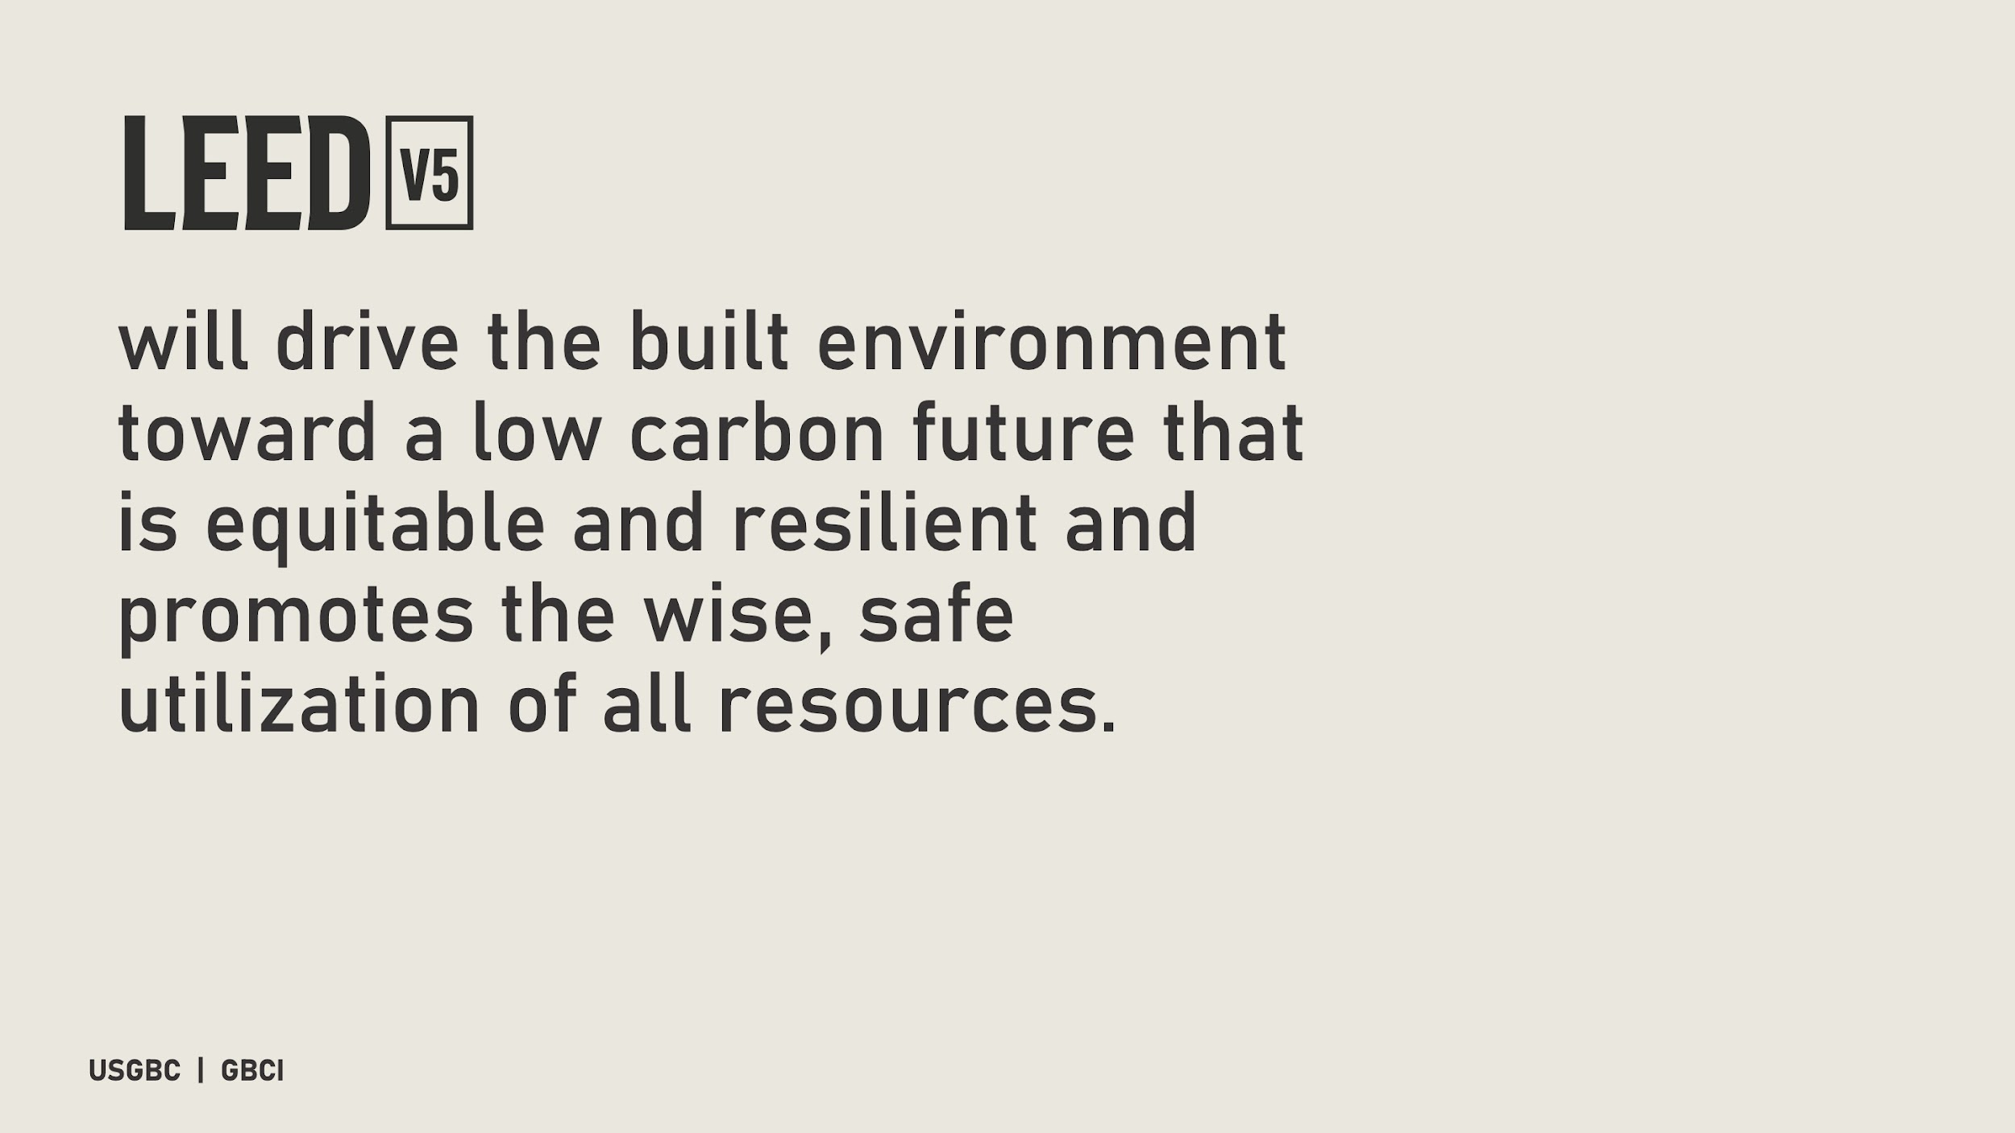
Notes:
This version is the result of deep and meaningful conversations with the LEED community and fueled by an urgency to address the most pressing global concerns. It is a representation of what we have heard from volunteers, members, stakeholders and many others about the needs driving business decisions across the built environment.
While each version of the ratings system addresses the needs with a sector specific approach, the mission is the same – evolve in a manner that equips the industry with the knowledge and tools needed to understand and address the key issues and challenges facing the built environment today.

Slide 32
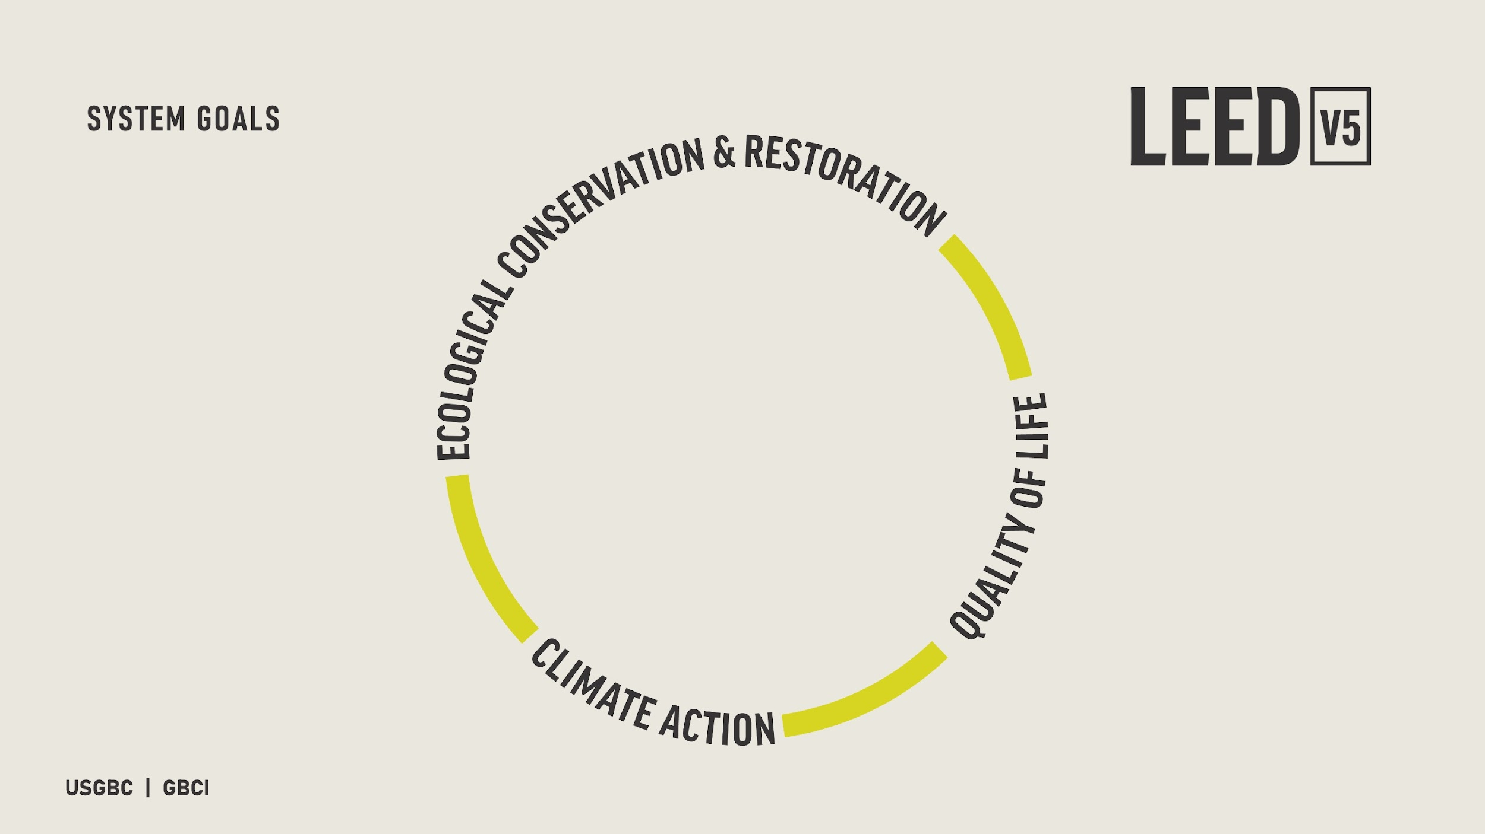
Notes:
LEED v5 is built around a restructured LEED rating system framework, at the top of which are the system goals:
- climate action
- quality of life
- ecological conservation and restoration.
These are the overarching areas of focus that will guide the next several versions of the rating system and will also serve as the mechanism for prioritizing the way project teams are rewarded for pursuing various strategies.

Slide 33
How
can we get involved?
Source: usgbc.org/articles/role-leed-climate-change-mitigation
Notes:
Why certify?
We stand for accountability, and we translate that accountability through the LEED third-party certification process. Behind LEED is an infrastructure developed by industry leaders that supports project teams as they innovate and create high performing buildings, homes and neighborhoods. USGBC invests more than $30 million annually to maintain, operate and improve LEED and its customer delivery.
The LEED plaque stands for leadership, and demonstrates that a building has been designed, built and is operating as intended. Being "built to LEED” or “LEED equivalency” doesn’t exist—there is no substitute for LEED certification.

Slide 34
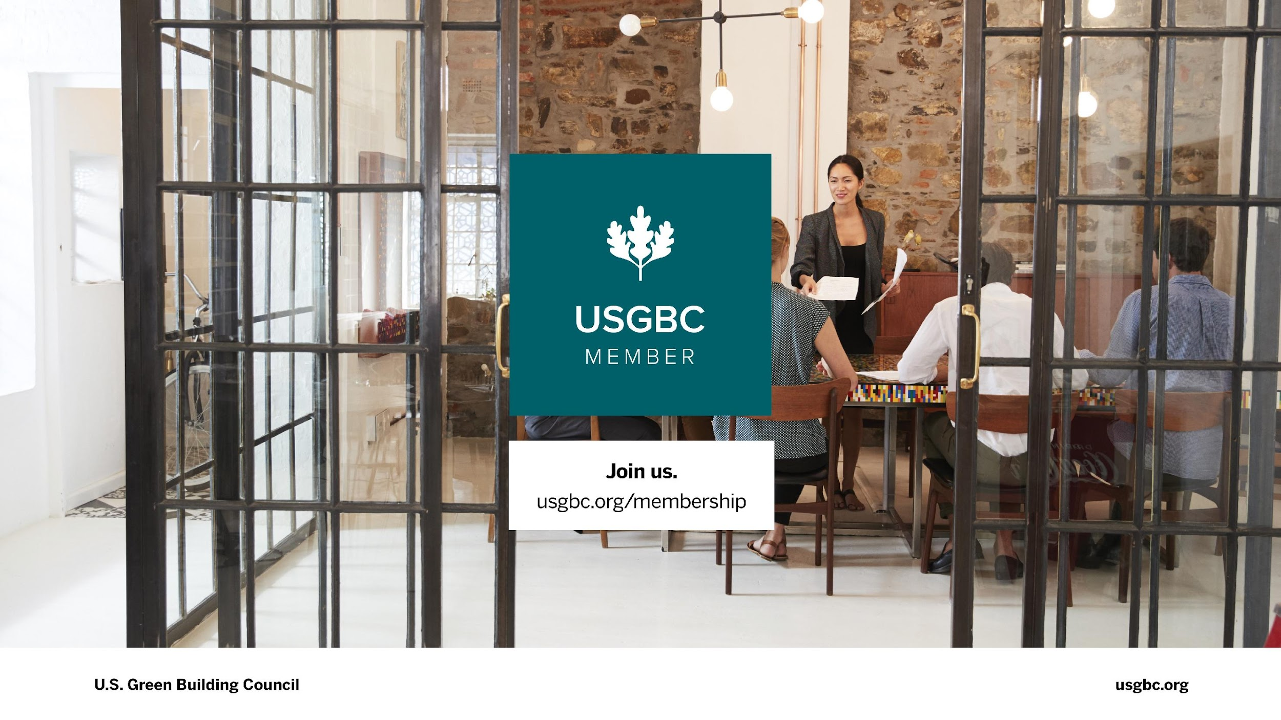
Notes:
And you’ll also want to join us and become a member of USGBC! USGBC Membership includes reduced rates for LEED registration and LEED certification, as well as reduced rate for access to Arc.
You’ll get access to an expert Account Manager from USGBC who will be your direct contact for anything you need and to help you grow your sustainable brand.
You’ll also receive award-winning support for all your buildings from world-class LEED experts as your portfolio moves forward to LEED certification.

Slide 35
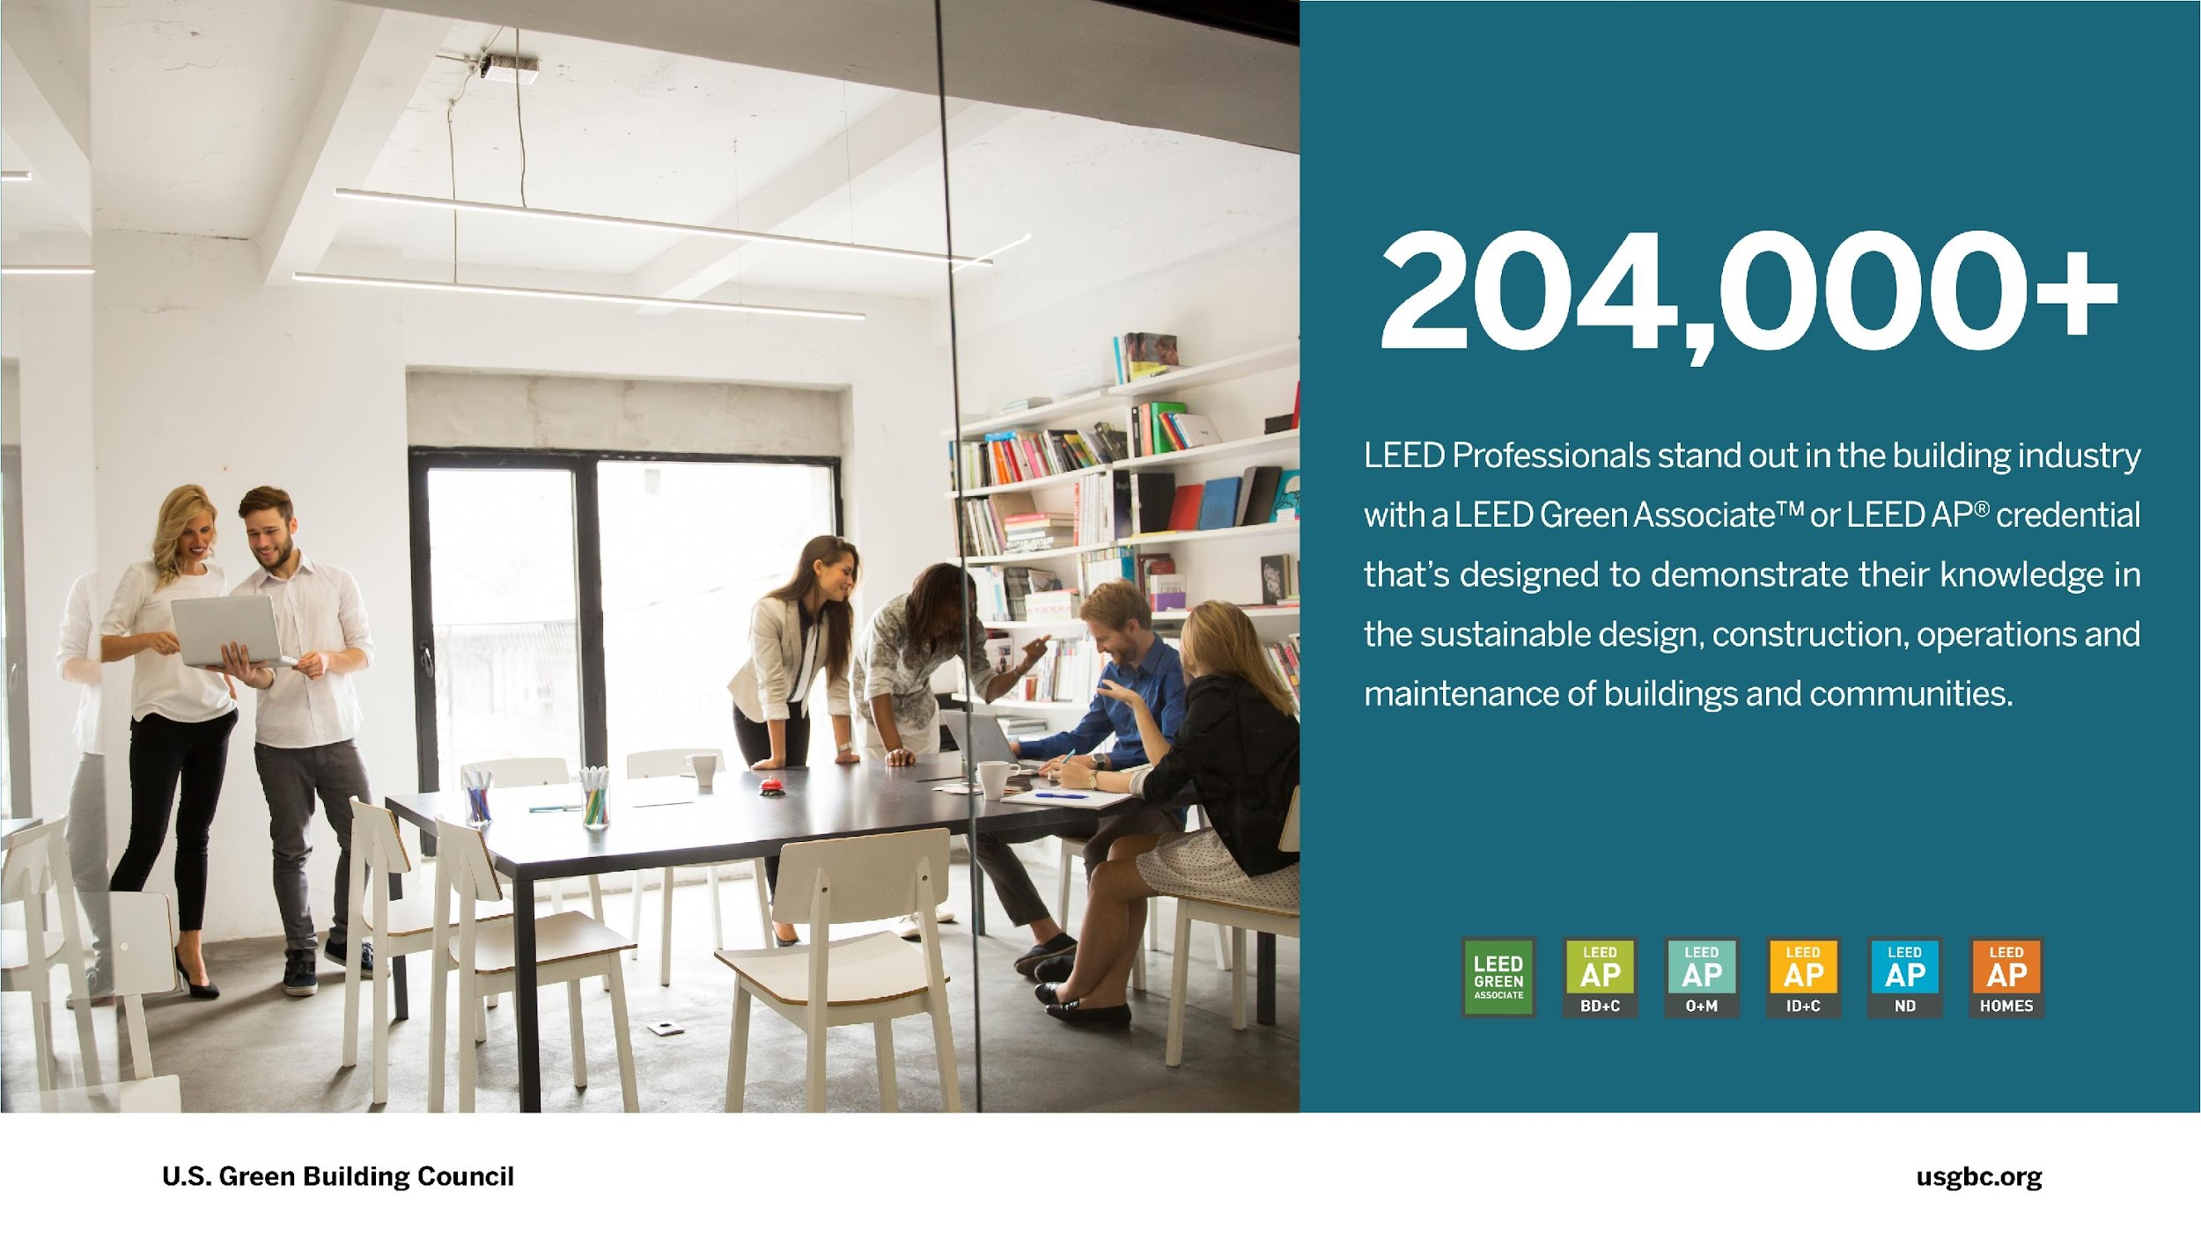
Notes:
A LEED credential denotes proficiency in today’s sustainable design, construction and operations standards. More than 204,000 professionals have earned a LEED credential to help advance their careers.

Slide 36
Questions?

