Slide 1


Creating Value through Sustainability
Madelyn Tutewiler

Slide 2




Stakeholders
Who cares about your sustainability practices? And why?
Customers
Reporting requirements, Framework Commitments, supplier agreements, reputational risk
Regulators
  SEC, TCFD, SASB, CSRD, SFDR, ESMA, ISSB
  Risk of Greenwashing
  SEC Climate Disclosures
ESG Stakeholders
Employees
Employee satisfaction, employee engagement, productivity, health and safety, workplace innovation, generational shift
Investors/Shareholders
Fiduciary duty, disclosures, material ESG factors, focused on metrics, risk management

Slide 3


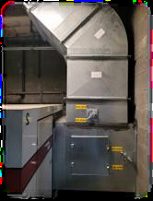

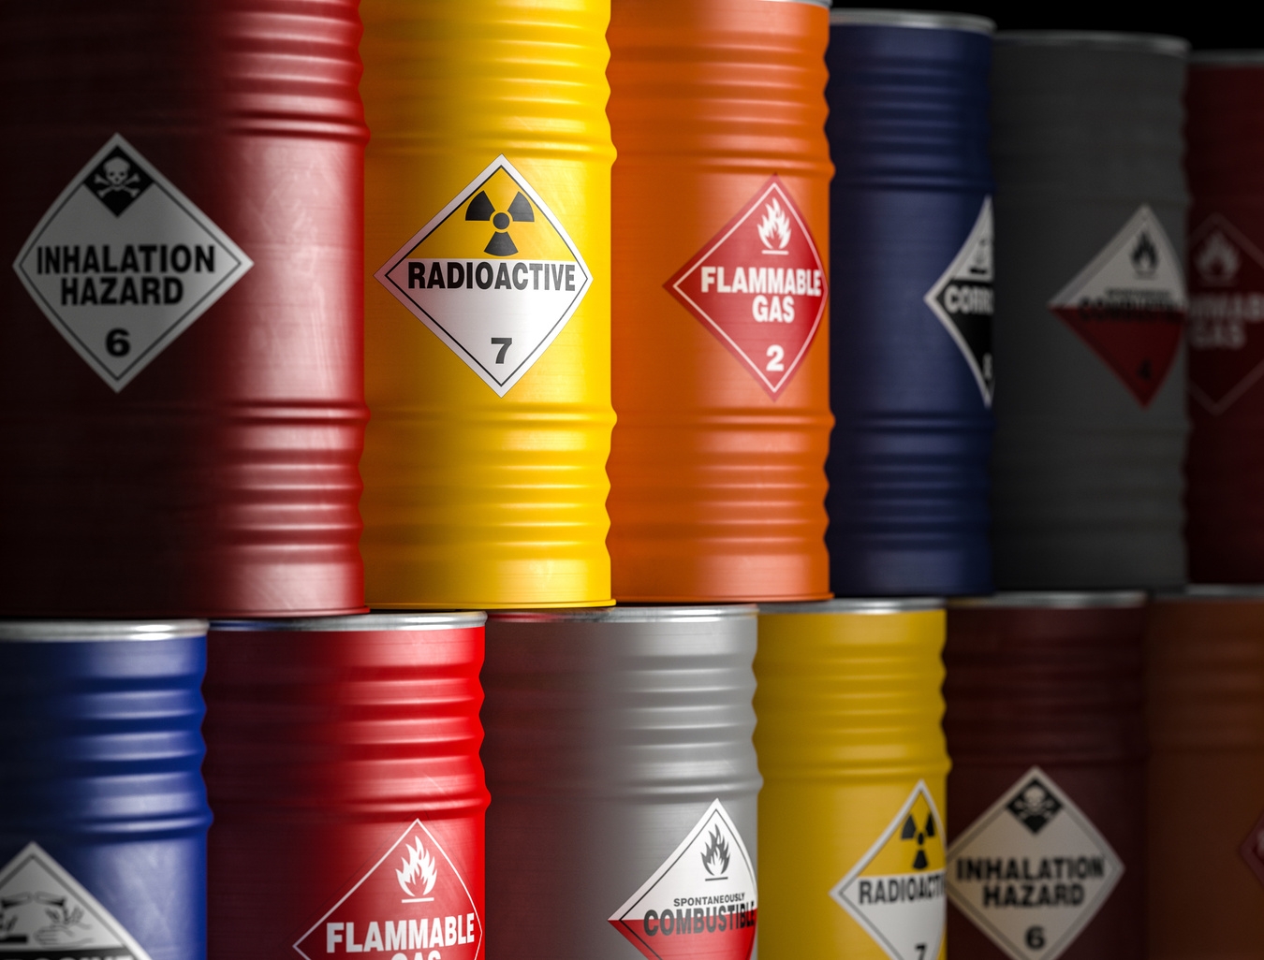
Value Creation
Waste Heat Recovery
LED Lighting Upgrade
Hazardous Waste
After implementing a waste heat recovery system on their compressed air system, a company was able to reduce their natural gas consumption by 5% annually.
By transitioning all lighting to LED, company was able to reduce their kWh consumption by 25% resulting in an annual savings of $82,000.
By selling hazardous waste stream to customer, company was able to eliminate hazardous waste and generate $192,000 annually.

Slide 4



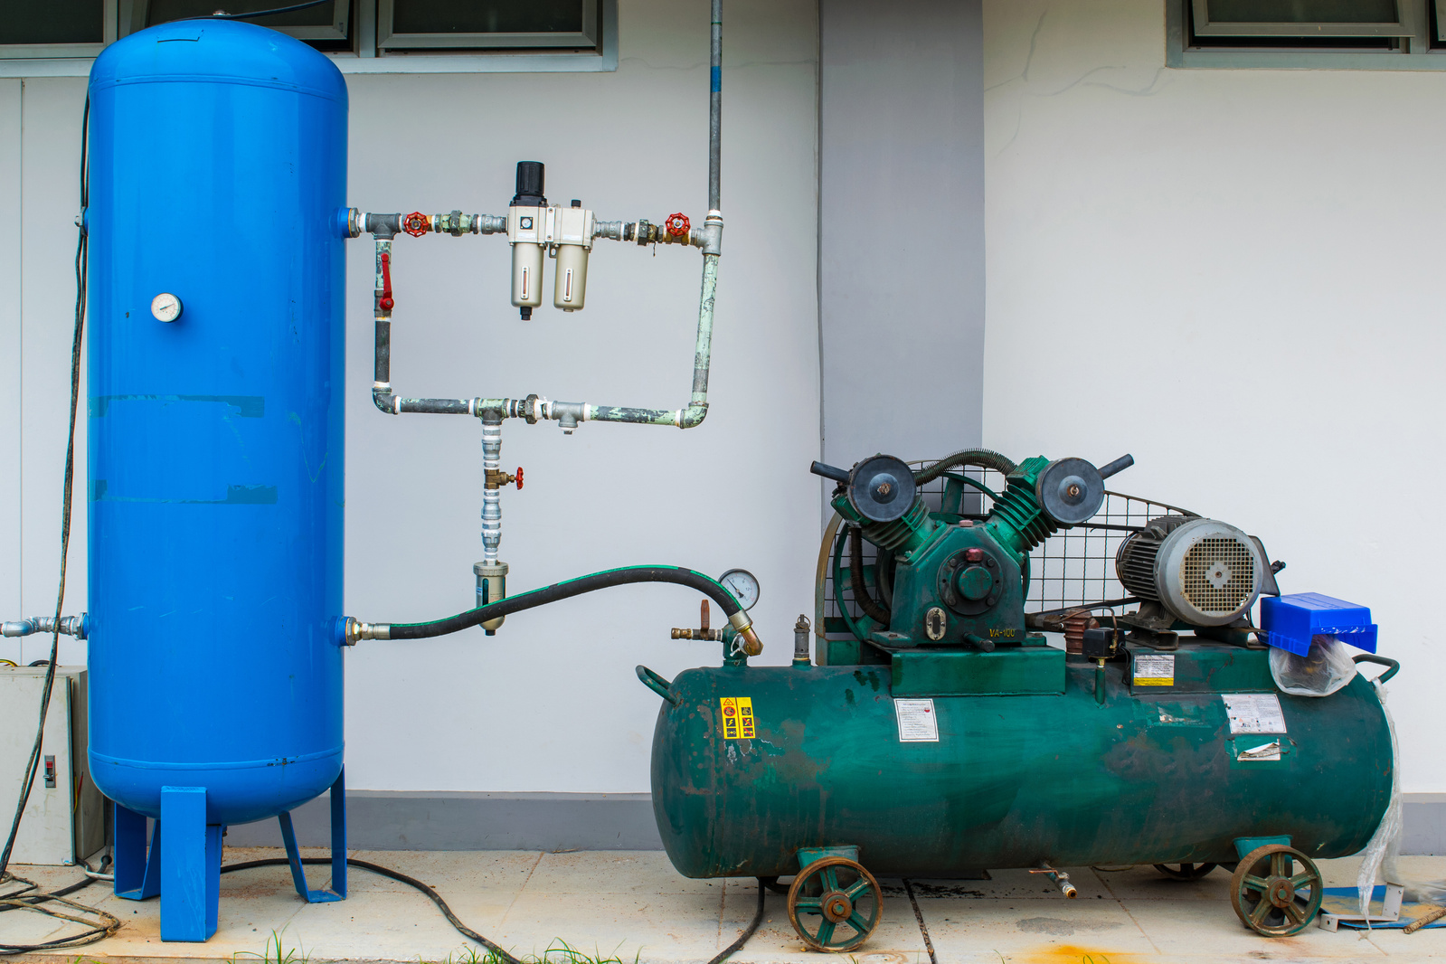
Value Creation
Improved Diversity
Renewable Energy
Compressed Air Improvements
After improving benefits, introducing better maternity leave, and increasing wages, a company increased women in workforce to 26% and reduced turnover by 42%.
Converted to 100% Renewable Energy through negotiating energy contracts and was able to save $240,000 over a two year period.
Using Fluke technology, company identified $32,000 in energy cost inefficiencies from 68 leaks in their compressed air system at a single location.

Slide 5





Implement
01
Define your organization’s purpose and gain buy in. Document policies and practices. Engage employees, leadership, and key stakeholders
It can be daunting to start a new program from scratch, but start with what you know and expand as you progress.
Assess where you are today. What are you already measuring? Reporting? What are the gaps that need to be filled? Where can you have the most impact?
02
03
Set your goals and determine how you will measure/track. Goals should be SMART and align with your ESG purpose.
Looking for something more comprehensive?
Report on your progress. Celebrate your wins and learn from poor performance. Avoid spinning poor performance & greenwashing.
04
Start with a framework:
  Global Reporting Initiative
  Carbon Disclosure Project
  Sustainable Accounting Standards Board
  International Sustainability Standards Board

Slide 6











Workforce & Diversity
Board Structure & Oversite
Reduce Turnover, increase diversity and talent pool, positive labor relations, improve employee morale, reduce fines and litigation
Increase diversity, identify corruption risk, standardize executive pay and bonus structure, increase business ethics
Water Use
Community Engagement
Reduce Usage, eliminate waste, process improvements, innovations, reduce inefficiencies, lower costs
Establish/maintain positive relationships in the community, streamline permitting/approvals, volunteering, donations
Opportunities for Value
Energy Use and Emissions
Policy & Values
Reduce Usage, eliminate waste, process improvements, innovations, reduce inefficiencies, lower costs
Reduce government intervention, ensure business ethics, reduce fines and litigation, ensure transparency and disclosures
Waste and Pollution
Customer Engagement
Eliminate waste streams, reduce costs associated with waste, innovation, process capture/re-use, waste treatments, remove inefficiencies
Positive brand recognition, reduce supply chain hurdles, ensure suppliers enhance ESG initiatives, drive improvement in the value chain
Health and Safety
Cyber & Data Security
Reduce/Eliminate injury and lost time injuries, reduce costs, improve employee morale, reduce turnover
Reduce downtime associated with cyber security risks, ensure adequate data and cyber security, strengthen risk management

Slide 7







THANK YOU
1-859-200-4610
mtutewiler@middleground.com
www.middleground.com
1500 Aristides Blvd
Lexington, KY 40511

