Slide 1
Lissa McCracken
Executive Director
Mark Toda
Sustainability Engineer
Andrea Rock
Sustainability Engineer
Matthew Newcomer
Sustainability Engineer
Caroline Dunlevy
Student Engineer
Dylan Pike
Student Engineer
Lana Almaliki
Student Engineer
Energy & Water Management
Through Sustainable Value Stream Mapping
Green Business Innovation Forum
Lexington, KY
May 31, 2024
Notes:
This presentation will discuss the basics of Sus value stream mapping to obtain an understanding of your performance related to sustainability and to identify potential opportunities for improvement.
Many companies have aggressive energy or GHG emission reduction goals and this is a tool that can help meet those goals.

Slide 2


Who is KPPC – Kentucky Pollution Prevention Center
KPPC is a state-mandated technical service center and Kentucky’s primary resource to help businesses, industries
and other organizations develop environmentally sustainable, cost-saving solutions for improved efficiency.
KPPC is based at the University of Louisville J.B. Speed
School of Engineering, and provides technical information
and assistance that is no-cost, confidential and non-regulatory.
Notes:
Created in 1994
Free
Confidential
Non-regulatory
Funded through State and federal funding with grants from EPA and the Department of Energy
Our focus is on assisting companies with reducing energy consumption, cost and greenhouse gas emissions.

Slide 3
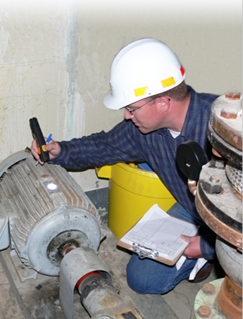
KPPC Approach
Utility Analysis
Electricity
Natural Gas
Water
Benchmarking
ENERGY STAR Portfolio Manager https://www.energystar.gov/buildings/benchmark
Energy Use Ratio, Water Use Ratio, GHG Emissions Ratio for Distilleries
https://kppc.org/ksmi/ssb/
On-Site Assessment
Energy and Cost Reduction Opportunities Renewables and New Technologies
Sustainable Value Stream Mapping
Notes:
You can’t manage what you don’t measure
As always your EM program start with data and if possible benchmarking to see how you rate compared to similar facilities.

Slide 4
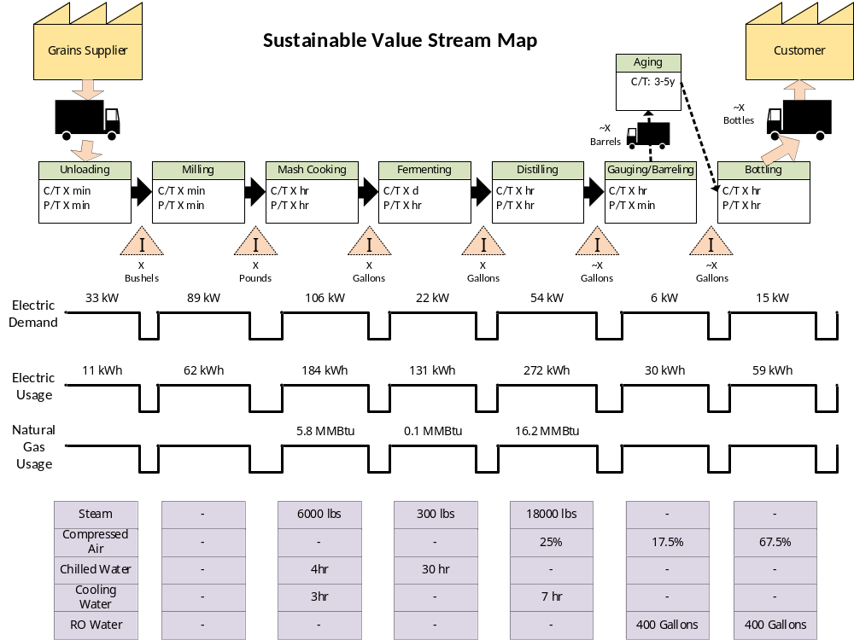
Sustainable Value Stream Map
Notes:
Visualize the entire process and then pinpoint areas that are of interest
kW and kWh
If on power service or TOD rates, charged separately for each

Slide 5
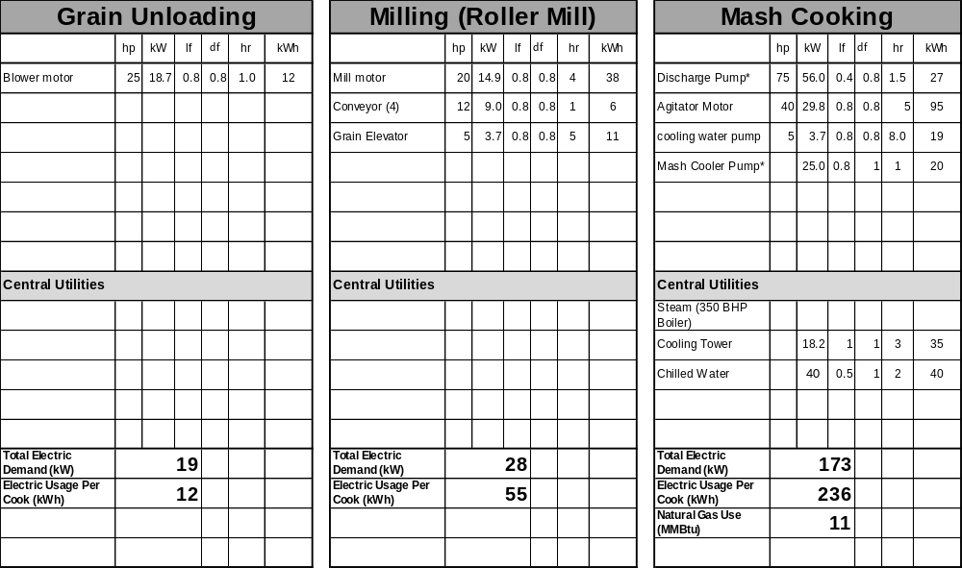
Sustainable Value Stream Map Development
Notes:
1: Define each process step
2: Catalog each piece of equipment in that step
Nameplate data
CTs on large equipment (The key is to measure actual usage, run time, etc.)
Central Utilities

Slide 6
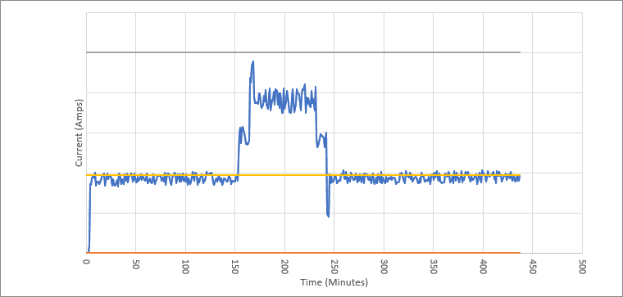
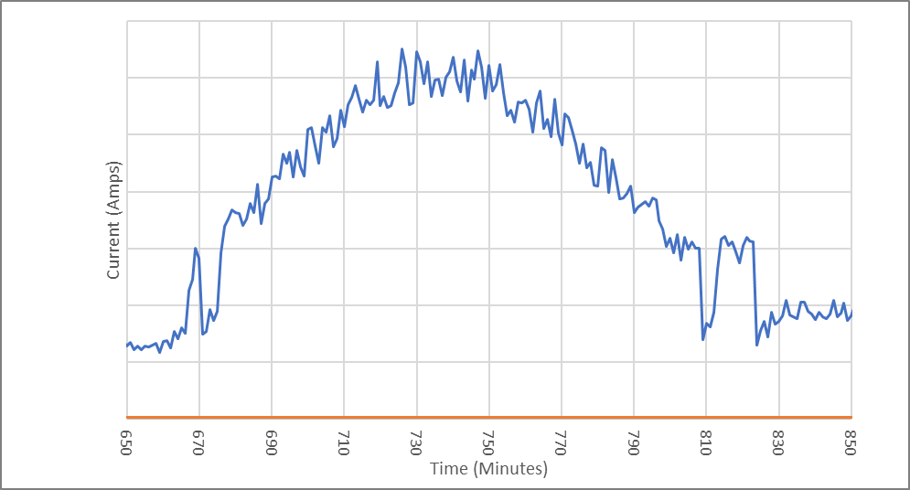
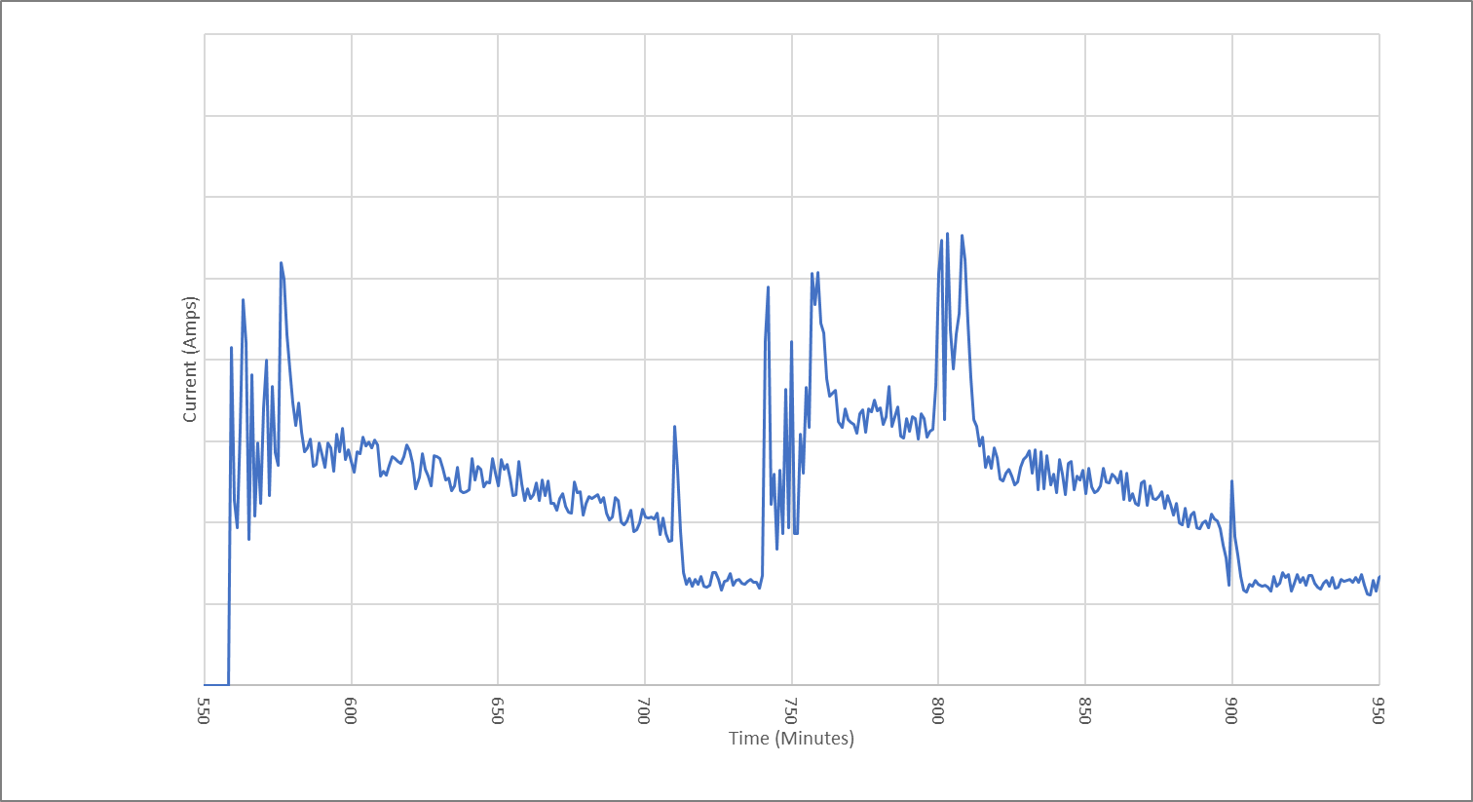
Chiller - Electric Current Transducer Data
Redacted data
Redacted data
Redacted data

Slide 7
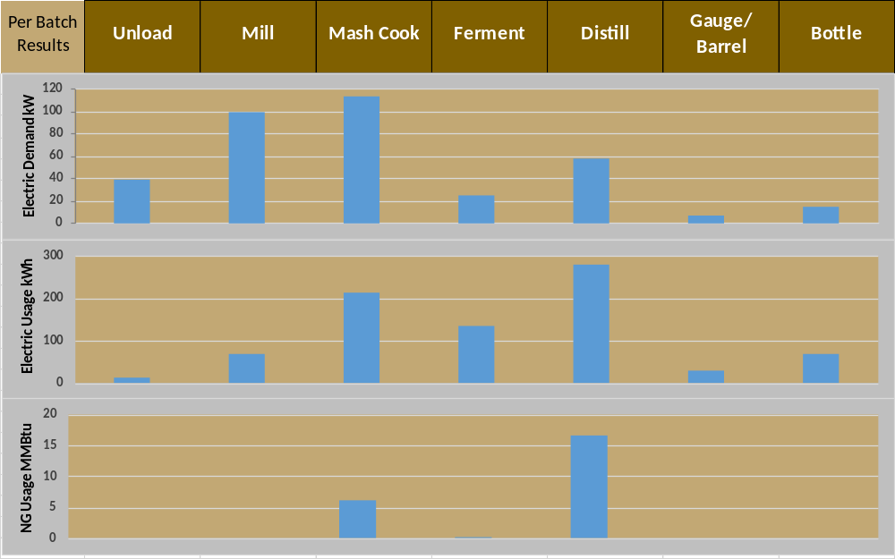
Sus-VSM Results

Slide 8
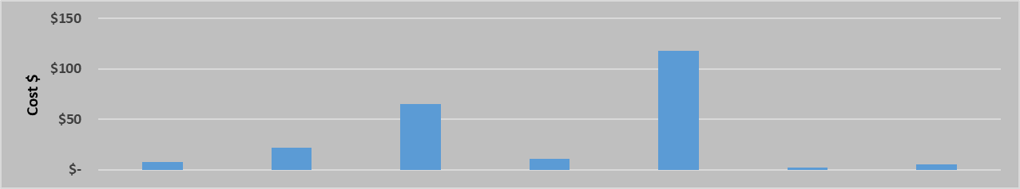
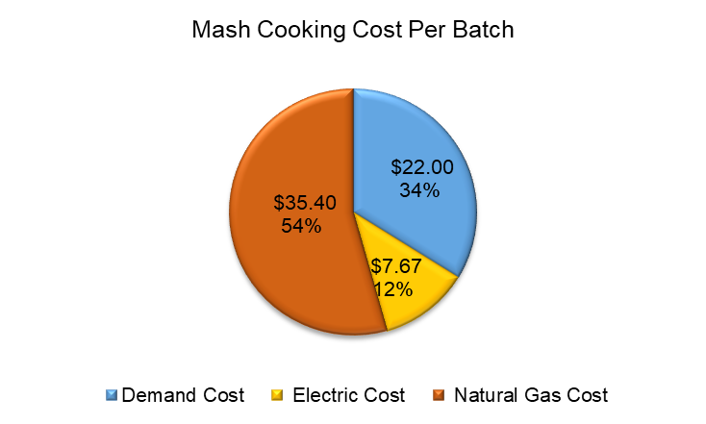
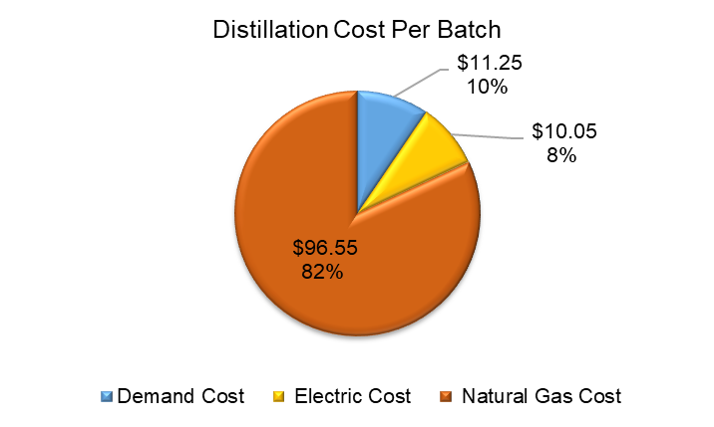
Sus-VSM Results
Notes:
What is the driver of energy costs in each step
What ESO can have the most impact

Slide 9
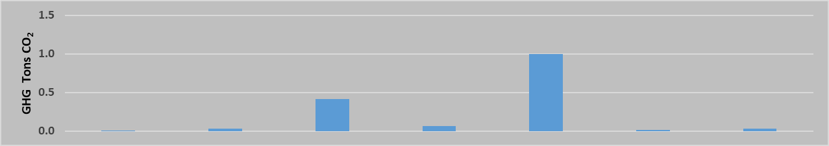
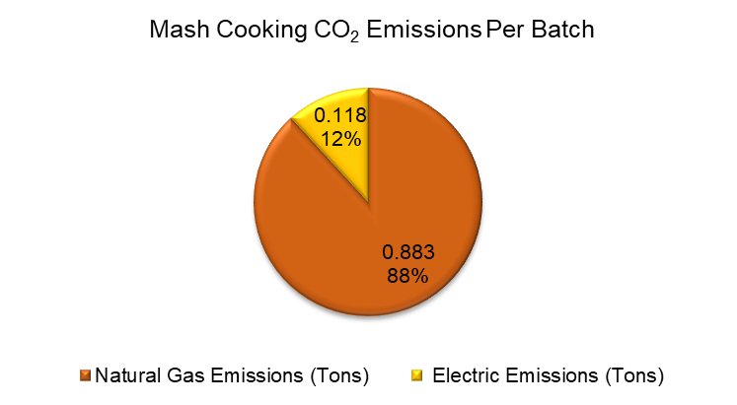
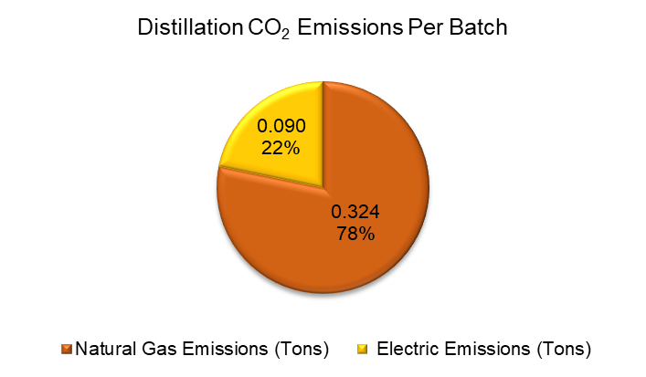
Sus-VSM Results

Slide 10
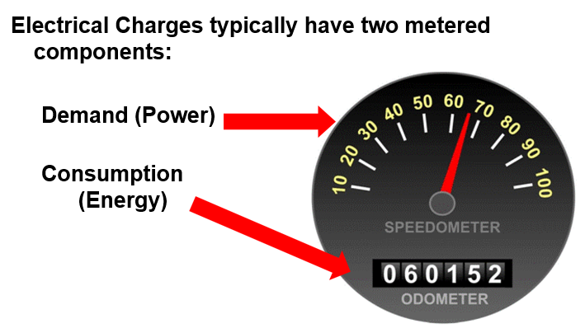
Energy and Cost Reduction Opportunities
Utilities:
Power Factor Correction
Demand Management/Load Shifting
Motors, pumps:
VFD, right-sizing
Compressed Air:
Pressure Reduction
Leak Management
Process Heating:
Heat Recovery
Boiler feedwater preheat
General Facility Improvements:
Lighting
Insulation
Indicates potential demand management opportunity
Notes:
Demand spike can be a significant cost depending on utility company and rate. This is where instrumenting equipment can be beneficial. Demand Management/Load Shedding or adding vfd/soft start

Slide 11
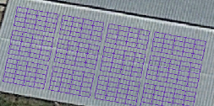
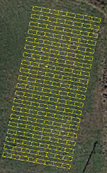
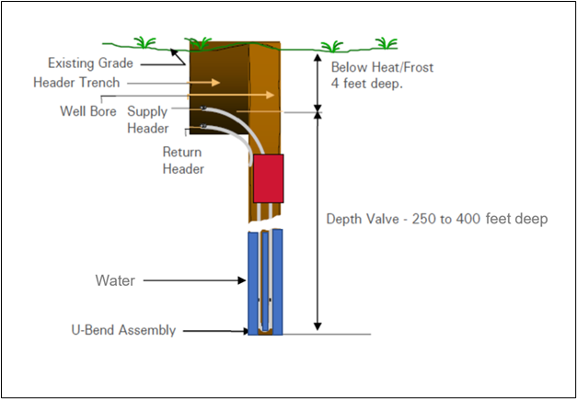
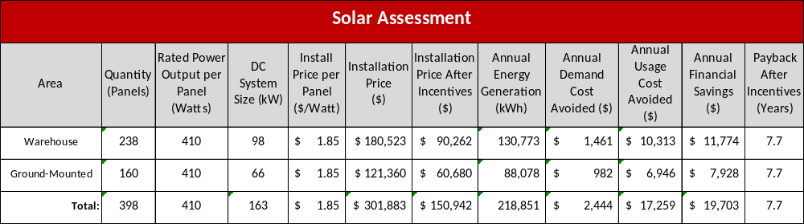
Renewables/New Technologies
Solar PV
Ground Water Cooling for
Process Cooling
Eligible for Federal Rebate Program

Slide 12
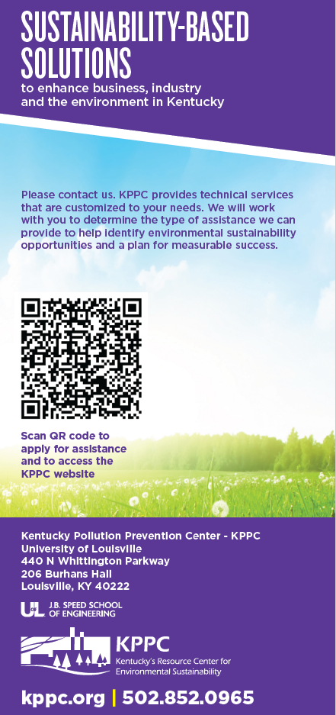

Lissa McCracken
Executive Director
Mark Toda
Sustainability Engineer
Andrea Rock
Sustainability Engineer
Matthew Newcomer
Sustainability Engineer
Caroline Dunlevy
Student Engineer
Dylan Pike
Student Engineer
Lana Almaliki
Student Engineer

