Slide 1
Sustainability – Renewable Energy
John D. Gagel
  Chief Sustainability Officer

Slide 2


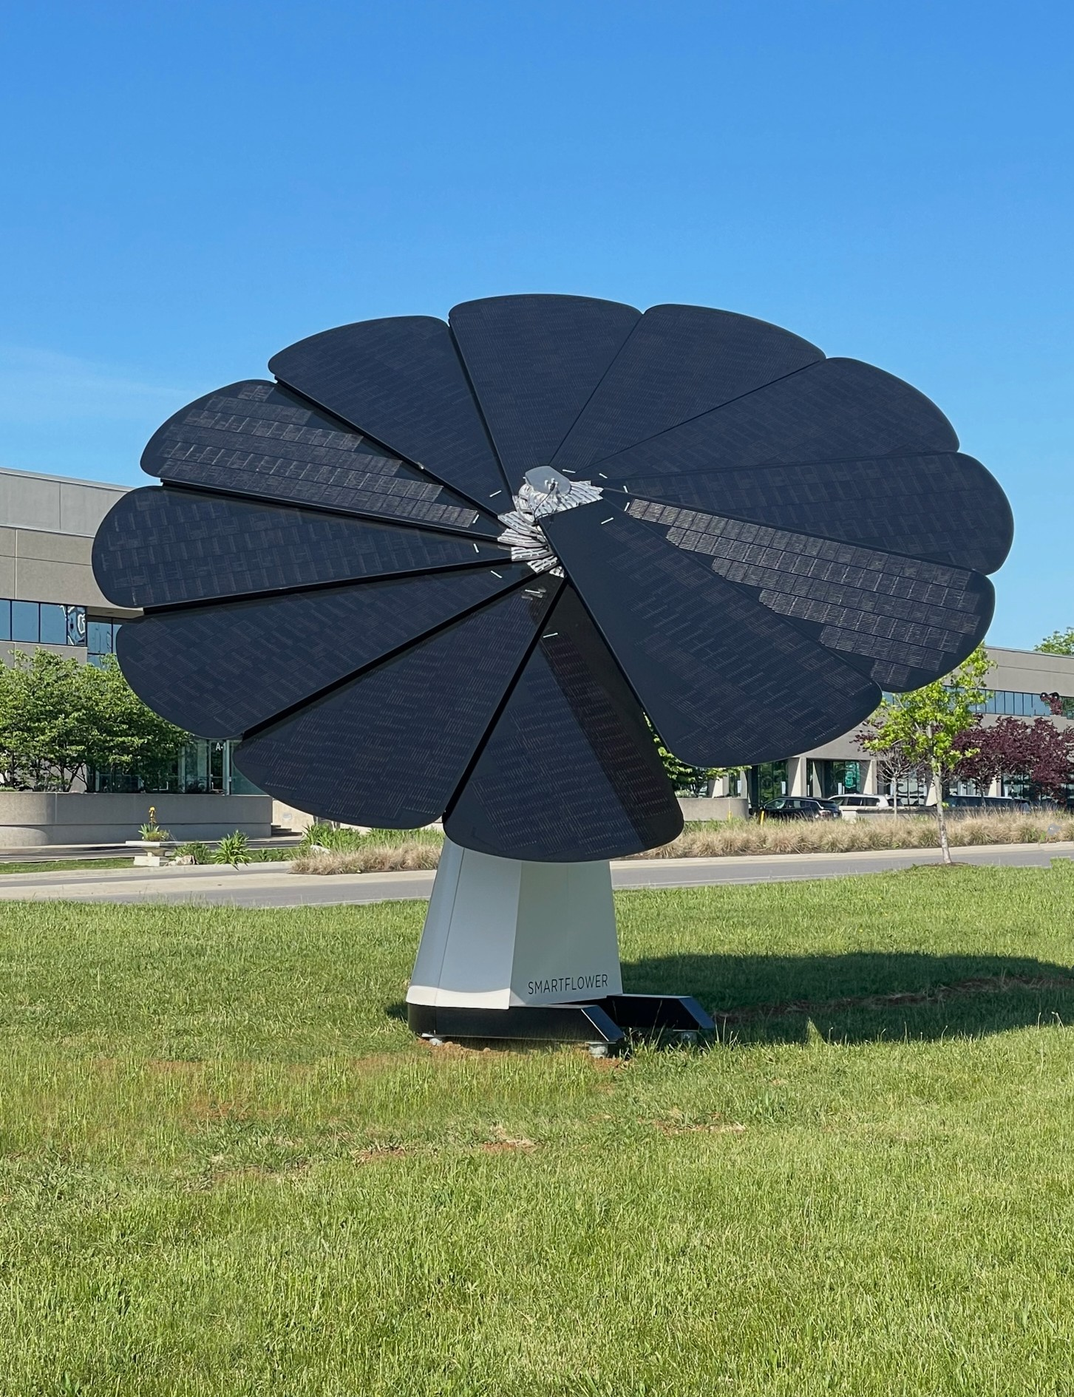

Lexmark
Solar array
Lexmark installed a 2 MW array on HQ property in 2022. This will account for approximately 10% of the overall energy needs in Lexington
Pollinator flowers are planted in the 8 acres housing the array
The array will provide additional STEM education opportunities for area students
This increased use of renewable energy will assist Lexmark’s carbon neutrality by 2035
Notes:
The solar array at Lexmark's corporate headquarters in Lexington, Kentucky will generate approximately 2MW of clean, renewable power. Key items to note are:
1. 2 MW will provide approximately 10% of the overall energy demand for the Lexington site
2. Pollinator flowers will be planted in and around the array to help support local pollinator habitat
3. The array will also be used as a resource for local primary and secondary schools and universities as a demonstration of careers and projects in science, technology, engineering and math (STEM0
4. Additional solar arrays are being planned for Lexmark's Cebu, Philippines and Juarez, Mexico locations

Slide 3
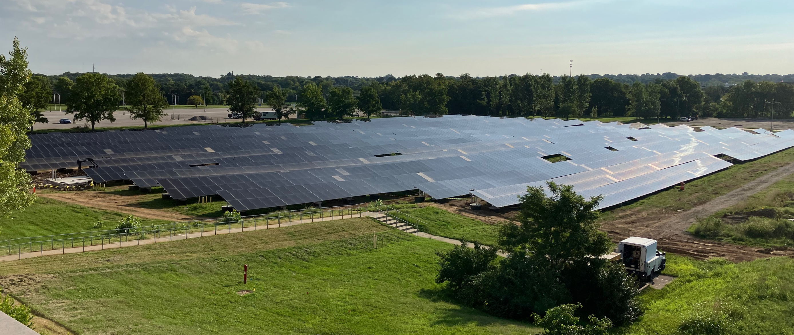
Lexmark Solar
Lexington Solar Array

