Slide 1
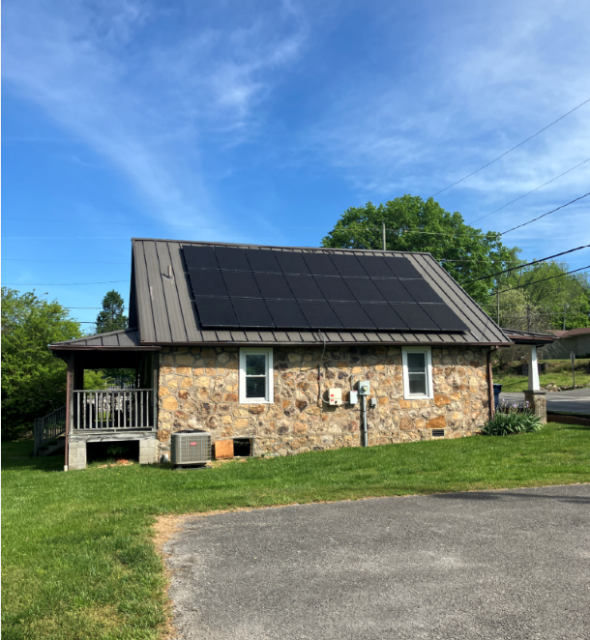
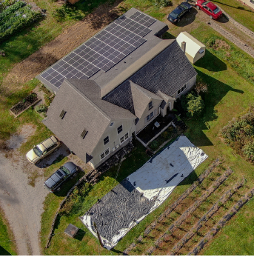
Energy 201: Your Business/Farm is Committed to Save Energy? What Now? A Dive Into the Process.
Joshua Bills / Mountain Association
Chris Woolery / Mountain Association

Slide 2
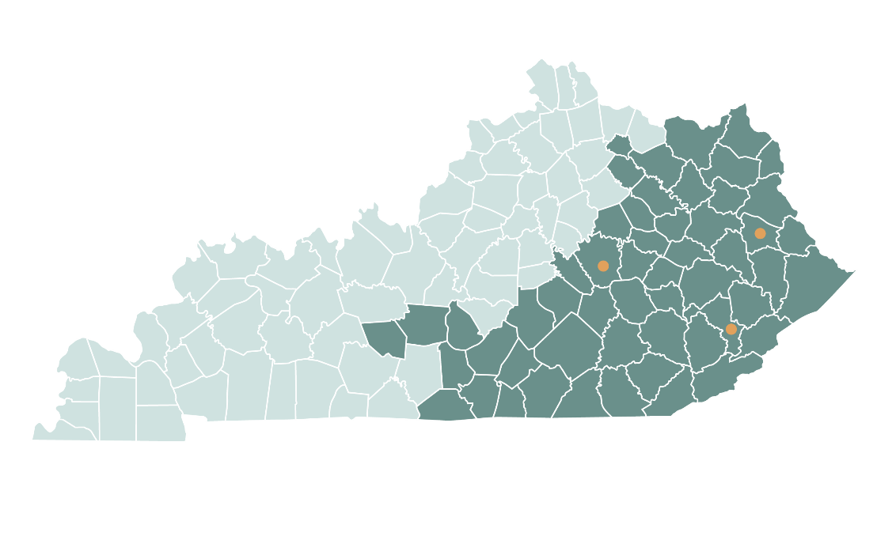
Mountain Association
Founded in 1976
Mission: We seek to create economic opportunity, strengthen democracy and support the sustainable use of natural resources.
MACED works toward a just transition to a new economy in Appalachia. We envision an economy that is more diverse, sustainable, equitable and resilient.
Notes:
That new economy should be locally based, community-driven, built on regional talent, traditions and assets, and it should embody the vision of a bright future.
Note to presenter: Optional to discuss MACED’s net assets and current loan portfolio here.

Slide 3

Seven-Step Energy Management Process (EMP)
Make the Commitment
Assess Performance & Opportunities
Set Performance Goals
Create an Action Plan
Implement the Action Plan
Evaluate Progress
Recognize Achievements
Resources:
Energy Star Guidelines for Energy Management; U of L KPPC (Kentucky Resource Center for Environmental Sustainability)
Notes:
Step 1: Hiring/appointing an Energy Manager/Coordinator
Establishing a Cross-functional Energy Team
Scheduling regular Energy Team meetings
Instituting an Energy Policy
Becoming an Energy Star Partner

Slide 4
Assessing Performance & Opportunities
Gather and Track Energy Consumption and Costs
Analyze Energy Use Patterns and Costs – Compare with Peers
Perform assessment/audit of energy use
Energy Billing Evaluation
Scan for All Available Incentives
Resources:
Energy Star Portfolio Manager; Utility Demand-Side-Management (DSM) programs; Utility Tariffs; Utility AMI Metering; State and Federal Opportunities
Notes:
Inflation Reduction Act 10x federal investment in clean energy than ever before.

Slide 5
Kentucky Utility Incentives
Set Up Online Account Access
  -for AMI View My Meter, accessing bills and energy use, accessing DSM incentives
Small Business Direct Install
  -receive energy audit with up to ~$675 worth of installed efficiency upgrades (LED replacement of linear fluorescents, low flow aerators, smart thermostats)
Business Rebates
  -lighting ($3 to $55 per bulb), Air Compressors, Chillers, Custom, Motors, Pumps, Variable Frequency Drives (VFDs)
Business Demand Response
  -for businesses with over 200 kW base demand and above (Power Service and larger rate classes) develop a plan to be able to curtail at least 50 kW when KU calls upon a dispatch event and receive payment incentive check if called upon and successfully curtailed.
There are more than listed here and more coming in 2025 (Peak Time Rebates and Appliance Recycling)

Slide 6
Host an EV Charging Station
Host an EV Charging Station
  LGE-KU https://lge-ku.com/environment/alternate-fuels-road/ev
  LGE-KU EV Hosting: https://lge-ku.com/environmental/environment/alternate-fuels-road/ev/hosting
  LGE-KU EV Pricing Guide: https://lge-ku.com/sites/default/files/media/files/downloads/EV-Charging-Station-Pricing-Summary-Guide.pdf
  *Hosting is a fixed cost per month for equipment with EV charging sales going to business customer. Option for utility side of meter or slightly lower cost on customer side of meter

Slide 7
Federal Opportunities
USDA Rural Energy for America Program (REAP) *not available in Fayette County unless you are an Ag Producer
  50 percent of project cost subsidized. Agricultural producers may be located in rural or non-rural areas. Renewable Energy System Grants (e.g. solar) have $2,500 minimum grant and $1,000,000 maximum grant. Energy Efficiency Grants have $1,500 minimum and maximum of $500,000.
  https://www.rd.usda.gov/programs-services/energy-programs/rural-energy-america-program-renewable-energy-systems-energy-efficiency-improvement-guaranteed-loans/ky
  Next Deadline: June 28, 2024 then September 30, 2024
Inflation Reduction Act
  Lots of incentives. Biggest one we work with for-profit businesses currently is the 30% Investment Tax Credit for renewable energy (solar projects) with bonus enhancements for larger percentage based on various criteria.

Slide 8
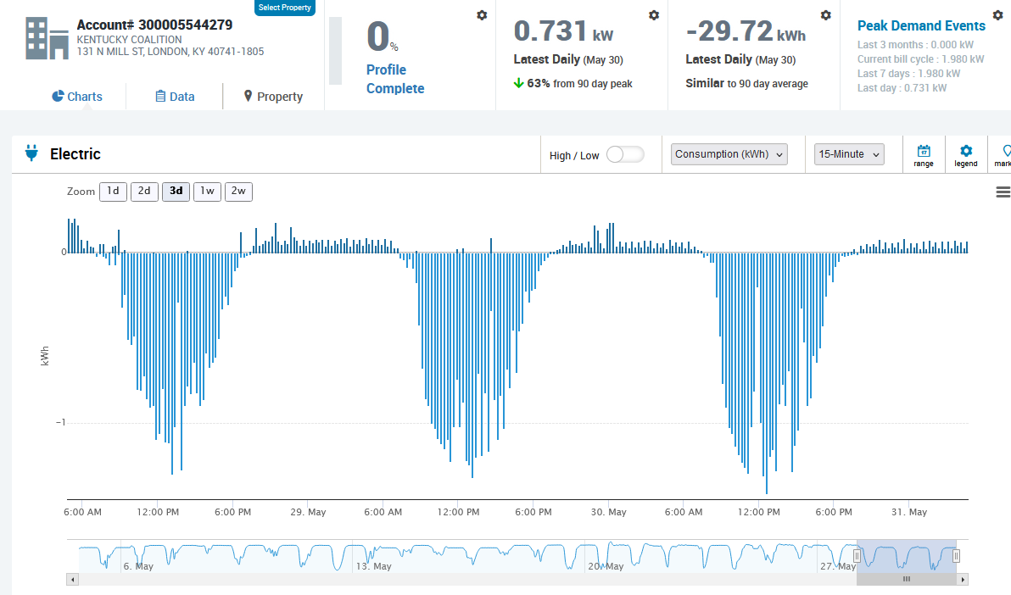
KU Advanced Metering Infrastructure (AMI)
NMS-2
GS export $0.07366
GS import $0.11869
PS export $0.07366
PS import $0.03191
Notes:
This example customer gets 1:1 NEM
GS export 62% (tariff) import
PS export

Slide 9
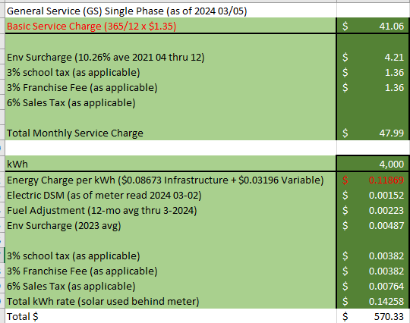
No Demand Charge! Requires average 12 mo. base demand below 50 kW
KU Rate Comparison General Service (GS) Default
Notes:
Straight line

Slide 10
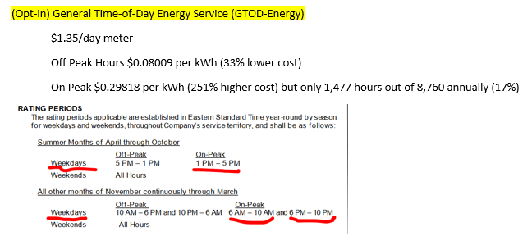
No Demand Charge! Less than 50 kW Ave. Demand
KU Rate Comparison General Service Time-of-Day (GTOD-Energy) Opt-In
Notes:
Straight line

Slide 11
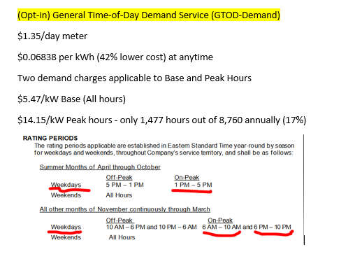
*Note has demand charge! Less than 50 kW Ave. Demand
KU Rate Comparison General Service Time-of-Day Demand (GTOD-Demand) Opt-In
Notes:
Straight line

Slide 12
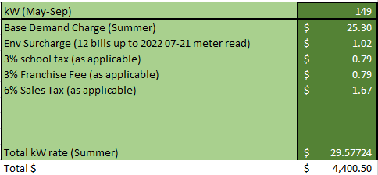
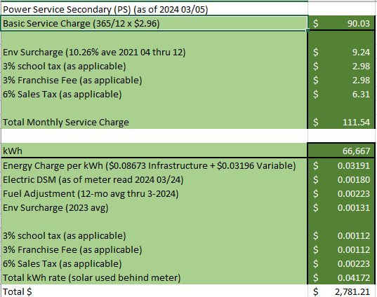
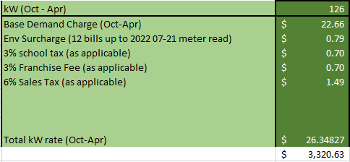
Exceptionally High Demand Charge! Exceptionally low Energy Charge! Requires between 50 and 250 kW 12 mo. average base demand.
KU Rate Comparison Power Service (PS) Default-No Opt-in Options Available
Notes:
Straight line

Slide 13

1. Apply online (free in the area we serve)* https://mtassociation.org/energy/apply-for-an-energy-audit
2. Billing review (free)
3. Energy assessment report (free)
4. Package REAP and On-Farm grant applications ($300-2% of project costs).
5. Retrofit prep: Connect with contractors, review quotes, financing
6. Post-retrofit quality assessment
*if outside our service territory we likely can connect you to other provider
Ready to See Your Energy Saving Opportunities? Get an energy audit!
Notes:
Straight line

Slide 14

Questions?
Josh Bills josh@mtassociation.org 859-893-6123
Chris Woolery chris@mtassociation.org 859-621-4765
Financing (limited to counties south and east of Fayette):
https://mtassociation.org/loan-inquiry/
Berea Office
433 Chestnut Street
Berea, KY 40403
859-986-2373
Hazard Office
420 Main Street
Hazard, KY 41701
606-439-0170
Prestonsburg Office
368 E Friend St, Ste 101
Prestonsburg, KY 41653
606-264-5910
859-986-2373 | mtassociation.org | info@mtassociation.org

